Slide 1
Introduction to XGBoost Regressor
Definition: XGBoost (Extreme Gradient Boosting) is an optimized distributed gradient boosting library designed to be highly efficient, flexible, and portable.
Developed by Tianqi Chen and the DMLC team.
Commonly used for both classification and regression tasks.

Slide 2
How XGBoost Regressor Works
1. Initialize the model with default parameters.
2. Train the model on the dataset using gradient boosting.
3. Evaluate the model’s performance and adjust parameters.
4. Repeat the process for a predefined number of iterations.
Calculate the LEAF
Calculate the Residuals
By reducing the residual, value can be predicted

Slide 3
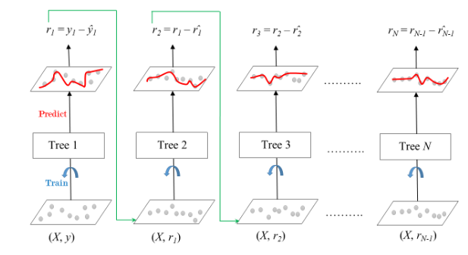

Slide 4
Practical Implementation
Libraries: Python’s xgboost library.
Example:
import xgboost as xgb
# Create DMatrix object
data_dmatrix = xgb.DMatrix(data=X_train, label=y_train)
# Define parameters
params = {'objective':'reg:squarederror', 'colsample_bytree': 0.3, 'learning_rate': 0.1, 'max_depth': 5, 'alpha': 10}
# Train the model
xg_reg = xgb.train(params=params, dtrain=data_dmatrix, num_boost_round=10)
# Predict
y_pred = xg_reg.predict(xgb.DMatrix(X_test))

