Slide 1
Personalized Hotel Recommender using Sentiment Analysis
CS 7641, Group - 41

Slide 2

Problem Definition
DESIRED STATE
Instead of displaying a generic hotel rating, our goal is to help the customer by making more individualized hotel suggestions that consider their preferences for different factors like pricing, cuisine, atmosphere, etc. In turn, this facilitates a quicker and more effective process for the customer to choose the best hotel depending on their preferences.
CURRENT STATE
When reserving a hotel, the most popular approach for making a good decision has been to read the ratings and reviews. But the main issue here is that these evaluations were made based on the viewpoint of one individual. A 5-star rating for one person may be a 2-star rating for another. Some people would select a hotel with a lower price over the ambiance, while others might do so regardless of cost.
2

Slide 3










We have 9 features available in our data set
Source: Kaggle – 515K Hotel Reviews Data in Europe
Average Score
Negative Review
Hotel Review
Hotel Name
Total Number of Reviews
Reviewer Score
Positive Review
Reviewer Nationality
Review Date
Hotel Address

Slide 4


Our process
Data Collation & Cleaning
Data Collation & Cleaning
Collection of data
Arranging the data
Treating the data accordingly
Exploratory Data Analysis
Data understanding
Getting better insights
Feature Engineering
Feature Engineering
Exploratory
Data Analysis
Deciding on the features
that help build our Model better
Model Building & Validation
Analytical algorithms to find patterns
Testing the models using data
Model Building & Validation
Output
Output
Using the model for desired outcome

Slide 5
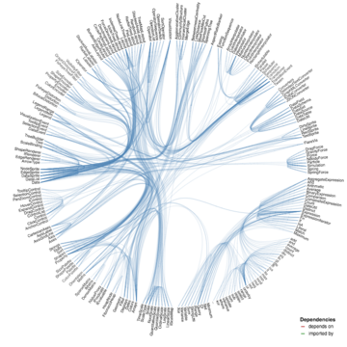
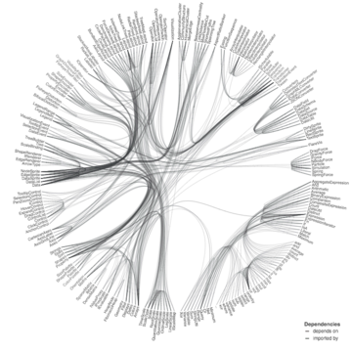

Methods: Unsupervised Learning
Hierarchical Clustering
Usage:
Breakdown the prominent review attributes into clusters and recommend best rated hotel for a user input.
Train Data: 515K Hotel Reviews Data in Europe
Expected Example Outcomes:
User Input: “I need a place which is cheap and comfy.”
Output:
“Hotel Europe Price: Moderate
Service: Good ”
Reach Goal:
Words with comparable meanings are placed in categories by the Hierarchical clustering algorithm.
GMM
DBSCAN

Slide 6

Methods: Supervised Learning
$
$
o
Usage:
Classification of reviews.
Train Data: 515K Hotel Reviews Data in Europe
Expected Example Outcomes:
Positive review list: “It was a Pleasant stay.”
Negative review list: “Service is not worth the price.”
Reach Goal:
Based on the Sentiment component, Classify the reviews into Positive, negative, and neutral categories.
o
Multi-class Logistic Regression
*
o
*
o
*
*
o
o
o
o
Support Vector Machine (SVM)
x
x
x
x
x
x
Random Forest Classifier

Slide 7
Potential Results and Discussion:
Unsupervised Learning:
Build a Hotel Recommendation system based on the categories of the reviews.
Ability to provide the best hotels based on the user preferences.
Examine it with various clustering Techniques
Supervised Learning:
Build a Sentiment classifier to tag the reviews into positive, negative, and neutral categories with an accuracy of 60 – 70 %.
Analyze it with different classification algorithms.

Slide 8
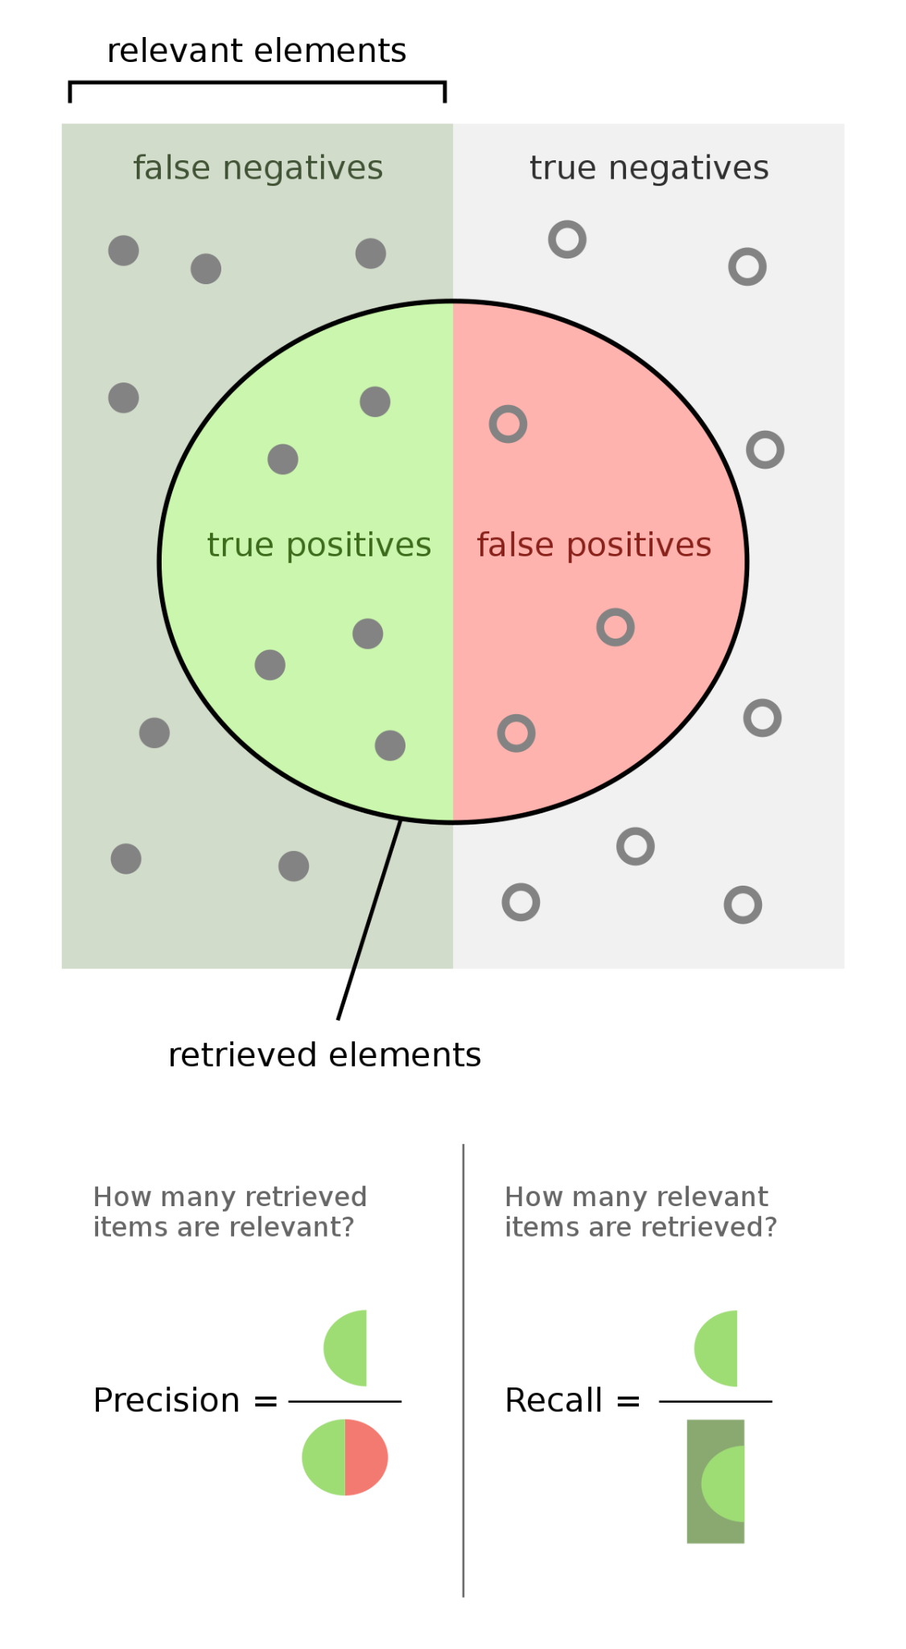

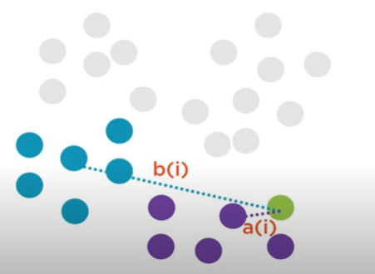
Evaluation Metrics
F Measure
Recall
Precision
Meteor
Silhouette Coefficient & BetaCV

Slide 9
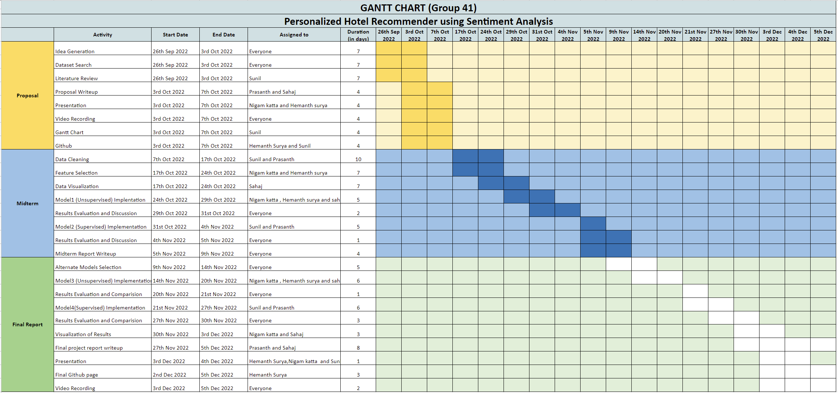
Proposed Timeline

Slide 10
Team Responsibilities
Sunil Ravilla | Supervised Learning, Data collection and Cleaning
Prasanth Bathala | Supervised Learning, Data collection and Cleaning
Nigam Katta | Unsupervised Learning, Exploratory Data Analysis
Hemanth Sai Surya Kumar Tammana | Unsupervised Learning, Evaluation Metrics
Sahaj Kumar Jha | Unsupervised Learning, Evaluation Metrics

Slide 11
Thank you

Slide 12
Problem Definition:
Checking the ratings/reviews had been the most commonly used method for identifying a suitable choice while booking a Hotel. However, the major concern here is that these ratings were given based on the unique perspective of a single user. One person's 5-star rating can be another person's 2-star rating . Some people might prefer a low price over the ambiance, while others might choose the hotel with better ambiance irrespective of the price.
Our aim is to aid the user by providing more personalized hotel recommendations by considering his preference of various aspects such as price, food, ambiance, etc rather than showing a general rating of the hotel. This in turn helps the user in identifying the most suitable hotel based on his choice, more efficiently and quickly.

Slide 13
Background:
Traveling is one of the most fundamental of human activities. While traveling, finding good accommodation is the most challenging part. Based on the statistics of 2018 travel booking, there were about 148 million online travel bookings, out of which 82% were via an app or website [1]. This draws attention to the reliance of people on websites and apps for finding accommodation. Most of these websites and apps have one or other metrics to help users to book hotels, however oftentimes they lack being user-centric, taking into account different variables for each user. Lot of work on this topic of hotel recommendation systems, takes just the user preference and not hotel reviews or doesn’t compute the difference of importance for different users [2].

Slide 14
Data & Features:
Source:
Kaggle
https://www.kaggle.com/datasets/jiashenliu/515k-hotel-reviews-data-in-europe
515K Hotel Reviews Data in Europe - 47 MB
Food quality
Ambiance
Service
Location
Price
Cleanliness
Features of Dataset

Slide 15
Evaluation Metrics
F Measure
Recall
Precision
METEOR
Silhouette Coefficient
BetaCV

