Slide 1
Pitch Detection with Machine Learning
Young-Shiuan Hsu

Slide 2
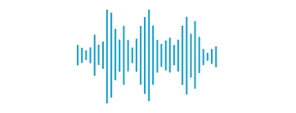
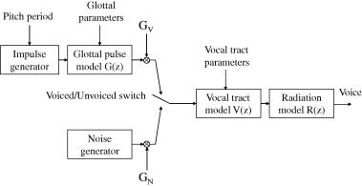
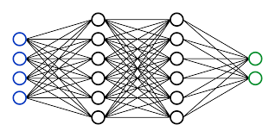
Pitch Extraction
Homomorphic Analysis (Cepstrum)
Linear Prediction Coding
Autocorrelation Method
How about Machine Learning?
What model to use?

Slide 3

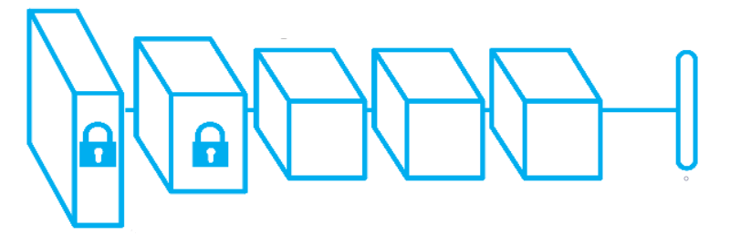
How different model perform?
Fully Connected Neural Network
Convolutional Neural Network
Transfer Learning

Slide 4
Training Dataset- PTDB-TUG Database
Pitch tracking database produced at Graz University of Technology (2011)
10 Female and 10 Male speakers from different countries
Total of 4720 wave files
Sampling rate 48KHz
Resolution: 16bits
Byte order: Little Endian

Slide 5
System design
Data Preprocess
Training
Result
Exclude silence
Each frame contains 480 samples
Normalize the dataset
Load labels
Train the model with different parameters
Layers
Activation function
Loss function
Compare the result of the testing data

Slide 6
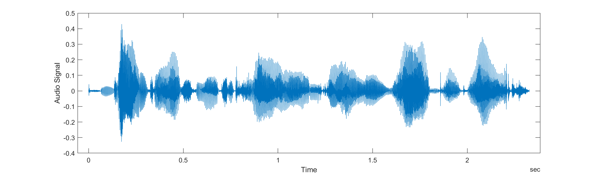
Nonoverlapping 480 samples(0.01sec)
Neural Network
Pitch Period: 0~400 Hz

Slide 7
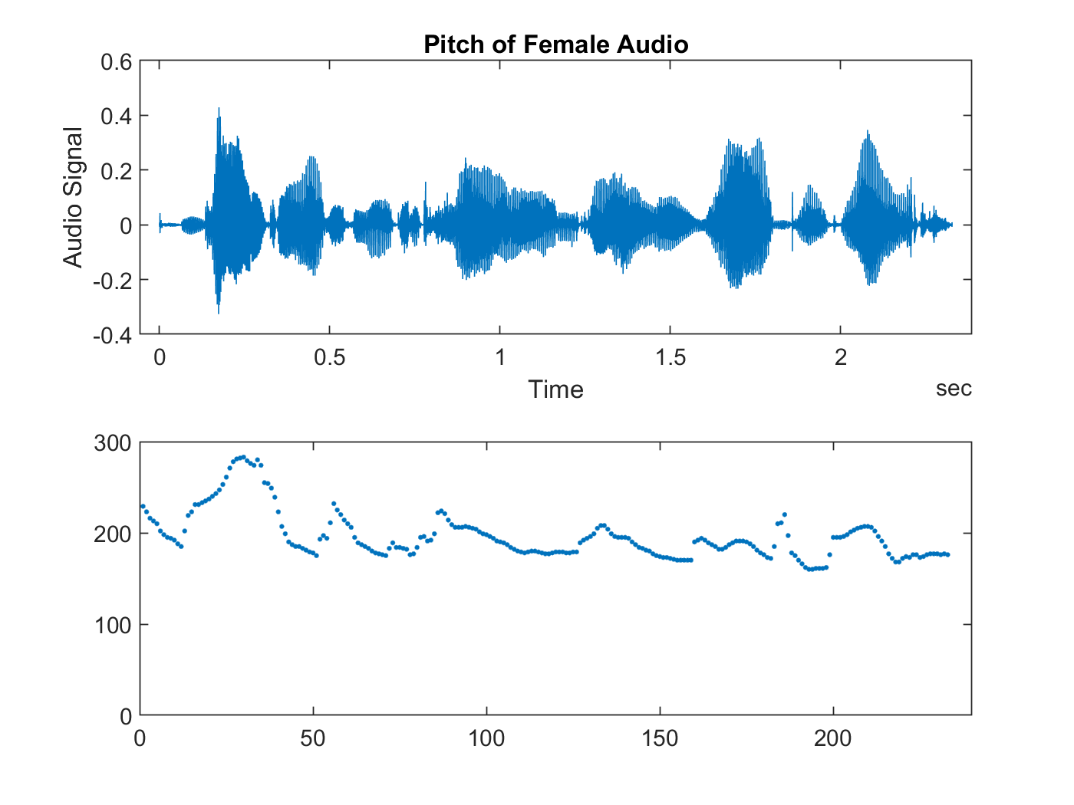
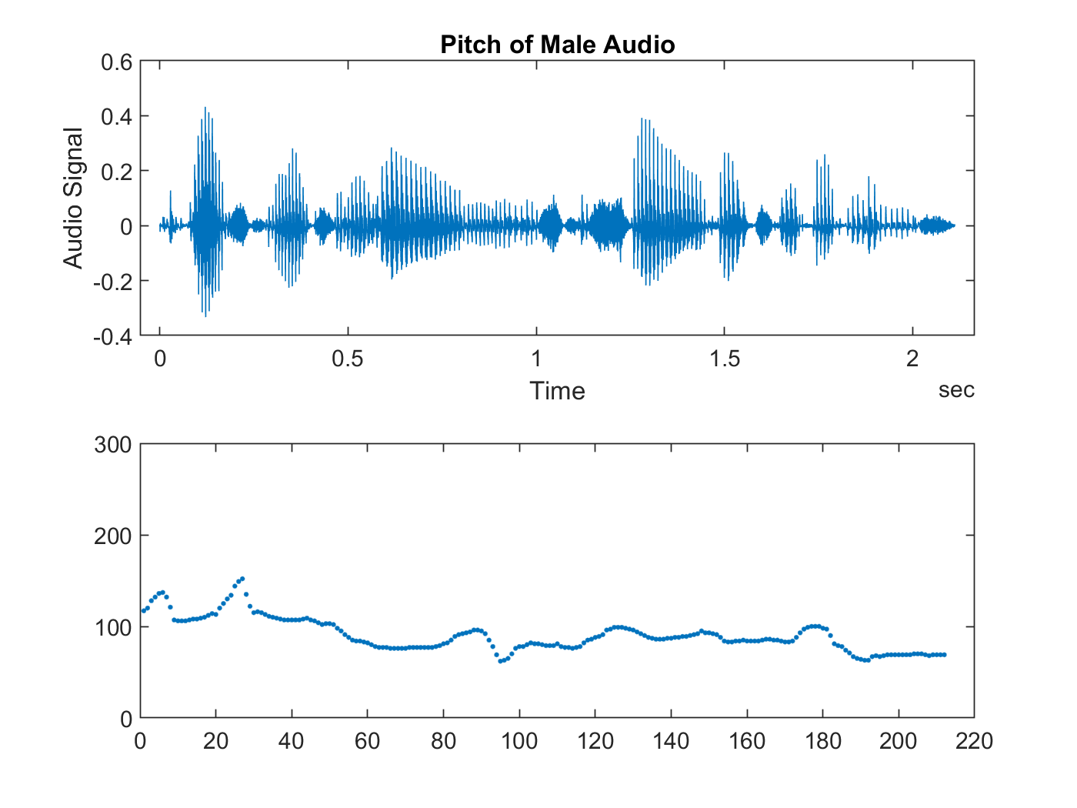

Slide 8
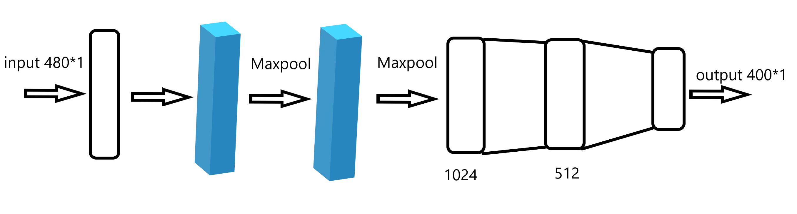
1D CNN

Slide 9
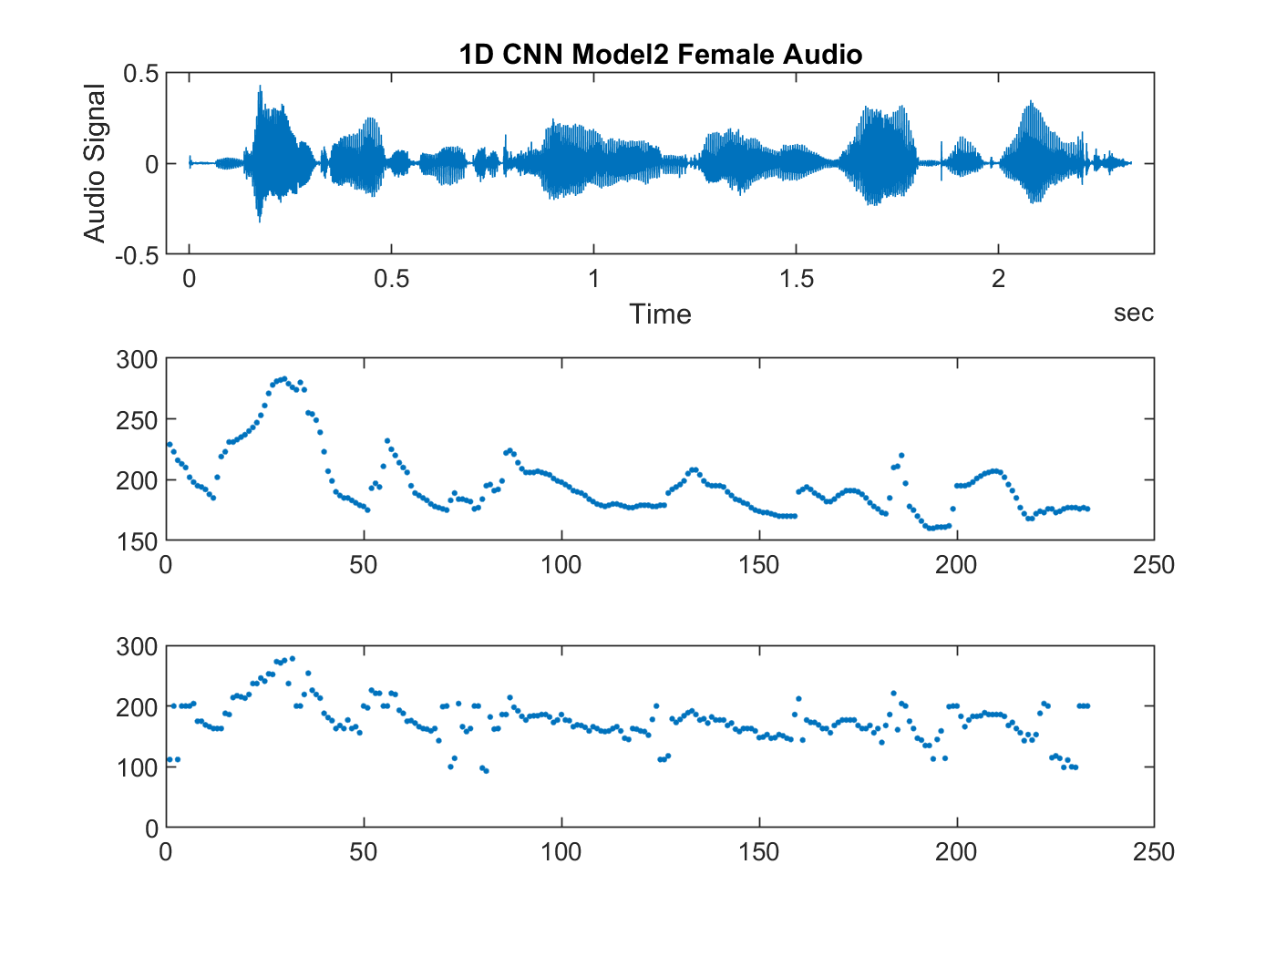
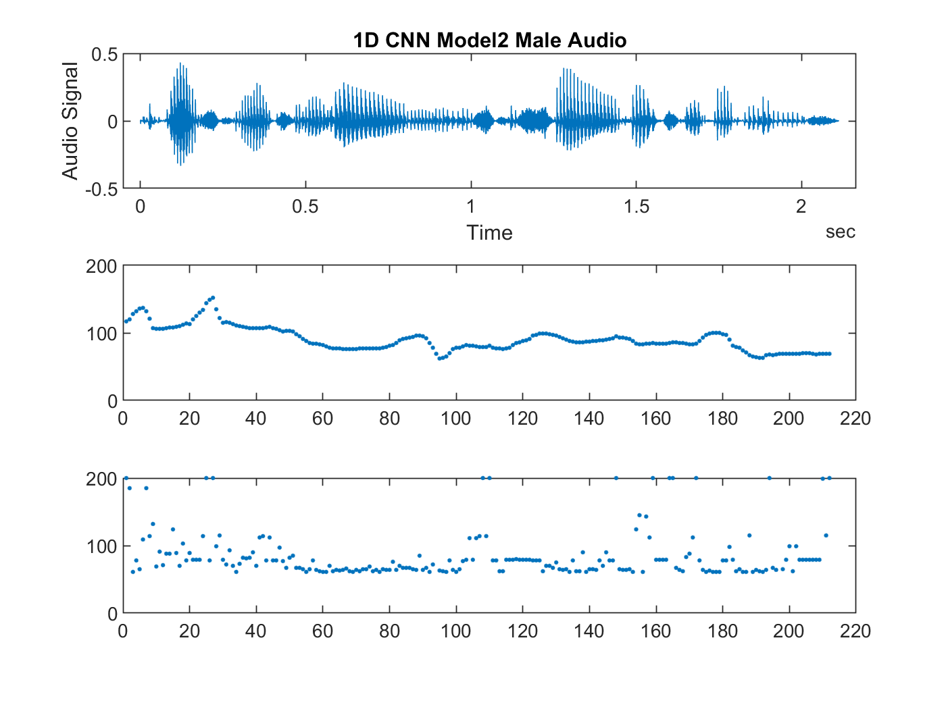

Slide 10
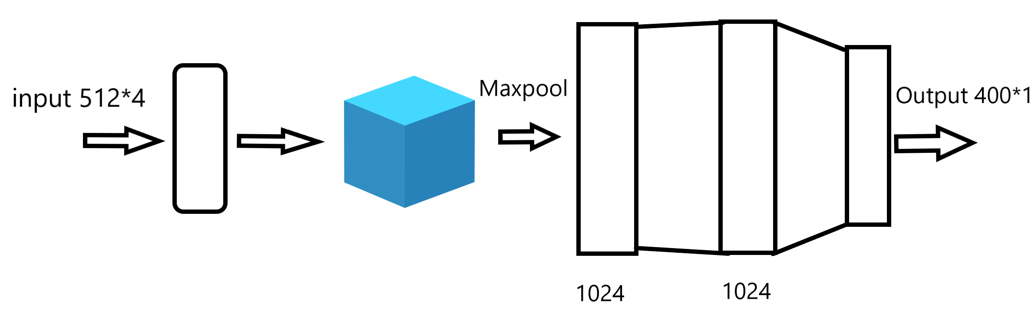
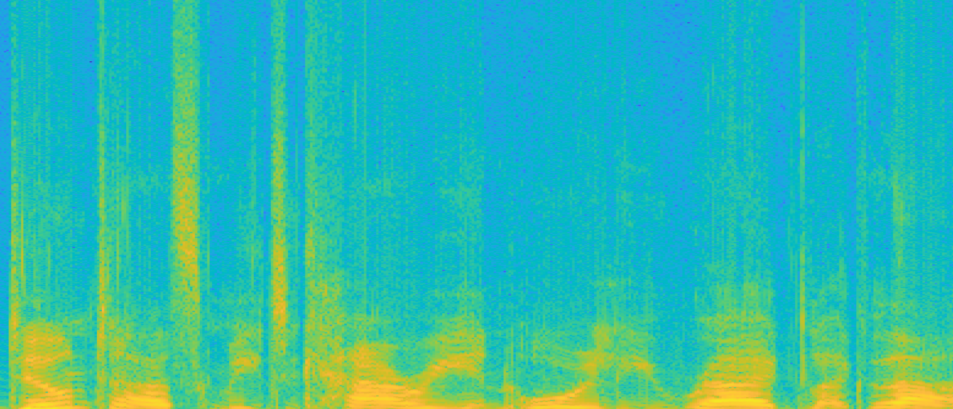
2D CNN Model
Window Shift:120 samples

Slide 11
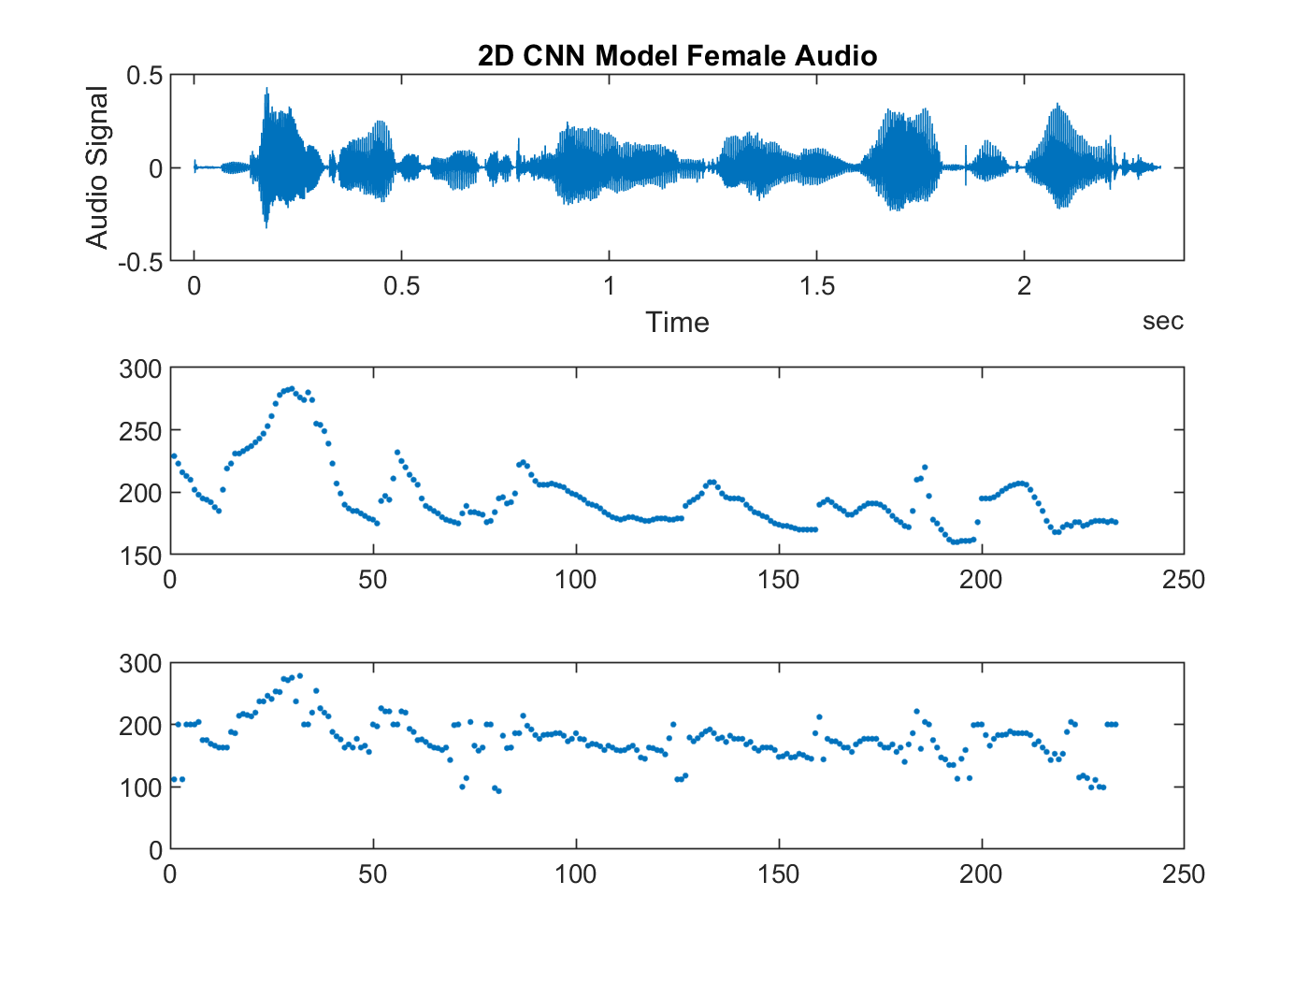
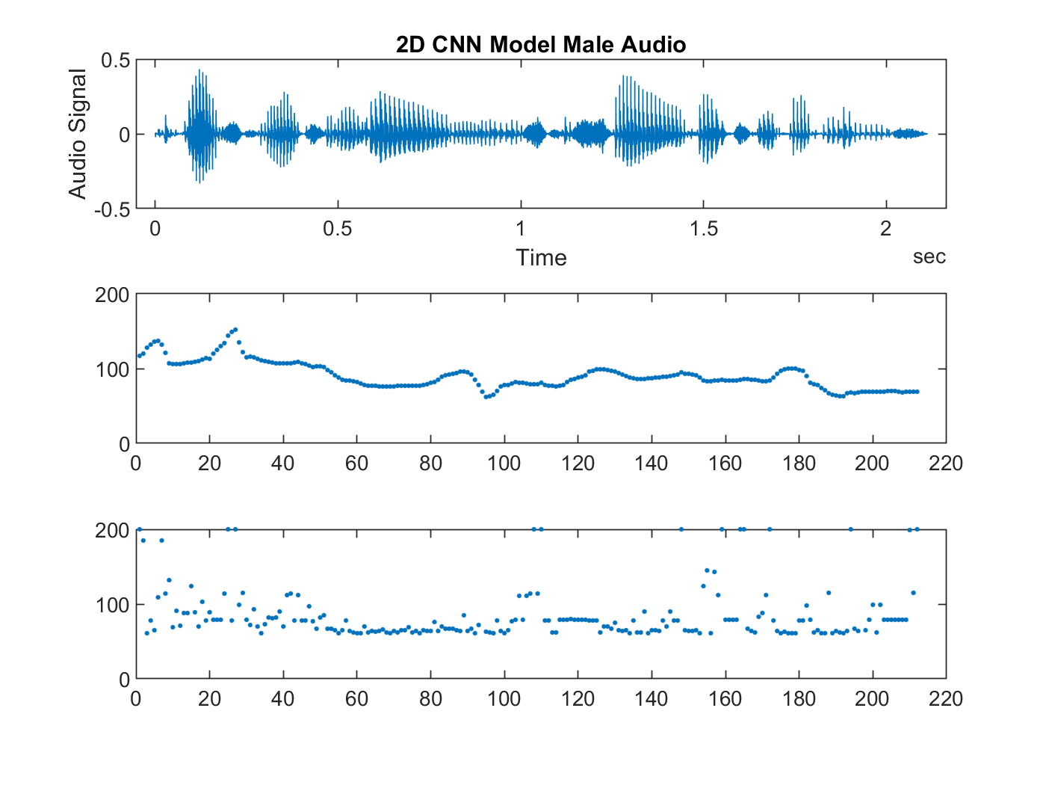

Slide 12
Error
Model | Female | Male
1D CNN | 5576 | 10761
2D CNN | 5832 | 5759

Slide 13
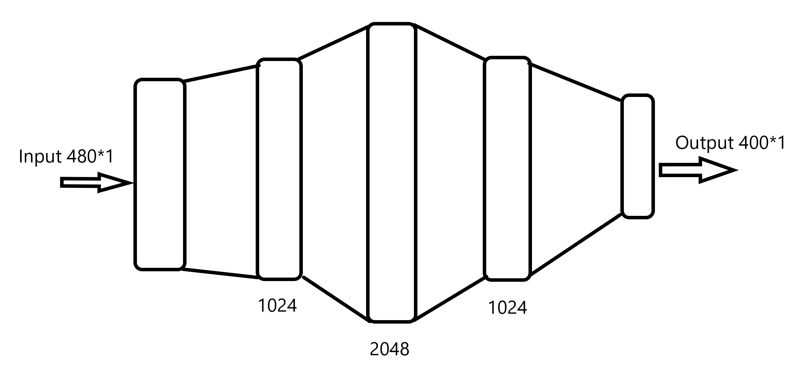
Fully Connected Model

Slide 14
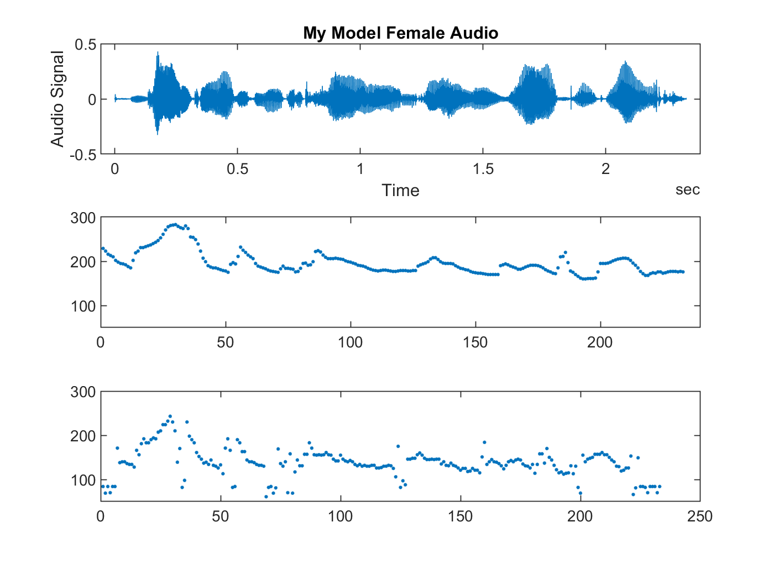


Slide 15
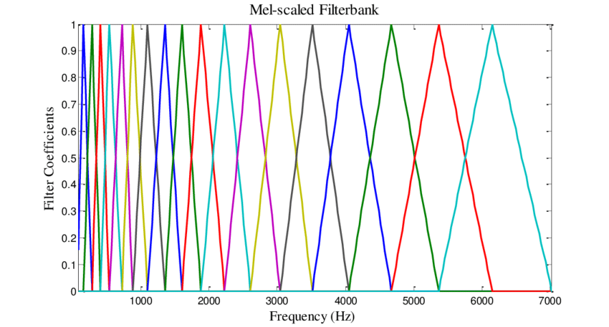
Feature Extraction - MFCC
STFT
Power Spectrum
MFCC
13
Derivative
13

Slide 16
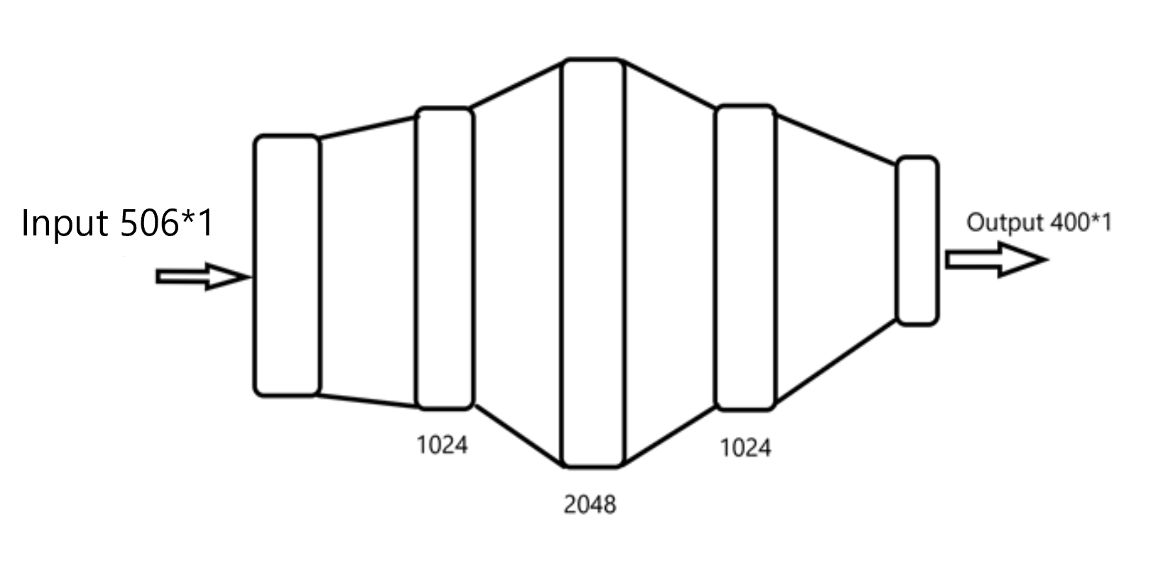
Feature Model (Data + MFCC)

Slide 17



Slide 18
Error value
Model | Female | Male
Fully Connected Model | 8042 | 5167
Feature Model (Data + MFCC) | 7489 | 4753

Slide 19
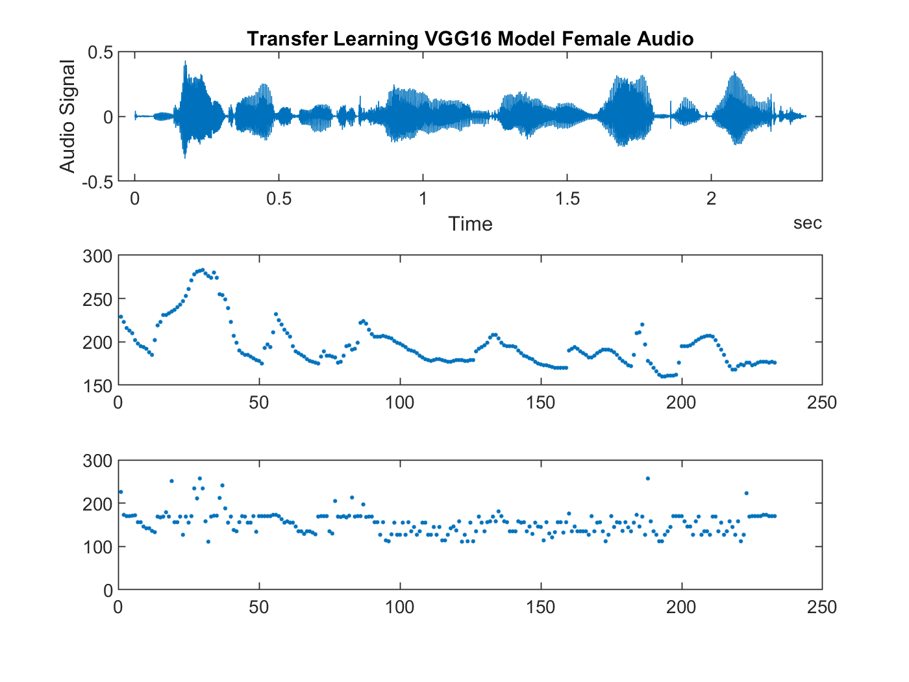
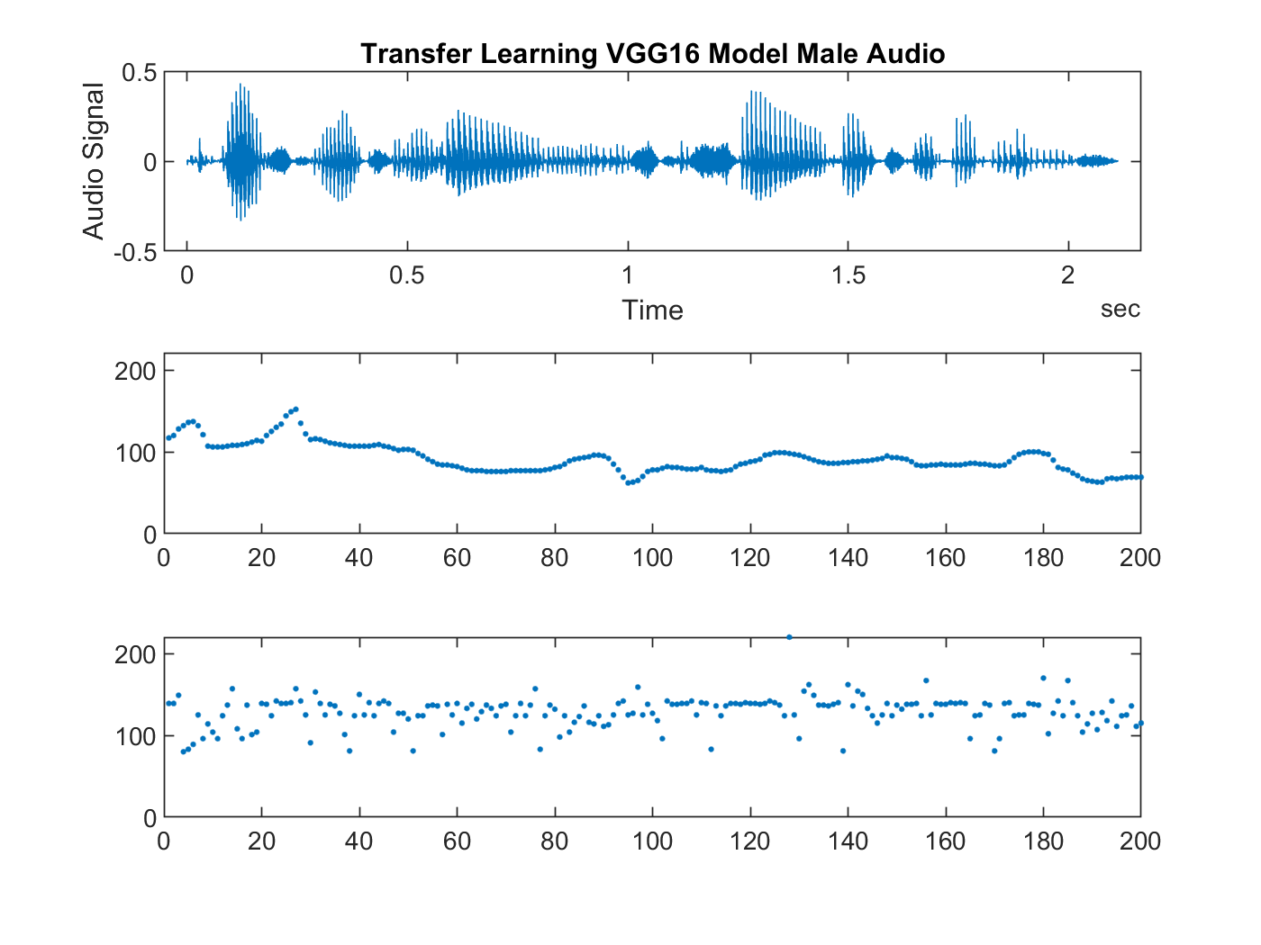
Transfer Learning VGG19

Slide 20
Error
Model | Female Audio | Male Audio
Fully Connected | 8042 | 5167
Feature Model (Data + MFCC) | 7489 | 4753
1D CNN | 5576 | 10761
2D CNN | 5832 | 5759
Transfer Learning | 10196 | 14713

Slide 21
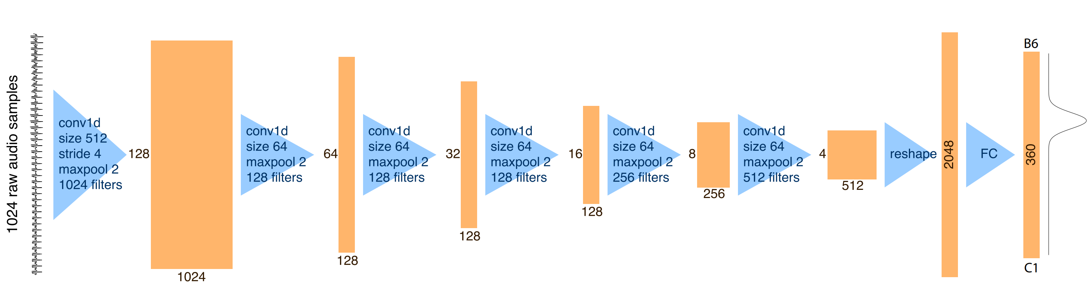
Crepe Package
Based on a deep convolutional neural network that operates directly on the time-domain waveform.
With accuracy of 99.4%

Slide 22
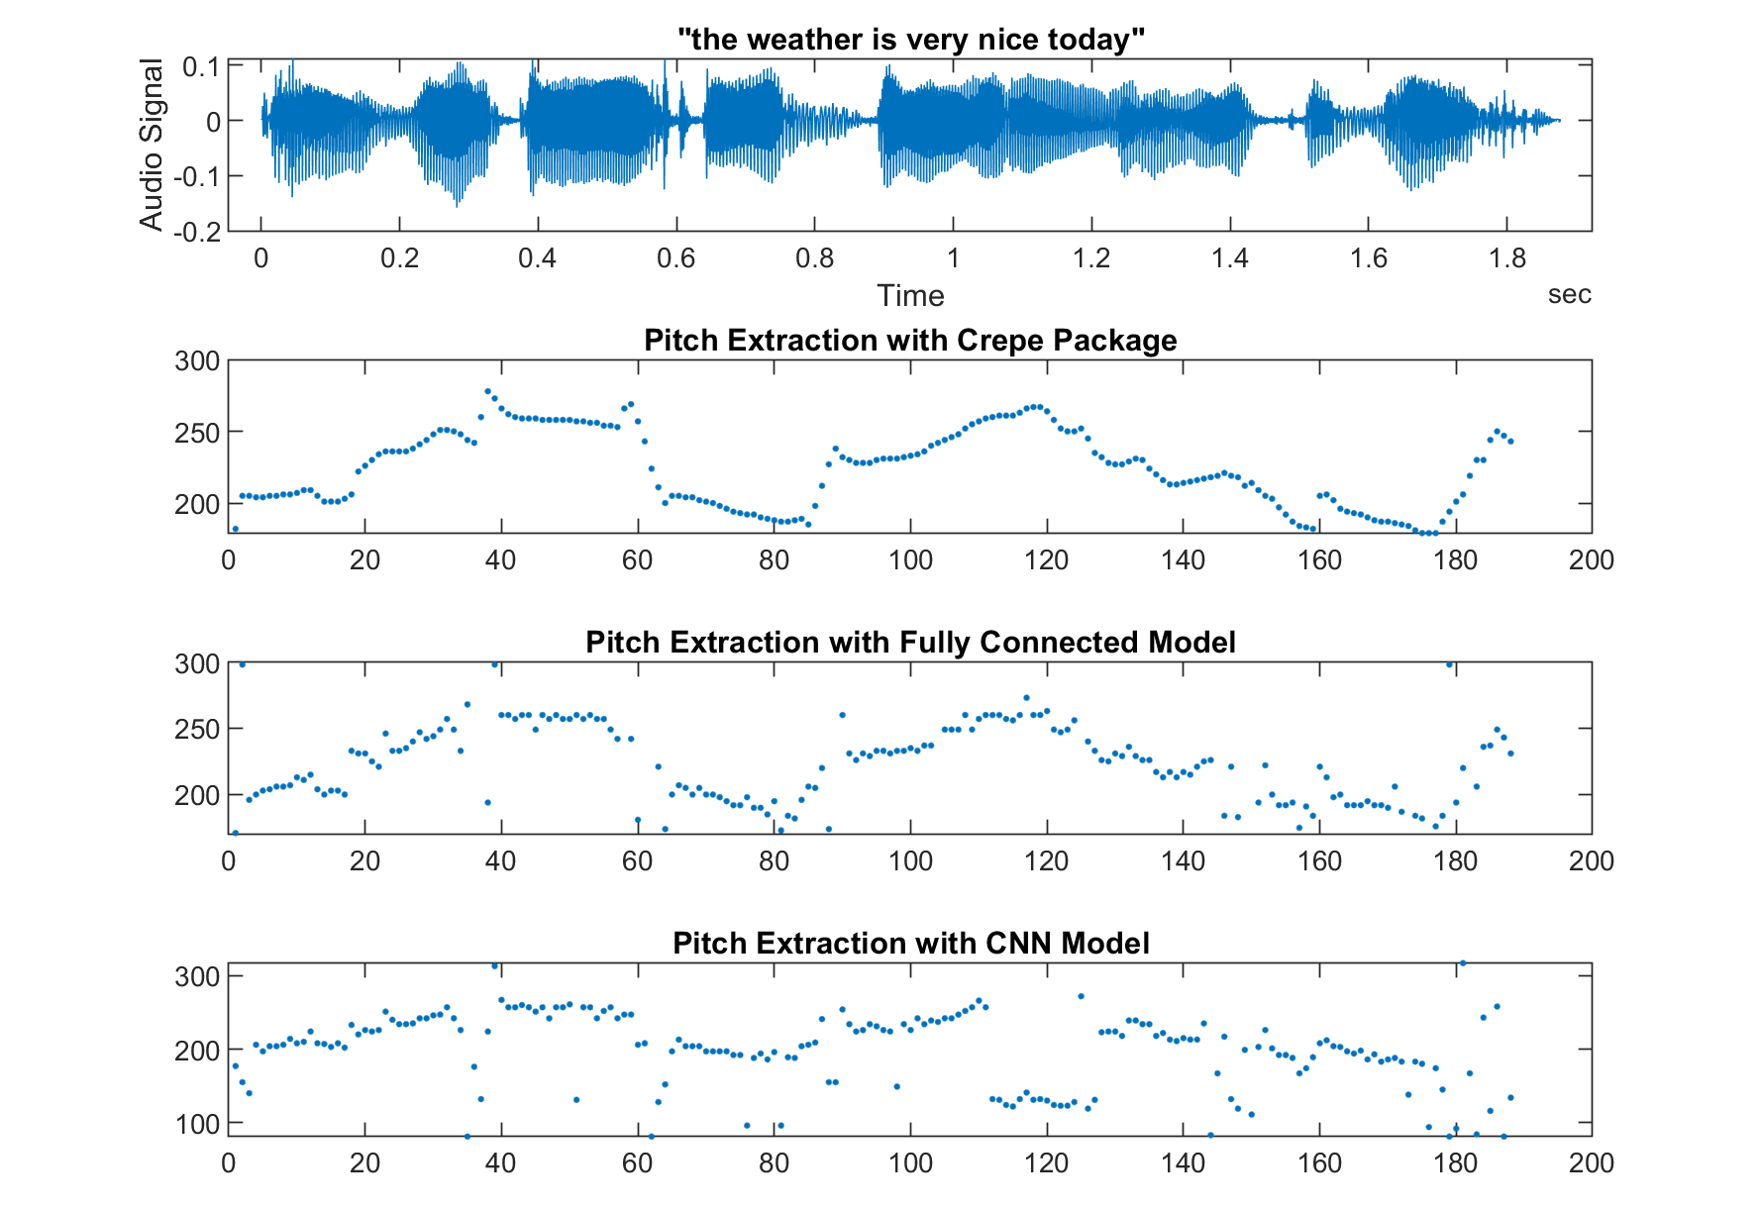
“The weather is very nice today”

Slide 23
Thank you!

