Slide 1
SDD2 Weekly Report
2020 WW33
(8/10-8/14)
Focus • Agility • Competitiveness
‹#›

Slide 2
Project Table - 2020/8
SBU | Head Count | Project Name | Note
IPC | 3 | Sanshin projects NCR projects, Siemens projects | Android 8.1 SUSE Enterprise Linux and other Linux OSes HERO SDK
SPD | 3 | BOXER-81X0AI, BOXER-82X0AI, BOXER-84X0AI, BOXER-8521AI | Jetson Xavier NX, Xavier NXP i.MX8M+Google TPU Jetson NANO EGX-like system, Docker, K8S, DeepStream Jetson TX2 OTA support HERO SDK
UP | 2 | UP2, UP Core Plus, UP Xtreme, UP | Normal Linux Kernel 5.0 on Ubuntu Yocto Linux 2.7 HERO SDK
ECD | 0.5 | COM-SKUC6, GENE-CML5, CEXD-AEIAMZ01, AQ7-QPL, PICO-WHUC4, GENE-WHU6, COM-WHUC6 | Device Drivers HERO SDK
SDD2 (SSC) | 2.5 | SSC Program | Remote Hardware Monitor HERO DMC and HERO Agent+ Other key projects 中華資案合作案,ITRI合作案,Delta合作案 Onyx Android projects Viewsonic VBS100
IPC | 6 | IPC BIOS Support
Focus • Agility • Competitiveness
‹#›

Slide 3
BIOS - Task Status
Done
[CometLake] Update the i210 PXE driver to fix LAN boot fail (2 days, 8/4, 0)
[MIX-Q370A][V04Q4][CFL] Fix issue for ScriptPro (3 days, 8/7, 0)
Set FPF to be the same as the standard product to aovid can’t power on
Add the setup password “SPTECH”
[TigerLake] Update AMI TigerLake codebase 5.19_1AWHY_RC0A.00.2A.32.022
[NPS-CT][CT] Enable security boot and security flash function (3 days, 8/10, 0)
‹#›

Slide 4
BIOS - Task Status
Done
[EMB-APL3][APL] Release EMB-APL3 formal BIOS for factory (2 days, 8/6, 0)
[EMB-APL3][APL] Modify the APCI Power button event by customer’s request (2 days, 8/7, 0)
[MIX-H310A2][CFL][AMI] Switch the numbers of COM port 1 and COM port 2 (2days, 8/4, 0)
[EMB-APL2] Check PXE could not be recognized in OS if we flashed BIOS from M09 to M07 (2 days, 8/4, 0)
[TPM-6600/6610][KBL] Add requirement from Fametech (2 days, 8/14, 0)
Modify BIOS strings and configuration
Close PME# (Wake on Ring)
Release BIOS TP66AM14/TP66BM14 for standard
[MAX-C246A][CFL] Check the yellow band device in device manager on T39 BIOS (1 day, 8/4, 0)
[FAY-003][APL] Release the formal BIOS with the following modifications (3 days, 8/7, 0)
Set the minimum backlight level to 20%
‹#›

Slide 5
BIOS - Task Status
On-going
[MIX-TLUD1][TGL] Prepare TigerLake codebase for MIX-TLUD1 (10 days, due date: 8/31)
[ElkhartLake] Study ElkhartLake and prepare codebase (60 days, due date: 10/31)
[AMD] Study Ryzen V2000 and prepare codebase (90 days, due date: 2021/3/31)
[MIX-Q370A1][CFL][V04Q4] Fix issue for ScriptPro (2 days, due date: 8/18)
Check the HSTI verification fail
Add LAN control setup options
[MAX-Q370A][CFL][V04QC] Add new requirement for LifeSize (2 days, due date: 8/20)
Remove other variables, only reserve lifesize variables
Change postlogo
Change some options default
Debug issue reported by customer
[ATX-Q170B] [KBL] Check SI test issue (2 days, due date: 8/19)
SATA ports still need to be adjusted
Change due date from 8/14 to 8/19
[EMB-B75A] [IB] Check BIOS version and customer’s requirement (1 day, due date: 8/17)
BIOS versions from customer’s two boards are the same

Slide 6
BIOS - Task Status
On-going
[SMS-W480][CML] Import and verifyLinux firmware update solution into CFL and APL codebase (18 days, due date: 8/12)
Coffeelake can do linux firmware update
Appllo lake can’t , because boot mode is not corr
Apollo lake can do linux firmware update , but no display while updating.
[FAY-003][APL] Check the screen flicker issue on customer’s eDP panel (5 days, due date: 8/21)
This issue was happened on the customer’s eDP, needed to check the specific device
[SCH-BT][BT] Check power on/off aging issue (9 days, due date: 8/21)
[VIV-APL2] Bring up the first BIOS (2 days, due date: 8/20)
[ATX-Q170B] [KBL] R1.2 test issue (8 days, due date: 8/28)
Check Smart FAN2 behavior
Check ATX/AT functionality
Only recognize two COM ports in Fedora
Win 7 driver installing issue

Slide 7
BIOS - Task Status
Pending
[CometLake] Check the BSOD issue caused by several PCI cards (3 days, due date: 7/17)
Can duplicate the issue on Intel CRB with Intel BIOS
EE will issue IPS to Intel
Test Condition :
Intel CML-S with PCH-H CRB (公板)
Intel BIOS: CMLSFWR1.R00.2095.D00.2002280938
Asmedia1083 PCI EVB
Intel PRO0/1000GT LAN Card ( BSOD的PCI LAN卡)
BSOD Stop Code: Driver Verifier DMA Violation

Slide 8
EC - Task Status
Done
[CometLake] Add New EC command to retrieve "Board Capabilities" (2 days, 8/14, 0)
Using CMD 0xBC can Get FAN, Temperature, Voltage and LED Sources
EC FW: PICMLT01.SW480.T20
[SMS-W480][CML] issue: Set CPU_FAN duty may cause System_FAN_1 RPM value not stable (2 days, 8/14, +2)
after debugging that the issue was PWM signal and tachometer coupling
- HW engineer will adjust layout to prevent coupling issue
change due date we asking ITE FAE the issue
Try to disable our code flow, use ECU tool to test PWM settings that still can reproduce the issue. Ask ITE FAE help us debugging the issue now
On-going
[FAY-KLU][KBL] Help to check panel resolution not match BIOS selected value in Ubuntu 18.04 (3 days, due date: 8/21)
change due date, since Siemens project demand
[SMS-W480][CML] ADC Voltage add detect internal VCC (+3V) power function (3 days, due date: 8/19)
switch ADC channel to probe VCC, VSTBY, AVCC voltage value
[SMS-W480][CML] According to customer request to add function to set LED solid/flashing mode feature (2 days, due date: 8/21)

Slide 9
Linux and Android Issue List
Done
[ECD][GENE-CML5] Ubuntu 20.04 driver support: DIO, HWM, Watchdog (5 days, 8/7, +3)
SAP已發出 (8/11)
On-going
[ECD][COM-CFHB6] Ubuntu 18.04 driver support: EC-I2C, EC-DIO, HWM, Watchdog (5 days, 8/21)
HWM, WDT已驗證可正常運作
索取Carrier board: CEXD-OHUQSI01-A02 線路圖
Focus • Agility • Competitiveness
‹#›

Slide 10
SMS-W480/SMS-H410
On-going
Write Linux OS Support Report (14 days, 7/24, +21)
[SMS-W480] [ALL OS] Test COM Port
[ISSUE] [SMS-W480] [Fedora/RedHat] COM Port can not transmission between DUT and HOST use minicom.
Siemens: Linux OS support issue fix
[ISSUE] [SMS-W480] [Debian/Fedora] Can not found LAN1 with ‘ifconfig’ and ‘Seting->Network’
Siemens: Run Linux stress & Cold boot test for OS test report (TBD)
Run Linux stress test for Ubuntu 18.04.0 test report
Run Linux stress test for Debian 9.12.0 test report
Run Linux stress test for Fedora 31 test report
Run Linux stress test for OpenSUSE Leap 15.1 test report
Run Linux stress test for SUSE Linux Enterprise Server 15 SP1 test report
Run Linux stress test for Red Hat Enterprise Linux 8.2 test report
Notes:
https://docs.google.com/spreadsheets/d/1sHnTT3IlPASuYO5UO2RDFfEHbT2QouuNpQaKEVw98G0/edit#gid=0

Slide 11
SMS-W480/SMS-H410
On-going
IPCBMC API Developing
Implement Siemens IPCBMC API (5 days, 7/24, +16)
Implement Alert funcion for Thermal, Fan speed
Implement LED control function
support ECD task and postpone this task
Notes:
https://docs.google.com/spreadsheets/d/1sHnTT3IlPASuYO5UO2RDFfEHbT2QouuNpQaKEVw98G0/edit#gid=0

Slide 12
UP Board
Done
On-going
[UP Xtreme][Yocto 2.7] build image and test on warrior-dev (2 days, due date: 07/31)
[UP Core Plus] test low latency kernel v5.0 on Ubuntu OS (5 days, due date: 07/31)
[UP Squared] Implement WCCT (5 days, due date: 8/14)
[UP Squared] Implement Boulder Springs (5 days,due date: 8/21)
[UP-EHL01] Build Yocto alpha 8 release Image and validation of I/O(5 days, due date: 8/21)
[UP-Xtreme] upload libmraa to launchpad (5 days, due date: 8/14)
LaunchPad can not build node-mraa & python-mraa-doc on bionic & focal.
[UP Board][Bug] pin 26 stuck with CS function (TBD)
[UP Xtreme][Issue] UP Xtreme SPI data checksum error above 3Mbps (TBD)
[UPN-APL] hardware validation (5 days, due date: 8/21)
Focus • Agility • Competitiveness
‹#›

Slide 13
VIV-APL4
On-going
[IPC][MVP] VIV-APL4 SDK: Implement Power cycle port API(5 days, due date: 9/11)
API function
[IPC] VIV-APL4 SDK: Get Power consumption(5 days, due date: 9/18)
API function
[IPC] VIV-APL4 SDK: Front Panel Status LED indicator GPIO control(5 days, due date: 9/18)
[IPC] VIV-APL4 SDK: LAN Switch IC(88E6390) first function Ready:Implement Get MAC API (Risk Item) (5 days, due date: 10/16)
[IPC] VIV-APL4 SDK: LAN Switch IC(88E6390) Related function Ready (Risk Item)(5 days, due date: 11/20)
[IPC] VIV-APL4 SDK: Model A SDK Release(5 days, due date: 11/27)
[IPC] VIV-APL4 SDK:Tuning Release for Model B(5 days, due date: 12/3)
[IPC] VIV-APL4 SDK:Tuning Release for Model C(5 days, due date: 01/13)
Focus • Agility • Competitiveness
‹#›

Slide 14
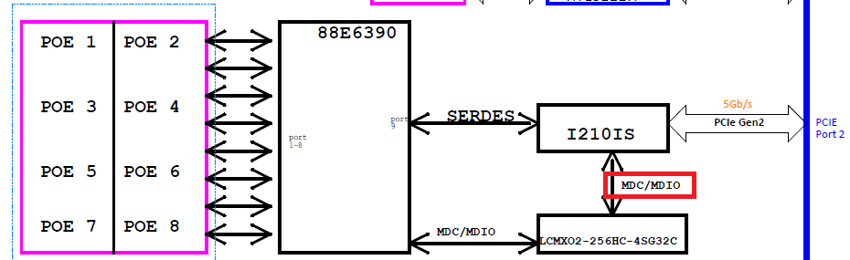
VIV-APL4
Focus • Agility • Competitiveness
‹#›

Slide 15
BOXER-81x0 AI
Done
[Boxer8170] Finish test items on JetPack 4.4 ubuntu image(2 days,dute date:8/7)
USB read/write speed too low
USB3.0 (A device: 20~40 MB/s , B device: 40~60MB/s)
Use JetPack 4.2 and JetPack4.4 to test speed
On-Going
[Boxer8170] Package ACLinux (5 days,dute date:8/21)

Slide 16
BOXER-822x AI
Done
[Boxer8221] Debug uboot changed issue (3 days, due date: 8/13)
工廠端回報的問題
Release image: ACLinux_4.9_ACLNX49D.NV03.BOXER-8221AI.7
On-going
[Boxer-8221AI] Try fuse and secureboot - part2 (2 days, due date: 7/29)
nv forum issue: https://forums.developer.nvidia.com/t/still-fail-to-enable-secureboot/144888
[Boxer-8220AI] ACLinux with Jetpack 4.4 (TBD)
[Boxer-8222AI] Verify ODM carrier board for Senstar (5 days, due date: 8/14)
Focus • Agility • Competitiveness
‹#›

Slide 17
BOXER-824x AI
On-going
[Boxer8240] Release ACLinux image with Jetpack 4.4 (5 days, due date: 8/20)
Focus • Agility • Competitiveness
‹#›

Slide 18
BOXER-825x AI
On-going
[Boxer-8250AI] Release ACLinux with Jetpack 4.4 (5 days, due date: 8/27)
[Boxer-8253AI] Verify A0.1 PCBA (8 days, due date: 8/26)
Focus • Agility • Competitiveness
‹#›

Slide 19
BOXER-8521AI
Done
Release first image for A0.2 PCBA (5 days, due date: 7/30, +12)
On-going
Bring up audio codec (5 days, due date: TBD)
SoC cannot recognize audio codec via I2C3 at boot time

Slide 20
VBS100
On-going
SR4 evaluation(TBD)
Sent the second evaluation on 8/5 (Add vCast item)
The customer is keeping update items of SR4. Need to wait for the final confirmation.

Slide 21
Intel SDO
On-going
Study Intel SDO 1.8 (7 days, 8/14, +3)
Study demo all-in-one
Has study DI, TO1, TO2 on device side
Need more time to study interactions between manufacturer, rendezvous, and owner server

Slide 22
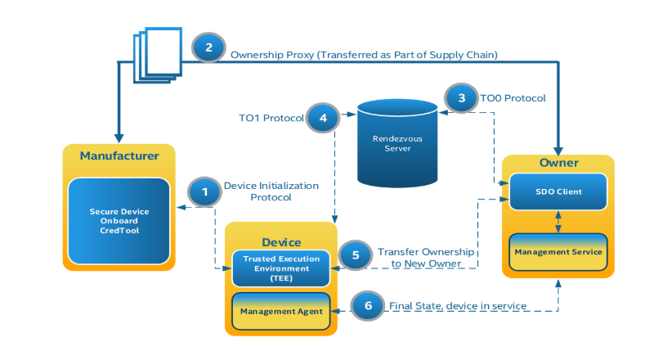
TO1
DI
TO2
rendezvous may be replaced when TO2

Slide 23
Web-based Hardware Monitor
Done
Build HERO DMC agent (nodejs) to binary (2 days, due date: 8/5, +7)
Due day changed due to ECD backlight driver porting task.
On-going
[HERODMC][WebUI] Add BIOS OTA (20 days, TBD)
[HERODMC] Implement BIOS OTA with fwupd tools (5 days, TBD)

Slide 24
Android BSP for Onyx
On-going
MPAD-800 (85 days, due date:10/24)
Android 10 bring up
Touchscreen OK
IRQ storm fixed
Brightness control OK
Shorten MIPI commands delay to speed up resume
Bluetooth OK
Audio OK but noise
RTC1010AL
Back camera of Intel CRB was fixed (BIOS)

Slide 25
Web Study
On-going
Study VueJS (5 days, due date: 8/07,+12)
version: v2.x
練習：以現成 todo-list 範例做修改
Study SQLite / MongoDB (5 days, due date: 8/14)
Study VuetifyJS (5 days, due date: 8/21)
version: v1.5.x

Slide 26


Slide 27
BOXER-8410AI
Done
Study QE test script(5 days, due date: 7/17)
Finish all script and start to study BOXER-8110 AI
Focus • Agility • Competitiveness
‹#›

Slide 28
Azure Sphere
Pending
[Azure Sphere] Implement GPIO application on ubuntu(1 day, due date:06/03)
[Azure Sphere] Transfer message via mqtt on ubuntu(4 days, due date:06/08)
[Azure Sphere] Transfer message via mqtt on windows (4 days, due date:06/12)

Slide 29
VBS100 SR4
TBD
OTA from USB disk
HDMI Input should be hidden when no signal
Remove navigation bar
Remove by default
Add dynamically
Implement Emergency Mode
Trigger by USB keyboard
Factory Reset, USB Debugging, Navigation Bar
Press hot key for 10 seconfs to trigger Factory Reset directly
An additional Emergency service or simple reaction service

Slide 30
Web-based Hardware Monitor
Pending
[HeroDMC] Device Management: Add Group function (5 days, due date: TDB)
[HeroDMC] Remote Control: design a easy use UI to replace DEMO UI (5 days, due date: TBD)
Rewrite HeroAgent with python (15 days, due date: TBD)
[HeroDMC] Account: change to use SSO login (? days, due date: TBD)
[HeroDMC] Device Authentication: implement SDA / SDO (? days, due date: TBD)
[HeroDMC] Support I2C Read/Write
Herosuit CLI Tool(5 days, due date: TBD)
Remote Control Agent (5 days, due date: TBD)
WebUI (5 days, due date: TBD)

Slide 31
BOXER-8410AI
Pending
Debug RS-485 not working on A1.0 PCBA (5 days, due date: TBD)
Focus • Agility • Competitiveness
‹#›

Slide 32
Sanshin
Done
On-going
OTA Server
Mount external folder to collect logs (TBD)
Apply correct certificate for web server (TBD)
Set valid date and correct domain name in the certificate
Keep the device awake and check the battery during OTA image downloading (TBD)

Slide 33
BOXER-6405M
Pending
Debug CentOS 7.5 installation failure issue (5 days, due date: 4/27, -3)
FAE cannot install CentOS 7.5 with the usb disk which is flashed by his own flash tool. Instead of entering installation GUI, screen shows dracut-initqueue timeout error repeatedly
After changing the flash tool to Rufus-3.9,FAE can install CentOS 7.5 successfully; however, RD cannot install CentOS 7.5 because screen always blanks before entering installation GUI in many trials
There might be some difference between machines of RD and FAE. But FAE has provided their machine to customer and RD cannot get the same machine to reproduce successful installation

Slide 34
Kneron KL520 SDK & Toolchain
Pending
Implement factory test tools with Kneron KL520 NPU (Ubuntu 18.04.3) (30 days,01/15)
Setup Kneron FD/FR model demo app (SDK v0.9.1) (5 days, 01/15)
Build boot, ncpu, scpu and model images (SDK v0.9.5) (2 days, 12/18, +21)
no Keil MDK
Test report from Kneron
https://pms-ipc.asus.com/redmine/issues/5739

Slide 35
Web-based Hardware Monitor
Pending
Implement functions for Intel SDO sdk (15 days, TBD)
Because device management DB is not implemented in SDO SDK, an extra DB function has to be implemented before production
Postponed due to technical documentation modification

Slide 36
SSC Program
Tasks
SmartGateway+, SmartGateway G2 (Topic Owner: PoHsien Lin)
SDO (Topic Owner: Yu-Hao Lin)
DM Certificate (Topic Owner: Yu-Hao Lin)
MES SmartGateway tasks (Topic Owner: Menghui)
HERO Space (Topic Owner: PoHsien Lin)
Account Management (Topic Owner: Menghui)
Meeting minutes:
https://docs.google.com/document/d/1DyCPIsbmLEpuIj-CgIX6QuYroTYh4cLerVD9n2pCUSw/edit

