Slide 1
SDD2 Weekly Report
2020 WW34
(8/17-8/21)
Focus • Agility • Competitiveness
‹#›

Slide 2
Project Table - 2020/8
SBU | Head Count | Project Name | Note
IPC | 3 | Sanshin projects NCR projects, Siemens projects | Android 8.1 SUSE Enterprise Linux and other Linux OSes HERO SDK
SPD | 3 | BOXER-81X0AI, BOXER-82X0AI, BOXER-84X0AI, BOXER-8521AI | Jetson Xavier NX, Xavier NXP i.MX8M+Google TPU Jetson NANO EGX-like system, Docker, K8S, DeepStream Jetson TX2 OTA support HERO SDK
UP | 2 | UP2, UP Core Plus, UP Xtreme, UP | Normal Linux Kernel 5.0 on Ubuntu Yocto Linux 2.7 HERO SDK
ECD | 1 | COM-SKUC6, GENE-CML5, CEXD-AEIAMZ01, AQ7-QPL, PICO-WHUC4, GENE-WHU6, COM-WHUC6 | Device Drivers HERO SDK
SDD2 (SSC) | 3 | SSC Program | Remote Hardware Monitor HERO DMC and HERO Agent+ Other key projects 中華資案合作案,ITRI合作案,Delta合作案 Onyx Android projects Viewsonic VBS100
IPC | 6 | IPC BIOS Support
Focus • Agility • Competitiveness
‹#›

Slide 3
BIOS - Task Status
Done
[MAX-Q470A][MIX-Q470D1][CML] Request HW to fix dediprog can’t be used if Ai1315 BIOS recovery unit is mounted on PCB (0.5 day, 8/11, 0)
[CometLake] Import PlatformPkg.dec to fix compiler error after updating AMI codebase 5.17_1AWDV_RC9.0.3F.20_038 (2 days, 8/12, 0)
[EMB-Q170A][SKL] Check the OA2.1 is no problem in BIOS side (0.5 day, 8/13, 0)
[TigerLake] Update AMI TigerLake codebase 5.19_1AWHY_RC0A.00.32.2A_023 (2 days, 8/14, 0)
[ATX-Q170B] [KBL] Customize BIOS for VNET (2 days, due date: 8/18)
Disabled COM3 port
Modified Smbios strings
Release formal BIOS V04MCM13
[ATX-Q170B] [KBL] Check SI reported issues (2 days, due date: 8/20)
Passed USB and SATA ports SI test
[FAY-003][APL] Check the screen flicker issue on customer’s eDP panel (5 days, 8/21, 0)
This issue happened on the customer’s eDP, needed to check the specific device
[ATX-Q170B] [KBL] R1.1 test issue (3 days, due date: 8/21)
Smart FAN2 function and behavior are normal
ATX/AT function is normal
Win 7 inbox driver doesn’t support ehci
After updated Intel I219 LAN driver with newer version, Windows security warning didn’t appear
‹#›

Slide 4
BIOS - Task Status
Done
[EMB-BT1][BT] Check internal pull type value for GPIO79 and GPIO88 (1 day, 8/21, 0)
Read pull type value by Intel GPIO configuration tool
‹#›

Slide 5
BIOS - Task Status
On-going
[MIX-Q370A1][CFL][V04Q4] Fix issue for ScriptPro (2 days, due date: 8/18)
Check the HSTI verification fail
Add LAN control setup options
[MAX-Q370A][CFL][V04QC] Add new requirement for LifeSize (2 days, due date: 8/20)
Remove other variables, only reserve lifesize variables
Change postlogo
Change default values of some options
Debug issues reported by customer
[EMB-B75A] [IB] Check BIOS version and customer’s requirement (1 day, due date: 8/17)
Check BSOD issue

Slide 6
BIOS - Task Status
On-going
[SCH-BT][BT] Check power on/off aging issue (10 days, due date: 8/28)
The failure rate is about 1/1000
System cannot enter S5 when power off event is triggered
[VIV-APL2] Bring up the first BIOS (2 days, due date: 8/20)
[ATX-Q170B] [KBL] R1.1 test issue (5 days, due date: 8/28)
Only recognize two COM ports in Fedora
ATX/AT string should be modified
Modify Boot display strings, adjust VBIOS options
[MIX-TLUD1][TGL] Prepare TigerLake codebase for MIX-TLUD1 (10 days, due date: 8/31)
[ElkhartLake] Study ElkhartLake and prepare codebase (60 days, due date: 10/31)
[AMD] Study Ryzen V2000 and prepare codebase (90 days, due date: 2021/3/31)
[FAY-KLU][KBL] Help to check panel resolution not match BIOS selected value in Ubuntu 18.04 (3 days, due date: 8/31)
change due date, since Siemens project demand

Slide 7
BIOS - Task Status
Pending
[CometLake] Check the BSOD issue caused by several PCI cards (3 days, due date: 7/17)
Can duplicate the issue on Intel CRB with Intel BIOS
EE will issue IPS to Intel
Test Condition :
Intel CML-S with PCH-H CRB (公板)
Intel BIOS: CMLSFWR1.R00.2095.D00.2002280938
Asmedia1083 PCI EVB
Intel PRO0/1000GT LAN Card ( BSOD的PCI LAN卡)
BSOD Stop Code: Driver Verifier DMA Violation

Slide 8
EC - Task Status
Done
[SMS-W480][CML] According to customer request to add function to set LED solid/flashing mode feature (2 days, 8/21, +0.5)
EC FW: PICMLF01.SW480.F11
[SMS-W480][CML] DVT motherboard use ifu.efi to update EC FW causing system restart (0.5 day, 8/18, 0)
it need prompt user: "Please turn off Power Supply and wait Power LED off"
EC flash command add /j to prohibit system reset
[SMS-W480][CML] Check customer’s CPU/System fan RPM (0.5 day, 8/21, 0)
On-going
[SMS-W480][CML] Refine LED Blink mode commands (2 days, due date: 8/25)
[SMS-W480][CML] System leakage issue (0.5 day, due date: 8/25)
Syetem suspend to S3 need set KB_RST# to Output Low
[SMS-W480][CML] ADC Voltage: add “detect internal VCC (+3V) power function” (3 days, due date: 8/28)
switch ADC channel to probe VCC, VSTBY, AVCC voltage value
change due date, because customer checking LED Blink mode functions

Slide 9
Linux and Android Issue List
Done
[ECD][COM-CFHB6] Ubuntu 18.04 driver support: EC-I2C, EC-DIO, HWM, Watchdog (5 days, 8/21, +0)
SAP已發出 SAP0000000230 (COM-CFHB6 Linux Driver SAP 20200820)
On-going
[ECD][CEXD-AEIAMZ01] provide driver support (5 days, 8/28)
Implement drivers: DIO, HWM, Watchdog, SmartFan
Focus • Agility • Competitiveness
‹#›

Slide 10
SMS-W480/SMS-H410
Done
IPCBMC API Developing
Implement Siemens IPCBMC API (5 days, 7/24, +30)
Alert funcions for Thermal, Fan speed are ready
LED control functions are ready
Siemens has no feedback about the spec of LED control function APIs, and SDD2 created the APIs for Siemens.
Released in 2.0.6, 2020/08/21 for AAEON QE test0
Write Linux OS Support Report (14 days, 7/24, +21)
Siemens: Linux OS support issue fix
[ISSUE] [SMS-W480] [Debian/Fedora] Can not found LAN1 with ‘ifconfig’ and ‘Setting->Network’ (10 days, 8/28)
Notes:
https://docs.google.com/spreadsheets/d/1sHnTT3IlPASuYO5UO2RDFfEHbT2QouuNpQaKEVw98G0/edit#gid=0

Slide 11
SMS-W480/SMS-H410
On-going
Siemens: Linux OS support issue fix
[ISSUE] [Debian] Can not get EDID from the monitor. (10 days, 9/11)
[ISSUE] [SMS-W480] [Fedora/RedHat] COM Port can not exchange data between DUT and HOST use minicom (5 days, 9/4)
[ISSUE] [Six OSs] Directly connect from DUT to iperf3 Serve without a switch, the network interface might be unexpectedly disabled. (5 days, 9/11)
Siemens: Run Linux stress & Cold boot test for OS test report (TBD)
Run Linux stress test for Ubuntu 18.04.0 test report
Run Linux stress test for Debian 9.12.0 test report
Run Linux stress test for Fedora 31 test report
Run Linux stress test for OpenSUSE Leap 15.1 test report
Run Linux stress test for SUSE Linux Enterprise Server 15 SP1 test report
Run Linux stress test for Red Hat Enterprise Linux 8.2 test report
Implement GUI BIOS update utility (5 days, 9/4)
Notes:
https://docs.google.com/spreadsheets/d/1sHnTT3IlPASuYO5UO2RDFfEHbT2QouuNpQaKEVw98G0/edit#gid=0

Slide 12
UP Board
Done
[UPN-APL] hardware validation (5 days, due date: 8/21, 0)
40 pin HAT function failed.
On-going
[UP Xtreme][Yocto 2.7] build image and test on warrior-dev (2 days, due date: 07/31, +24)
[UP Core Plus] test low latency kernel v5.0 on Ubuntu OS (5 days, due date: 07/31, +24)
[UP Squared] Implement WCCT (5 days, due date: 9/30)
[UP Squared] Implement Boulder Springs (5 days,due date:9 /30)
[UP-EHL01] Build Yocto alpha 8 release Image and do validation of I/O(5 days, due date: 8/28)
[UP-Xtreme] upload libmraa to launchpad (5 days, due date: 8/14)
LaunchPad can not build node-mraa & python-mraa-doc on bionic & focal.
[UP Xtreme][Issue] UP Xtreme SPI data checksum error above 3Mbps (4 days, due date: 8/31)
[UPN-APL] Enable 40pin HAT function (2 days, due date: 8/25)
[UP Board][Bug] pin 26 stuck with CS function (TBD)
Focus • Agility • Competitiveness
‹#›

Slide 13
VIV-APL4
On-going
[IPC][MVP] VIV-APL4 SDK: Implement Power cycle port API(5 days, due date: 9/11)
API function
[IPC] VIV-APL4 SDK: Get Power consumption(5 days, due date: 9/18)
API function
[IPC] VIV-APL4 SDK: Front Panel Status LED indicator GPIO control(5 days, due date: 9/18)
[IPC] VIV-APL4 SDK: LAN Switch IC(88E6390) first function Ready:Implement Get MAC API (Risk Item) (5 days, due date: 10/16)
study I210 driver & 88e6390 datasheet
[IPC] VIV-APL4 SDK: LAN Switch IC(88E6390) Related function Ready (Risk Item)(5 days, due date: 11/20)
[IPC] VIV-APL4 SDK: Model A SDK Release(5 days, due date: 11/27)
[IPC] VIV-APL4 SDK:Tuning Release for Model B(5 days, due date: 12/3)
[IPC] VIV-APL4 SDK:Tuning Release for Model C(5 days, due date: 01/13)
Focus • Agility • Competitiveness
‹#›

Slide 14
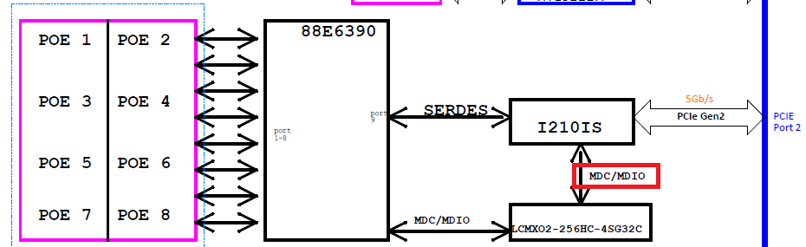
VIV-APL4
Critical Issue
MDIO might not be able to be controlled by Intel I210 NIC
Focus • Agility • Competitiveness
‹#›

Slide 15
BOXER-81x0 AI
Done
[Boxer-8170] Release ACLinux with Jetpack 4.4 (5 days,dute date:8/21)
On-going
[Boxer-8170] Release TX2 4GB Image with Jetpack 4.4 (28 days,dute date:9/14)

Slide 16
BOXER-822x AI
Done
[Boxer-8222AI] Verify ODM carrier board for Senstar (5 days, due date: 8/14, 0)
On-going
[Boxer-8221AI] Try fuse and secureboot - part2 (5 days, due date: 9/3)
nv forum issue: https://forums.developer.nvidia.com/t/still-fail-to-enable-secureboot/144888
due date changed, wait for response from Nvidia
[Boxer-8220AI] ACLinux with Jetpack 4.4 (TBD)
Focus • Agility • Competitiveness
‹#›

Slide 17
BOXER-824x AI
Done
[Boxer8240] Release ACLinux image with Jetpack 4.4 (5 days, due date: 8/20)
Release image: ACLinux_4.9_ACLNX49D.NV04.BOXER-8240-AI.1
Focus • Agility • Competitiveness
‹#›

Slide 18
BOXER-825x AI
On-going
[Boxer-8250AI] Release ACLinux with Jetpack 4.4 (5 days, due date: 8/27)
[Boxer-8253AI] Verify A0.1 PCBA (8 days, due date: 8/26)
Porting of HDMI-IN(TC358743) function is on-going
Focus • Agility • Competitiveness
‹#›

Slide 19
BOXER-8521AI
On-going
Bring up audio codec (5 days, due date: TBD)
SoC cannot recognize audio codec via I2C3 at boot time

Slide 20
VBS100
On-going
SR4 evaluation(TBD)
It’s under negotiation.

Slide 21
Intel SDO
Done
Study Intel SDO 1.8 (7 days, 8/14, +5)
Study is finished.
On-going
Manufacturer Service(5 days, 8/27)
Run in docker image - OK
Create software keystore - OK
Put default Rendezvous Info in database - OK
Put default Owner Public Key in database
Collect device voucher files

Slide 22
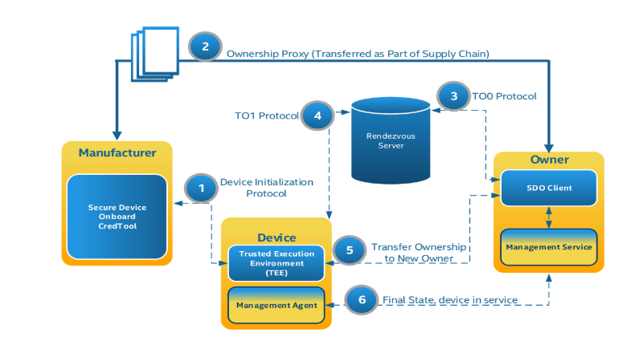
Manufacturer sends voucher files to Owner
Rendezvous doesn’t keep redirect info in DB.
rendezvous may be replaced when TO2

Slide 23
Intel SDO
On-going
Rendezvous Service phase 1(3 days, 9/2)
Run in docker image
Rendezvous Service phase 2(10 days, TBD)
Store redirect info in database
Store activation info in database
Implement an interface to get activation

Slide 24
Intel SDO
On-going
Owner Service(5 days, TBD)
Run in docker image
Create software keystore - OK
Design an interface to put voucher files into Owner Service
Device(3 days, TBD)
Create keypair

Slide 25
Web-based Hardware Monitor
On-going
[HERODMC][WebUI] Add BIOS OTA (20 days, TBD)
[HERODMC] Implement BIOS OTA with fwupd tools (5 days, due date: 8/21)
Use SMS-W480 as target board for test
SMS-W480 can’t success reboot or shutdown on Ubuntu 20.04.1

Slide 26
Android BSP for Onyx
On-going
MPAD-800 (85 days, due date:10/24)
Android 10 bring up
Audio OK but noise
G-sensor OK
Light sensor?
Study Camera HAL3

Slide 27
Web Study
Done
Study VueJS (5 days, due date: 8/07, +10)
version: v2.x
On-going
Study SQLite / MongoDB (5 days, due date: 8/28)
due date changed due to “Study VueJS”
Study VuetifyJS (5 days, due date: TBD)
version: v1.5.x
[VueJS] 以 todo-list 範例 (20 days, due date: 9/25)
熟悉 VueJS 操作
配合 SQLite 做資料儲存 / 管理
配合 VuetifyJS 排版、美化頁面

Slide 28
AIoT Survey
Done
Docker survey (08/10 ~ 08/12)
INTEL OpenVINO (08/13 ~ 08/20)
Convert a Tensorflow model to IR
Model Server
[Demo] Face Recognition Demo
[Demo] Face Detection Demo
[Demo] Interactive Face Detection Demo
Ongoing
MICROSOFT X NVIDIA 實作課程 – 運用 AI 深度學習打造智慧產線瑕疵檢測應用 (08/26)
英特爾物聯網軟體研討會 (08/27)
NVIDIA X III 林口新創園邊緣運算技術交流工作坊 (08/28)
NVIDIA NGC (5 days, 09/03)
Backlog
INTEL NCS2, NVIDIA TensorRT

Slide 29

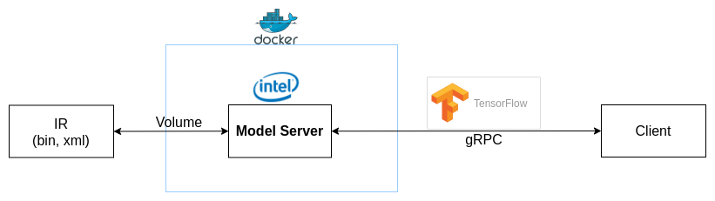
AIoT Survey
Convert a model to IR
Model serving

Slide 30


Slide 31
Azure Sphere
Pending
[Azure Sphere] Implement GPIO application on ubuntu(1 day, due date:06/03)
[Azure Sphere] Transfer message via mqtt on ubuntu(4 days, due date:06/08)
[Azure Sphere] Transfer message via mqtt on windows (4 days, due date:06/12)

Slide 32
VBS100 SR4
TBD
OTA from USB disk
HDMI Input should be hidden when no signal
Remove navigation bar
Remove by default
Add dynamically
Implement Emergency Mode
Trigger by USB keyboard
Factory Reset, USB Debugging, Navigation Bar
Press hot key for 10 seconfs to trigger Factory Reset directly
An additional Emergency service or simple reaction service

Slide 33
Web-based Hardware Monitor
Pending
[HeroDMC] Device Management: Add Group function (5 days, due date: TDB)
[HeroDMC] Remote Control: design a easy use UI to replace DEMO UI (5 days, due date: TBD)
Rewrite HeroAgent with python (15 days, due date: TBD)
[HeroDMC] Account: change to use SSO login (? days, due date: TBD)
[HeroDMC] Device Authentication: implement SDA / SDO (? days, due date: TBD)
[HeroDMC] Support I2C Read/Write
Herosuit CLI Tool(5 days, due date: TBD)
Remote Control Agent (5 days, due date: TBD)
WebUI (5 days, due date: TBD)

Slide 34
Web-based Hardware Monitor
Pending
Implement functions for Intel SDO sdk (15 days, TBD)
Because device management DB is not implemented in SDO SDK, an extra DB function has to be implemented before production
Postponed due to technical documentation modification

Slide 35
Sanshin
Done
On-going
OTA Server
Mount external folder to collect logs (TBD)
Apply correct certificate for web server (TBD)
Set valid date and correct domain name in the certificate
Keep the device awake and check the battery during OTA image downloading (TBD)

Slide 36
BOXER-6405M
Pending
Debug CentOS 7.5 installation failure issue (5 days, due date: 4/27, -3)
FAE cannot install CentOS 7.5 with the usb disk which is flashed by his own flash tool. Instead of entering installation GUI, screen shows dracut-initqueue timeout error repeatedly
After changing the flash tool to Rufus-3.9,FAE can install CentOS 7.5 successfully; however, RD cannot install CentOS 7.5 because screen always blanks before entering installation GUI in many trials
There might be some difference between machines of RD and FAE. But FAE has provided their machine to customer and RD cannot get the same machine to reproduce successful installation

Slide 37
Kneron KL520 SDK & Toolchain
Pending
Implement factory test tools with Kneron KL520 NPU (Ubuntu 18.04.3) (30 days,01/15)
Setup Kneron FD/FR model demo app (SDK v0.9.1) (5 days, 01/15)
Build boot, ncpu, scpu and model images (SDK v0.9.5) (2 days, 12/18, +21)
no Keil MDK
Test report from Kneron
https://pms-ipc.asus.com/redmine/issues/5739

Slide 38
SSC Program
Tasks
SmartGateway+, SmartGateway G2 (Topic Owner: PoHsien Lin)
SDO (Topic Owner: Yu-Hao Lin)
DM Certificate (Topic Owner: Yu-Hao Lin)
MES SmartGateway tasks (Topic Owner: Menghui)
HERO Space (Topic Owner: PoHsien Lin)
Account Management (Topic Owner: Menghui)
Meeting minutes:
https://docs.google.com/document/d/1DyCPIsbmLEpuIj-CgIX6QuYroTYh4cLerVD9n2pCUSw/edit

