Slide 1
SDD2 Weekly Report
2020 WW35
(8/24-8/28)
Focus • Agility • Competitiveness
‹#›

Slide 2
Project Table - 2020/8
SBU | Head Count | Project Name | Note
IPC | 3 | Sanshin projects NCR projects, Siemens projects | Android 8.1 SUSE Enterprise Linux and other Linux OSes HERO SDK
SPD | 3 | BOXER-81X0AI, BOXER-82X0AI, BOXER-84X0AI, BOXER-8521AI | Jetson Xavier NX, Xavier NXP i.MX8M+Google TPU Jetson NANO EGX-like system, Docker, K8S, DeepStream Jetson TX2 OTA support HERO SDK
UP | 2 | UP2, UP Core Plus, UP Xtreme, UP | Normal Linux Kernel 5.0 on Ubuntu Yocto Linux 2.7 HERO SDK
ECD | 1 | COM-SKUC6, GENE-CML5, CEXD-AEIAMZ01, AQ7-QPL, PICO-WHUC4, GENE-WHU6, COM-WHUC6 | Device Drivers HERO SDK
SDD2 (SSC) | 3 | SSC Program | Remote Hardware Monitor HERO DMC and HERO Agent+ Other key projects 中華資案合作案,ITRI合作案,Delta合作案 Onyx Android projects Viewsonic VBS100
IPC | 6 | IPC BIOS Support
Focus • Agility • Competitiveness
‹#›

Slide 3
BIOS - Task Status
Done
[MAX-Q370A][CFL] Customize BIOS for LifeSize (3 days, 8/19, 0)
Reboot the system after pressing F4/ESC to exit the setup menu to prevent the password can’t be promoted
Only reserve Lifesize key (lifesize-emerald PK), remove other AAEON and Microsoft keys
Allow the secure policy can change keys after flashing BIOS
Change the boot option priority to USBKey -> Network -> HDD
System will show “No option to boot to.” if no boot device attached
Fix the logo provided by customer can’t be shown durng POST
Change CHA_FAN1 to manual mode and set its initial speed to 70%
Enable the “Case Open Warning”
Change multiple setup items default value
[VIV-APL2] Provided VAPL2T00 for bring up the board successfully
[MIX-Q370A1][CFL] Customize BIOS for ScriptPro (3 days, 8/18, +2)
Fix the password will disappear after load default.
Add "PCH LAN Controller" & "I211-AT" items into BIOS Setup -> Chipset -> PCH-IO Configuration
Support HSTI and pass the HSTI verification
‹#›

Slide 4
BIOS - Task Status
Done
[CometLake] Modify the codebase behavior (0.5 day, 8/21, 0)
Revert te AMT tokens since the latest codebase fix the AMT library issue
Revert the PcieSataController module since the new module is not compatible with Asmedia
[FAY-003][APL] Check the screen flicker issue on customer’s eDP panel (5 days, 8/21, 0)
This issue happened on the customer’s eDP, needed to check the specific device
[ATX-Q170B] [KBL] R1.1 test issue (5 days, due date: 8/28, 0)
The customer doesn’t use Fedora, remove this test item
Open ATX/AT option for matching jumper adjustment
Modify Boot display strings
Match PCIe ports order with BIOS options
[EMB-BT1][BT] Check internal pull type value for GPIO79 and GPIO88 (1 day, 8/21, 0)
Read pull type value by Intel GPIO configuration tool
‹#›

Slide 5
BIOS - Task Status
On-going
[EMB-B75A] [IB] Check BIOS version and customer’s requirement (1 day, due date: 8/17)
Check BSOD issue
[VGS-7840][CFL] Issue SAP and formal release to NCR (1 day, due dayte: 9/3)
[VIV-APL2] Check the EMMC control (D28:F0) cant recognize Emmc storage (1 day, due date: 8/26)
[VIV-APL2] Customize BIOS for VIVOTEK (3 days, due date: 9/30)
Design the boot priority change mechanism for customer factory process
[EMB-APL3] Provide HW RMT for debug memory test fail reference (3 days, due date: 9/4)
[CoffeeLake] Implement Hero SDK BFPI SPEC 0.5 version (5 days, due date:9/11)
[MIX-Q470D1][CML] Prepare the project module and bring up BIOS (5 days, due date: 9/18)
[MAX-Q470A][CML] Prepare the project module and bring up BIOS (5 days, due date: 10/06)
[SBY-Q470E][CML] Prepare the project module and bring up BIOS (5 days, due date: 10/22)
[MIX-TLUD1][TGL] Prepare TigerLake codebase for MIX-TLUD1 (10 days, due date: 8/31)
[ElkhartLake] Study ElkhartLake and prepare codebase (60 days, due date: 10/31)
[AMD] Study Ryzen V2000 and prepare codebase (90 days, due date: 2021/3/31)

Slide 6
BIOS - Task Status
On-going
[SCH-BT][BT] Check power on/off aging issue (10 days, due date: 8/28)
The failure rate is about 1/1000
System cannot enter S5 when power off event is triggered
[FAY-KLU][KBL] Help to check panel resolution not match BIOS selected value in Ubuntu 18.04 (3 days, due date: 9/2)
change due date, since Siemens project demand

Slide 7
BIOS - Task Status
Pending
[CometLake] Check the BSOD issue caused by several PCI cards (3 days, due date: 7/17)
Can duplicate the issue on Intel CRB with Intel BIOS
EE will issue IPS to Intel
Test Condition :
Intel CML-S with PCH-H CRB (公板)
Intel BIOS: CMLSFWR1.R00.2095.D00.2002280938
Asmedia1083 PCI EVB
Intel PRO0/1000GT LAN Card ( BSOD的PCI LAN卡)
BSOD Stop Code: Driver Verifier DMA Violation

Slide 8
EC - Task Status
Done
[SMS-W480][CML] Modify FAN policy (0.5 day, 8/25, 0)
FAN Auto/Silent/Performance mode set different duty cycle value
FAN Level-0 do not turn off FAN duty (keep rotation)
[SMS-W480][CML] System leakage issue (0.5 day, 8/25, 0)
Syetem suspend to S3 need set KB_RST# to Output Low
[SMS-W480][CML] Define LED Blink mode commands (2 days, 8/25, 0)
Always On, LED On/Off per 0.5s, and LED On/Off per 1s
Release EC FW and spec to SW team
On-going
[SMS-W480][CML] ADC Voltage not accuracy (2 days, due date: 8/31)
ADC probe voltage not consistent with EC reading value
[SMS-W480][CML] ADC Voltage: add “detect internal VCC (+3V) power function” (3 days, due date: 9/4)
switch ADC channel to probe VCC, VSTBY, AVCC voltage value
change due date, because customer modify LED Blink mode behaviors
[Common] Add EC command to Get/Set FAN policy table (3 days, due date: 9/4)
including Auto/Silent/Performance mode
[MIX-TLUD1][TGL] Prepare EC FW for MIX-TLUD1 (3 days, due date: 9/11)

Slide 9
Linux and Android Issue List
Done
[ECD][COM-CFHB6] Ubuntu 18.04 driver support: EC-I2C, EC-DIO, HWM, Watchdog (5 days, 8/21, +0)
SAP已發出 SAP0000000230 (COM-CFHB6 Linux Driver SAP 20200820)
On-going
[ECD][CEXD-AEIAMZ01] provide driver support (5 days, 8/28)
Implement drivers: DIO, HWM, Watchdog, SmartFan
Focus • Agility • Competitiveness
‹#›

Slide 10
SMS-W480/SMS-H410
Done
IPCBMC API Developing
Implement Siemens IPCBMC API (5 days, 7/24, +30)
Alert funcions for Thermal, Fan speed are ready
LED control functions are ready
Siemens has no feedback about the spec of LED control function APIs, and SDD2 created the APIs for Siemens.
Released in 2.0.6, 2020/08/21 for AAEON QE test0
Notes:
https://docs.google.com/spreadsheets/d/1sHnTT3IlPASuYO5UO2RDFfEHbT2QouuNpQaKEVw98G0/edit#gid=0

Slide 11
SMS-W480/SMS-H410
On-going
[SMS-W480] Siemens: Linux OS support issue fix
[ISSUE] [Debian] Can not get EDID from the monitor. (10 days, 9/11)
[ISSUE] [Fedora/RedHat] COM Port can not exchange data between DUT and HOST use minicom (5 days, 9/4)
[ISSUE] [Six OSs] Directly connect from DUT to iperf3 Serve without a switch, the network interface might be unexpectedly disabled. (5 days, 9/18)
[ISSUE] [Fedora] Can not boot to desktop with a DVI monitor. (5 days, 9/25)
Siemens: Run Linux stress & Cold boot test for OS test report
Write cold boot test tool (1 days, 8/26)
Write stress test tool (1 days, 8/27)
[SMS-W480] [Ubuntu] Run Linux Cold boot test for Ubuntu 18.04.0 test report (1 days, 8/28)
Notes:
https://docs.google.com/spreadsheets/d/1sHnTT3IlPASuYO5UO2RDFfEHbT2QouuNpQaKEVw98G0/edit#gid=0

Slide 12
SMS-W480/SMS-H410
On-going
Siemens: Run Linux stress & Cold boot test for OS test report
[SMS-W480] [Debian] Run Linux Cold boot test for Debian 9.12.0 test report (1 days, 8/28)
[SMS-W480] [Fedora] Run Linux Cold boot ss test for Fedora 31 test report (1 days, 8/31)
[SMS-W480] [OpenSUSE] Run Linux Cold boot test for OpenSUSE Leap 15.1 test report (1 days, 09/01)
[SMS-W480] [SUSE Enterprise] Run Linux Cold boot test for SUSE Linux Enterprise Server 15 SP1 test report (1 days, 09/01)
[SMS-W480] [RedHat] Run Linux Cold boot test for Red Hat Enterprise Linux 8.2 test report (1 days, 8/31)
[SMS-W480] [Ubuntu] Run Linux stress test for Ubuntu 18.04.0 test report (2 days, 10/06)
[SMS-W480] [Debian]Run Linux stress test for Debian 9.12.0 test report (2 days, 09/28)
[SMS-W480] [Fedora]Run Linux stress test for Fedora 31 test report (2 days, 09/21)
[SMS-W480] [OpenSUSE] Run Linux stress test for OpenSUSE Leap 15.1 test report (2 days, 09/07)
[SMS-W480] [SUSE Enterprise] Run Linux stress test for SUSE Linux Enterprise Server 15 SP1 test report (2 days, 8/31)
[SMS-W480] [RedHat] Run Linux stress test for Red Hat Enterprise Linux 8.2 test report (2 days, 09/14)
Implement GUI BIOS update utility (5 days, 9/4)
Notes:
https://docs.google.com/spreadsheets/d/1sHnTT3IlPASuYO5UO2RDFfEHbT2QouuNpQaKEVw98G0/edit#gid=0

Slide 13
UP Board
Done
[UPN-APL] Enable 40pin HAT function (2 days, due date: 8/25, 0)
I2C, UART(ttyS4) failed on kernel 5.0.0-1
[UPN-EHL] Build Yocto alpha 8 release Image and validate the HAT Pin ( 5 days, due
date: 8/28, 0)
The most functions must to be verified from PSE site, so that the validation is limited on Yocto BSP.
On-going
[UP Core Plus] test low latency kernel v5.0 on Ubuntu OS (5 days, due date: 07/31, +24)
[UPN-EHL] Build PSE validation (5 days, due date: 9/11)
[UP2] Implement WCCT (5 days, due date: 9/30)
[UP2] Implement Boulder Springs (5 days,due date:9 /30)
Focus • Agility • Competitiveness
‹#›

Slide 14
UP Board
On-going
[UP-Xtreme] upload libmraa to launchpad (5 days, due date: 8/14)
LaunchPad can not build node-mraa & python-mraa-doc on bionic & focal
[UP Xtreme][Issue] UP Xtreme SPI data checksum error above 3Mbps (4 days, due date: 8/31)
kernel 5.3.5 has improvement
[UP][Bug] pin 26 stuck with CS function (1 day, dure date: 9/14)
[UP2] Upgrade kernel version to 5.4 (5 days, dure date: 9/7)
[UP] Upgrade kernel version to 5.4(5 days, dure date: 9/14)
[UP Xtreme] Upgrade kernel version to 5.4(5 days, dure date: 9/21)
Focus • Agility • Competitiveness
‹#›

Slide 15
VIV-APL4
On-going
[IPC][MVP] VIV-APL4 SDK: Implement Power cycle port API(5 days, due date: 9/11)
API function
[IPC] VIV-APL4 SDK: Get Power consumption(5 days, due date: 9/18)
API function
[IPC] VIV-APL4 SDK: Front Panel Status LED indicator GPIO control(5 days, due date: 9/18)
[IPC] VIV-APL4 SDK: LAN Switch IC(88E6390) first function Ready:Implement Get MAC API (Risk Item) (5 days, due date: 10/16)
study I210 driver & 88e6390 datasheet
[IPC] VIV-APL4 SDK: LAN Switch IC(88E6390) Related function Ready (Risk Item)(5 days, due date: 11/20)
[IPC] VIV-APL4 SDK: Model A SDK Release(5 days, due date: 11/27)
[IPC] VIV-APL4 SDK:Tuning Release for Model B(5 days, due date: 12/3)
[IPC] VIV-APL4 SDK:Tuning Release for Model C(5 days, due date: 01/13)
Focus • Agility • Competitiveness
‹#›

Slide 16
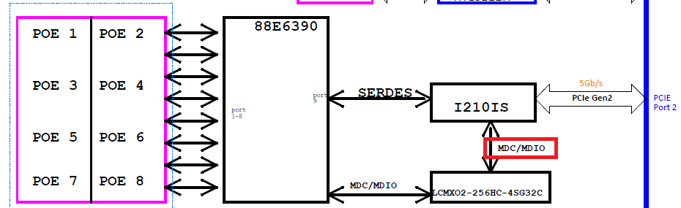
VIV-APL4
Critical Issue
MDIO might not be able to be controlled by Intel I210 NIC
Focus • Agility • Competitiveness
‹#›

Slide 17
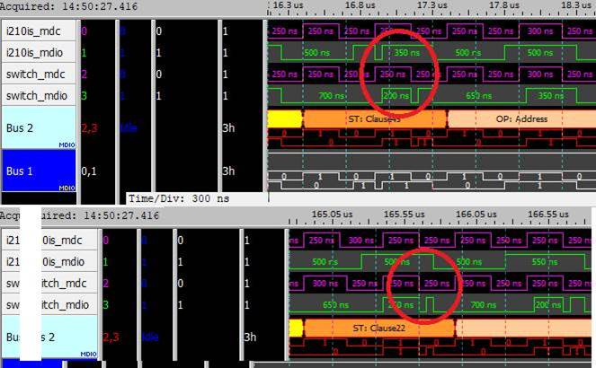
VIV-APL4
Focus • Agility • Competitiveness
‹#›

Slide 18
BOXER-81x0 AI
On-going
[Boxer-8170] Release TX2 4GB Image with Jetpack 4.4 (28 days,dute date:9/14)

Slide 19
BOXER-822x AI
On-going
[Boxer-8221AI] Try fuse and secureboot - part2 (5 days, due date: 9/3)
nv forum issue: https://forums.developer.nvidia.com/t/still-fail-to-enable-secureboot/144888
due date changed, wait for response from Nvidia
[Boxer-8220AI] ACLinux with Jetpack 4.4 (TBD)
[Boxer-8222AI] Fix Midori web browser cannot display YouTube (3 days, due date: 9/4)
[Boxer-8222AI] Prepare test steps for system factory PE (3 days, due date: 9/16)
Focus • Agility • Competitiveness
‹#›

Slide 20
BOXER-825x AI
Done
[Boxer-8250AI] Release ACLinux with Jetpack 4.4 (5 days, due date: 8/27, 0)
Release image: ACLNX49D.NV05.BOXER-8250AI.1
[Boxer-8253AI] Verify A0.1 PCBA (8 days, due date: 8/26, 0)
On-going
[BOXER-8253AI] Bring up HDMI input function (5 days, due date: 9/11)
Focus • Agility • Competitiveness
‹#›

Slide 21
BOXER-8521AI
On-going
Bring up audio codec (5 days, due date: TBD)
SoC cannot recognize audio codec via I2C3 at boot time

Slide 22
VBS100
On-going
SR4 evaluation(TBD)
Give feedback on customer’s comment on 8/28. Wait for the response from the customer.

Slide 23
Intel SDO
Done
Manufacturer Service(5 days, 8/27)
Run in docker image - OK
Create software keystore - OK
Put default Rendezvous Info in database - OK
Put default Owner Public Key in database - OK
Add Web interface to collect device voucher files - OK
Fix the wrong UUID stored in database - OK
Rendezvous Service phase 1(3 days, 9/2, -2)
Run in docker image - OK

Slide 24
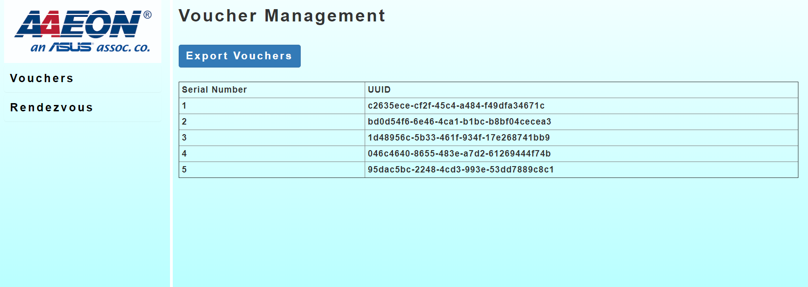
SDO Manufacturer Service

Slide 25
Intel SDO
On-going
Owner Service(5 days, 9/7)
Create software keystore - OK
Run in docker image
Design an interface to put voucher files into Owner Service
Device(3 days, TBD)
Create keypair(ECDSA only) - OK
Run in Android
Rendezvous Service phase 2(10 days, TBD)
Store redirect info in database
Store activation info in database
Implement an interface to get activation statistic
Reseller Service(TBD)

Slide 26
Web-based Hardware Monitor
On-going
[HERODMC][WebUI] Add BIOS OTA (20 days, TBD)
[HERODMC] Implement BIOS OTA with fwupd tools (5 days, due date: 8/21)
Use SMS-W480 as target board for test
python script is OK, but UI should draw by client side not server side

Slide 27
Android BSP for Onyx
On-going
MPAD-800 (85 days, due date:10/24)
Android 10 bring up
Audio playback OK
Audio recording not OK
Headphone POP?
Battery level and LED status
AC adapter

Slide 28
Web Study
On-going
Study SQLite / MongoDB (5 days, due date: 8/28)
Install SQLite
Practice SQLite Language (SELET,INSERT,CREATE,...)
Study VuetifyJS (5 days, due date: TBD)
version: v1.5.x
[VueJS] 以 todo-list 範例 (20 days, due date: 9/25)
熟悉 VueJS 操作 (Done)
配合 SQLite 做資料儲存 / 管理
配合 VuetifyJS 排版、美化頁面

Slide 29
AIoT Survey
Done
08/26 MICROSOFT X NVIDIA 實作課程 – 運用 AI 深度學習打造智慧產線瑕疵檢測應用
資料整理, 資料探索
遷移式學習
TensorRT
08/27 英特爾物聯網軟體研討會
以Intel OpenVINO toolkit 為展示重點
08/28 NVIDIA X III 林口新創園邊緣運算技術交流工作坊
經典算法介紹
遷移式學習
錄影軟體推薦 OBS (https://obsproject.com/)
On-going
Tkinter + OpenVINO + Docker (5 days, 09/04)
HERO SDK (5 days, 09/11)
MQTT (5 days, 09/18)

Slide 30


Slide 31
Azure Sphere
Pending
[Azure Sphere] Implement GPIO application on ubuntu(1 day, due date:06/03)
[Azure Sphere] Transfer message via mqtt on ubuntu(4 days, due date:06/08)
[Azure Sphere] Transfer message via mqtt on windows (4 days, due date:06/12)

Slide 32
VBS100 SR4
TBD
OTA from USB disk
HDMI Input should be hidden when no signal
Remove navigation bar
Remove by default
Add dynamically
Implement Emergency Mode
Trigger by USB keyboard
Factory Reset, USB Debugging, Navigation Bar
Press hot key for 10 seconfs to trigger Factory Reset directly
An additional Emergency service or simple reaction service

Slide 33
Web-based Hardware Monitor
Pending
[HeroDMC] Device Management: Add Group function (5 days, due date: TDB)
[HeroDMC] Remote Control: design a easy use UI to replace DEMO UI (5 days, due date: TBD)
Rewrite HeroAgent with python (15 days, due date: TBD)
[HeroDMC] Account: change to use SSO login (? days, due date: TBD)
[HeroDMC] Device Authentication: implement SDA / SDO (? days, due date: TBD)
[HeroDMC] Support I2C Read/Write
Herosuit CLI Tool(5 days, due date: TBD)
Remote Control Agent (5 days, due date: TBD)
WebUI (5 days, due date: TBD)

Slide 34
Web-based Hardware Monitor
Pending
Implement functions for Intel SDO sdk (15 days, TBD)
Because device management DB is not implemented in SDO SDK, an extra DB function has to be implemented before production
Postponed due to technical documentation modification

Slide 35
Sanshin
Done
On-going
OTA Server
Mount external folder to collect logs (TBD)
Apply correct certificate for web server (TBD)
Set valid date and correct domain name in the certificate
Keep the device awake and check the battery during OTA image downloading (TBD)

Slide 36
BOXER-6405M
Pending
Debug CentOS 7.5 installation failure issue (5 days, due date: 4/27, -3)
FAE cannot install CentOS 7.5 with the usb disk which is flashed by his own flash tool. Instead of entering installation GUI, screen shows dracut-initqueue timeout error repeatedly
After changing the flash tool to Rufus-3.9,FAE can install CentOS 7.5 successfully; however, RD cannot install CentOS 7.5 because screen always blanks before entering installation GUI in many trials
There might be some difference between machines of RD and FAE. But FAE has provided their machine to customer and RD cannot get the same machine to reproduce successful installation

Slide 37
BOXER-824x AI
Done
[Boxer8240] Release ACLinux image with Jetpack 4.4 (5 days, due date: 8/20)
Release image: ACLinux_4.9_ACLNX49D.NV04.BOXER-8240-AI.1
Focus • Agility • Competitiveness
‹#›

Slide 38
Kneron KL520 SDK & Toolchain
Pending
Implement factory test tools with Kneron KL520 NPU (Ubuntu 18.04.3) (30 days,01/15)
Setup Kneron FD/FR model demo app (SDK v0.9.1) (5 days, 01/15)
Build boot, ncpu, scpu and model images (SDK v0.9.5) (2 days, 12/18, +21)
no Keil MDK
Test report from Kneron
https://pms-ipc.asus.com/redmine/issues/5739

Slide 39
SSC Program
Tasks
SmartGateway+, SmartGateway G2 (Topic Owner: PoHsien Lin)
SDO (Topic Owner: Yu-Hao Lin)
DM Certificate (Topic Owner: Yu-Hao Lin)
MES SmartGateway tasks (Topic Owner: Menghui)
HERO Space (Topic Owner: PoHsien Lin)
Account Management (Topic Owner: Menghui)
Meeting minutes:
https://docs.google.com/document/d/1DyCPIsbmLEpuIj-CgIX6QuYroTYh4cLerVD9n2pCUSw/edit

