Slide 1
Importlib.metadata and you!
Or
Production and Packages: "A Tale of Two Versions"

Slide 2

Who is this Darwin guy?
Software Engineer with 8 years of experience.
Full-stack web apps, server administration, API and systems architecture, and much, much more!
Mostly worked at small companies and startups, filled several roles.
Worn many, many hats through those roles.
(Valve plz hire, kthxbye)

Slide 3
What is importlib.metadata?
Importlib.metadata is a library available in Python versions 3.8 and newer. A backported version is available as importlib_metadata (Python 2.7.16+)
It provides access to metadata from installed package resources.
It replaces and extends similar functionality from the entry point API and metadata API resources found in pkg_resources
The primary purpose of this new library is increased efficiency and consolidation of functionality

Slide 4
What all is included in the library?
Entry points ( console scripts, distutils commands, distutils setup_keywords, egg_info, etc. )
Distribution Metadata ( Python version requirement, distribution version, author info, etc )
Convenience methods ( version, dist, requires )

Slide 5
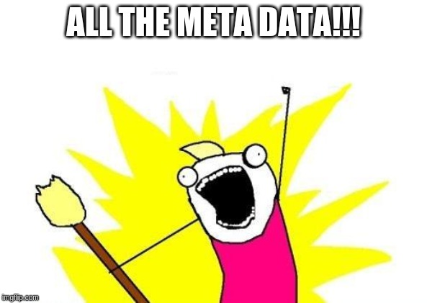
How Meta does Metadata get?
All metadata attached to a package is returned via the metadata() method
This includes some information that is returned by other methods ( version, requires, etc )
In other words...

Slide 6
Let's try it out!

Slide 7
Contact & Materials
Github: github.com/darwinpanderson
Repository: github.com/darwinpanderson/python38_importlib_metadata

