Slide 1

Stop, Drop, & Stash!!! It’s Git!
Ashley Hunt
hsv.py
10/6/17

Slide 2
Acknowledgements
Huntsville West for hosting us!
Antonio Montoya for all of his help and generosity towards our meetup
hsv.py for keeping Python / Tech interest alive in Huntsville
Pat Viafore for suggesting this talk (and all of his help and energy for this meetup group)
Northrop Grumman and Boeing
Experience that made this talk possible
My coworkers for Git questions & tolerating the initial versions of this talk

Slide 3

This is a “fun” talk
This is a talk aimed at all levels
I will talk about commands (don’t try to memorize)
There is a lot of information (Especially if you’re new to Git)
Ask questions any time
If you think of questions after: ash.n.hunt@gmail.com
Slides will be available

Slide 4


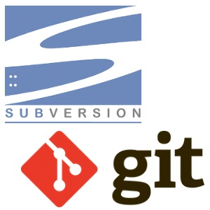



What is Version Control?

Slide 5
What is “Version Control”?
You’ve used it without knowing it
Wikipedia, Word, VI, Minecraft… “undo” button
We’ve all made our own: writing code, saving text files
Hope that the name / date is good enough info to ID
There is software made for this (VCS)
There are several different types
“Everything” types vs. “VCS only” types (back-end)
Proprietary vs. Open Source
Centralized vs. Distributed

Slide 6
Saving your own versions can be confusing
serverDataList.csv
serverDataListNew.csv
serverDataList_7-4-2014.csv
serverDataList_Bob.csv
serverDataList_BobFix.csv
serverDataList_really.csv
serverDataList_reallyFinal.csv
serverDataList_reallyFinalNewVersion.csv

Slide 7
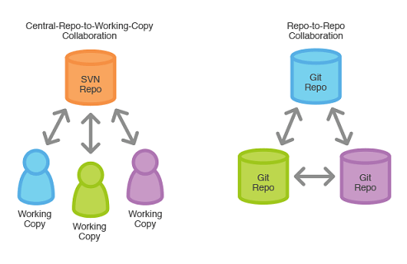
Centralized vs. Distributed
IMG: http://blog.lauramamina.com/article?title=version%20control%20systems%20-%20svn%20vs%20git

Slide 8
Centralized vs. Distributed: Summary
Central
Connection Dependent
Reliance on the server (and backup)
Everyone gets the same copy
Distributed
Everyone has a backup copy (and can interact with each other)
It seems chaotic (and can be, if uncontrolled)
You can always work (no dependence on a central server)
Summary: The main difference
“Master” copy is serverside or “Master” is where the team / you make it

Slide 9
My Opinion: Tools for the Job
The best tools are either:
Simple tools: “do one job, do it well”
Assemblies of simple tools that work together
VCS: The most popular dev tools are simple ones
Git “Stupid version control”
Git, SVN, Mercurial, Perforce – VCS only
Clearcase (suite), CVS, IBM Apex, Harvest, etc. – VCS + other things (env / process)
Ultimately, the best tool is the one that you feel comfortable using.
SVN is not a bad tool ☺

Slide 10
Main features of a VCS
“Versions” of files are kept in a tracking system
Commit access control
“atomic” operations, locks (concurrent access)
Merging of changes
Labeling a saved state (“release” or “tag”) and ability to retrieve it

Slide 11
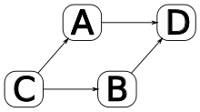
Some Terminology
Repository – area where code is kept
Baseline – development or product most recent stable state of code
Merge
Integration (between baselines)
Resolution of changes between two states
Several different algorithms to accomplish this
Commit
Tag / Label / Branch
“in development” work
“releases”

Slide 12
History of Git
First there was ….Bitkeeper!
2005, Linus wanted something similar
Bitkeeper and Monotone were doing something right
Speed and scalability were the focuses
Had to be open source, distributed
Git’s name: Linus speaks about CVS and Subversion
Git and Mercurial were born! (two GNU projects)
C / sh / perl / tcl / python
Linus kept ownership until 2005
Junio Hamano is current owner (Google dev & major contributor)

Slide 13



Wait…Mercurial?
Git’s sibling project: also developed by GNU
Also distributed, Python & C
Simpler commands, more SVN-like, meant to be easier to transition
“The only other GOOD VCS” – Linus (not a direct quote)
That name!
VS

Slide 14

How is Git Gud?
Speed
Design: ~3 second patch application in mind
Works off of file deltas, little expense for branches & tags
You might not want to have LOTS of branches…but it can be done
Distribution!
Everyone is a “master”
No reliance on a central server
Potentially very backed up
It is safe. Really safe.
Hashes to track
It’s hard to “truly” erase a file
You have to try to lose your work*
You can do anything* you need to do
Note: Very large repositories often use other SW

Slide 15

Comparisons to other VCS
Git wins in speed
Size of the repos is very small
Great UI tool support (and there’s a Tortoise)
Git wins in flexibility
Git “wins in complexity”
Git wins in popularity of new projects
Bazaar, the Python VCS (Python 2, C)
Mercurial

Slide 16
My Advice
Folks new to Git are at an advantage
Taking the time to learn it is worth it
Do not be afraid to experiment
Every problem has been encountered before
Git is mature, there is a wealth of help online
When in doubt, make a branch and assess the situation

Slide 17
Usage
Installing
Website: https://git-scm.com
Check the version
Local Configuration setup (user.name, user.email, git config –list to check)
Use the help feature as needed, it’s pretty good
Stuff you need to know before starting
Cmdline vs. GUI
Cmdline knowledge will be longer lasting
Changes need to be “staged”
Things aren’t “saved” without committing
If there’s a remote, changes aren’t “shared” without pushing

Slide 18
New User Config
You will have to identify yourself to git
git config user.name “Ashley Hunt”
git config user.email ash.n.hunt@gmail.com
Or add the global option if your machine is yours!
Git config --global user.name “name”
Git config --global user.email “email”
Ssh key (local GitHub and GitLab)
Not needed for https communication
To use ssh, add an ssh key to the interface for server communication

Slide 19
A Few Terms
Repository a file container, where the files are stored under VC, shorthand “repo”
Trunk the “master” repository, establishes the current development baseline at any given time
Clone to copy the repository (verb) or your copy (noun) of the repository; this is also a repository
Add / Rm control commands to “stage” changes for commit
Commit locally (within your clone ) save your changes for tracking
Push publically (in the origin, designated master repo) save your changes for tracking
Pull grab updates from the designated master repo, can be used with the rebase option
Checkout switch to a specified branch or tag
Branch a workspace within a repository; changes are tracked with deltas as compared to the original starting point of each file
Tag essentially a locked branch, cannot be changed (tag a build or release)
HEAD last commit in a branch
Rebase When you rebase, git finds the base of your branch, finds all the commits between that base and HEAD, and replays those commits on the HEAD of the branch you're rebasing onto
Merge You’ve made changes, you want to push them, but you receive changes to the same files from someone else in an update before you do; these must be merged before proceeding
Fetch grab all tags
Stage mark a change for committing at the next opportunity

Slide 20
Let’s Talk Commands
I want to make a project
I want to work on something that exists
Statusing: I want to check something
Branching, Tagging, grabbing changes, merging
More advanced stuff: submodules & troubleshooting

Slide 21
I want to make a project
Repository creation
Initialize a repository
git init <repository name>
git init myProject
Bare repositories
Git init myProject.git -–bare
No “checkout” exists in a bare repo
No one can actually work here (this might be good)
Typically named with a .git on the end
Permission control
Cmdline – Unix permissions / user access
Web-based Interfaces – in project settings or group / user settings

Slide 22
Repository initialization
init
init --bare
git init
has a checkout
git init --bare
No checkout
Locks others out from working there
git clone
“checkout” cmd
Works with either
checkout
No checkout
checkout
clone
checkout

Slide 23
Project Creation
If bare repo, make a clone (your copy)
git clone /dir/myRepo.git bobsRepo
Add items and stage
cd bobsRepo
cp file.txt .
git add file.txt - stages file to be committed
Commit code
git commit –m “added the file”
(if needed) push

Slide 24
I want to work on something that exists
Concept of an origin (the remote, most often trunk)
Clone: similar to an SVN checkout; your copy
Track: git remote –v lists information about the repo
Synax is “git clone <location> <(optional) clone name>
Examples:
git clone /myPath/GitRepo/rabbit.git myRabbit
git clone https://github.com/Shopify/draggable.git

Slide 25

Branching
A branch is basically your workspace, copied from another branch (usually master)
Every repo comes with a default master
Branching is a “safe workplace” – you aren’t changing master
git branch – list all branches, * branch is active
git branch <name> – create a branch, does NOT switch to it
git branch –a – track a remote branch
git –d <name> – delete a branch (similar with tag, must push)
git checkout <branch> – switch to a branch
Branches are disposable and cheap (size-wise)
Most workflows involve a branch rather than working out of “master”
*

Slide 26
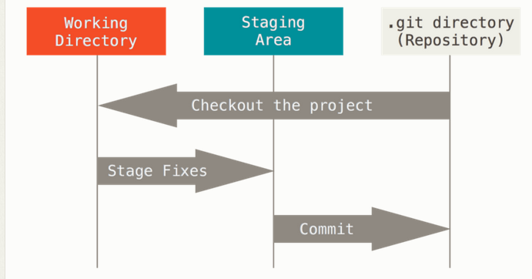
A “Checkout” Does not require a “Check-in”
Your initial copy is a clone of (or is itself) a master repository
“checkout” switches between branches or tags (or revisions)
It can also reset a file to wipe your changes – git checkout file

Slide 27

What is the “HEAD”?
HEAD is the most recent commit in the current branch
HEAD can be used in commands instead of the hash of the most recent commit
Every branch has a HEAD
What happens if you checkout a specific revision?

Slide 28

Detached HEAD
You can get here by checking out a revision
It’s called “detached” because your changes don’t belong to a specific branch
Best thing to do is create a branch for your changes
You may see this in:
Use of submodules
Doing rebases
Checking out a tag

Slide 29
Saving locally
git diff
Useful to see changes made to a specific file (GUIs have an interface with this)
Can be configured to your choice of tool (Diff, Meld, BeyondCompare, etc.)
git status – important command!
Check the staging status of files
stage changes
git add <file or folder> - if you’ve added something new or changed something
git rm <file or folder> - if you’ve removed something
Move (mv) and Copy (cp) also
git commit -<option>
git commit –m “message”
git commit –F <path to file with message> - useful for tying in AGILE backlog story numbers

Slide 30
Retrieving Saves / Revisions
git pull
git fetch
git pull --rebase
git revert <commit number>
git reset --hard <file> or git checkout <file>

Slide 31
Rebase or not to rebase?
Synax
Git pull
Git pull --rebase
Rebase combines a pull, a merge, and a fetch
Pull grabs updates from the origin (trunk)

Slide 32
Sharing Changes: Git Push
git push origin master
You can also set the default remote to have a different name or use a different branch
git merge <branch> and push
Rejected?
You might need an update! (do a pull)
You might have unstaged changes (do a commit or checkout or reset or a stash for these changes)
You might have an address / syntax issue

Slide 33
Statusing: I want to check if a file changed
“Did I accidentally change a file?”
Is it staged to be committed?
Can include permissions changes
Commands
git status
git diff
git log
git whatchanged

Slide 34
Tags, Sharing Changes
The .gitignore files
A .gitignore file is a file that lists files that git should ignore!
Add & commit this
Git will automatically ignore executables
If you need to add executables, you must use a –f option (in general not a good idea)
Branching vs. tagging
Tags are basically “locked” branches
They can both be deleted
Sharing changes between branches
Merges between branches unless only certain changes are needed (cherry-pick)
Sharing changes between remotes
Add the remote path / address and pull from it or push to it

Slide 35
Quick Notes on Remotes
It is possible to add and share changes with other repositories
Remember: the “master” is where the team designates it to be
git remote add <name> <address>
Ex. git remote add mario https://mushroomKingdom.com
Once added, you can interact with the repo (based on its permissions) like you would with the master
This permits collaboration on a large item in the workflow

Slide 36

It’s Intimidating at First: Don’t Worry

Slide 37
Can we export? (SVN)
Yes, but not with a single command as in SVN
Make your clone
Every clone comes with the .git folder
Rm –rf .git inside your clone
May want to remove the .gitignore files too
This copy is now detached from Git and is your export!

Slide 38

A Useful Tool: Git Stash
Sometimes you may want to grab updates (git pull) without running the risk of conflicts to your local changes
Git stash is an option
Your local changes are saved but not committed until you apply and officially commit them
This is a good “quick fix” to get updates
Syntax
git stash - saves off your changes
git stash apply - applies to branch (no commit)
git stash drop - deletes the stash

Slide 39
Some more advanced stuff
Cherrypicking changes
The ability to be in one branch and choose certain changes out of another branch (or remote) and merge them in to your branch
Example: git cherry-pick <commit>
Git squash (rewriting history)
“squashes” several of your commits together, so that they appear as one commit
This rewrites selected history
Why do it? Reduces the git log
Example using git pick:
pick f7f3f6d changed my name
squash 310154e updated README formatting
squash a5f4a0d added cat-file
You will be prompted to edit the new commit message upon commit

Slide 40
Submodules
What is a submodule?
It’s basically a mini-repository, remotely tied to another repository
Great for separate projects that must be inter-linked
Example: Browser release (main repo) with an ad-blocker addon (submodule repo)
How to set one up
git submodule add <address/path> <place in the main repo>
git submodule add /mnt/mySub.git lib/mySub
How to clone within an existing repo
git submodule --init
git submodule --update

Slide 41
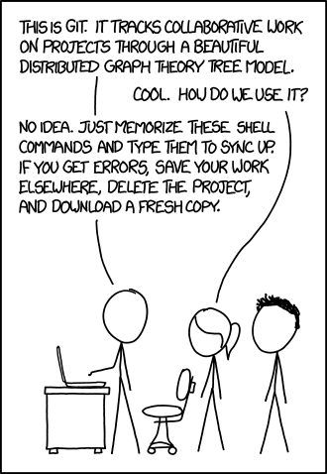
Troubleshooting
Errors can sometimes sound confusing
Remember to check
Git Status
If you’re on the branch you think you’re on
If there are any remote updates

Slide 42
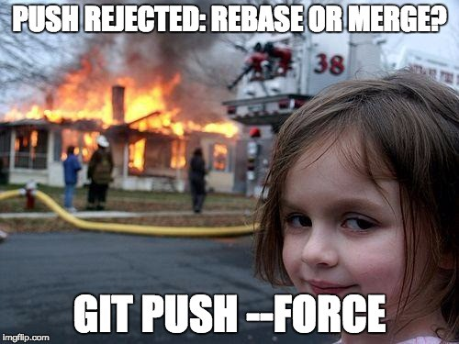
There are no permanent mistakes*

Slide 43
Troubleshooting
Detached head – this is not as scary as it sounds!
This is like a temporary branch
Create a branch, switch to it
I’ve committed something accidentally
Git revert will undo the commit
Git says
I have unstaged changes
I’m x commits behind master
I’m x commits ahead of master
When in doubt, make a (new) branch, switch to it or do a stash

Slide 44
An example of a common workflow
Create or clone a project
Contribute (make changes)
Branch, checkout, work in the branch
Stage changes, commit with informative messages
Complete work & save (push / pull request)
Transitionary phase (peer reviews, layers of testing, reverts if needed)
Merge with master – release – tag is created (locked)

Slide 45
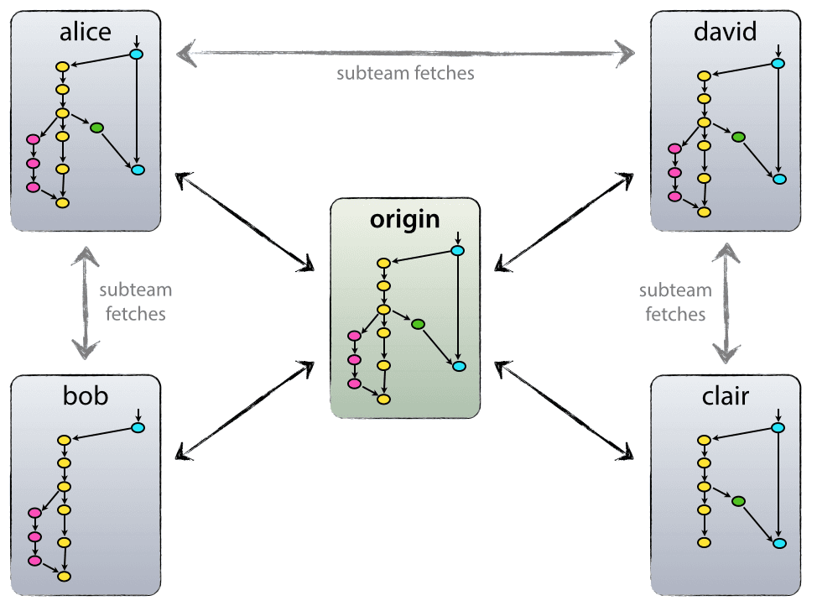
An example of a common workflow
http://nvie.com/posts/a-successful-git-branching-model

Slide 46
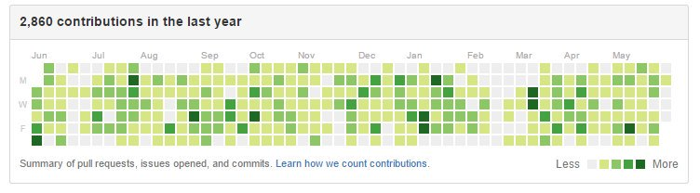
GitHub
https://github.com
Signup is free for public use, $7/month for unlimited private repositories
Interact with the web interface to create repositories, add files, etc.

Slide 47
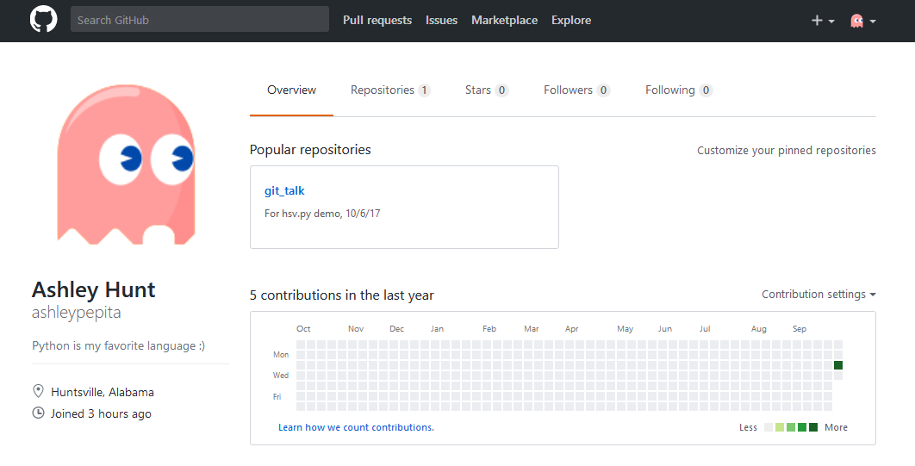
GitHub

Slide 48
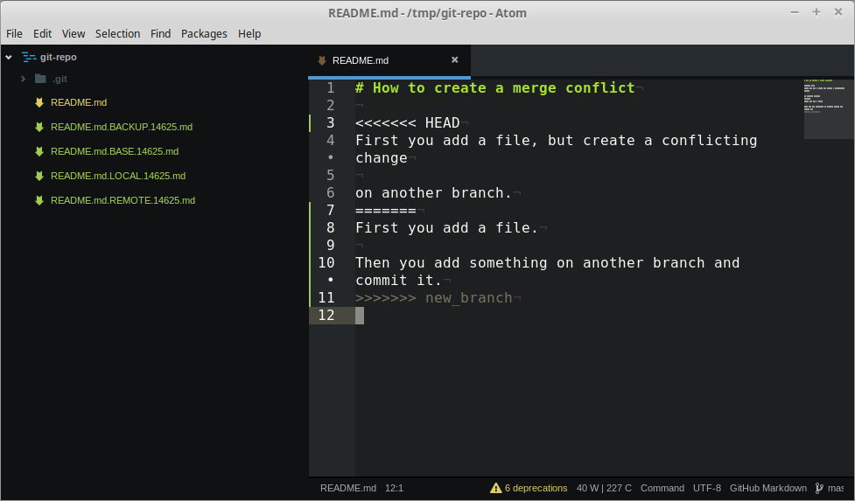
What’s a “Pull Request”?
A request to push! (share publicly to the origin repo)
This is a chance to have your changes reviewed by someone else
If granted, a merge occurs (automatically unless there are conflicts)
Git prompts you with difference files to resolve the conflicts

Slide 49
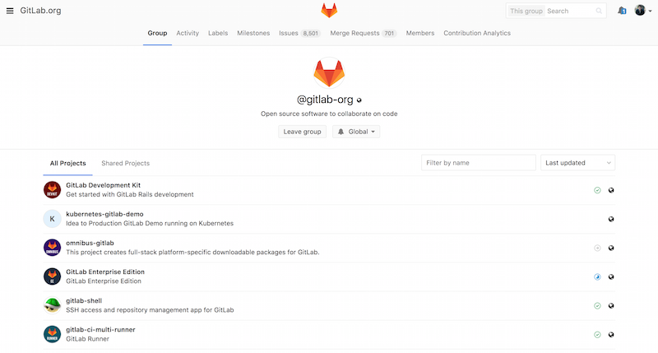
GitLab

Slide 50

Other interfaces worth mentioning
Atlassian’s Bitbucket
Option to use Git or Mercurial
A good example of an “assembly of tools” with JIRA, Confluence, Bamboo…

Slide 51
Some good books
Git Pocket Guide by Richard E. Silverman (O’Reilley)
Pro Git by Scott Chacon and Ben Straub
Available online for free at https://git-scm.com/book/en/v2
Git for Teams by Emma Jane Hogbin Westby

Slide 52
Some good references
https://git-scm.com/book/en/v2
https://try.github.io
https://learngitbranching.js.org
https://www.codeacademy.com/learn/learn-git
http://git.rocks
https://www.codeschool.com/courses/git-real

