Slide 1
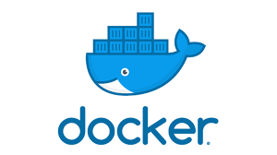
How My Company Saved Hundreds of Hours Using Docker
By Kyle Galloway

Slide 2

Storytime - Why Docker?
How do you save time on a Python/C++ project that takes weeks to gather the proper setup, 6+ hours to build the first time, and 2+ hours to build each time after that??
How do I make the project easy to run for a person outside of the core development group (project lead)??
What if this project has new developers being added every 3 months??

Slide 3

How it started
Originally, we had a problem of reproducing build environments. Many times, there was only 1 machine or server that could ever build and run any given project.

Slide 4
Docker solution
Docker solved these problems by allowing us to pass around build environment instructions.
It even allowed us to make “images” of these environments to ensure that they were the same between multiple machines.

Slide 5
What is Docker?
Docker is a software that allows you to create containers to build or run software.
These containers can be based on popular linux distributions such as Ubuntu, Alpine, Debian, or Fedora.
You can run initial setup commands inside the containers using a Dockerfile (config file) or work on them through a command line interface.

Slide 6

Docker images
Images are “snapshots” of docker containers. Each command in a Dockerfile makes a new image and these are stacked on each other to create the final image. (Sizes can be reduced, with some work.)
An image can be saved and passed to someone else or another computer and loaded in a minimal amount of time.

Slide 7

How it grew
Soon, we realized that Docker was helping us document requirements as well as save time.
Once we built an image, we could keep re-running the software as we were building and developing it without incurring the cost of maintaining a machine and without rebuilding the development environment.

Slide 8
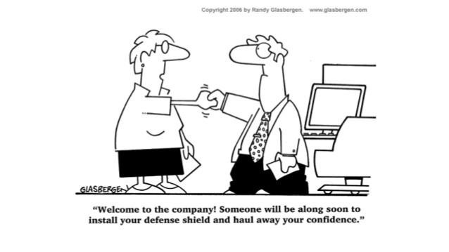
How it saved time
Reduced time to setup and use software
On-ramping new developers to projects was faster
Managing complex software suites.
It even allowed us to stop work on a piece of software for months and have it be functional and well-documented when we come back to it.

Slide 9

Final Results
Docker has reduced entire system setups to a single, simple command. It made building and deploying software a minor issue, which has allowed our development teams to focus on the software itself, instead of the surrounding infrastructure.
This focus has allowed our development team to build more robust software in less time and could do the same for you.

Slide 10
How does this help you
Do you need a documented build system?
Do you need to stop replicating the same setup across computers?
Is there software that you want to use, but it takes too long to build and update each time?
Are there times where you say or hear “It works on my machine”?
Can you build your software on Windows? Linux? MacOS?
Can your colleagues build your software without having to spend large amounts of time installing dependencies and finding the right build software?
Do you need an isolated secure environment to build or run your software?

Slide 11






Who uses Docker?

Slide 12
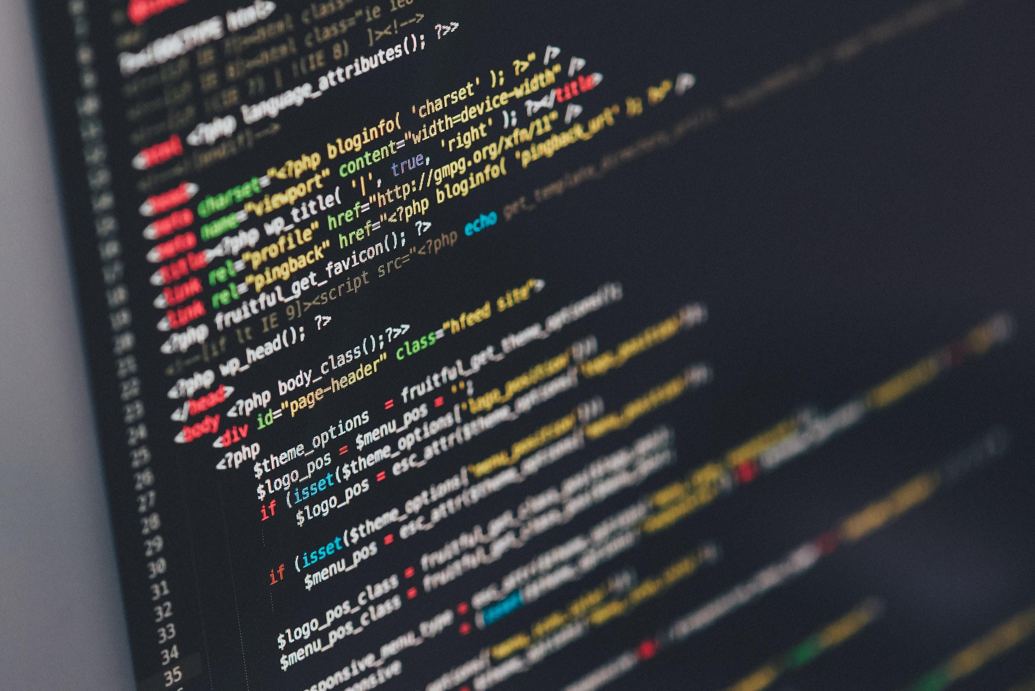
How is Docker used?
General software development
Server software
Microservices
Legacy system builds
CI/CD Systems
Load balancing
On-demand systems

Slide 13
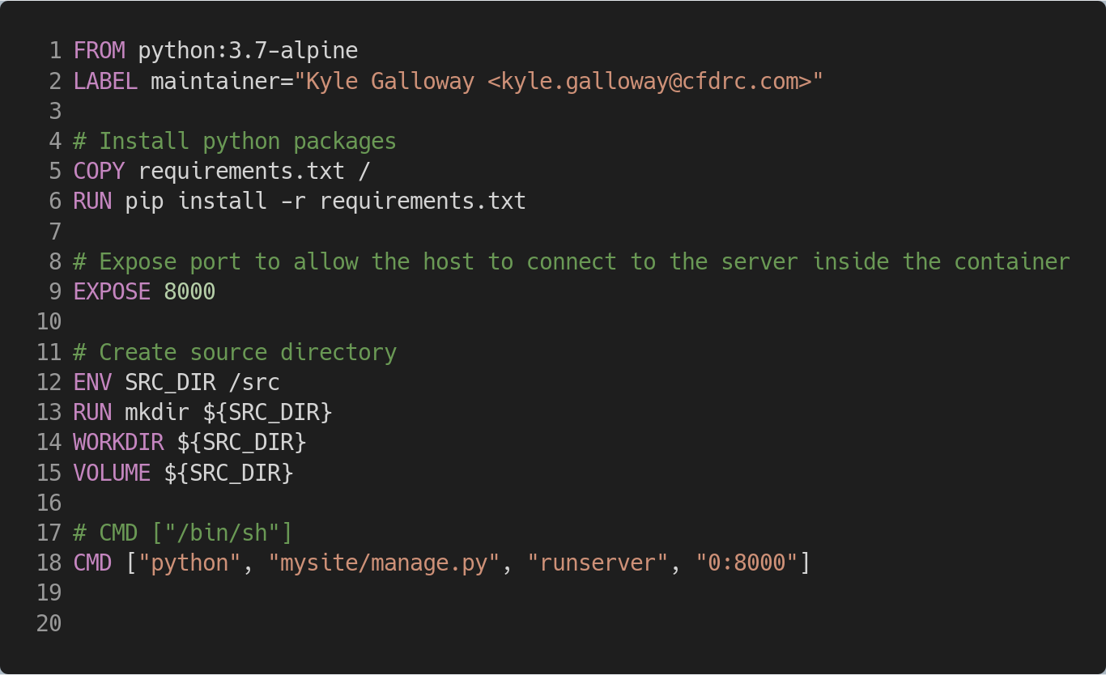
Python Example
Created using Carbon

Slide 14
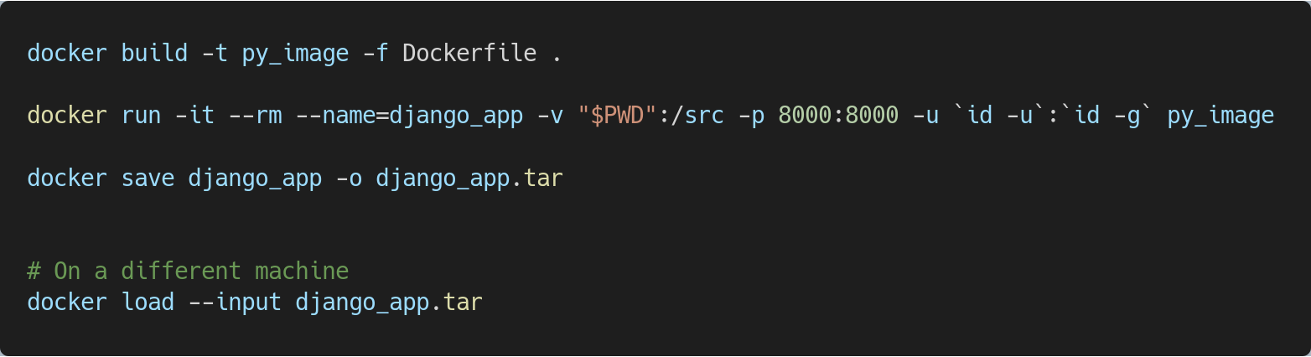
Python Example Instructions
Created using Carbon

Slide 15
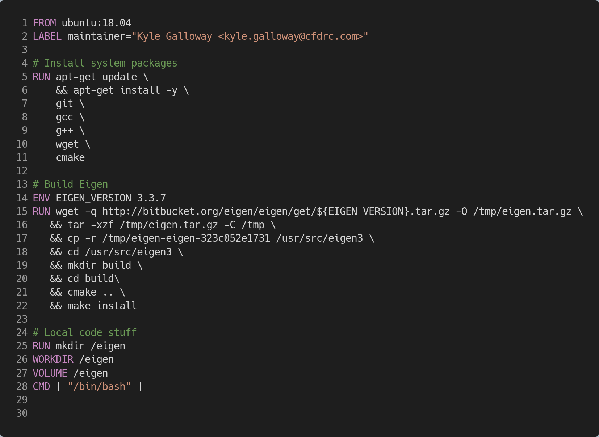
C++ Example
Created using Carbon

Slide 16
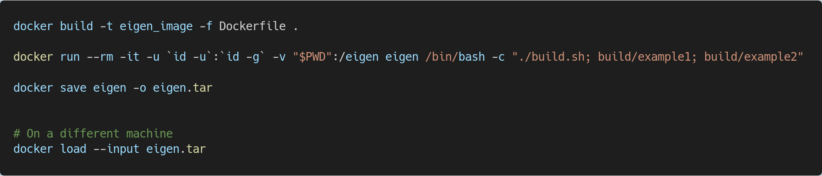
C++ Example Instructions
Created using Carbon

Slide 17
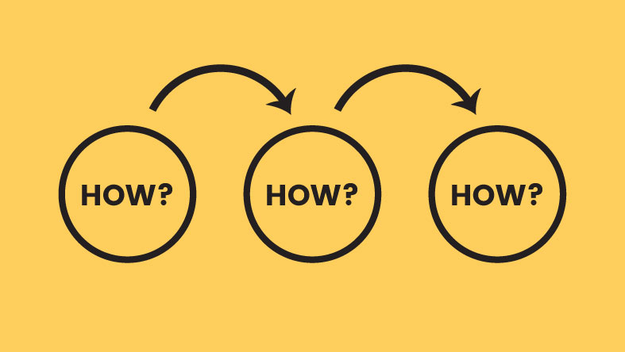
More Examples
https://github.com/kylegalloway/docker-talk

