Slide 1
非典型工作資料整理

Slide 2
Age-specific Part-time, temporary or dispatched workers
 | 2011 | 2012 | 2013 | 2014 | 2015 | 2016 | 2017
Total | 6.5 | 6.79 | 6.94 | 6.93 | 6.98 | 7.04 | 7.11
15-24 years | 25.44 | 24.15 | 25.28 | 25.87 | 24.74 | 24.31 | 23.53
25-44 years | 3.74 | 4.29 | 4.65 | 4.43 | 4.45 | 4.68 | 4.83
45-64 years | 6.95 | 7.23 | 6.8 | 7.01 | 7.19 | 7.03 | 7.08
65 years & over | 10.78 | 7.17 | 8 | 7.96 | 8.86 | 8.22 | 8.15

Slide 3
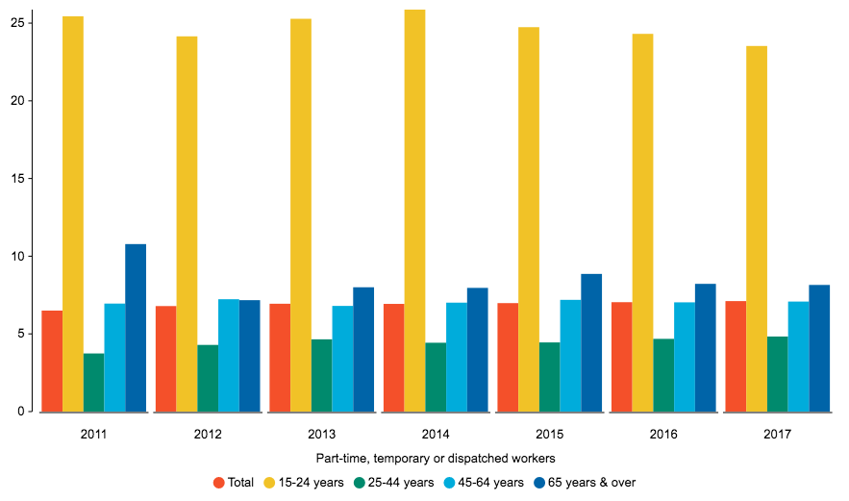

Slide 4
Age-specific Non-standard Workers
category |  | 2011 | 2012 | 2013 | 2014 | 2015 | 2016 | 2017
Part-time, temporary or dispatched workers | Total | 6.5 | 6.79 | 6.94 | 6.93 | 6.98 | 7.04 | 7.11
 | 15-24 years | 25.44 | 24.15 | 25.28 | 25.87 | 24.74 | 24.31 | 23.53
Part-time workers | Total | 3.54 | 3.61 | 3.66 | 3.6 | 3.62 | 3.65 | 3.68
 | 15-24 years | 19.81 | 19.48 | 18.48 | 18.48 | 17.62 | 16.57 | 16.3
Temporary or dispatched workers | Total | 4.97 | 5.29 | 5.39 | 5.41 | 5.47 | 5.52 | 5.55
 | 15-24 years | 19.13 | 20.02 | 21.37 | 22.1 | 21.13 | 21.15 | 20.31

Slide 5
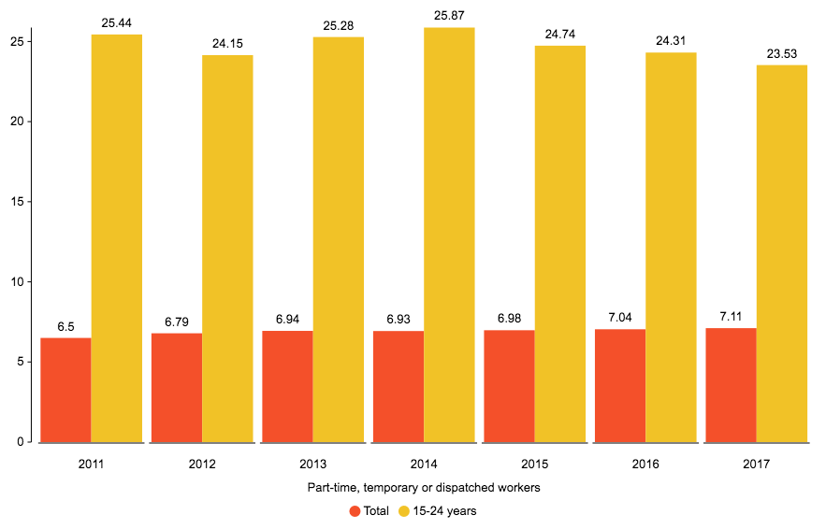
Part-time, temporary or dispatched workers

Slide 6
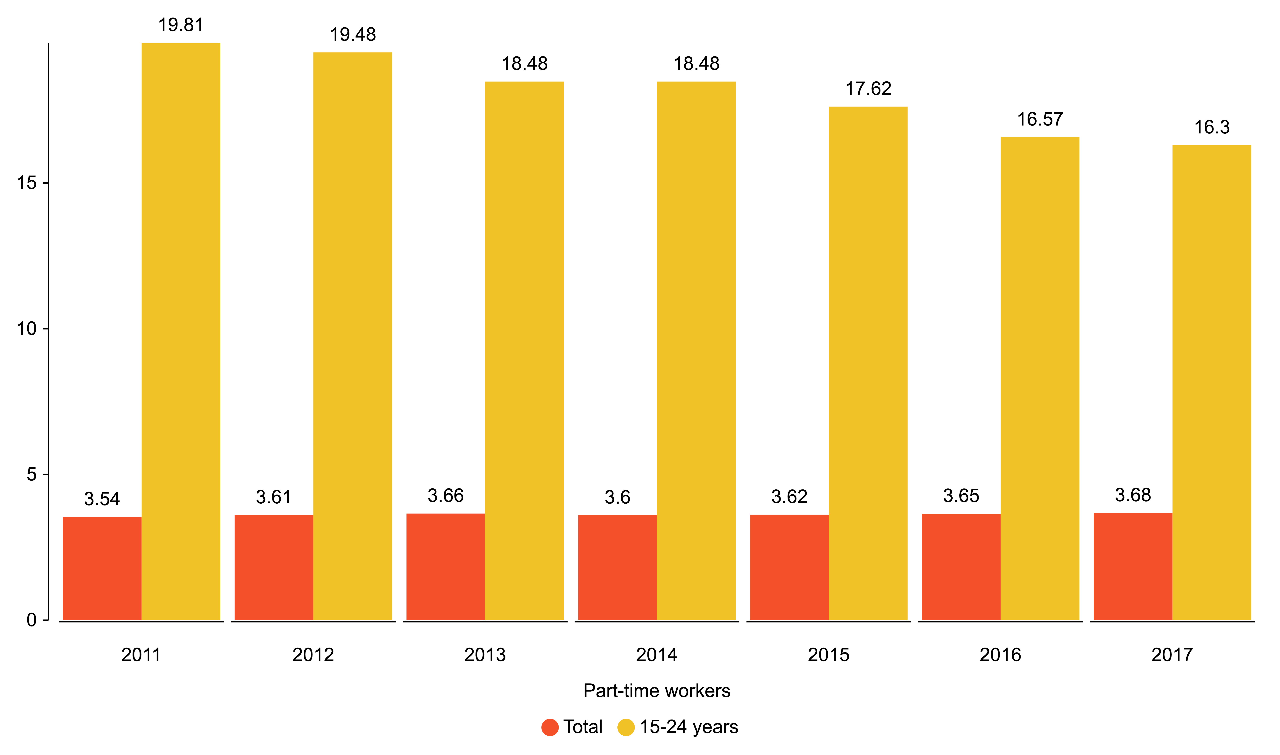
Part-timeworkers

Slide 7
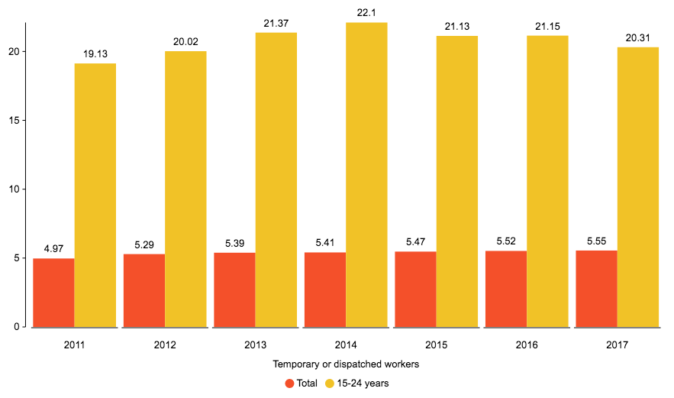
Temporary or dispatched workers

Slide 8
年輕群體佔非典型工作百分比
 | 2011 | 2012 | 2013 | 2014 | 2015 | 2016 | 2017
Part-time, temporary or dispatched workers | 0.27 | 0.25 | 0.26 | 0.26 | 0.25 | 0.25 | 0.24
Part-time workers | 0.39 | 0.38 | 0.36 | 0.35 | 0.34 | 0.32 | 0.32
Temporary or dispatched workers | 0.27 | 0.27 | 0.28 | 0.28 | 0.27 | 0.27 | 0.26

Slide 9
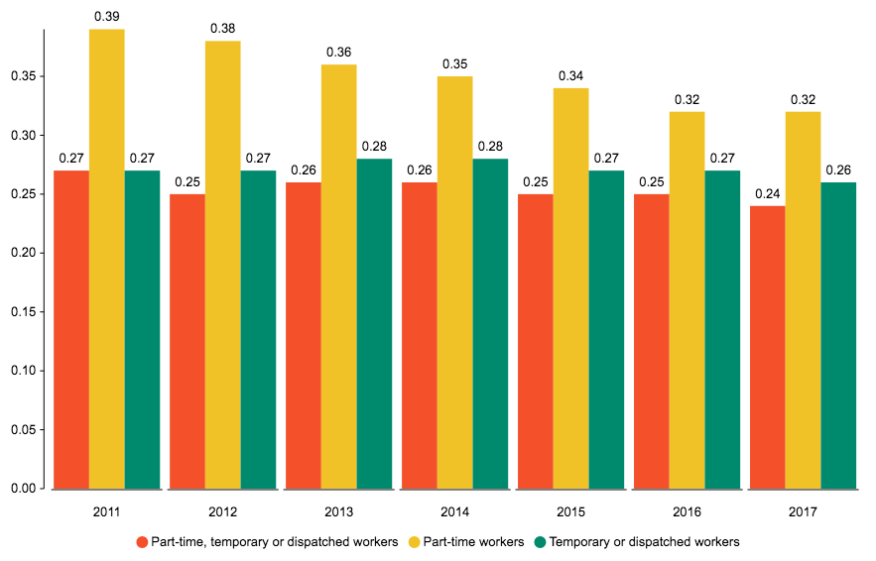
年輕群體佔非典型工作百分比

Slide 10
各年齡佔非典型比例
 | 2011 | 2012 | 2013 | 2014 | 2015 | 2016 | 2017
15-24 years | 0.27 | 0.25 | 0.26 | 0.26 | 0.25 | 0.25 | 0.24
25-44 years | 0.32 | 0.35 | 0.37 | 0.35 | 0.34 | 0.35 | 0.36
45-64 years | 0.37 | 0.38 | 0.35 | 0.37 | 0.38 | 0.38 | 0.38
65 years & over | 0.03 | 0.02 | 0.02 | 0.02 | 0.03 | 0.03 | 0.03

Slide 11
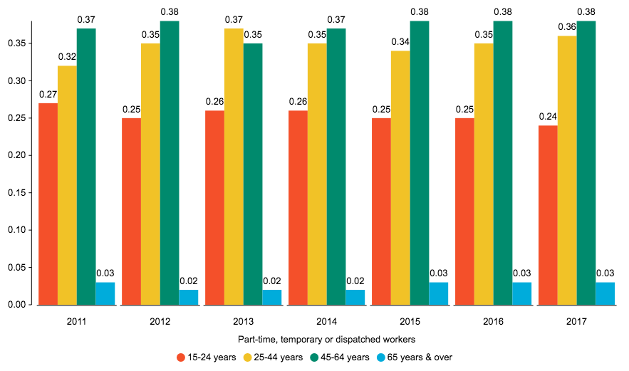
各年齡佔非典型比例

Slide 12
非典型工作平均薪資
Year/ Worktype | 2011 | 2012 | 2013 | 2014 | 2015 | 2016 | 2017
Part-time, temporary or dispatched workers | 19038 | 19971 | 19724 | 20581 | 21268 | 22023 | 22550
Non part-time, temporary or dispatched workers | 36400 | 36726 | 36980 | 37364 | 37866 | 38446 | 39074
Full-time workers | 35922 | 36253 | 36454 | 36885 | 37413 | 38036 | 38656
Part-time workers | 14382 | 14805 | 14552 | 14691 | 14868 | 14987 | 15442
Temporary or dispatched workers | 19526 | 19994 | 20265 | 20906 | 21693 | 22748 | 23566
Non temporary or dispatched workers | 36096 | 36464 | 36665 | 37077 | 37581 | 38143 | 38739

Slide 13
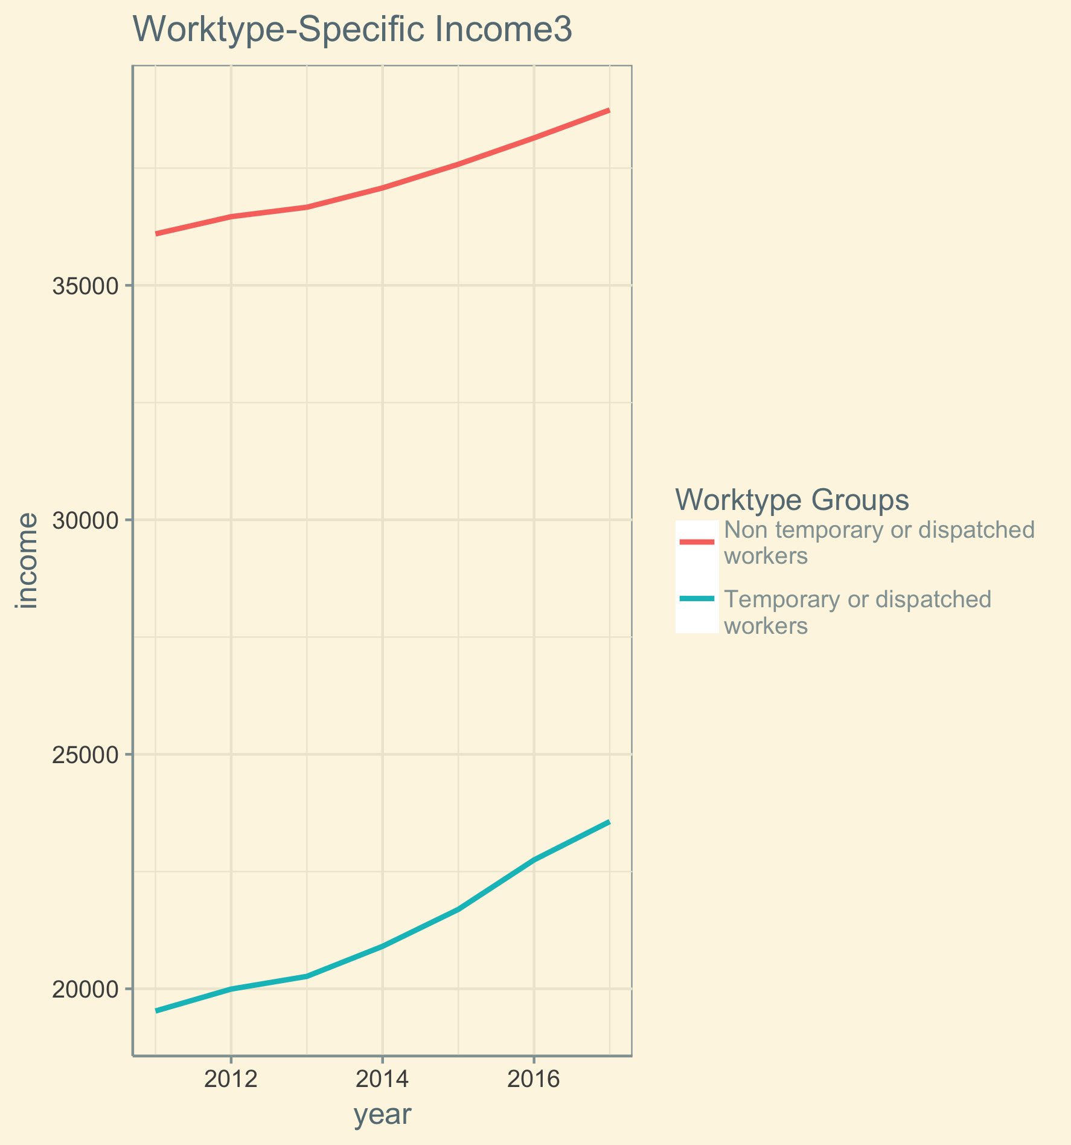

Slide 14
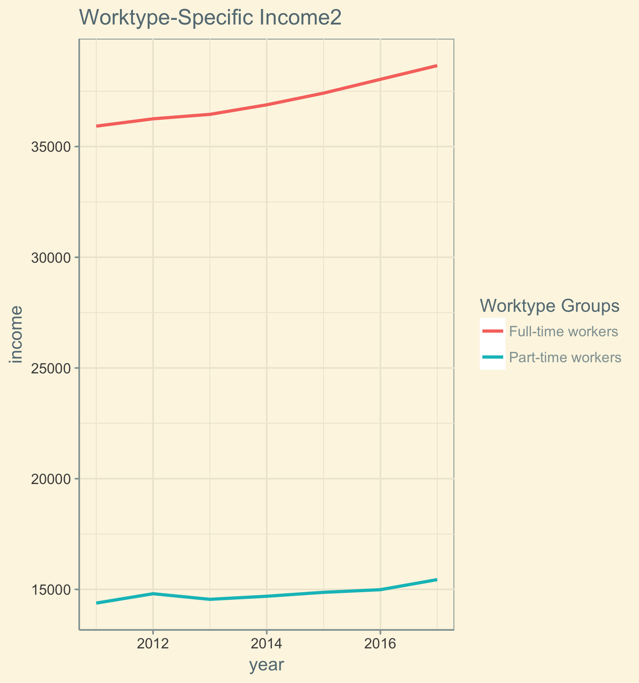

Slide 15
