Slide 1
非典型工作資料整理

Slide 2
Age-specific Non-standard Workers
category |  | 2011 | 2012 | 2013 | 2014 | 2015 | 2016 | 2017
Part-time, temporary or dispatched workers | Total | 6.5 | 6.79 | 6.94 | 6.93 | 6.98 | 7.04 | 7.11
 | 15-24 years | 25.44 | 24.15 | 25.28 | 25.87 | 24.74 | 24.31 | 23.53
Part-time workers | Total | 3.54 | 3.61 | 3.66 | 3.6 | 3.62 | 3.65 | 3.68
 | 15-24 years | 19.81 | 19.48 | 18.48 | 18.48 | 17.62 | 16.57 | 16.3
Temporary or dispatched workers | Total | 4.97 | 5.29 | 5.39 | 5.41 | 5.47 | 5.52 | 5.55
 | 15-24 years | 19.13 | 20.02 | 21.37 | 22.1 | 21.13 | 21.15 | 20.31

Slide 3
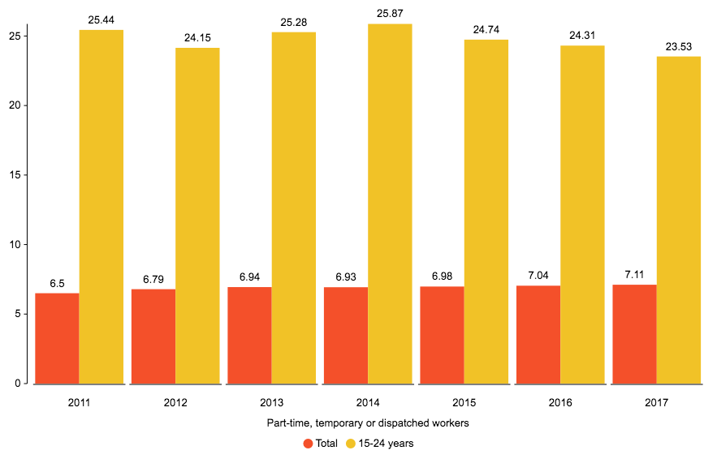
Part-time, temporary or dispatched workers

Slide 4
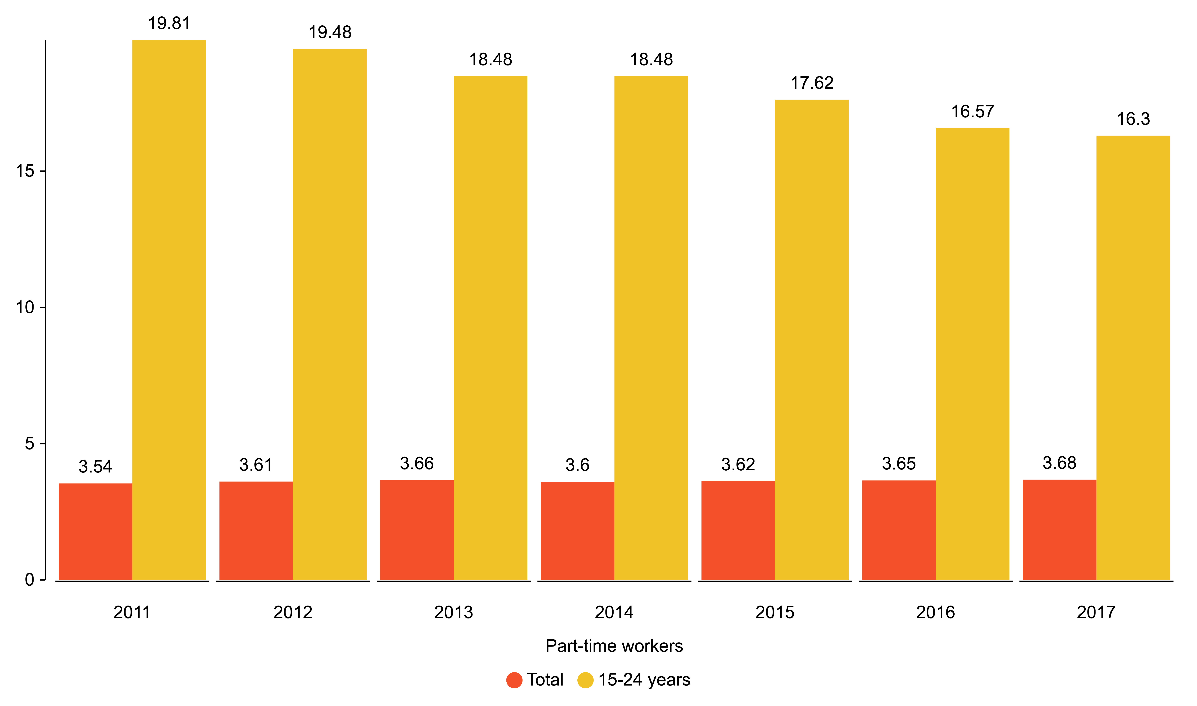
Part-timeworkers

Slide 5
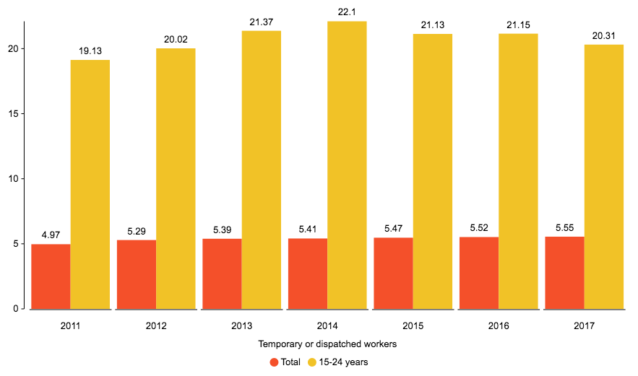
Temporary or dispatched workers

Slide 6
年輕群體佔非典型工作百分比
 | 2011 | 2012 | 2013 | 2014 | 2015 | 2016 | 2017
Part-time, temporary or dispatched workers | 5.56 | 5.75 | 5.65 | 5.46 | 5.65 | 5.79 | 5.93
Part-time workers | 26.74 | 26.66 | 27.8 | 28.09 | 26.96 | 27.21 | 26.39
Temporary or dispatched workers | 5.94 | 5.97 | 5.85 | 5.64 | 5.83 | 5.94 | 6.08

Slide 7
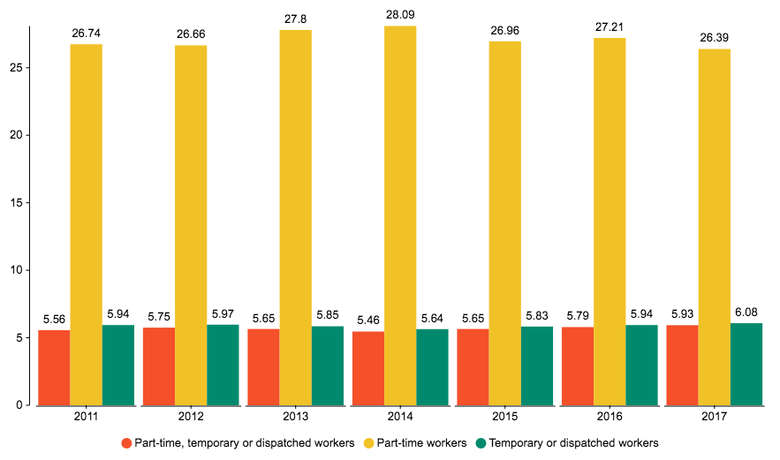
年輕群體佔非典型工作百分比

