Slide 1
Chat Noir
Howard Swope
CSC4900 - Dr. Wang
Final Project
11/12/2016

Slide 2

Introduction
I am Howard Swope
I chose to do a chat program and called it Chat Noir after the Parisian cabaret
I will discuss the application’s:
Architecture
Languages
Tool set
Important software techniques
Featureset

Slide 3
Architecture
Systems Architecture – Node Diagram
Software Architecture – Package Diagram
Primary Patterns
Data Model

Slide 4
Languages
Kotlin – client and server
Java – client and server
SQL - database
Groovy – build system
JSON – data serialization

Slide 5
Tool Set
Intellij
JavaFX Scene Builder
Gradle
Github
SmartGit

Slide 6
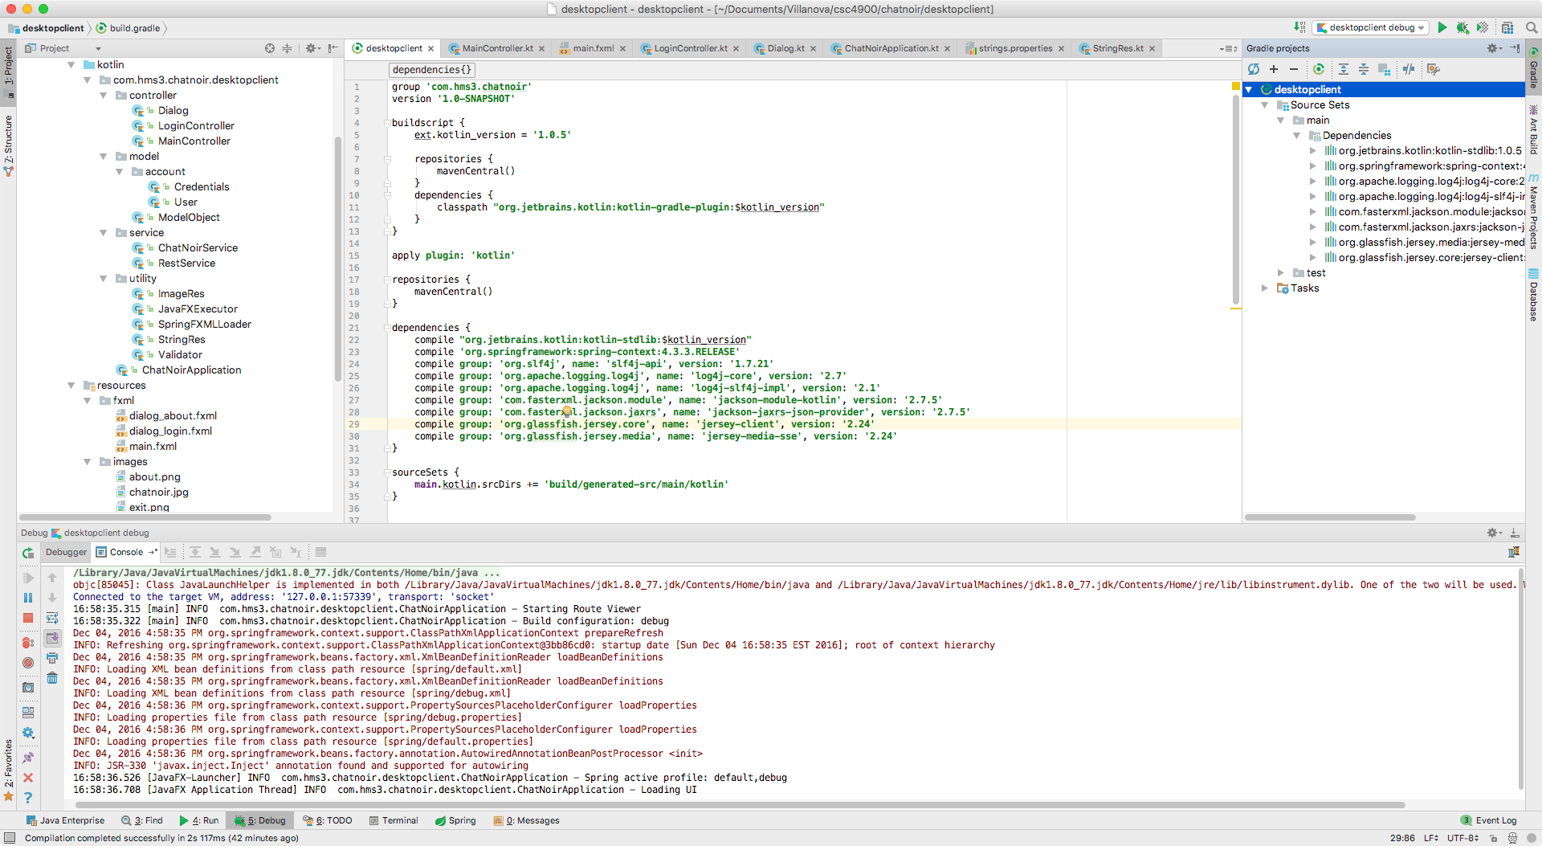
IntelliJ
Notes:
JetBrains Java IDE
Supports all aspects of the build process
Coding - edit, compile build
Standard library support (eg. Spring)
Standard tool support (eg. Gradle)
Source control interaction
Database modeling and interaction

Slide 7
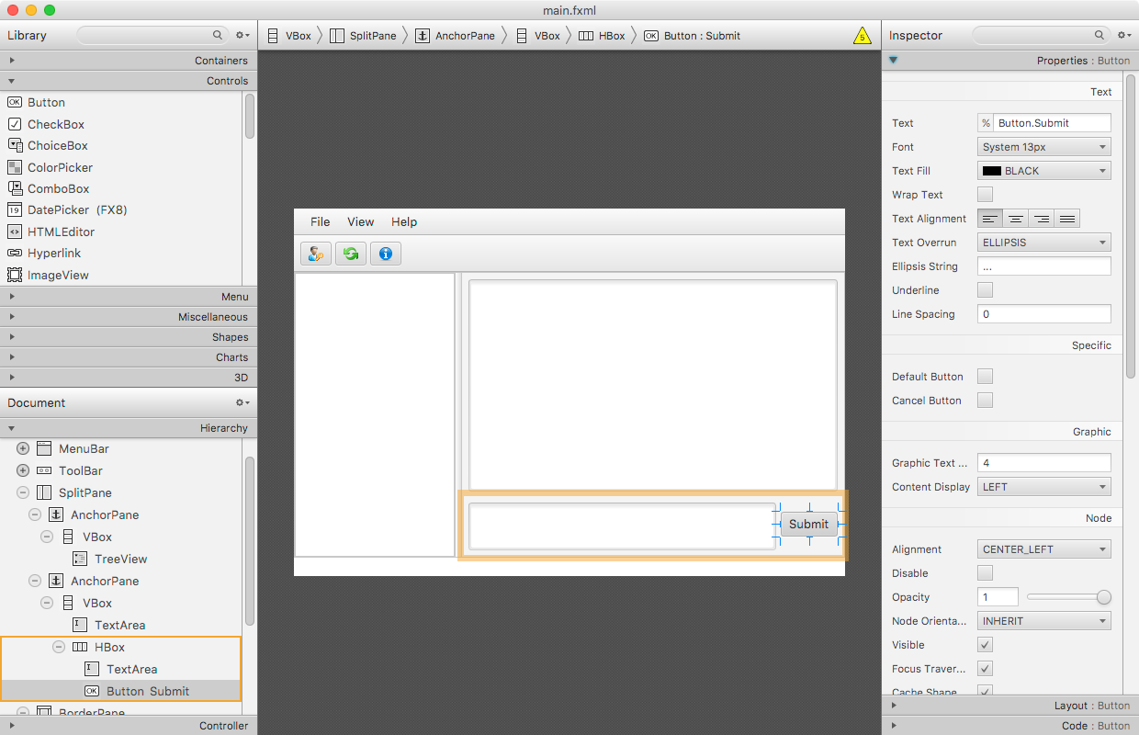
JavaFX Scene Builder
Notes:
Visual GUI builder
Facilitates layout visually
Outputs XML that is consumed by the application

Slide 8
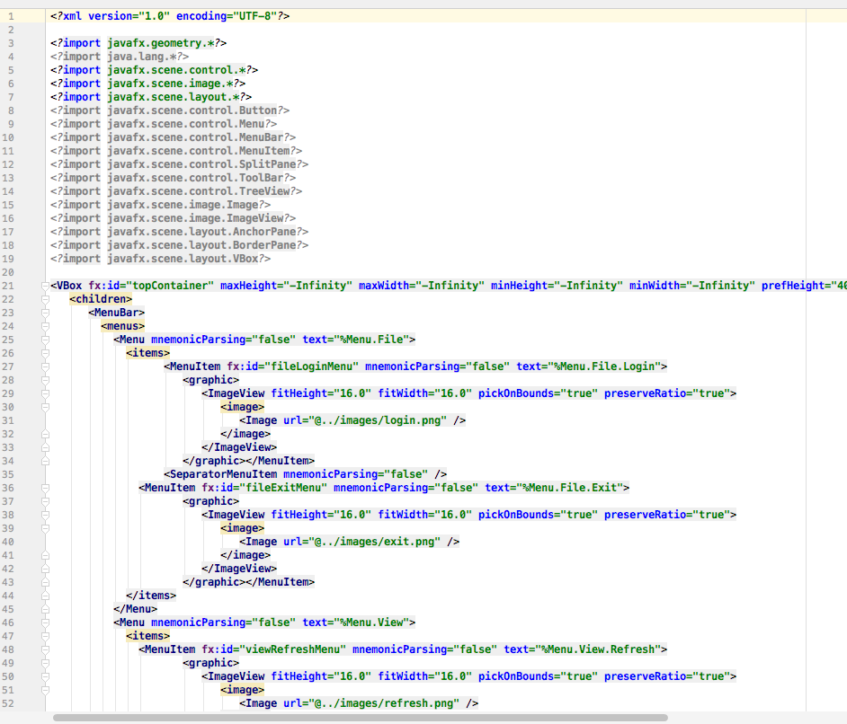
JavaFX Scene Builder

Slide 9
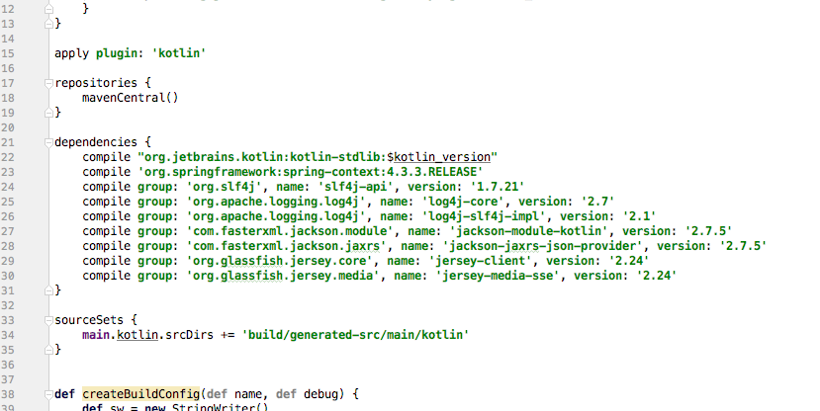
Gradle
Notes:
Build tool
Dependency management
Task runner
Groovy build scripts
Rich plugin architecture

Slide 10
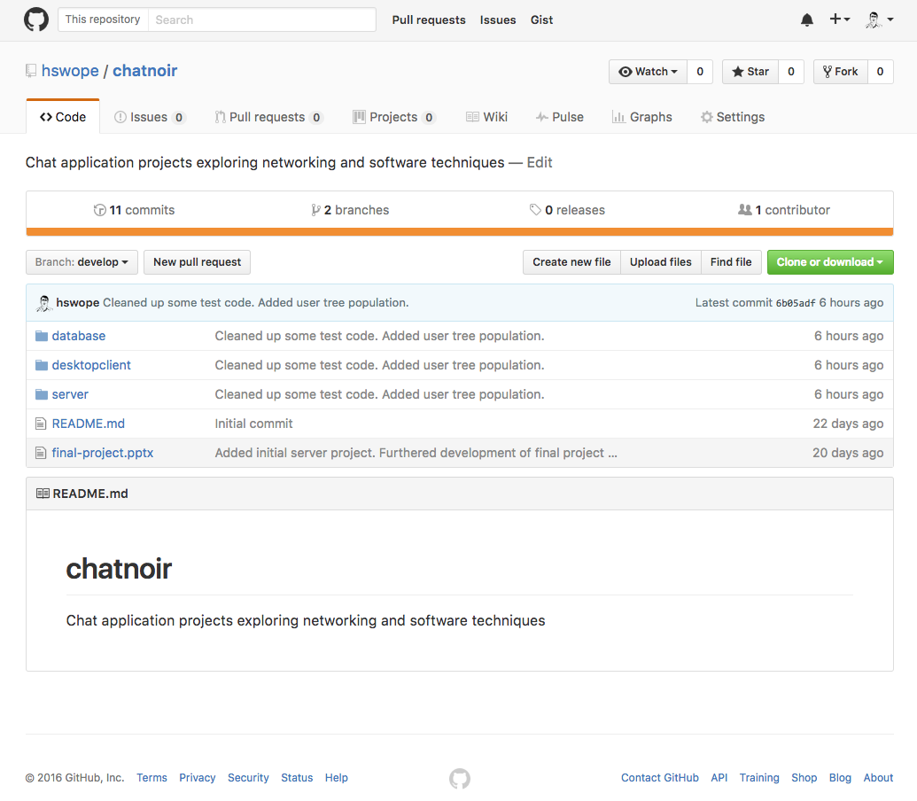
Github
https://github.com/hswope/chatnoir
Notes:
On line source repository

Slide 11
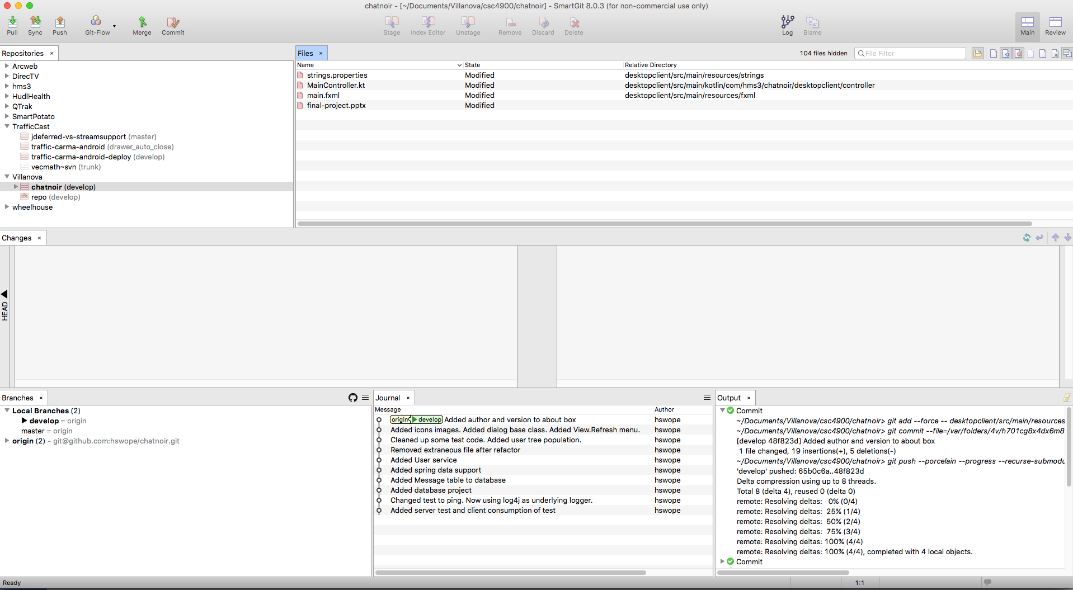
SmartGit
Notes:
Tool for visual interaction with git repositories
Provides great tools for:
Looking at history
Branch comparison
File Diffs

Slide 12
Software Techniques
Build
Deploy
Source Control
Dependency Injection
Configuration
String Translation
Rest Support
Database Support
Threading model – Asynchronous Support
Form Validation

Slide 13
Feature Set

Slide 14
Wrap Up
Github: https://github.com/hswope/chatnoir
Kotlin: https://kotlinlang.org/
PostgresSQL: https://www.postgresql.org/
Jet Brains: https://www.jetbrains.com/
Smart Git: http://www.syntevo.com/smartgit/
Any Questions?

