Slide 1
Chat Noir
Howard Swope
CSC4900 - Dr. Wang
Final Project
11/12/2016

Slide 2

Introduction
I am Howard Swope
I chose to do a chat program and called it Chat Noir after the Parisian cabaret
I will discuss the application’s:
Architecture
Languages
Tool set
Important software techniques
Featureset

Slide 3
Architecture
Systems Architecture – Node Diagram
Software Architecture – Package Diagram
Primary Patterns
Data Model

Slide 4
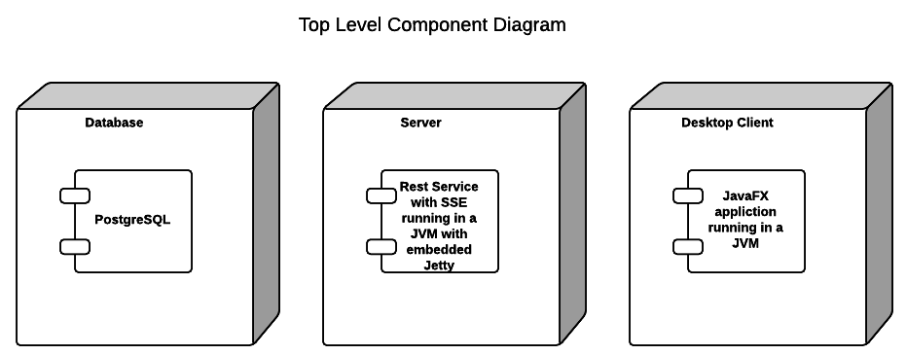
Systems Architecture

Slide 5
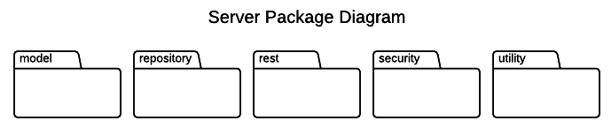
Server Software Architecture
Notes:
Model
JSON and database
Repository
Database interaction
Rest
Rest service endpoints
Security
Classes supporting the BASIC Auth
Utility
Helper classes like String resources and Logging Facade

Slide 6
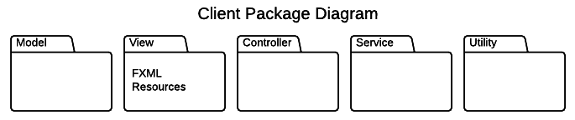
Client Software Architecture
Notes:
Model
JSON
View
FXML Resources
Controller
Interaction between view and model
Handles user interaction
Service
Application services especially making rest calss
Utility
Helper classes like string resources and image resources
Thread executors
Form validators

Slide 7
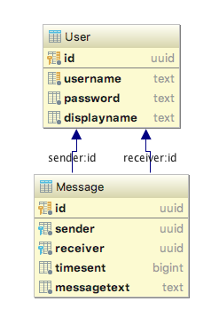
Data Model

Slide 8
Languages
Kotlin – client and server
Java – client and server
SQL - database
Groovy – build system
JSON – data serialization

Slide 9
Tool Set
Intellij
JavaFX Scene Builder
Gradle
Github
SmartGit

Slide 10
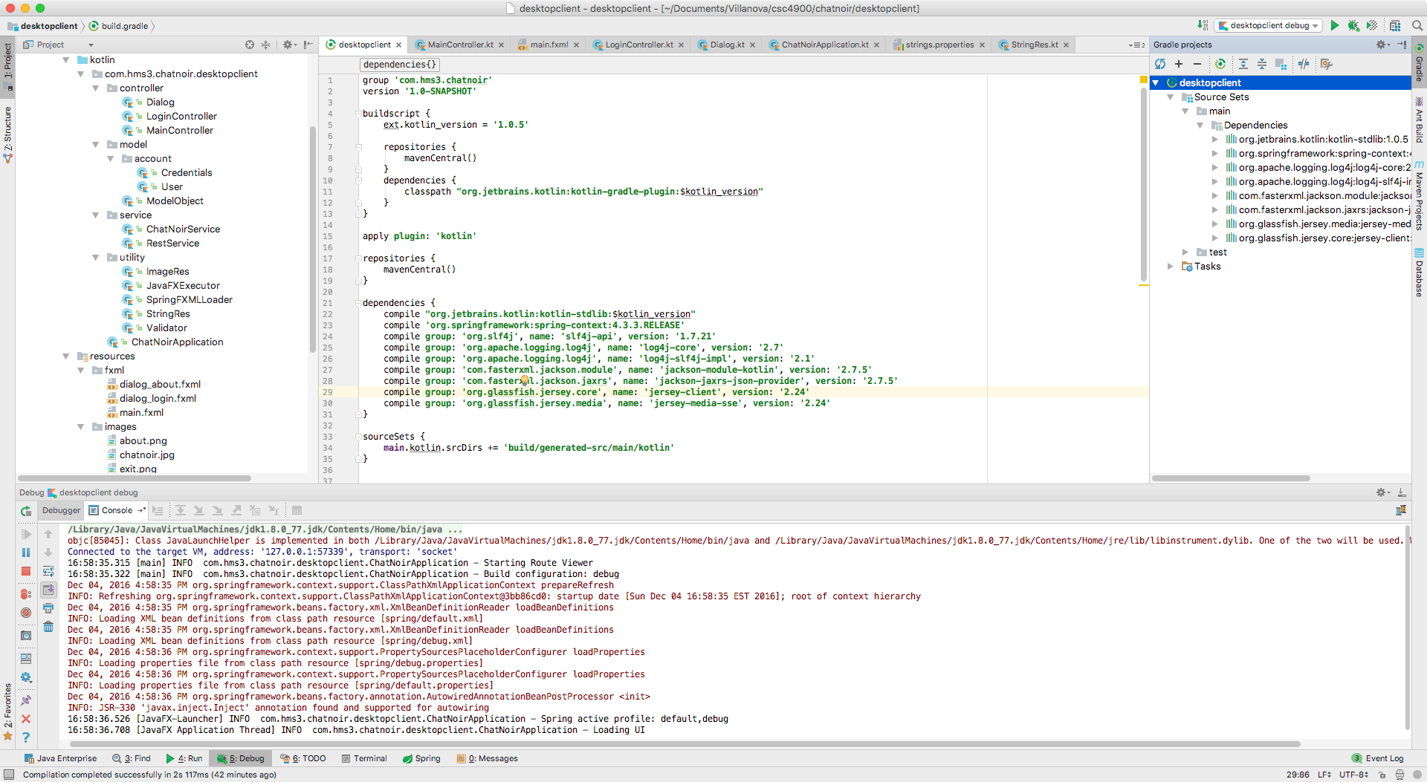
IntelliJ
Notes:
JetBrains Java IDE
Supports all aspects of the build process
Coding - edit, compile build
Standard library support (eg. Spring)
Standard tool support (eg. Gradle)
Source control interaction
Database modeling and interaction

Slide 11
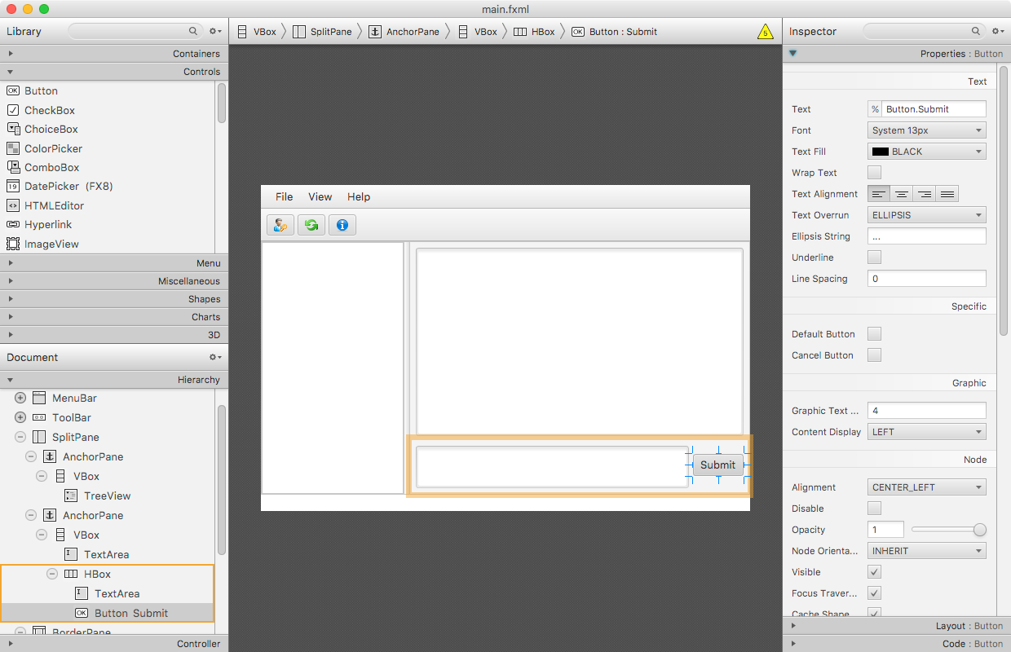
JavaFX Scene Builder
Notes:
Visual GUI builder
Facilitates layout visually
Outputs XML that is consumed by the application

Slide 12
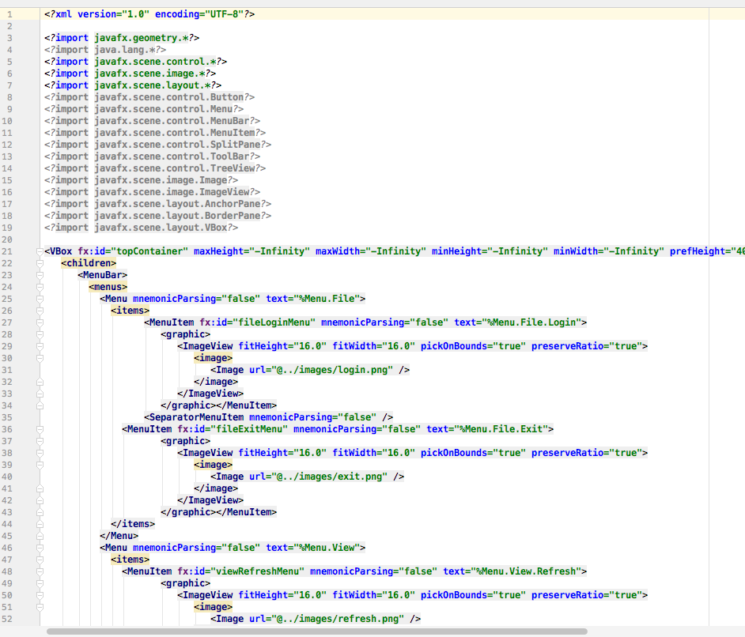
JavaFX Scene Builder

Slide 13
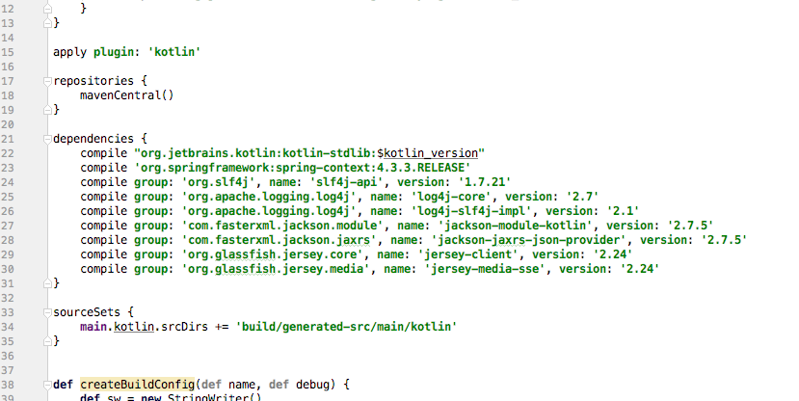
Gradle
Notes:
Build tool
Dependency management
Task runner
Groovy build scripts
Rich plugin architecture

Slide 14
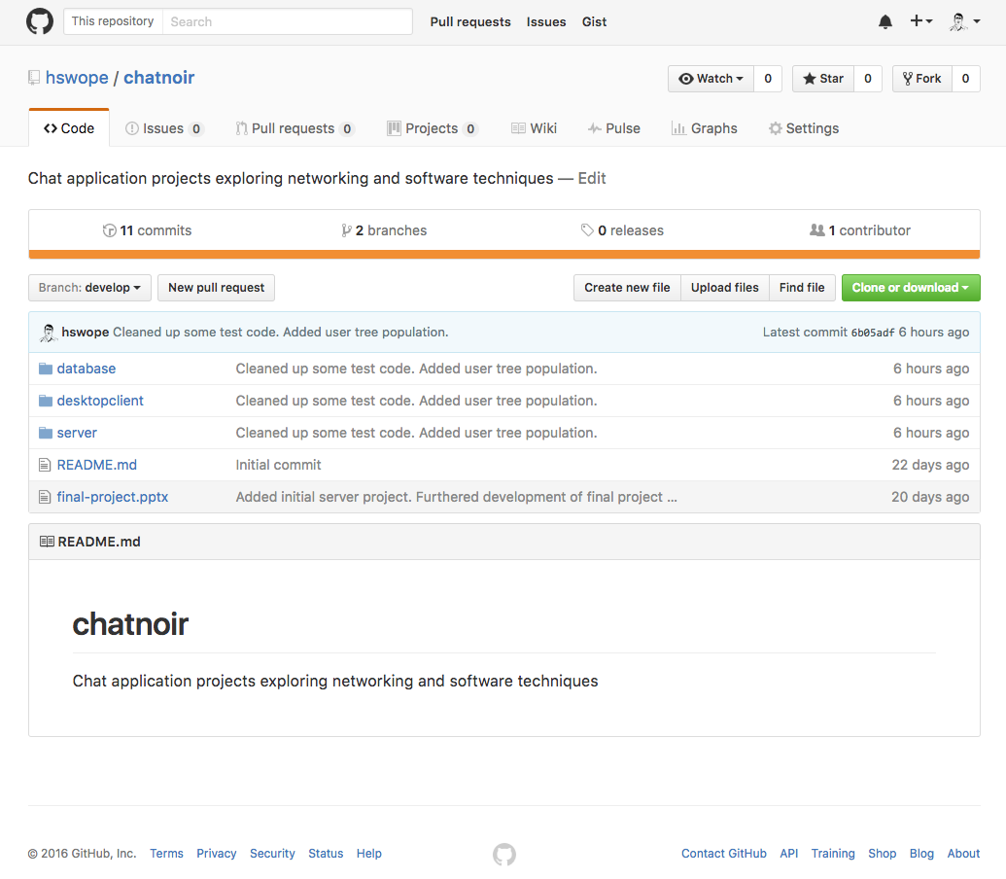
Github
https://github.com/hswope/chatnoir
Notes:
On line source repository

Slide 15
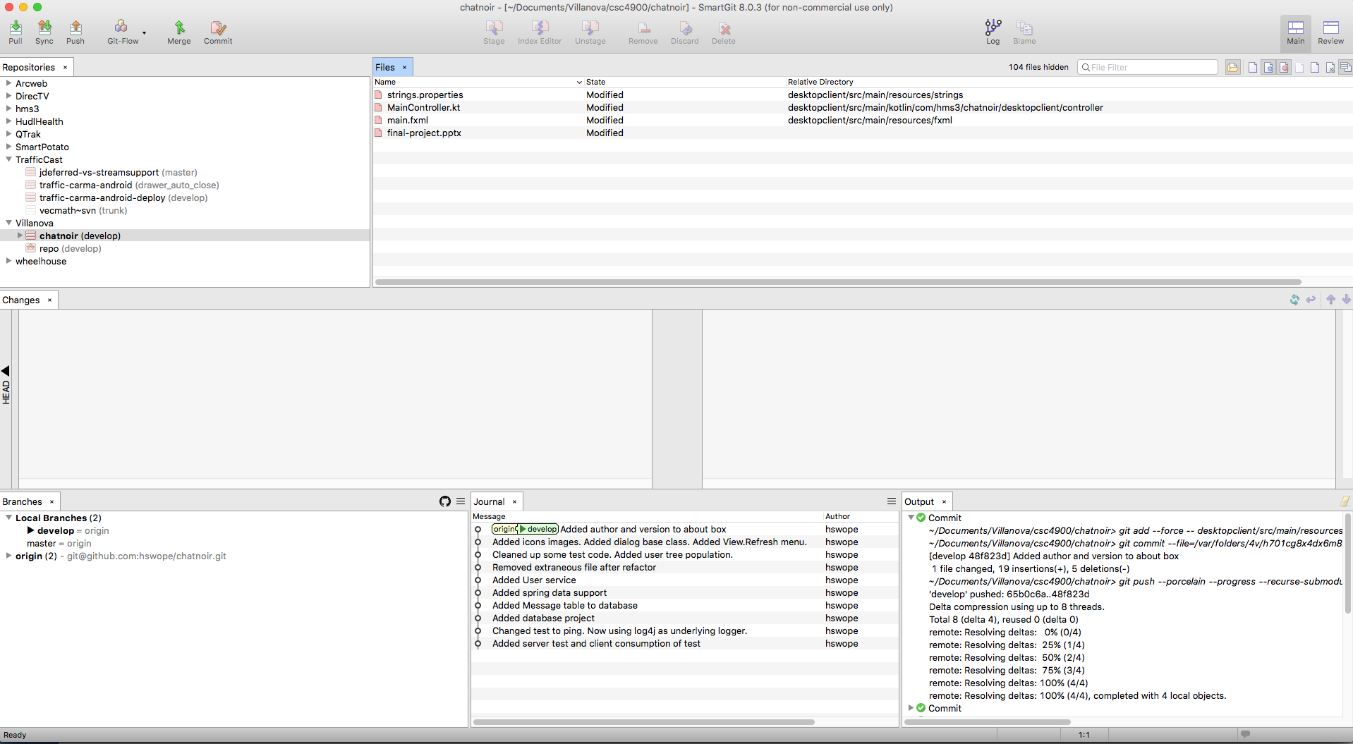
SmartGit
Notes:
Tool for visual interaction with git repositories
Provides great tools for:
Looking at history
Branch comparison
File Diffs

Slide 16
Software Techniques
Build – Gradle
Logging – SLF4J | Log4J | SLF4J façade for java logging
Source Control - Git
Dependency Injection - Spring
Configuration – Spring, Custom build config class
String Translation – String tables as java resource bundles
Rest Support – Jersey library for server and client
JSON Support – Jackson library
Database Support – Spring Data | Hibernate JPA | JDBC
Asynchronous Calling – Completable Futures
Form Validation – Custom Validators

Slide 17
Feature Set
Log in
Refresh
About
Direct messaging
Conversation history
Basic Auth

Slide 18
Wrap Up
Github: https://github.com/hswope/chatnoir
Kotlin: https://kotlinlang.org/
PostgresSQL: https://www.postgresql.org/
Jet Brains: https://www.jetbrains.com/
Smart Git: http://www.syntevo.com/smartgit/
Any Questions?

