Slide 1
Final Project Dr. Damian’s CSC 8470
Howard Swope

Slide 2
Discussion Points
Who I am
Project overview
Why it interested me
The project – Files, object models, workflows, etc
The stack – Tools, libraries, hardware, etc
Concluding observations
Q&A

Slide 3
Who I Am
My name is Howard Swope
I am a software engineer of 25 years
I have a wide resume covering many different technologies
I have spent a fair amount of time in graphics and multimedia
I have worked on planetarium products and products providing 3D simulation for television news.
I hold 4 European and 4 US pattents for graphic techniques simulating traffic in 3D

Slide 4
Project Overview
My project sets out to:
Create an engine, of sophistication comensurate with the time available, that ingests data from blender in a generic way and renders it in a stand alone application.
The application should use COLLADA for data serialization.
The application should exercise many of the techniques learned in class.
The application should be built entirely with open tools.
The application should run on the major platforms.
(I also had a side goal of having an excuse to learn the Qt library)

Slide 5
Why It Interested Me
I wanted to attack the problem space at a lower level
In the past I have written a simulation engine with the aid of a gaming engine
I wanted to solve the problem with open tools creating solutions that can run on any platform
In the past I have done windows only using DirectX and 3DS Max
I wanted to learn the internals of COLLADA
I have been provided data in collada and have had trouble with 3rd party importers
I wanted to learn the problem / solution space from a “meta” vantage point.
Collada is perfect for this as it is so versatile and is designed to be very generic from the beginning.
There is no better way to “own” the knowledge of a given subject.

Slide 6
The Project

Slide 7
Collada
Royalty free
XML scema
Facilitates digital asset exchange for the 3D industry
http://www.collada.org

Slide 8
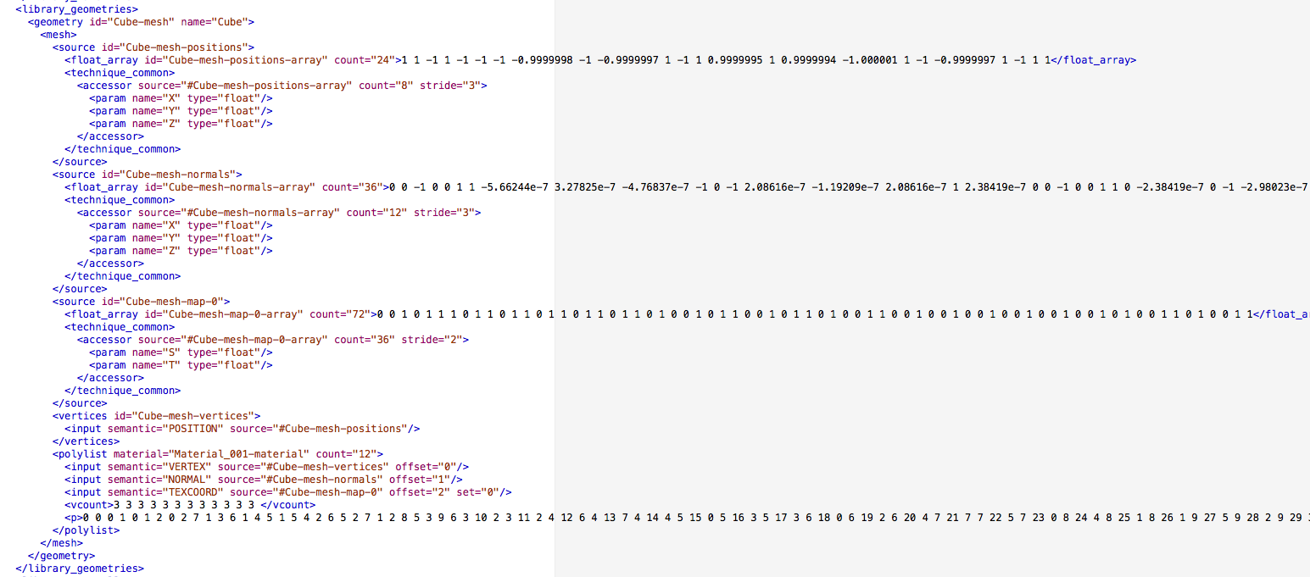
Excerpt from Collada File
Mesh

Slide 9
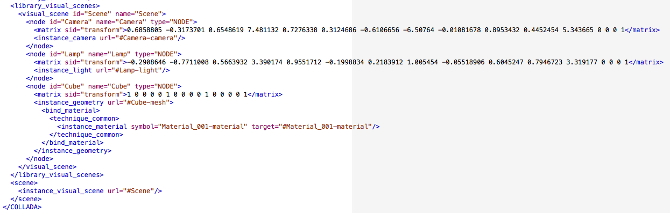
Excerpt from Collada File
Scene

Slide 10
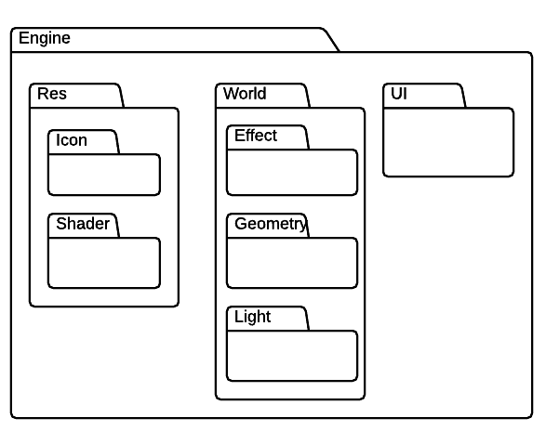
Packages

Slide 11
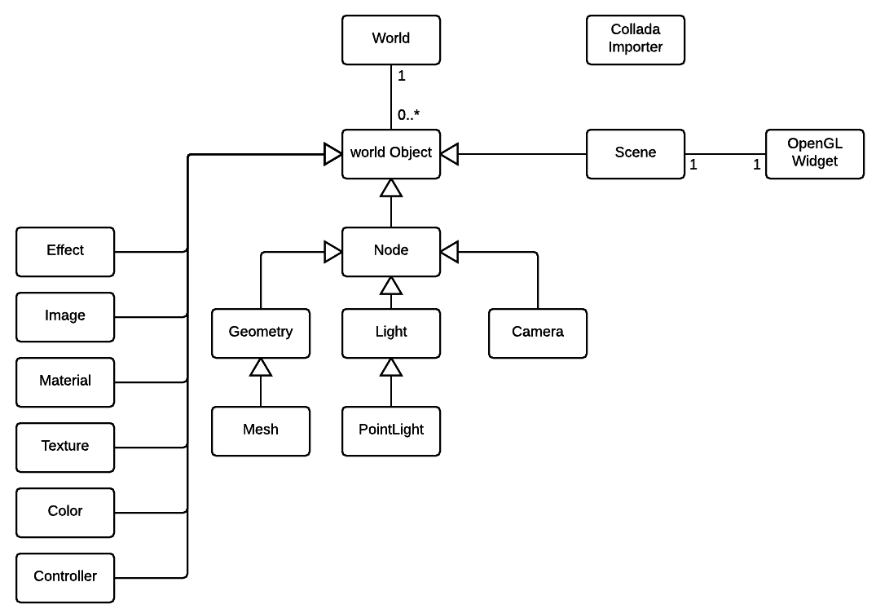
High Level Object Model

Slide 12
Major Work Flows
OpenGL Initialization
General opengl init
Creation of OpenGL context
Compiling of engine shaders
Collada Import
deserialization of collada to in memory objects
World Initialization
Occurs when the UI is given its world
World objects create their GPU specific constructs
Scene Render
An individual Frame is rendered
Uses scene camera, lighting
And geometry
World Destruction and Cleanup

Slide 13
Other Issues of Note
GPU resources are limitted
World objects are limitted to as few as necessary
Scene objects are instanced world objects which share common resources but have unique transformations
Resources consist of:
Geometry data
Materials
Textures
Collada is XML based
This makes it very readable, but very slow
The current importer uses DOM traversal for expediency and the need for experimentation
A production implementation would do a single read pass through.

Slide 14
The Stack

Slide 15
Tools
Blender - Modeling
Gimp – Raster image manipulation
Qt Creator – GUI creation
CLion – Most C++ coding and debuggin

Slide 16
Technologies
Compiler – Clang / LLVM
Build – CMAKE and QMAKE (new for this project)
Language - C++
3D Library – OpenGL
Supporting Library Qt (new for this project)
GUI Toolkit – Qt (new for this project)

Slide 17
Parting Observations
I am impressed with the vastness of the task of creating a generic engine.
To really do this problem justice I would have to incorporate shaders that are built and compiled on the fly
Collada is quite a specification given the sophistication of the problem space that it attempts to capture. Meta to the extream
I highly recommend CLion and the Qt library for anyone writing multiplatform in C++.
CLion and all jet brains tools are great
Qt has a huge breadth of base class support.
Side note – very surprised by the frequency of pass by value objects that wrap pointers. Seems to be an evolving C++ trend
I was very impressed with this course and the way it managed to cover many important aspects of this space from both a high and low level perspective

Slide 18
Q&A

