Slide 1
BATTLESHIP - MOCKUPS
Müllner, Huber, Kralicek, Deubler

Slide 2
Game Design
Different game and ship modes as In-App purchases
Local Achievments
Unlock abilities
Count wins
No local multiplayer
Instead concentration on bluetooth

Slide 3
Game Design II
Simple flat layout
Chat? With predefined messages
Small ad-banner at the top
No fullscreen
Can be removed with in-app purchase

Slide 4
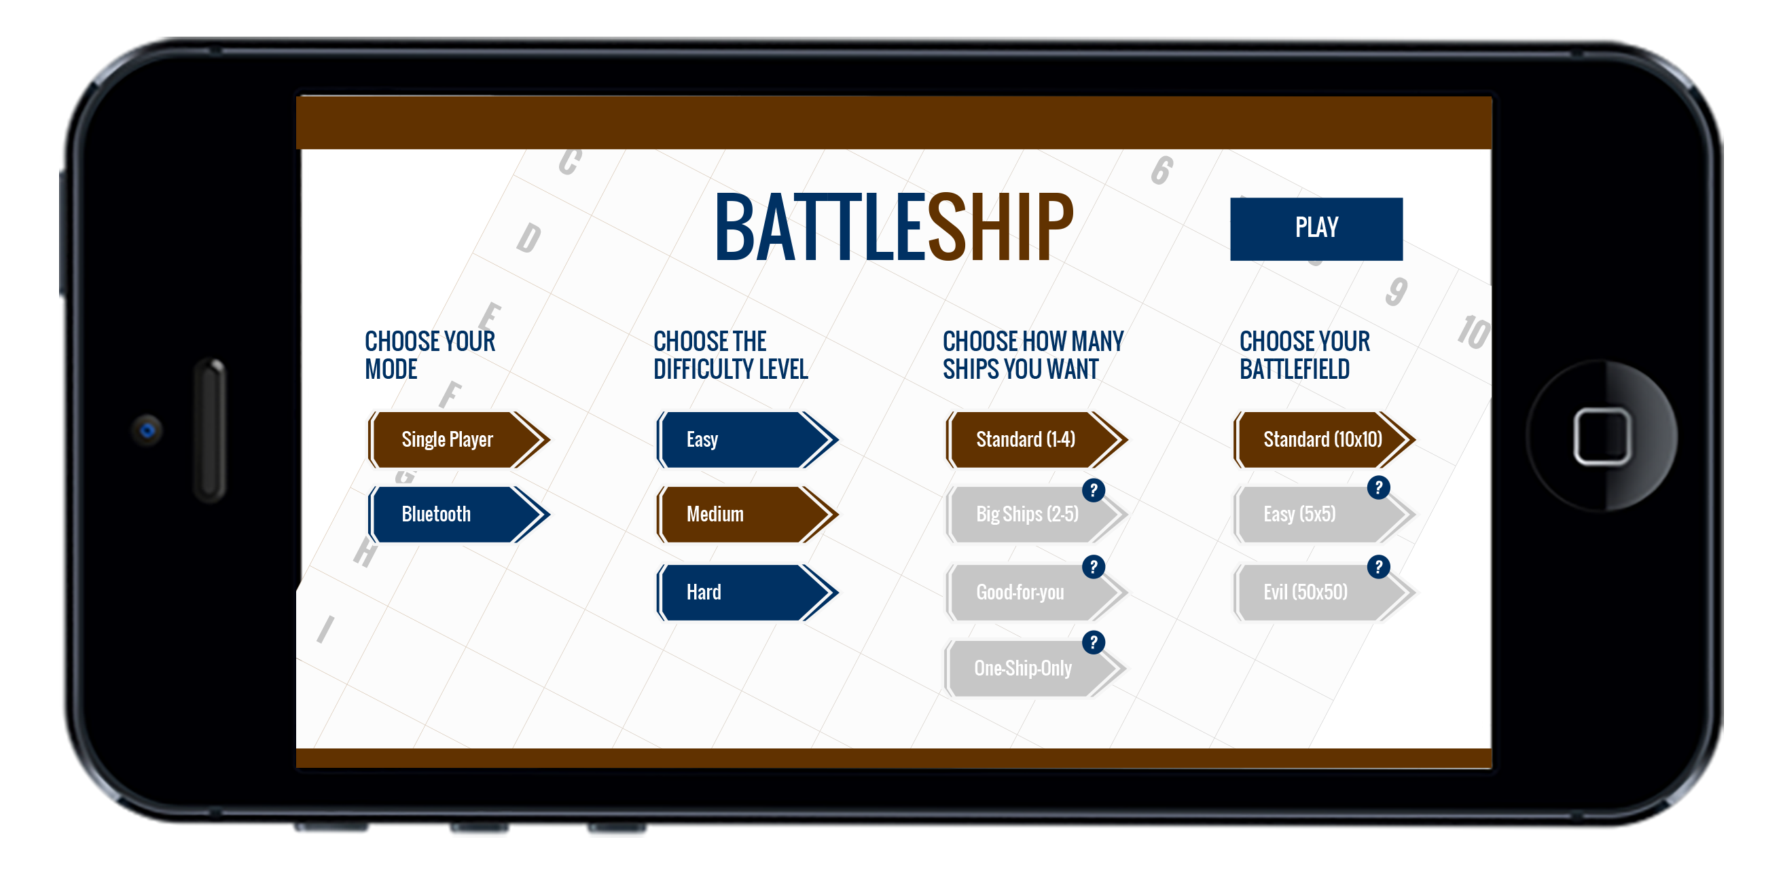
Main menu

Slide 5
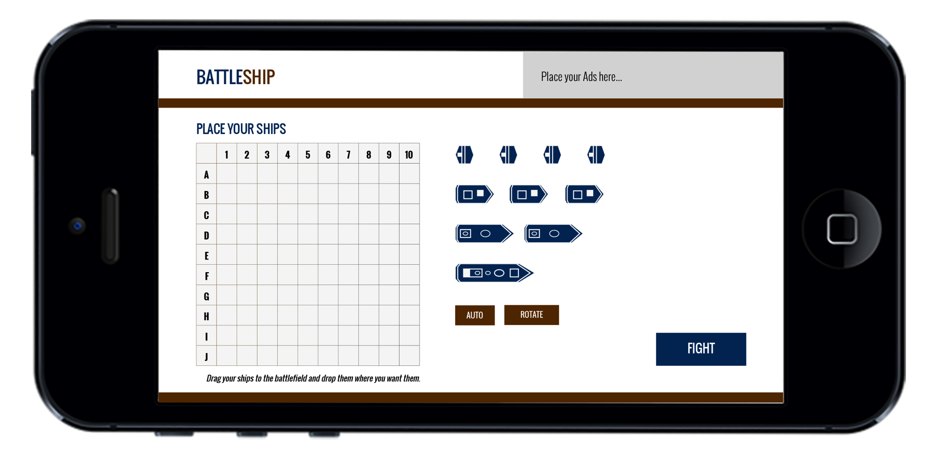
Place ships

Slide 6
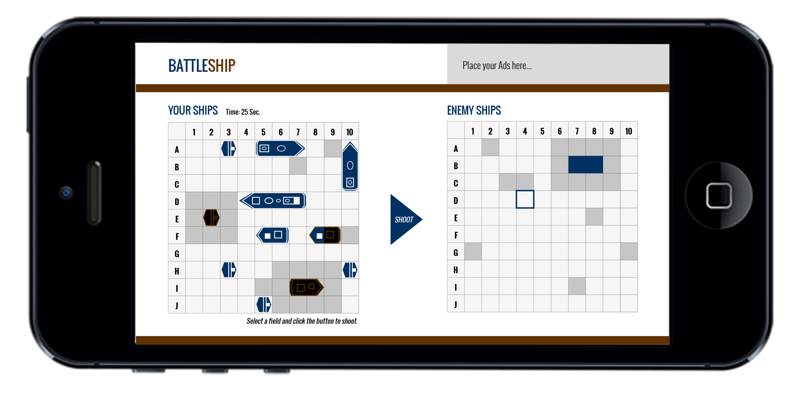
Battle

Slide 7
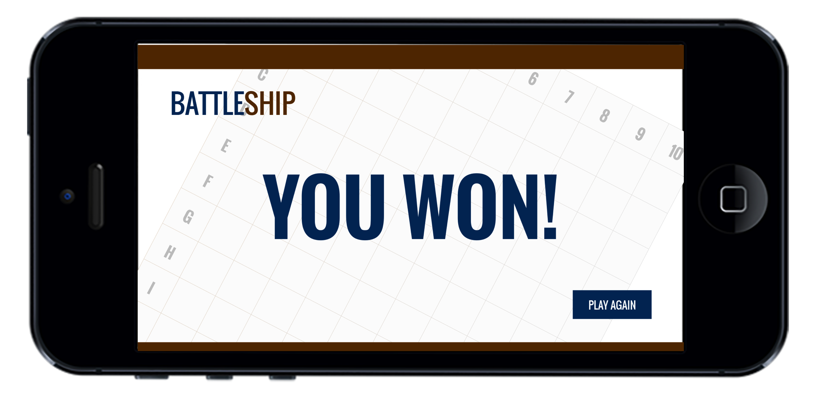
Win

Slide 8
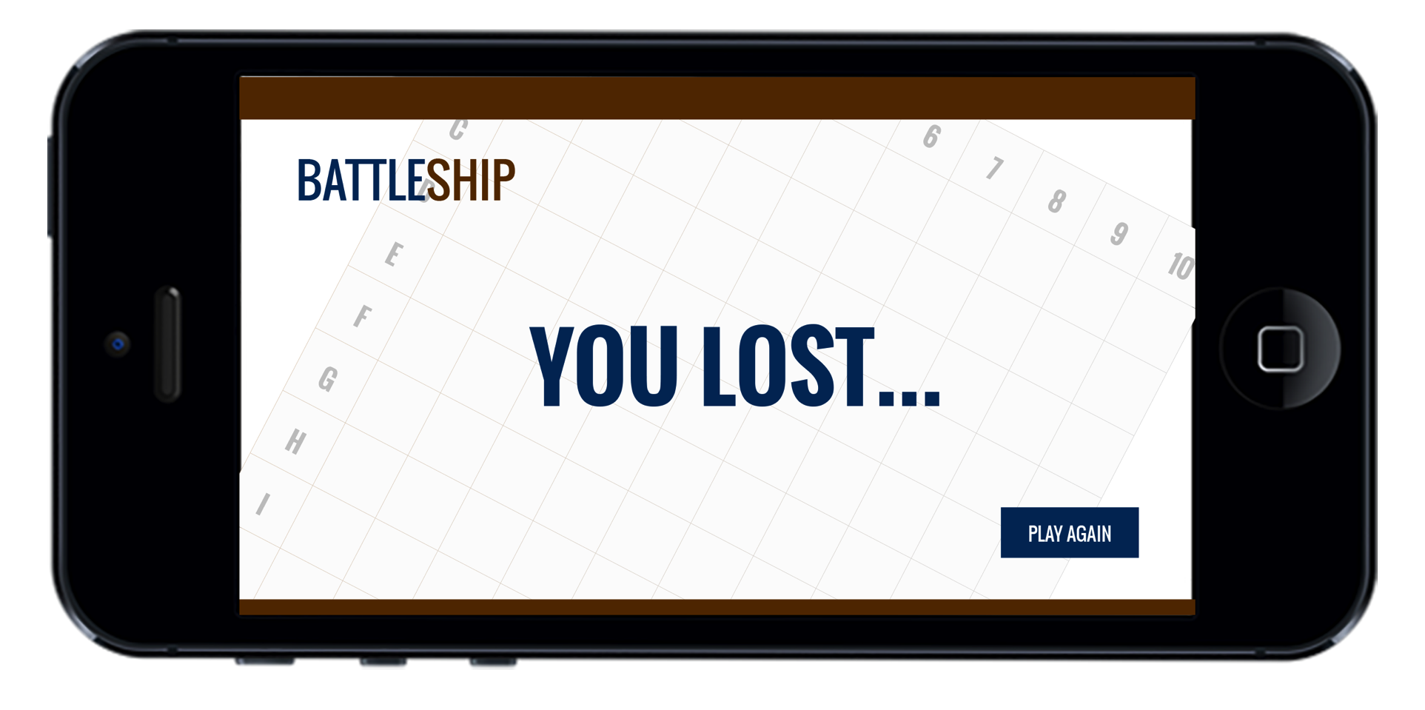
Loose

Slide 9
Questions?

