Slide 1
Cross-platform
Müllner, Huber, Kralicek, Deubler

Slide 2
Bluetooth
Tried various Libraries
No Cross-Platform, which we consider mandatory
Mostly BLE for Heart rate monitors, etc.
Buggy or outdated
Couldn‘t even get Android to Android working
cordova-plugin-chrome-apps-bluetoothSocket
cordova-plugin-networking-bluetooth
cordova-plugin-ble-central
BluetoothSerial

Slide 3
Network
Platform independent
Global matchmaking
Everybody is de facto online
Common use case
Well documented and many possibilities
We need a backend anyway… (more later)

Slide 4

Network
Use of socket.io
enables real-time bidirectional event-based communication
up-to-date and well maintained
easy to use with NodeJS Server
easy to use with Cordova
NPM package

Slide 5



Network
socket.io server runs as Node-app inside a Docker container
nginx container in front as http proxy
forwards traffic to container
accessible through http://kdeubler.at/socket.io/
a little bit of work to get websockets through

Slide 6
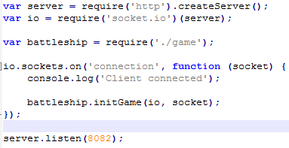
Network
app.js starts the server
include socket.io
include game.js
contains listeners
execute „network logic“
defined in package.json
listens on incoming connections

Slide 7
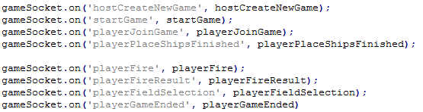
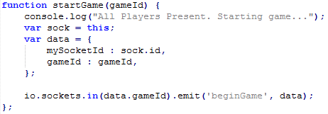
Network
define functions that can be called by the client
socket.io manages sockets in „rooms“
perfect for our case
host creates room
second player joins room
emit messages within this room
different broadcasting methods
send to all except sender

Slide 8
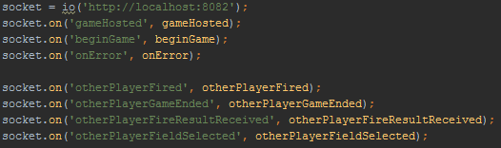
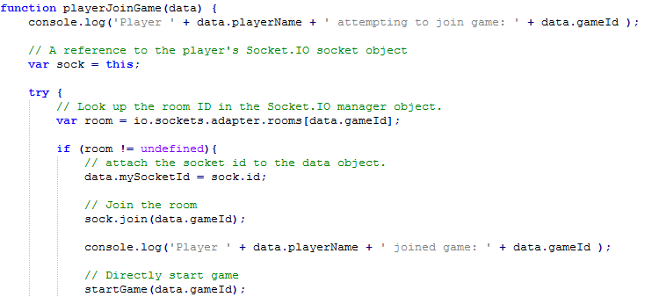
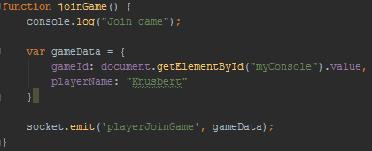
Network

Slide 9
Google Play Services iOS Game Center
Notes:
iOS

Slide 10
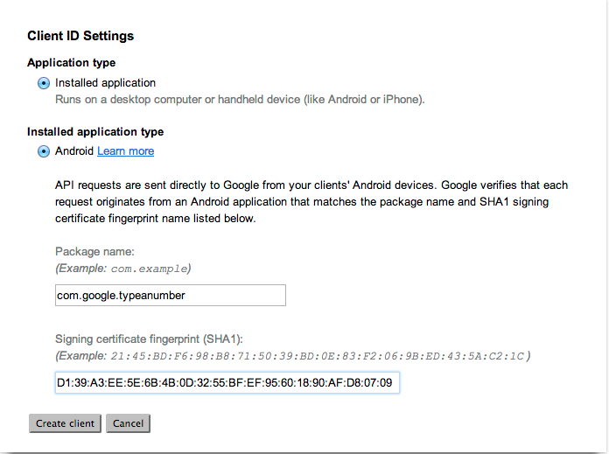
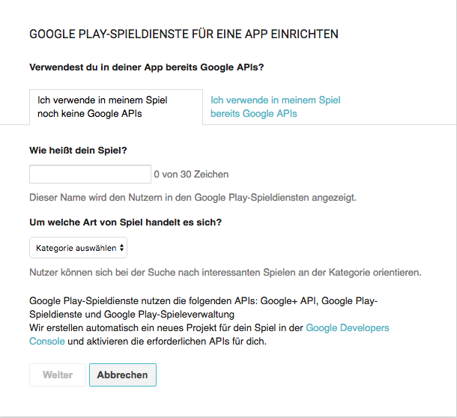
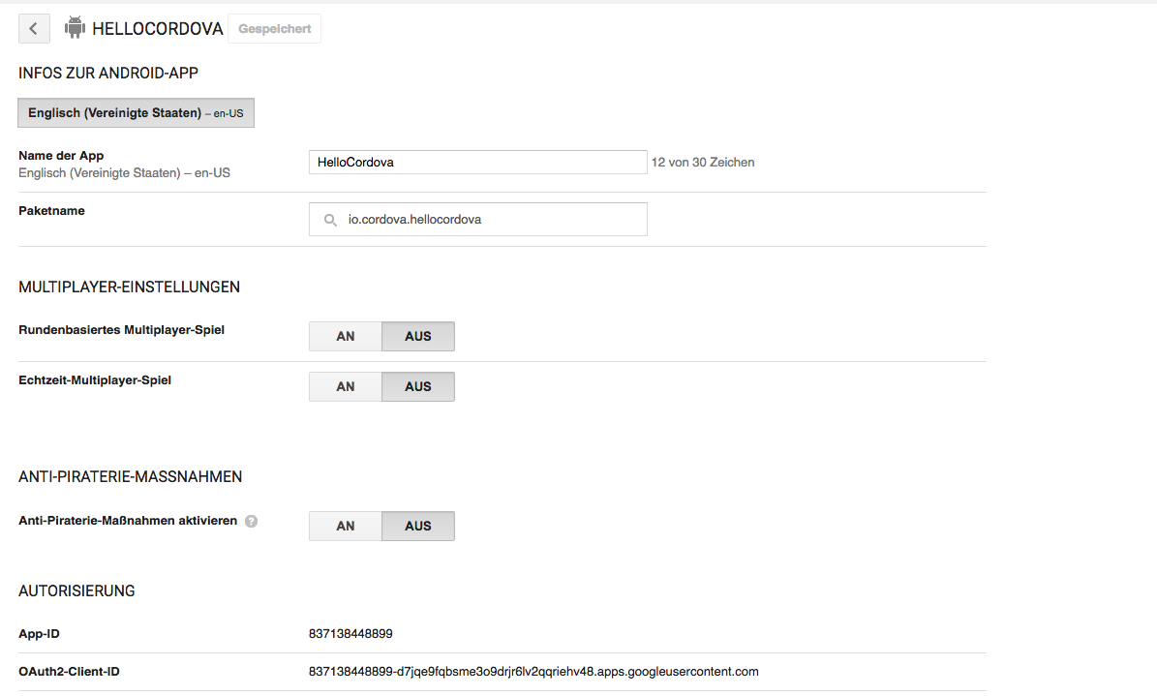
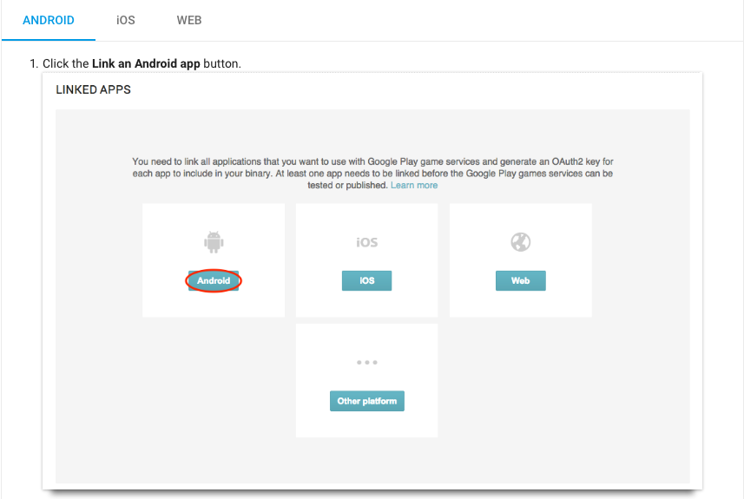
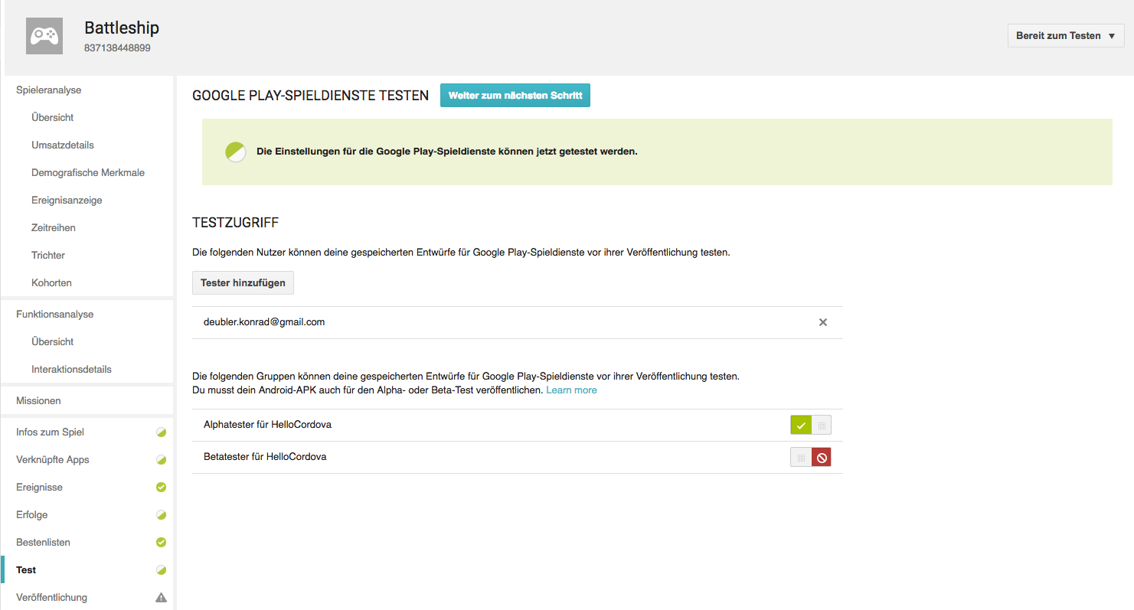
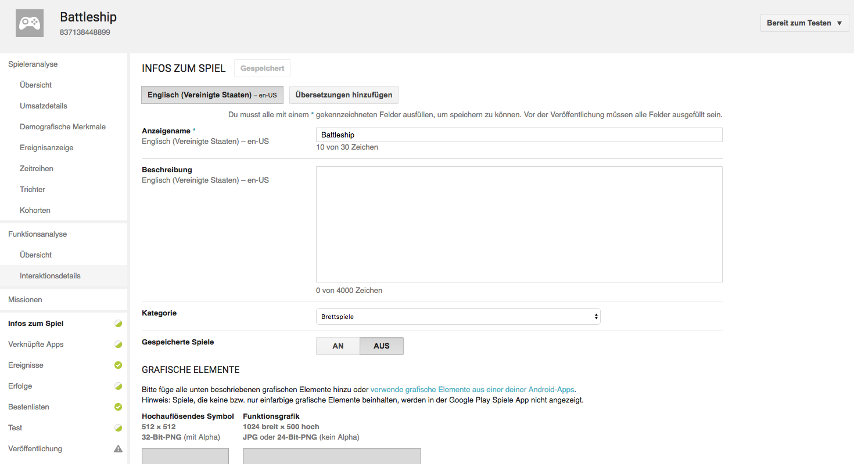
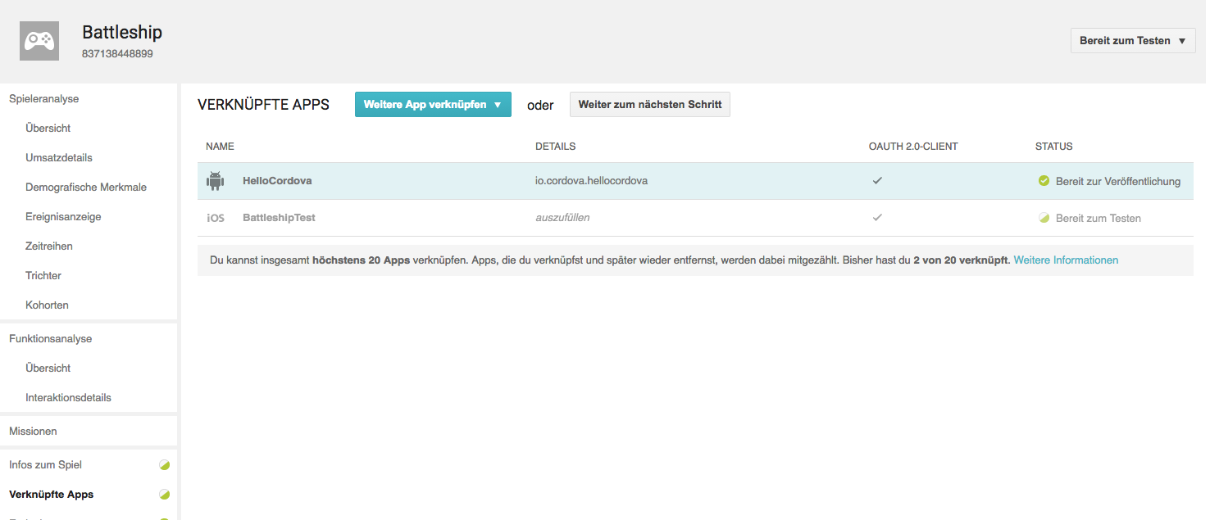
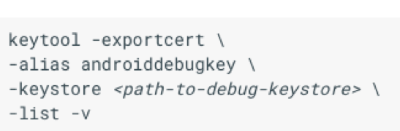
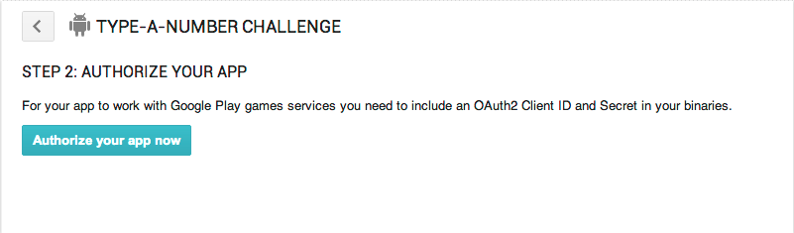
Google Developer Console
Create
Link
Authorize
Test

Slide 11
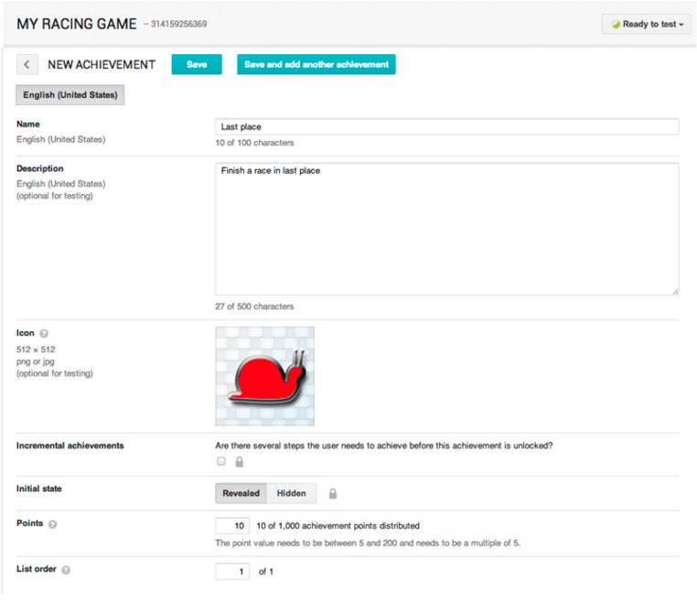
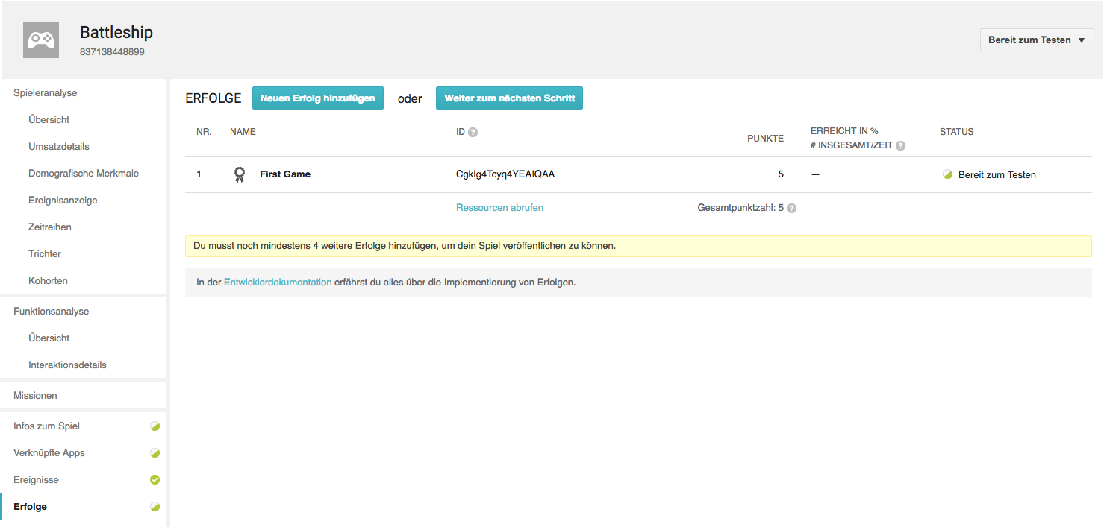
Google Developer Console II
Add

Slide 12
Plugins
artberri/cordova-plugin-play-games-services
cranberrygame/cordova-plugin-game
ludei/atomic-plugins-googleplaygames
cocoon-google-play-games-social-plugin
floatinghotpot/google-play-services
Notes:
App id beim Installieren des plugins angeben müssen
Offer methods for auth signOut
unlockAchievement (json data)

Slide 13
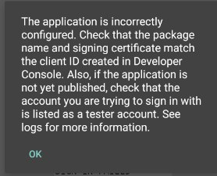
Result

Slide 14
Alternatives
Facebook Games API
Plugins available
Write new Plugin for Google Play Services
Own Webservice

Slide 15
Pitfalls / things I liked
Plugins are written for one app and not maintained
Plugins often copies of other plugins with few “enhancement”
Google Play Service Documentation

Slide 16
Good starting points
Google Play Services API Documentation
iOS Developer Library

Slide 17
Demo

Slide 18
Questions?

