Slide 1
BATTLESHIP
Müllner, Huber, Kralicek, Deubler

Slide 2
Overview
The game
Ideas
Basics
Implementation goals
Extensions
Technologies & Platforms

Slide 3

The game - Ideas
Take classic game to modern era
Simple, but many possibilities
It‘s always fun to play a game
In-App purchases possible
Multiplayer games perfect for cross-platform

Slide 4
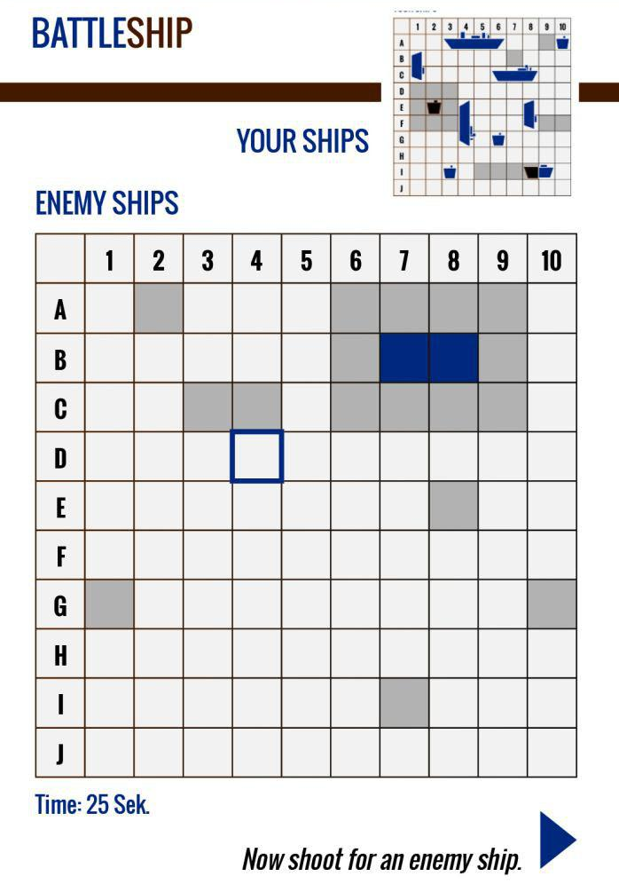
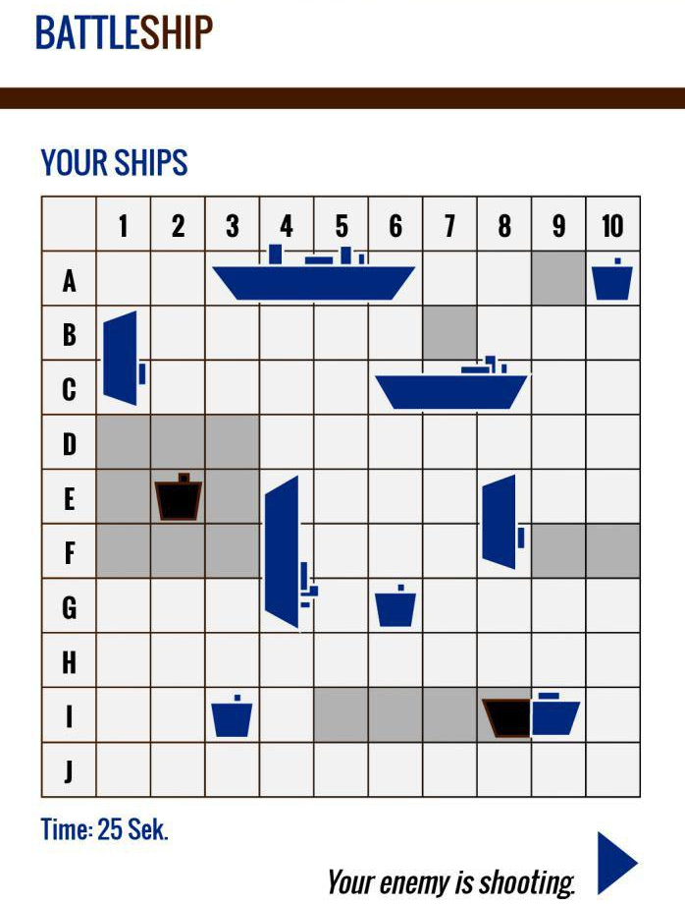
The game – Basics
2 Players
10x10 Board
6-10 Ships per Player
Turn-based firing
Extra shot for a hit
Sink enemy fleet

Slide 5
The game - Implementation goals
Singleplayer against AI (2-3 difficulties)
Multiplayer Bluetooth
Cross-platform
Multiplayer Internet (optional)
Cross-platform
Random matching or direct play?
Extensions (optional)

Slide 6
The game - Extensions
Game mechanics
Game modes (only 1 ship e. g.)
New / different ships
Items
Special abilities
Monetarization
Skins for ships
Different Background / Board
Items

Slide 7
Platforms & Technologies
Platforms
iOS
Android
Windows 10 Mobile (optional)
Technologies
Apache Cordova

Slide 8
QUESTIONS?

