Slide 1
Battleship

Slide 2
The true object of all human life is play.
- G. K. Chesterton

Slide 3
Aboard, Commander
Crush the enemy fleet turn by turn.
Become the greatest Naval Commander of all time!

Slide 4

A classic board game, Revisited. Extended.
Play against AI
Play against Friends
Platform independent
Anywhere, Anytime

Slide 5
Classic game.
Flat design
Back to the roots! We use simple but elegant shapes and colors conveying the spirit of the game.
Instant action
We put a heavy focus on usability and intuitive usage, also on a flat menu structure.

Slide 6
Modern approach.
New game modes
4 Ship-sets
x 3 Board sizes
= infinite possibilities
New enemies
Fight against commanders around the world, or just the person sitting next to you.
New challenges
Can you unlock all the achievements and become the greatest commander of all time?

Slide 7
Technology is key.
Apache Cordova
Mobile application development framework, works with HTML, CSS & JS
jQuery
Fast, small, and feature-rich JavaScript library, simplifying event handling, animation, Ajax and more
socket.io
Event-based bi-directional communication layer for realtime web applications
Docker
Automating the deployment of applications inside software containers

Slide 8
Fun. Worldwide.
our server

Slide 9
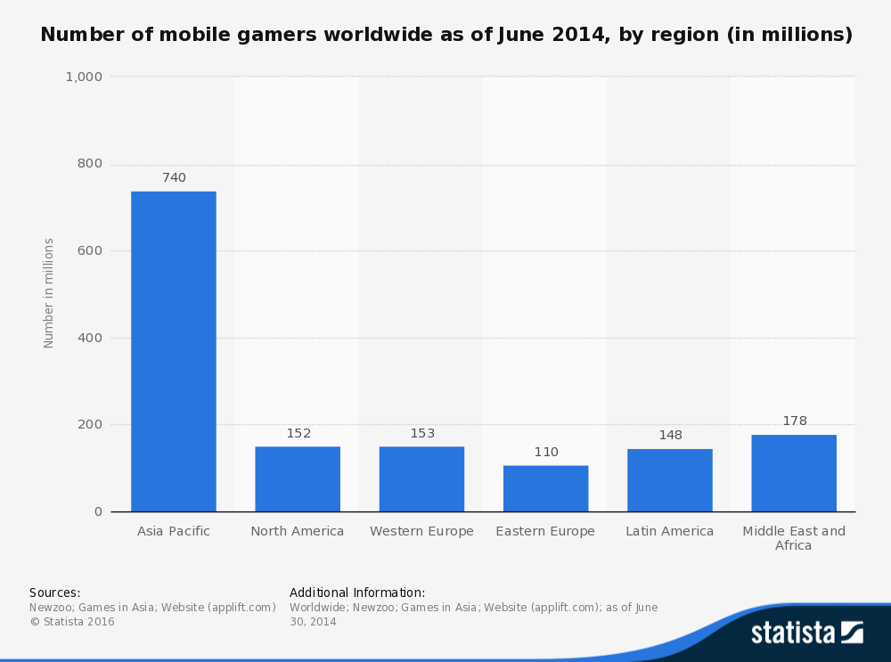

Slide 10
reach 1,481,124,000
people

Slide 11
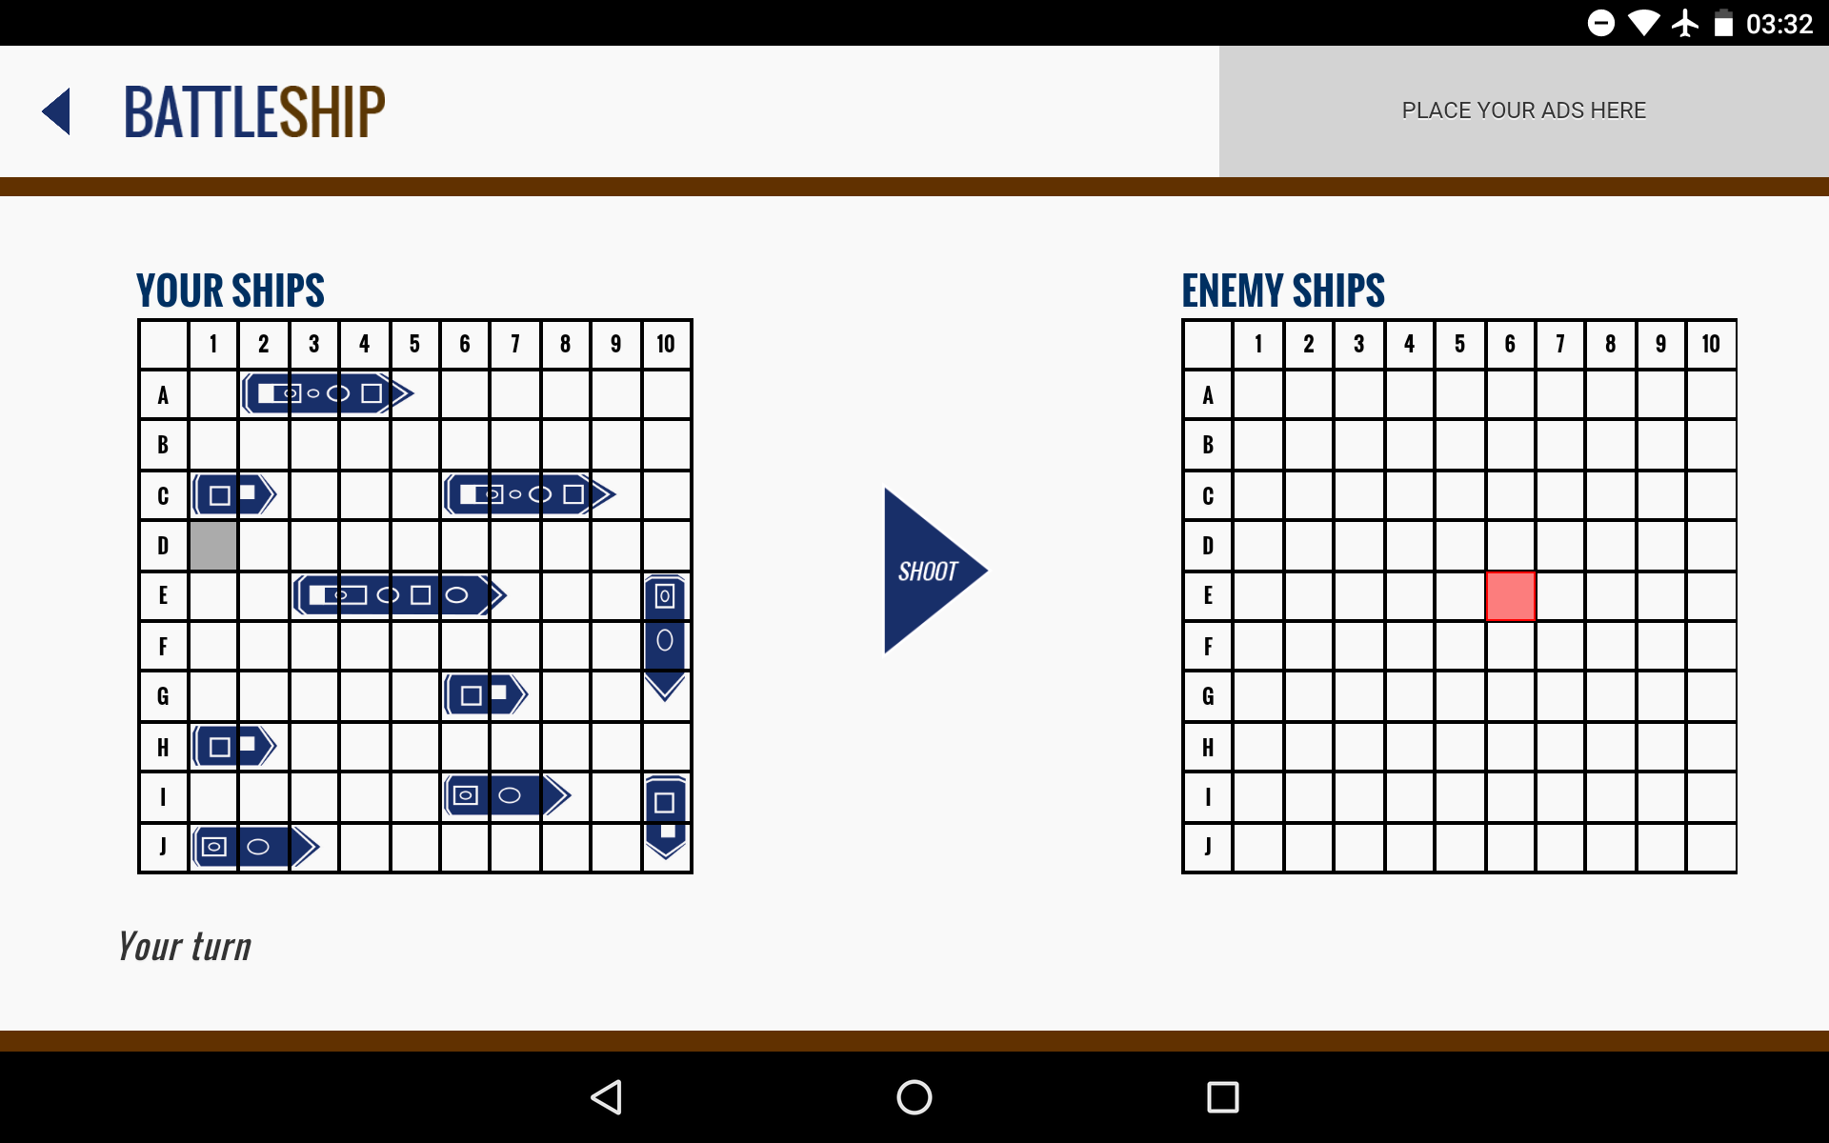
Smartphone / Tablet
The game scales perfectly with smaller screens and imparts a comfortable gaming experience.

Slide 12
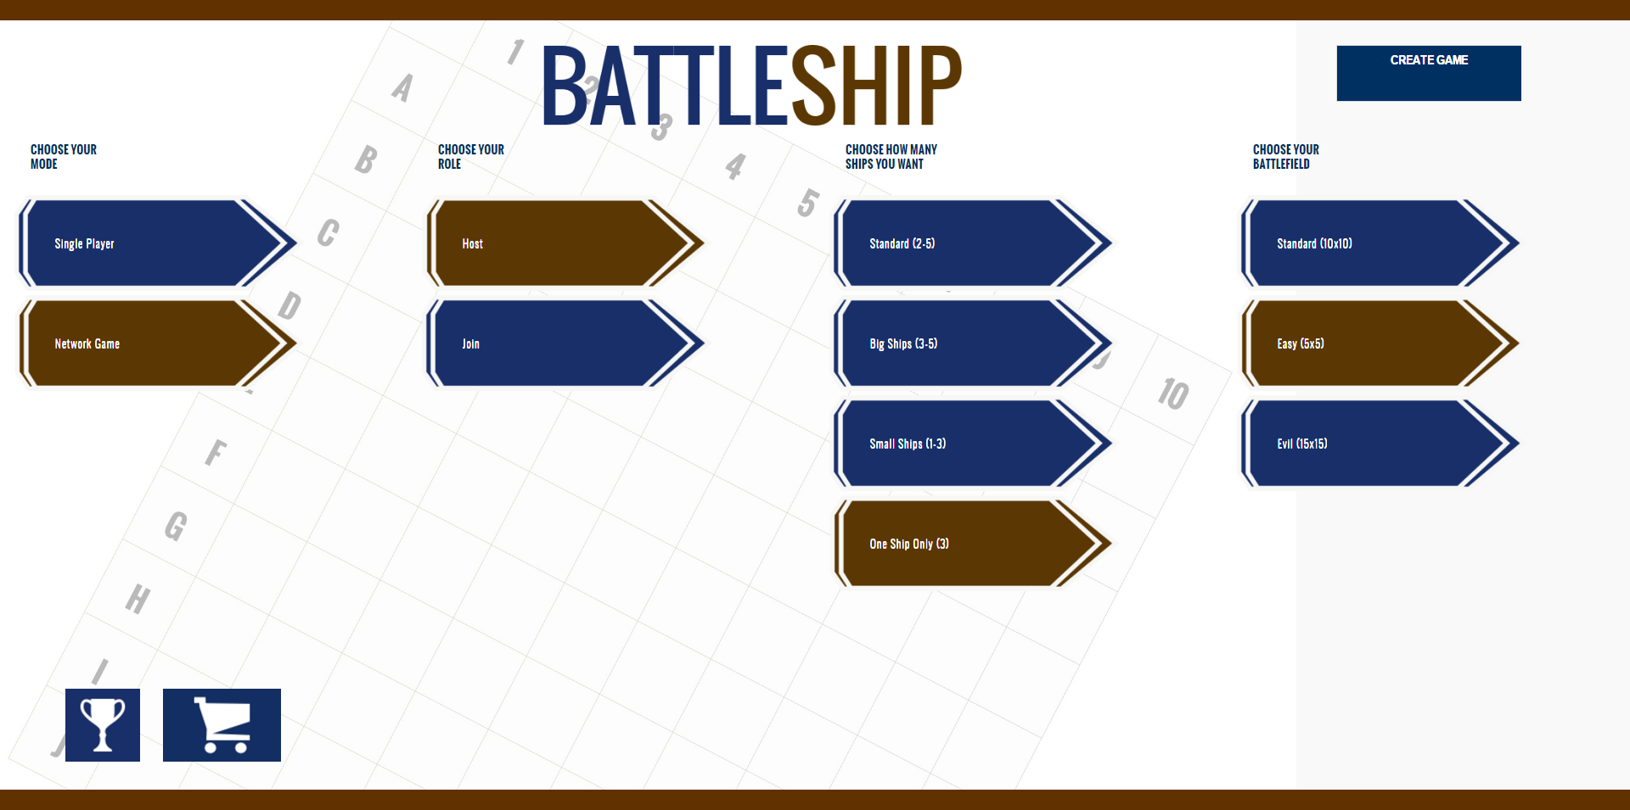
Place your screenshot here
Desktop
Fully responsive and enjoyable, even on big screens.

Slide 13
Thank you!
(this was the everything-is-awesome part)

Slide 14
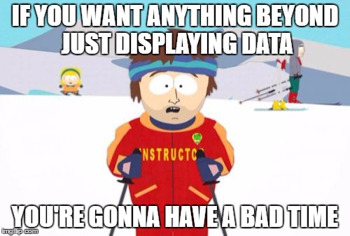
Cordova in a nutshell

Slide 15
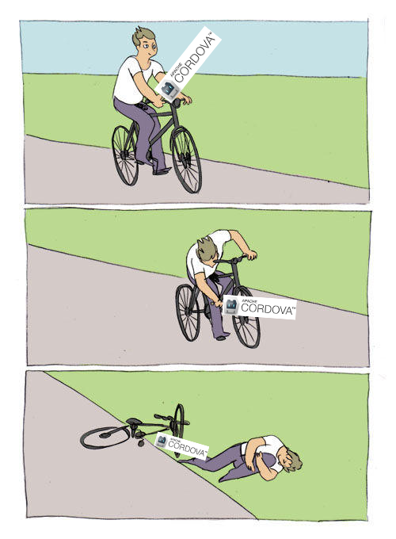
Recap
Cordova
Web-Dev experience required
Cross-platform works without adaption – as long as nothing native is required
Debugging nearly impossible on devices
Bluetooth
Only support for BLE-Devices
Libraries outdated or for specific usecases only
Under iOS not possible at all
Google Play Services
No Plugin works
REST-Workaround
Only Achievements, no purchases
Well documented
socket.io
Perfect for our usecase
Server required
Works as intended
Callback-hell
jQuery, –mobile, -UI
Simplifies Event-handling
Helps with UI-Management
Problem with Landscape mode, as everything gets calculated from height
Drag & Drop not supported

Slide 16
Questions?

