Slide 1



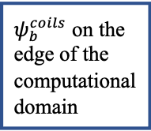









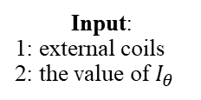
Input:
1: external coils
2: the value of $I_{θ}$
Store $ψ$ as $ψ_{old}$
$$ψ_{b}=ψ_{bw}^{coils}$$
$$ψ_{b}=ψ_{bw}^{coils}+ψ_{b}^{p}$$
Update $P=C×P(ψ)$ with $ψ$
$$ψ_{b}^{p}$$
no
C=C$×I_{θ}/I_{p}$
$ψ=wψ_{old}+\left(1−w\right)ψ$
$$d<ε$$
yes
Post-processing

Slide 2












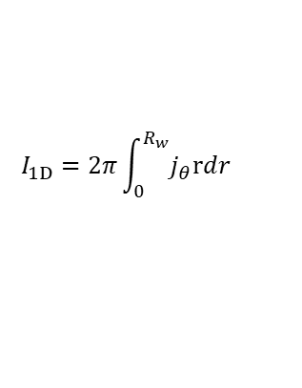


Initial guesses current $I_{coils}$ of coils
Input:
$\left(β_{s},δ_{s}\right)$
Fixed-boundary
Free-boundary
Input:
$B_{e},R_{s},R_{w}$
$I_{coils}=I_{coils}×$ $ψ_{bm}/ψ_{b2}$
$$ψ_{b2}=ψ_{bm}$$
no
yes
$$ψ_{b}=C_{I}ψ_{b}$$
$$C_{I}=wC_{I}+$$
$$\left(1−w\right)C_{I}×Be/B_{e1}$$
G-S solver
d$<ε$

