Slide 1
Git Tutorial

Slide 2
Content
Introduction to Git/GitHub/GitKraken
How to register on GitHub for a Pro account
How to create and manage GitHub repositories
How to create GitHub projects
How to link GitHub projects to GitHub repositories
GitHub

Slide 3
Introduction to Git/GitHub/GitKraken
Git
Distributed Version Control System for tracking changes in files
Coordinates work between multiple developers
Who made what changes and when
Revert back at any time
GitHub: central source
Git repository hosting service
Remote repository
GitKraken
Git GUI Client
Helps developers become more productive and efficient

Slide 4
How to register on GitHub for a Pro account
https://github.com/
https://education.github.com/students

Slide 5
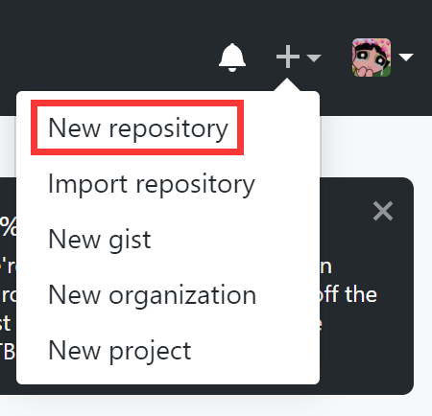
How to create and manage GitHub repositories
Repository
A "directory" where files and folders can exist
Contains all of the files (including documentation), and stores each file’s revision history
Create and manage GitHub repositories

Slide 6
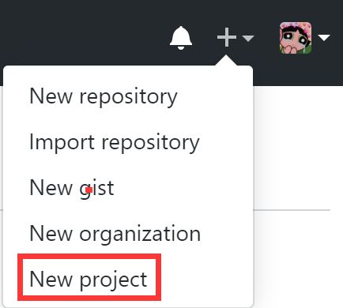
How to create GitHub projects
Project
Provides a visual board that is typical of many Project Management tools
Helps you organize and prioritize your work
Create GitHub projects

Slide 7
How to link GitHub projects to GitHub repositories
Link when creating the project
Link after creating the project

Slide 8
Git Tutorial

Slide 9
Content
Where to get GitKraken and register for a Pro account
https://www.gitkraken.com/
How to sign-in to GitKraken using the GitHub account credentials
How to connect the GitKraken client to the GitHub account
How to commit
How to push/pull to/from the remote GitHub repository

Slide 10
Git Tutorial

Slide 11
Content
How to create and manage GitKraken Glo Boards
How to link/synchronize GitHub repositories with GitKraken Glo Boards
How to set up board columns
How to set up task cards
How to set up sub tasks for task cards
How to set up Milestones

Slide 12
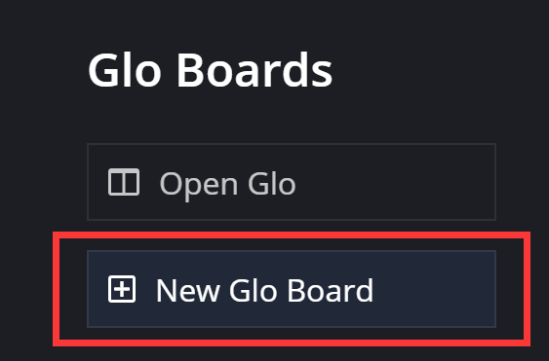
How to create and manage GitKraken Glo Boards
GitKraken Glo Boards
Kanban-style issue tracking system
Helps developers and teams collaboratively track tasks
Create Glo Boards

Slide 13
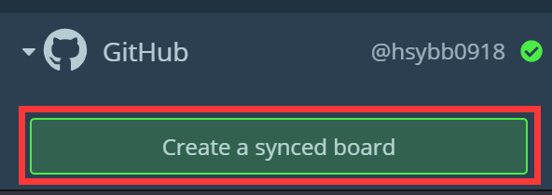
How to link/synchronize GitHub repositories with GitKraken Glo Boards
Sync a Glo Board with the Issues
Synced Board

Slide 14
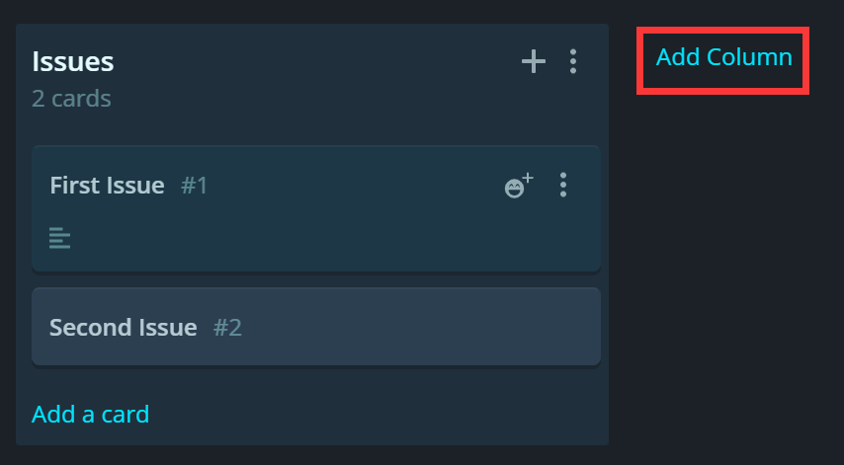
How to set up board columns

Slide 15
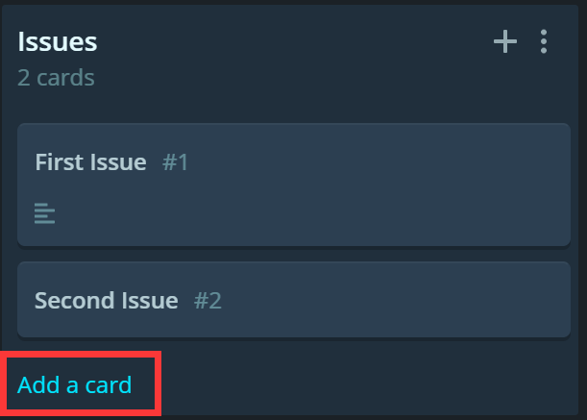
How to set up task cards

Slide 16
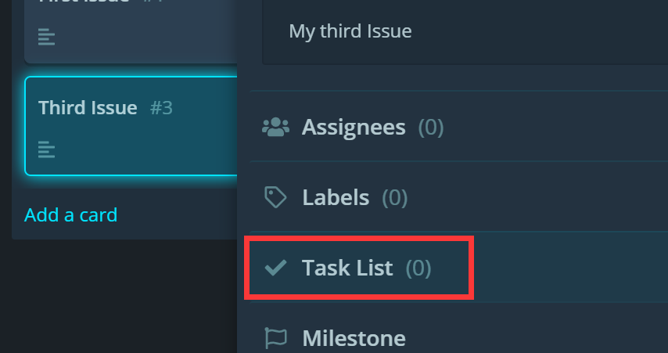
How to set up sub tasks for task cards

Slide 17
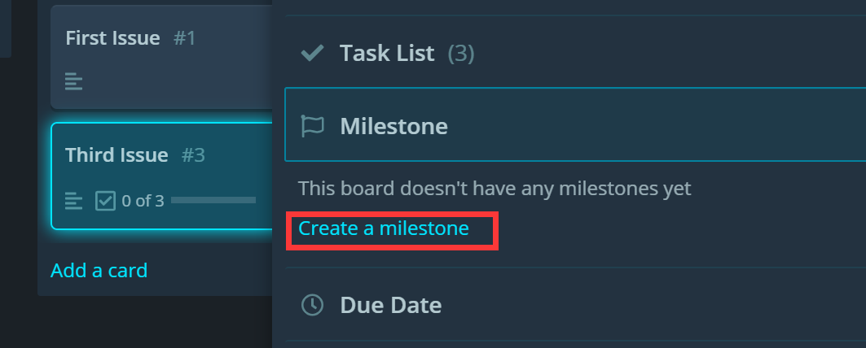
How to set up Milestones
Track progress on groups of issues

Slide 18
Content
Two-way connecting task card (Glo) and git commit (GitKraken)
Connect task card to git commit
Connect git commit to task card

Slide 19
Git LFS

Slide 20
Problems with Large binary files
Git LFS: Git Large File Storage
Big files: xxx.psd, xxx.fbx, xxx.aiff, …
Any changes you made to binary files are tracked as an additional copy of the files
Local repo: Image = 100MB
Image(1) = 100MB
Image(2) = 100MB
…
With LFS, working with large assets becomes easier
Remote repo > 300Mb

Slide 21
Git LFS
Git LFS is a Git extension that allows users to save space by storing binary files in a different location
Light weight reference object → LFS server
Link to the actual asset on the Git LFS server
How to use Git LFS on GitKraken

