Slide 1
Time-varying coefficients models
Claudia von Brömssen
Dept of Energy and Techology

Slide 2
What are time-varying coefficients?
We have already seen that we let trend estimates vary with season.
We get new trend lines for each month.
But here the ’coefficients’ do not vary smoothly changing from one month to another, instead a new trend line is estimated for each month.

Slide 3
What are time-varying coefficients?
Example: Fyrisån
A strong downward trend, especially in the 1970s.
This is due to improvements in wastwater treatment.

Slide 4
What are time-varying coefficients?
Example: Fyrisån
The relationship between river runoff and total phosphorus concentrations also changes with time.
During the 70s increased runoff leads to dilution = a negative relationship
Later increased runoff leads increased concentration = a positive relationship

Slide 5
What are time-varying coefficients?
Time constant relationships between concentration and runoff:
1965 -2013 1965-1984 1994-2013

Slide 6
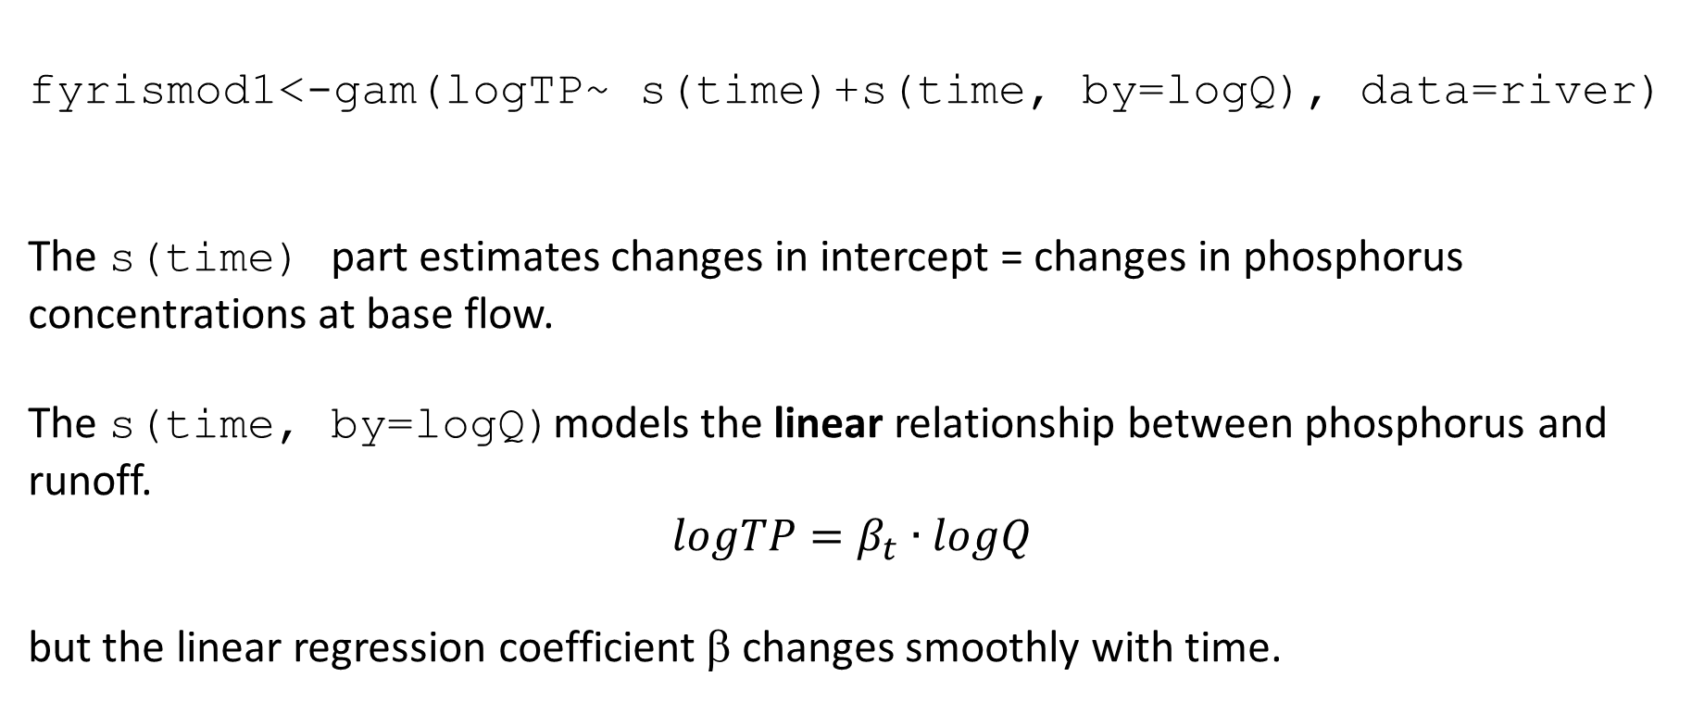
Fitting time-varying coefficients
fyrismod1<-gam(logTP~ s(time)+s(time, by=logQ), data=river)
The s(time) part estimates changes in intercept = changes in phosphorus concentrations at base flow.
The s(time, by=logQ)models the linear relationship between phosphorus and runoff.
$$logTP=β_{t}∙logQ$$
but the linear regression coefficient β changes smoothly with time.

Slide 7
Fitting time-varying coefficients
Plotting the coefficient β_{t} illustrates how the concentration-runoff relationship changes with time.
From a negative relationship before 1985 to a positive one after that.

Slide 8
Fitting time-varying coefficients
fyrismod2<-gamm(logTP ~ s(time) + te(time,Månad, by=logQ) , data=river)
We could also model varying-coefficients over both years and month.
There we see that the high positive regression coefficients are observed mainly during summer and autumn month.

Slide 9
Open questions
Estimating time varying regression coefficients leads to rather complex models, which easily can lead to non-convergence or other modelling problems.
In all regression models estimates of intercept and regression coefficients are correlated. Since in out study the intercept changes with time this could have effects on the regression coefficient, even if the relationship between runoff and concentration is constant.
The intercept is the level of concentrations when discharge is 0 and is here used as a proxy for base-flow. Base flow is, of course, never at 0 and can furthermore change with time as well.

