Slide 1
Chapter 10
Implementing Subprograms

Slide 2
Chapter 10 Topics
The General Semantics of Calls and Returns
Implementing “Simple” Subprograms
Implementing Subprograms with Stack-Dynamic Local Variables
Nested Subprograms
Blocks
Implementing Dynamic Scoping
Copyright © 2017 Pearson Education, Ltd. All rights reserved.
1-<number>

Slide 3
The General Semantics of Calls and Returns
The subprogram call and return operations of a language are together called its subprogram linkage
General semantics of calls to a subprogram
  Parameter passing methods
  Stack-dynamic allocation of local variables
  Save the execution status of calling program
  Transfer of control and arrange for the return
  If subprogram nesting is supported, access to nonlocal variables must be arranged
Copyright © 2017 Pearson Education, Ltd. All rights reserved.
1-<number>

Slide 4
The General Semantics of Calls and Returns
General semantics of subprogram returns:
  In mode and inout mode parameters must have their values returned
  Deallocation of stack-dynamic locals
  Restore the execution status
  Return control to the caller
Copyright © 2017 Pearson Education, Ltd. All rights reserved.
1-<number>

Slide 5
Implementing “Simple” Subprograms
Call Semantics:
- Save the execution status of the caller
- Pass the parameters
- Pass the return address to the called
- Transfer control to the called
Copyright © 2017 Pearson Education, Ltd. All rights reserved.
1-<number>

Slide 6
Implementing “Simple” Subprograms (continued)
Return Semantics:
  If pass-by-value-result or out mode parameters are used, move the current values of those parameters to their corresponding actual parameters
  If it is a function, move the functional value to a place the caller can get it
  Restore the execution status of the caller
  Transfer control back to the caller
Required storage:
  Status information, parameters, return address, return value for functions, temporaries
Copyright © 2017 Pearson Education, Ltd. All rights reserved.
1-<number>

Slide 7
Implementing “Simple” Subprograms (continued)
Two separate parts: the actual code and the non-code part (local variables and data that can change)
The format, or layout, of the non-code part of an executing subprogram is called an activation record
An activation record instance is a concrete example of an activation record (the collection of data for a particular subprogram activation)
Copyright © 2017 Pearson Education, Ltd. All rights reserved.
1-<number>

Slide 8
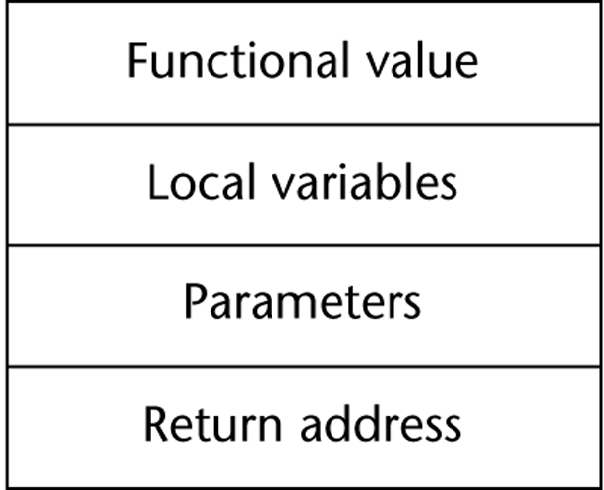
An Activation Record for “Simple” Subprograms
Copyright © 2017 Pearson Education, Ltd. All rights reserved.
1-<number>

Slide 9
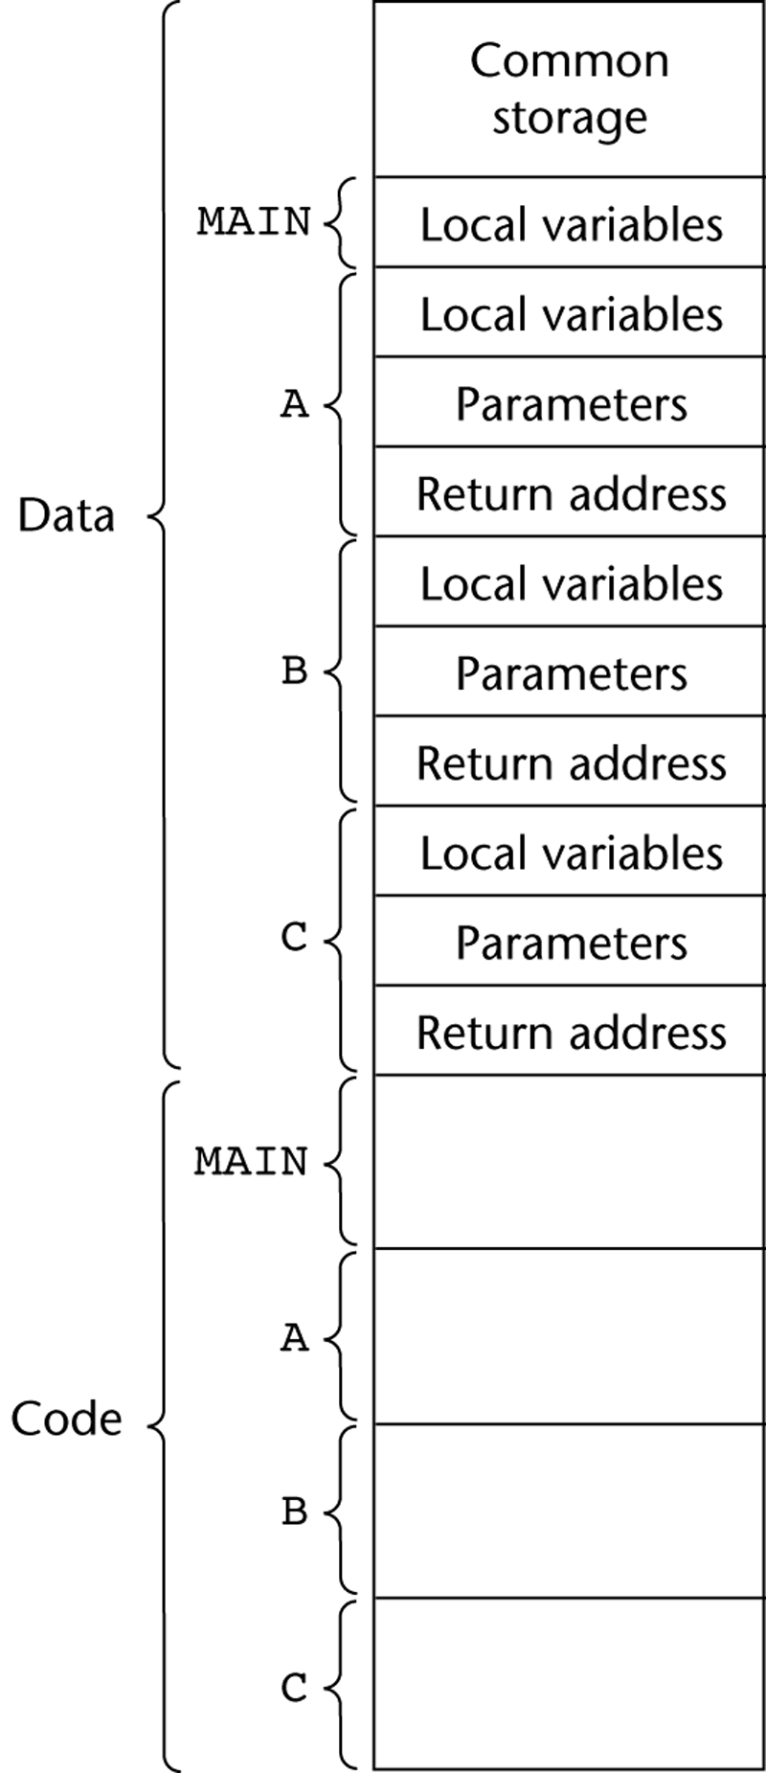
Code and Activation Records of a Program with “Simple” Subprograms
Copyright © 2017 Pearson Education, Ltd. All rights reserved.
1-<number>

Slide 10
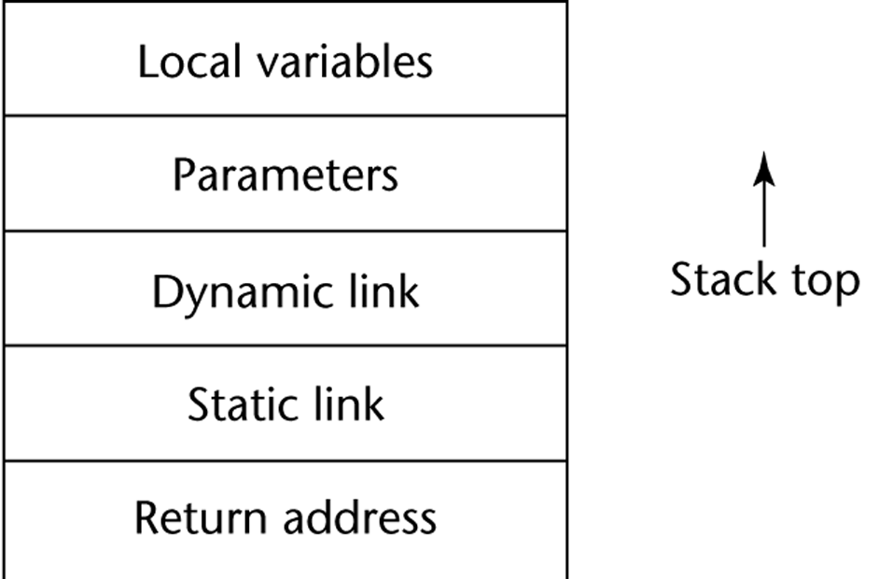
Implementing Subprograms with Stack-Dynamic Local Variables
More complex activation record
  The compiler must generate code to cause implicit allocation and deallocation of local variables
  Recursion must be supported (adds the possibility of multiple simultaneous activations of a subprogram)
Copyright © 2017 Pearson Education, Ltd. All rights reserved.
1-<number>

Slide 11
Implementing Subprograms with Stack-Dynamic Local Variables: Activation Record
The activation record format is static, but its size may be dynamic
The dynamic link points to the top of an instance of the activation record of the caller
An activation record instance is dynamically created when a subprogram is called
Activation record instances reside on the run-time stack
The Environment Pointer (EP) must be maintained by the run-time system. It always points at the base of the activation record instance of the currently executing program unit
Copyright © 2017 Pearson Education, Ltd. All rights reserved.
1-<number>

Slide 12
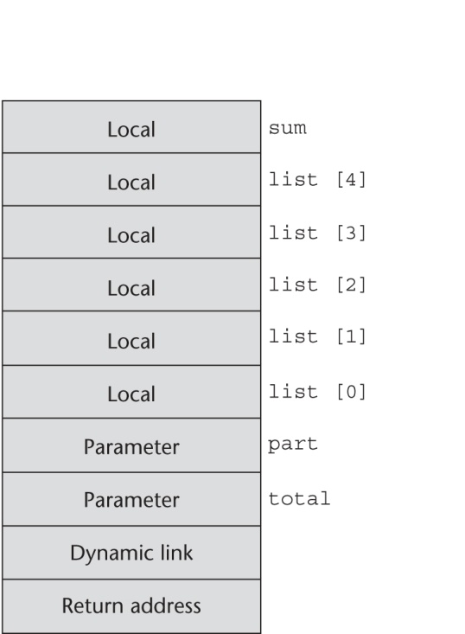
An Example: C Function
void sub(float total, int part)
{
int list[5];
float sum;
…
}
Copyright © 2017 Pearson Education, Ltd. All rights reserved.
1-<number>

Slide 13
Revised Semantic Call/Return Actions
Caller Actions:
  Create an activation record instance
  Save the execution status of the current program unit
  Compute and pass the parameters
  Pass the return address to the called
  Transfer control to the called
Prologue actions of the called:
  Save the old EP in the stack as the dynamic link and create the new value
  Allocate local variables
Copyright © 2017 Pearson Education, Ltd. All rights reserved.
1-<number>

Slide 14
Revised Semantic Call/Return Actions (continued)
Epilogue actions of the called:
  If there are pass-by-value-result or out-mode parameters, the current values of those parameters are moved to the corresponding actual parameters
  If the subprogram is a function, its value is moved to a place accessible to the caller
  Restore the stack pointer by setting it to the value of the current EP-1 and set the EP to the old dynamic link
  Restore the execution status of the caller
  Transfer control back to the caller
Copyright © 2017 Pearson Education, Ltd. All rights reserved.
1-<number>

Slide 15
An Example Without Recursion
void fun1(float r) {
int s, t;
...
fun2(s);
...
}
void fun2(int x) {
int y;
...
fun3(y);
...
}
void fun3(int q) {
...
}
void main() {
float p;
...
fun1(p);
...
}
main calls fun1
fun1 calls fun2
fun2 calls fun3
Copyright © 2017 Pearson Education, Ltd. All rights reserved.
1-<number>

Slide 16
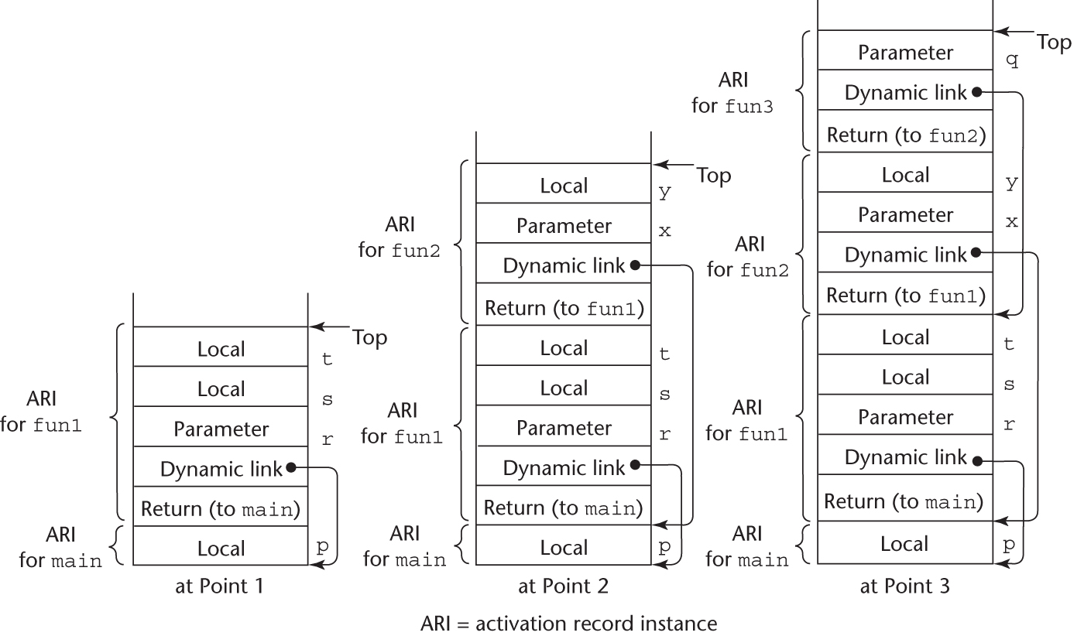
An Example Without Recursion
Copyright © 2017 Pearson Education, Ltd. All rights reserved.
1-<number>

Slide 17
Dynamic Chain and Local Offset
The collection of dynamic links in the stack at a given time is called the dynamic chain, or call chain
Local variables can be accessed by their offset from the beginning of the activation record, whose address is in the EP. This offset is called the local_offset
The local_offset of a local variable can be determined by the compiler at compile time
Copyright © 2017 Pearson Education, Ltd. All rights reserved.
1-<number>

Slide 18
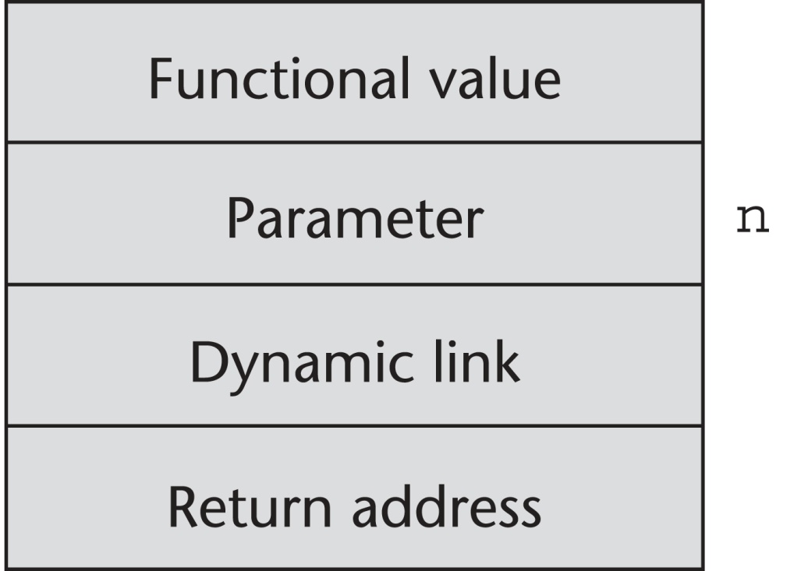
An Example With Recursion
The activation record used in the previous example supports recursion
int factorial (int n) {
<-----------------------------1
if (n <= 1) return 1;
else return (n * factorial(n - 1));
<-----------------------------2
}
void main() {
int value;
value = factorial(3);
<-----------------------------3
}
Copyright © 2017 Pearson Education, Ltd. All rights reserved.
1-<number>

Slide 19
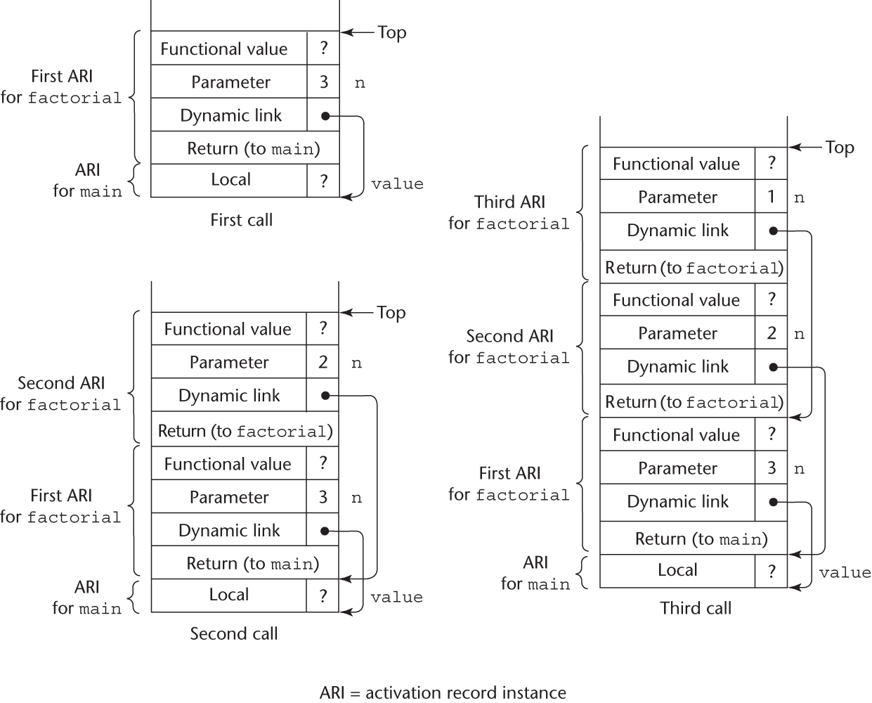
Stacks for calls to factorial
Copyright © 2017 Pearson Education, Ltd. All rights reserved.
1-<number>

Slide 20
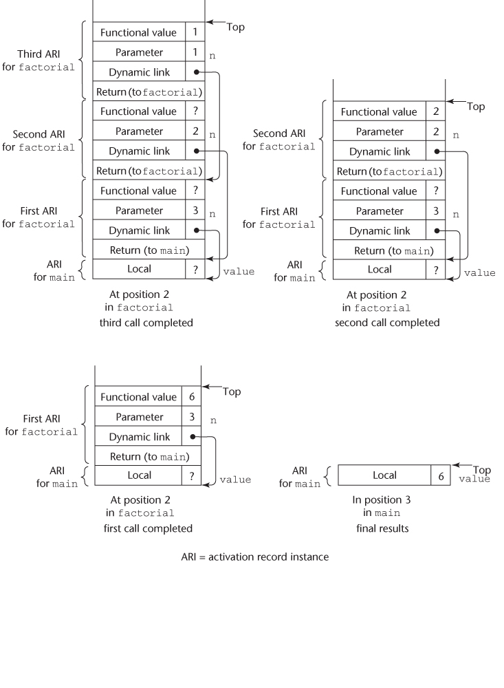
Stacks for returns from factorial
Copyright © 2017 Pearson Education, Ltd. All rights reserved.
1-<number>

Slide 21
Nested Subprograms
Some non-C-based static-scoped languages (e.g., Fortran 95+, Ada, Python, JavaScript, Ruby, and Lua) use stack-dynamic local variables and allow subprograms to be nested
All variables that can be non-locally accessed reside in some activation record instance in the stack
The process of locating a non-local reference:
  Find the correct activation record instance
  Determine the correct offset within that activation record instance
Copyright © 2017 Pearson Education, Ltd. All rights reserved.
1-<number>

Slide 22
Locating a Non-local Reference
Finding the offset is easy
Finding the correct activation record instance
  Static semantic rules guarantee that all non-local variables that can be referenced have been allocated in some activation record instance that is on the stack when the reference is made
Copyright © 2017 Pearson Education, Ltd. All rights reserved.
1-<number>

Slide 23
Static Scoping
A static chain is a chain of static links that connects certain activation record instances
The static link in an activation record instance for subprogram A points to one of the activation record instances of A's static parent
The static chain from an activation record instance connects it to all of its static ancestors
Static_depth is an integer associated with a static scope whose value is the depth of nesting of that scope
Copyright © 2017 Pearson Education, Ltd. All rights reserved.
1-<number>

Slide 24
Static Scoping (continued)
The chain_offset or nesting_depth of a nonlocal reference is the difference between the static_depth of the reference and that of the scope when it is declared
A reference to a variable can be represented by the pair:
(chain_offset, local_offset),
where local_offset is the offset in the activation
record of the variable being referenced
Copyright © 2017 Pearson Education, Ltd. All rights reserved.
1-<number>

Slide 25
Example JavaScript Program
function main(){
var x;
function bigsub() {
var a, b, c;
function sub1 {
var a, d;
function main(){
var x;
function bigsub() {
var a, b, c;
function sub1 {
var a, d;
a = b + c; ←-------------------------------1
...
} // end of sub1
function sub2(x) {
var b, e;
Copyright © 2017 Pearson Education, Ltd. All rights reserved.
1-<number>

Slide 26
Example JavaScript Program (continued)
function sub3() {
var c, e;
...
sub1();
...
e = b + a; ←------------------------------2
} // end of sub3 ...
sub3();
...
a = d + e; ←--------------------------------3
} // end of sub2
...
sub2(7);
...
} // end of bigsub
...
bigsub();
...
} // end of main
Copyright © 2017 Pearson Education, Ltd. All rights reserved.
1-<number>

Slide 27
Example JavaScript Program (continued)
Call sequence for main
main calls bigsub
bigsub calls sub2
sub2 calls sub3
sub3 calls sub1
Copyright © 2017 Pearson Education, Ltd. All rights reserved.
1-<number>

Slide 28
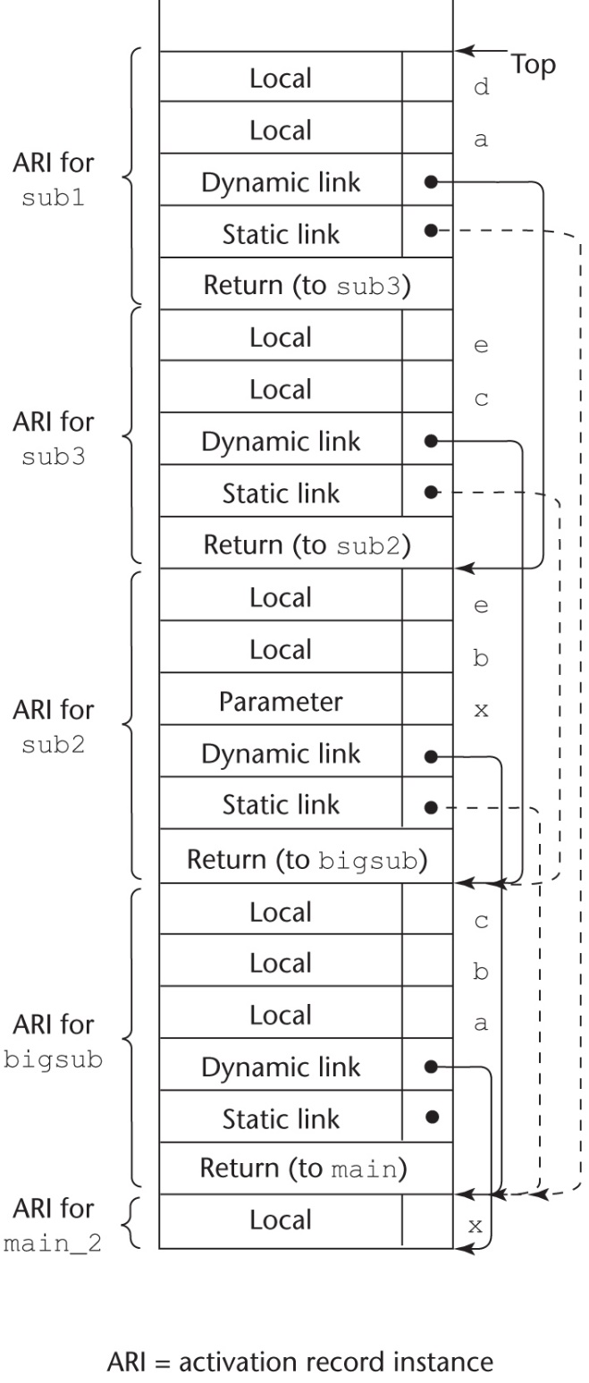
Stack Contents at Position 1
Static Chain Maintenance
At the call,
- The activation record instance must be built
- The dynamic link is just the old stack top pointer
- The static link must point to the most recent ari of the static parent
- Two methods:
1. Search the dynamic chain
2. Treat subprogram calls and
definitions like variable references
and definitions
Copyright © 2017 Pearson Education, Ltd. All rights reserved.
1-<number>

Slide 29
Evaluation of Static Chains
Problems:
1. A nonlocal areference is slow if the
nesting depth is large
2. Time-critical code is difficult:
a. Costs of nonlocal references are
difficult to determine
b. Code changes can change the
nesting depth, and therefore the cost
Copyright © 2017 Pearson Education, Ltd. All rights reserved.
1-<number>

Slide 30
Blocks
Blocks are user-specified local scopes for variables
An example in C
{int temp;
temp = list [upper];
list [upper] = list [lower];
list [lower] = temp
}
The lifetime of temp in the above example begins when control enters the block
An advantage of using a local variable like temp is that it cannot interfere with any other variable with the same name
Copyright © 2017 Pearson Education, Ltd. All rights reserved.
1-<number>

Slide 31
Implementing Blocks
Two Methods:
  Treat blocks as parameter-less subprograms that are always called from the same location
    Every block has an activation record; an instance is created every time the block is executed
  2. Since the maximum storage required for a block can be statically determined, this amount of space can be allocated after the local variables in the activation record
Copyright © 2017 Pearson Education, Ltd. All rights reserved.
1-<number>

Slide 32
Implementing Dynamic Scoping
Deep Access: non-local references are found by searching the activation record instances on the dynamic chain
- Length of the chain cannot be statically
determined
- Every activation record instance must
have variable names
Shallow Access: put locals in a central place
  One stack for each variable name
  Central table with an entry for each variable name
Copyright © 2017 Pearson Education, Ltd. All rights reserved.
1-<number>

Slide 33
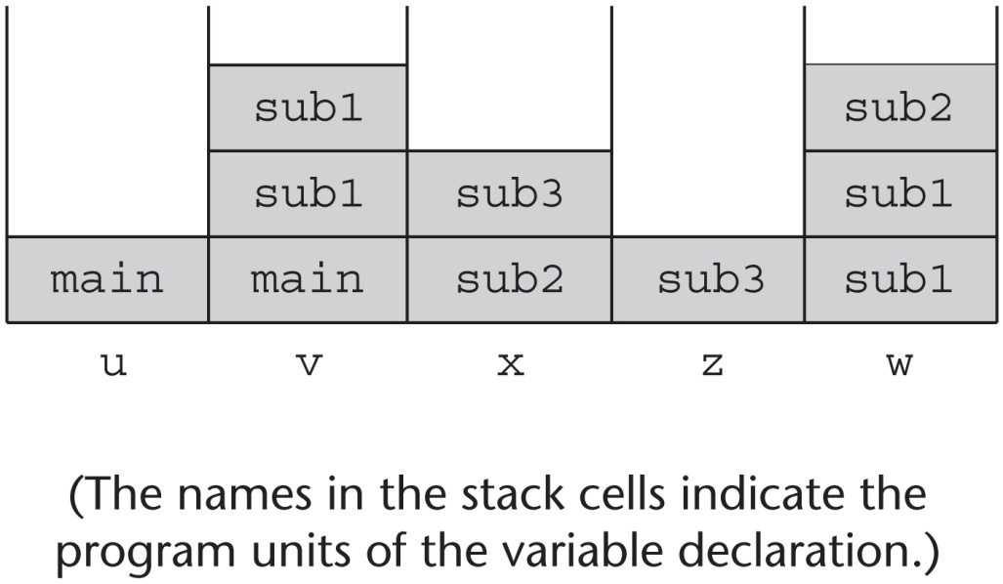
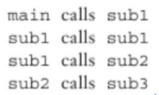

Using Shallow Access to Implement Dynamic Scoping
void sub3() {
int x, z;
x = u + v;
…
}
void sub2() {
int w, x;
…
}
void sub1() {
int v, w;
…
}
void main() {
int v, u;
…
}
Copyright © 2017 Pearson Education, Ltd. All rights reserved.
1-<number>

Slide 34
Summary
Subprogram linkage semantics requires many action by the implementation
Simple subprograms have relatively basic actions
Stack-dynamic languages are more complex
Subprograms with stack-dynamic local variables and nested subprograms have two components
  actual code
  activation record
Copyright © 2017 Pearson Education, Ltd. All rights reserved.
1-<number>

Slide 35
Summary (continued)
Activation record instances contain formal parameters and local variables among other things
Static chains are the primary method of implementing accesses to non-local variables in static-scoped languages with nested subprograms
Access to non-local variables in dynamic-scoped languages can be implemented by use of the dynamic chain or thru some central variable table method
Copyright © 2017 Pearson Education, Ltd. All rights reserved.
1-<number>

