Slide 1
Chapter 6
Data Types

Slide 2
Chapter 6 Topics
Introduction
Primitive Data Types
Character String Types
Enumeration Types
Array Types
Associative Arrays
Record Types
Tuple Types
List Types
Union Types
Pointer and Reference Types
Type Checking
Strong Typing
Type Equivalence
Theory and Data Types
Copyright © 2017 Pearson Education, Ltd. All rights reserved.
1-<number>

Slide 3
Introduction
A data type defines a collection of data objects and a set of predefined operations on those objects
A descriptor is the collection of the attributes of a variable
An object represents an instance of a user-defined (abstract data) type
One design issue for all data types: What operations are defined and how are they specified?
Copyright © 2017 Pearson Education, Ltd. All rights reserved.
1-<number>

Slide 4
Primitive Data Types
Almost all programming languages provide a set of primitive data types
Primitive data types: Those not defined in terms of other data types
Some primitive data types are merely reflections of the hardware
Others require only a little non-hardware support for their implementation
Copyright © 2017 Pearson Education, Ltd. All rights reserved.
1-<number>

Slide 5
Primitive Data Types: Integer
Almost always an exact reflection of the hardware so the mapping is trivial
There may be as many as eight different integer types in a language
Java’s signed integer sizes: byte, short, int, long
Copyright © 2017 Pearson Education, Ltd. All rights reserved.
1-<number>

Slide 6
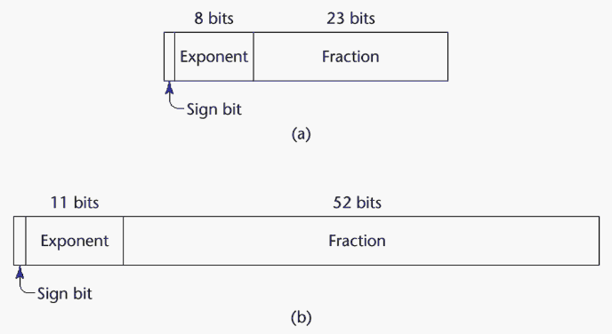
Primitive Data Types: Floating Point
Model real numbers, but only as approximations
Languages for scientific use support at least two floating-point types (e.g., float and double; sometimes more
Usually exactly like the hardware, but not always
IEEE Floating-Point
Standard 754
Copyright © 2017 Pearson Education, Ltd. All rights reserved.
1-<number>

Slide 7
Primitive Data Types: Complex
Some languages support a complex type, e.g., C99, Fortran, and Python
Each value consists of two floats, the real part and the imaginary part
Literal form (in Python):
(7 + 3j), where 7 is the real part and 3 is the imaginary part
Copyright © 2017 Pearson Education, Ltd. All rights reserved.
1-<number>

Slide 8
Primitive Data Types: Decimal
For business applications (money)
  Essential to COBOL
  C# offers a decimal data type
Store a fixed number of decimal digits, in coded form (BCD)
Advantage: accuracy
Disadvantages: limited range, wastes memory
Copyright © 2017 Pearson Education, Ltd. All rights reserved.
1-<number>

Slide 9
Primitive Data Types: Boolean
Simplest of all
Range of values: two elements, one for “true” and one for “false”
Could be implemented as bits, but often as bytes
  Advantage: readability
Copyright © 2017 Pearson Education, Ltd. All rights reserved.
1-<number>

Slide 10
Primitive Data Types: Character
Stored as numeric codings
Most commonly used coding: ASCII
An alternative, 16-bit coding: Unicode (UCS-2)
  Includes characters from most natural languages
  Originally used in Java
  C# and JavaScript also support Unicode
32-bit Unicode (UCS-4)
  Supported by Fortran, starting with 2003
Copyright © 2017 Pearson Education, Ltd. All rights reserved.
1-<number>

Slide 11
Character String Types
Values are sequences of characters
Design issues:
  Is it a primitive type or just a special kind of array?
  Should the length of strings be static or dynamic?
Copyright © 2017 Pearson Education, Ltd. All rights reserved.
1-<number>

Slide 12
Character String Types Operations
Typical operations:
  Assignment and copying
  Comparison (=, >, etc.)
  Catenation
  Substring reference
  Pattern matching
Copyright © 2017 Pearson Education, Ltd. All rights reserved.
1-<number>

Slide 13
Character String Type in Certain Languages
C and C++
  Not primitive
  Use char arrays and a library of functions that provide operations
SNOBOL4 (a string manipulation language)
  Primitive
  Many operations, including elaborate pattern matching
Fortran and Python
  Primitive type with assignment and several operations
Java
  Primitive via the String class
Perl, JavaScript, Ruby, and PHP
- Provide built-in pattern matching, using regular
expressions
Copyright © 2017 Pearson Education, Ltd. All rights reserved.
1-<number>

Slide 14
Character String Length Options
Static: COBOL, Java’s String class
Limited Dynamic Length: C and C++
  In these languages, a special character is used to indicate the end of a string’s characters, rather than maintaining the length
Dynamic (no maximum): SNOBOL4, Perl, JavaScript
Copyright © 2017 Pearson Education, Ltd. All rights reserved.
1-<number>

Slide 15
Character String Type Evaluation
Aid to writability
As a primitive type with static length, they are inexpensive to provide--why not have them?
Dynamic length is nice, but is it worth the expense?
Copyright © 2017 Pearson Education, Ltd. All rights reserved.
1-<number>

Slide 16
Character String Implementation
Static length: compile-time descriptor
Limited dynamic length: may need a run-time descriptor for length (but not in C and C++)
Dynamic length: need run-time descriptor; allocation/deallocation is the biggest implementation problem
Copyright © 2017 Pearson Education, Ltd. All rights reserved.
1-<number>

Slide 17
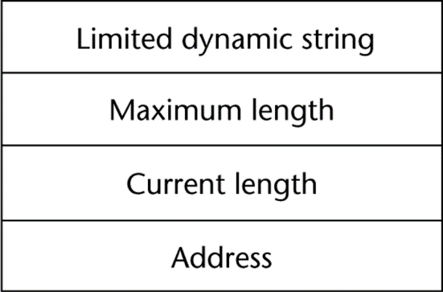
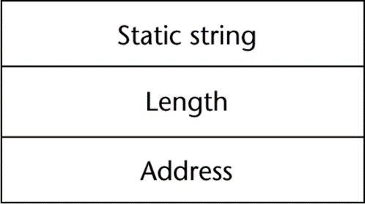
Compile- and Run-Time Descriptors
Compile-time descriptor for static strings
Run-time descriptor for limited dynamic strings
Copyright © 2017 Pearson Education, Ltd. All rights reserved.
1-<number>

Slide 18
User-Defined Ordinal Types
An ordinal type is one in which the range of possible values can be easily associated with the set of positive integers
Examples of primitive ordinal types in Java
  integer
  char
  boolean
Copyright © 2017 Pearson Education, Ltd. All rights reserved.
1-<number>

Slide 19
Enumeration Types
All possible values, which are named constants, are provided in the definition
C# example
  enum days {mon, tue, wed, thu, fri, sat, sun};
Design issues
  Is an enumeration constant allowed to appear in more than one type definition, and if so, how is the type of an occurrence of that constant checked?
  Are enumeration values coerced to integer?
  Any other type coerced to an enumeration type?
Copyright © 2017 Pearson Education, Ltd. All rights reserved.
1-<number>

Slide 20
Evaluation of Enumerated Type
Aid to readability, e.g., no need to code a color as a number
Aid to reliability, e.g., compiler can check:
  operations (don’t allow colors to be added)
  No enumeration variable can be assigned a value outside its defined range
  C# and Java 5.0 provide better support for enumeration than C++ because enumeration type variables in these languages are not coerced into integer types
Copyright © 2017 Pearson Education, Ltd. All rights reserved.
1-<number>

Slide 21
Array Types
An array is a homogeneous aggregate of data elements in which an individual element is identified by its position in the aggregate, relative to the first element.
Copyright © 2017 Pearson Education, Ltd. All rights reserved.
1-<number>

Slide 22
Array Design Issues
What types are legal for subscripts?
Are subscripting expressions in element references range checked?
When are subscript ranges bound?
When does allocation take place?
Are ragged or rectangular multidimensional arrays allowed, or both?
What is the maximum number of subscripts?
Can array objects be initialized?
Are any kind of slices supported?
Copyright © 2017 Pearson Education, Ltd. All rights reserved.
1-<number>

Slide 23
Array Indexing
Indexing (or subscripting) is a mapping from indices to elements
array_name (index_value_list) → an element
Index Syntax
  Fortran and Ada use parentheses
    Ada explicitly uses parentheses to show uniformity between array references and function calls because both are mappings
  Most other languages use brackets
Copyright © 2017 Pearson Education, Ltd. All rights reserved.
1-<number>

Slide 24
Arrays Index (Subscript) Types
FORTRAN, C: integer only
Java: integer types only
Index range checking
- C, C++, Perl, and Fortran do not specify
range checking
- Java, ML, C# specify range checking
Copyright © 2017 Pearson Education, Ltd. All rights reserved.
1-<number>

Slide 25
Subscript Binding and Array Categories
Static: subscript ranges are statically bound and storage allocation is static (before run-time)
  Advantage: efficiency (no dynamic allocation)
Fixed stack-dynamic: subscript ranges are statically bound, but the allocation is done at declaration time
  Advantage: space efficiency
Copyright © 2017 Pearson Education, Ltd. All rights reserved.
1-<number>

Slide 26
Subscript Binding and Array Categories (continued)
Fixed heap-dynamic: similar to fixed stack-dynamic: storage binding is dynamic but fixed after allocation (i.e., binding is done when requested and storage is allocated from heap, not stack)
Copyright © 2017 Pearson Education, Ltd. All rights reserved.
1-<number>

Slide 27
Subscript Binding and Array Categories (continued)
Heap-dynamic: binding of subscript ranges and storage allocation is dynamic and can change any number of times
  Advantage: flexibility (arrays can grow or shrink during program execution)
Copyright © 2017 Pearson Education, Ltd. All rights reserved.
1-<number>

Slide 28
Subscript Binding and Array Categories (continued)
C and C++ arrays that include static modifier are static
C and C++ arrays without static modifier are fixed stack-dynamic
C and C++ provide fixed heap-dynamic arrays
C# includes a second array class ArrayList that provides fixed heap-dynamic
Perl, JavaScript, Python, and Ruby support heap-dynamic arrays
Copyright © 2017 Pearson Education, Ltd. All rights reserved.
1-<number>

Slide 29
Array Initialization
Some language allow initialization at the time of storage allocation
  C, C++, Java, C# example
  int list [] = {4, 5, 7, 83}
  Character strings in C and C++
  char name [] = ″freddie″;
  Arrays of strings in C and C++
  char *names [] = {″Bob″, ″Jake″, ″Joe″];
  Java initialization of String objects
  String[] names = {″Bob″, ″Jake″, ″Joe″};
Copyright © 2017 Pearson Education, Ltd. All rights reserved.
1-<number>

Slide 30
Heterogeneous Arrays
A heterogeneous array is one in which the elements need not be of the same type
Supported by Perl, Python, JavaScript, and Ruby
Copyright © 2017 Pearson Education, Ltd. All rights reserved.
1-<number>

Slide 31
Array Initialization
C-based languages
  int list [] = {1, 3, 5, 7}
  char *names [] = {″Mike″, ″Fred″, ″Mary Lou″};
Python
  List comprehensions
  list = [x ** 2 for x in range(12) if x % 3 == 0]
  puts [0, 9, 36, 81] in list
Copyright © 2017 Pearson Education, Ltd. All rights reserved.
1-<number>

Slide 32
Arrays Operations
APL provides the most powerful array processing operations for vectors and matrixes as well as unary operators (for example, to reverse column elements)
Python’s array assignments, but they are only reference changes. Python also supports array catenation and element membership operations
Ruby also provides array catenation
Copyright © 2017 Pearson Education, Ltd. All rights reserved.
1-<number>

Slide 33
Rectangular and Jagged Arrays
A rectangular array is a multi-dimensioned array in which all of the rows have the same number of elements and all columns have the same number of elements
A jagged matrix has rows with varying number of elements
  Possible when multi-dimensioned arrays actually appear as arrays of arrays
C, C++, and Java support jagged arrays
F# and C# support rectangular arrays and jagged arrays
Copyright © 2017 Pearson Education, Ltd. All rights reserved.
1-<number>

Slide 34
Slices
A slice is some substructure of an array; nothing more than a referencing mechanism
Slices are only useful in languages that have array operations
Copyright © 2017 Pearson Education, Ltd. All rights reserved.
1-<number>

Slide 35
Slice Examples
Python
  vector = [2, 4, 6, 8, 10, 12, 14, 16]
  mat = [[1, 2, 3], [4, 5, 6], [7, 8, 9]]
  vector (3:6) is a three-element array
  mat[0][0:2] is the first and second element of the first row of mat
Ruby supports slices with the slice method
  list.slice(2, 2) returns the third and fourth elements of list
Copyright © 2017 Pearson Education, Ltd. All rights reserved.
1-<number>

Slide 36
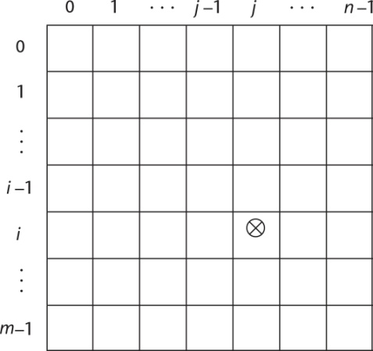
Implementation of Arrays
Access function maps subscript expressions to an address in the array
Access function for single-dimensioned arrays:
address(list[k]) = address (list[lower_bound])
+ ((k-lower_bound) * element_size)
Copyright © 2017 Pearson Education, Ltd. All rights reserved.
1-<number>

Slide 37
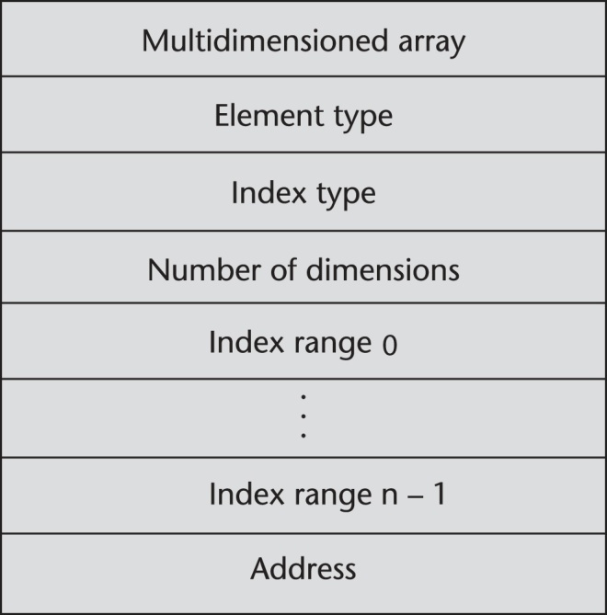
Accessing Multi-dimensioned Arrays
Two common ways:
  Row major order (by rows) – used in most languages
  Column major order (by columns) – used in Fortran
  A compile-time descriptor
  for a multidimensional
  array
Copyright © 2017 Pearson Education, Ltd. All rights reserved.
1-<number>

Slide 38
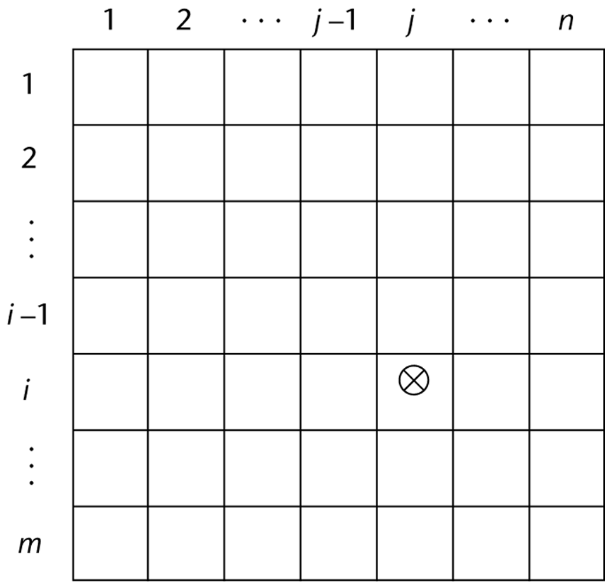
Locating an Element in a Multi-dimensioned Array
General format
  Location (a[I,j]) = address of a [row_lb,col_lb] + (((I - row_lb) * n) + (j - col_lb)) * element_size
Copyright © 2017 Pearson Education, Ltd. All rights reserved.
1-<number>

Slide 39
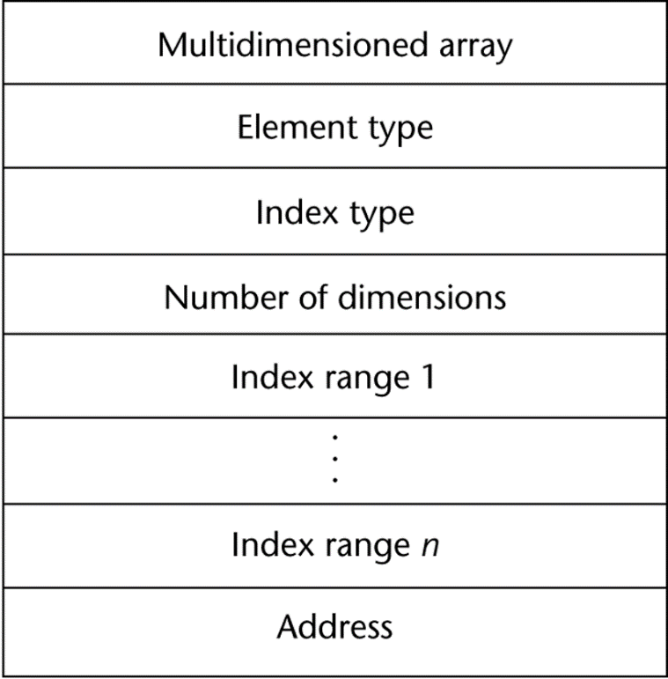
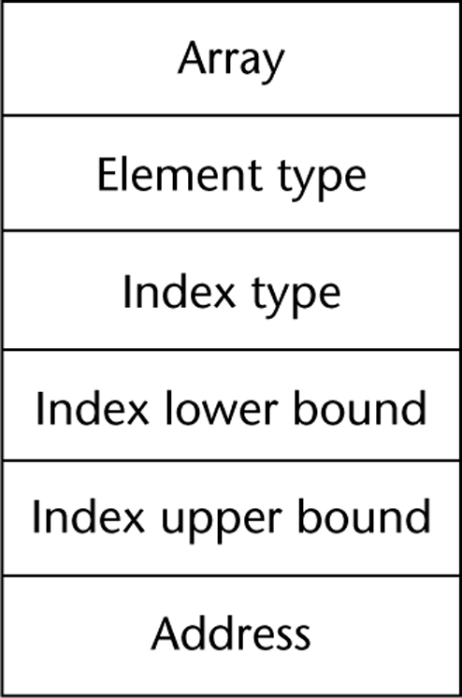
Compile-Time Descriptors
Single-dimensioned array
Multidimensional array
Copyright © 2017 Pearson Education, Ltd. All rights reserved.
1-<number>

Slide 40
Associative Arrays
An associative array is an unordered collection of data elements that are indexed by an equal number of values called keys
  User-defined keys must be stored
Design issues:
- What is the form of references to elements?
- Is the size static or dynamic?
Built-in type in Perl, Python, Ruby, and Lua
  In Lua, they are supported by tables
Copyright © 2017 Pearson Education, Ltd. All rights reserved.
1-<number>

Slide 41
Associative Arrays in Perl
Names begin with %; literals are delimited by parentheses
  %hi_temps = ("Mon" => 77, "Tue" => 79, "Wed" => 65, …);
Subscripting is done using braces and keys
  $hi_temps{"Wed"} = 83;
  Elements can be removed with delete
  delete $hi_temps{"Tue"};
Copyright © 2017 Pearson Education, Ltd. All rights reserved.
1-<number>

