Slide 1
Chapter 9
Subprograms

Slide 2
Chapter 9 Topics
Introduction
Fundamentals of Subprograms
Design Issues for Subprograms
Local Referencing Environments
Parameter-Passing Methods
Parameters That Are Subprograms
Calling Subprograms Indirectly
Design Issues for Functions
Overloaded Subprograms
Generic Subprograms
User-Defined Overloaded Operators
Closures
Coroutines
Copyright © 2017 Pearson Education, Ltd. All rights reserved.
1-<number>

Slide 3
Introduction
Two fundamental abstraction facilities
  Process abstraction
    Emphasized from early days
    Discussed in this chapter
  Data abstraction
    Emphasized in the1980s
    Discussed at length in Chapter 11
Copyright © 2017 Pearson Education, Ltd. All rights reserved.
1-<number>

Slide 4
Fundamentals of Subprograms
Each subprogram has a single entry point
The calling program is suspended during execution of the called subprogram
Control always returns to the caller when the called subprogram’s execution terminates
Copyright © 2017 Pearson Education, Ltd. All rights reserved.
1-<number>

Slide 5
Basic Definitions
A subprogram definition describes the interface to and the actions of the subprogram abstraction
  In Python, function definitions are executable; in all other languages, they are non-executable
  In Ruby, function definitions can appear either in or outside of class definitions. If outside, they are methods of Object. They can be called without an object, like a function
  In Lua, all functions are anonymous
A subprogram call is an explicit request that the subprogram be executed
A subprogram header is the first part of the definition, including the name, the kind of subprogram, and the formal parameters
The parameter profile (aka signature) of a subprogram is the number, order, and types of its parameters
The protocol is a subprogram’s parameter profile and, if it is a function, its return type
Copyright © 2017 Pearson Education, Ltd. All rights reserved.
1-<number>

Slide 6
Basic Definitions (continued)
Function declarations in C and C++ are often called prototypes
A subprogram declaration provides the protocol, but not the body, of the subprogram
A formal parameter is a dummy variable listed in the subprogram header and used in the subprogram
An actual parameter represents a value or address used in the subprogram call statement
Copyright © 2017 Pearson Education, Ltd. All rights reserved.
1-<number>

Slide 7
Actual/Formal Parameter Correspondence
Positional
  The binding of actual parameters to formal parameters is by position: the first actual parameter is bound to the first formal parameter and so forth
  Safe and effective
Keyword
  The name of the formal parameter to which an actual parameter is to be bound is specified with the actual parameter
  Advantage: Parameters can appear in any order, thereby avoiding parameter correspondence errors
  Disadvantage: User must know the formal parameter’s names
Copyright © 2017 Pearson Education, Ltd. All rights reserved.
1-<number>

Slide 8
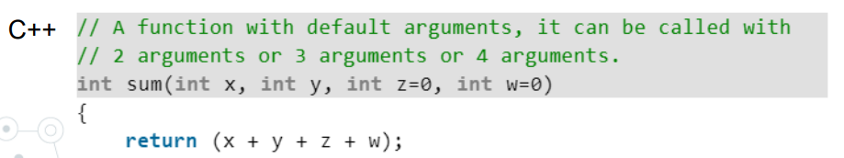
Formal Parameter Default Values
In certain languages (e.g., C++, Python, Ruby, PHP), formal parameters can have default values (if no actual parameter is passed)
  In C++, default parameters must appear last because parameters are positionally associated (no keyword parameters)
Variable numbers of parameters
  C# methods can accept a variable number of parameters as long as they are of the same type—the corresponding formal parameter is an array preceded by params
  In Ruby, the actual parameters are sent as elements of a hash literal and the corresponding formal parameter is preceded by an asterisk.
Copyright © 2017 Pearson Education, Ltd. All rights reserved.
1-<number>

Slide 9
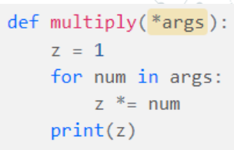
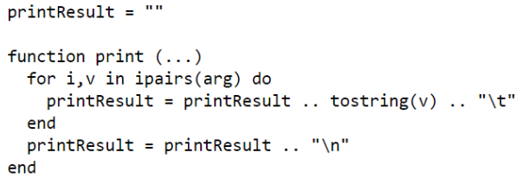
Variable Numbers of Parameters (continued)
  In Python, the actual is a list of values and the corresponding formal parameter is a name with an asterisk
  In Lua, a variable number of parameters is represented as a formal parameter with three periods; they are accessed with a for statement or with a multiple assignment from the three periods
Copyright © 2017 Pearson Education, Ltd. All rights reserved.
1-<number>

Slide 10
Procedures and Functions
There are two categories of subprograms
  Procedures are collection of statements that define parameterized computations
  Functions structurally resemble procedures but are semantically modeled on mathematical functions
    They are expected to produce no side effects
    In practice, program functions have side effects
Copyright © 2017 Pearson Education, Ltd. All rights reserved.
1-<number>

Slide 11
Design Issues for Subprograms
Are local variables static or dynamic?
Can subprogram definitions appear in other subprogram definitions?
What parameter passing methods are provided?
Are parameter types checked?
If subprograms can be passed as parameters and subprograms can be nested, what is the referencing environment of a passed subprogram?
Are functional side effects allowed?
What types of values can be returned from functions?
How many values can be returned from functions?
Can subprograms be overloaded?
Can subprogram be generic?
If the language allows nested subprograms, are closures supported?
Copyright © 2017 Pearson Education, Ltd. All rights reserved.
1-<number>

Slide 12
Local Referencing Environments
Local variables can be stack-dynamic
- Advantages
    Support for recursion
    Storage for locals is shared among some subprograms
  Disadvantages
    Allocation/de-allocation, initialization time
    Indirect addressing
    Subprograms cannot be history sensitive
Local variables can be static
  Advantages and disadvantages are the opposite of those for stack-dynamic local variables
Copyright © 2017 Pearson Education, Ltd. All rights reserved.
1-<number>

Slide 13
Local Referencing Environments: Examples
In most contemporary languages, locals are stack dynamic
In C-based languages, locals are by default stack dynamic, but can be declared static
The methods of C++, Java, Python, and C# only have stack dynamic locals
In Lua, all implicitly declared variables are global; local variables are declared with local and are stack dynamic
Copyright © 2017 Pearson Education, Ltd. All rights reserved.
1-<number>

Slide 14
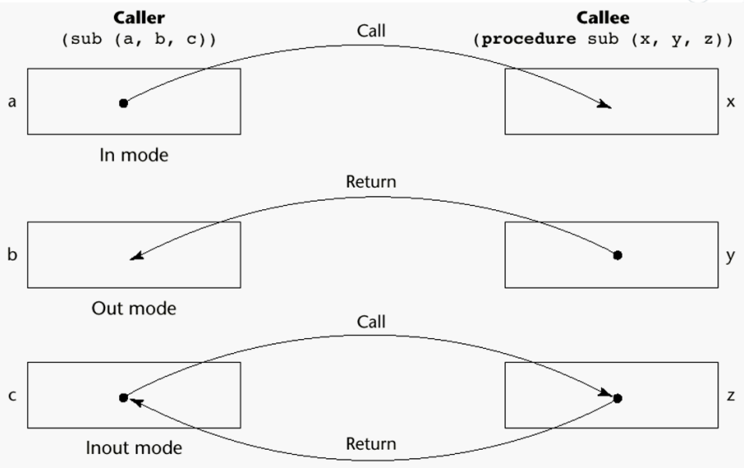
Semantic Models of Parameter Passing
In mode
Out mode
Inout mode
Copyright © 2017 Pearson Education, Ltd. All rights reserved.
1-<number>

Slide 15
Conceptual Models of Transfer
Physically move a value
Move an access path to a value
Copyright © 2017 Pearson Education, Ltd. All rights reserved.
1-<number>

Slide 16
Pass-by-Value (In Mode)
The value of the actual parameter is used to initialize the corresponding formal parameter
  Normally implemented by copying
  Can be implemented by transmitting an access path but not recommended (enforcing write protection is not easy)
  Disadvantages (if by physical move): additional storage is required (stored twice) and the actual move can be costly (for large parameters)
  Disadvantages (if by access path method): must write-protect in the called subprogram and accesses cost more (indirect addressing)
Copyright © 2017 Pearson Education, Ltd. All rights reserved.
1-<number>

Slide 17
Pass-by-Result (Out Mode)
When a parameter is passed by result, no value is transmitted to the subprogram; the corresponding formal parameter acts as a local variable; its value is transmitted to caller’s actual parameter when control is returned to the caller, by physical move
  Require extra storage location and copy operation
Potential problems:
  sub(p1, p1); whichever formal parameter is copied back will represent the current value of p1
  sub(list[sub], sub); Compute address of list[sub] at the beginning of the subprogram or end?
Copyright © 2017 Pearson Education, Ltd. All rights reserved.
1-<number>

Slide 18
Pass-by-Value-Result (inout Mode)
A combination of pass-by-value and pass-by-result
Sometimes called pass-by-copy
Formal parameters have local storage
Disadvantages:
  Those of pass-by-result
  Those of pass-by-value
Copyright © 2017 Pearson Education, Ltd. All rights reserved.
1-<number>

Slide 19
Pass-by-Reference (Inout Mode)
Pass an access path
Also called pass-by-sharing
Advantage: Passing process is efficient (no copying and no duplicated storage)
Disadvantages
  Slower accesses (compared to pass-by-value) to formal parameters
  Potentials for unwanted side effects (collisions)
  Unwanted aliases (access broadened)
  fun(total, total); fun(list[i], list[j]; fun(list[i], i);
Copyright © 2017 Pearson Education, Ltd. All rights reserved.
1-<number>

Slide 20
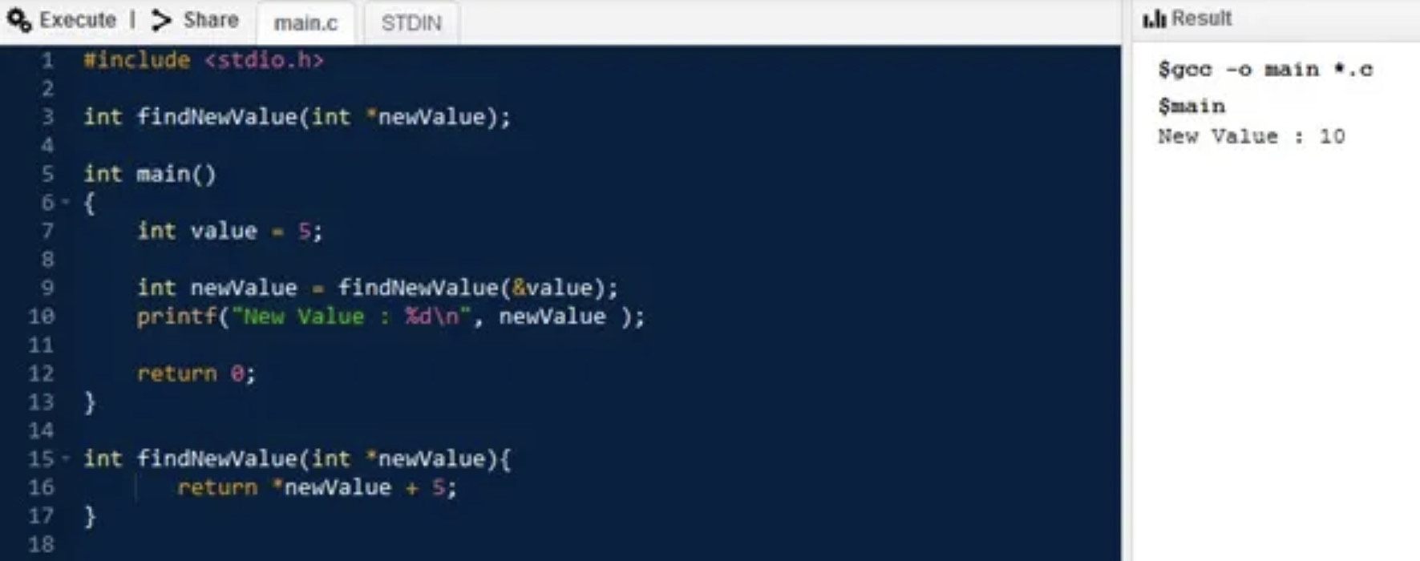
Pass-by-Reference
Copyright © 2017 Pearson Education, Ltd. All rights reserved.
1-<number>

Slide 21
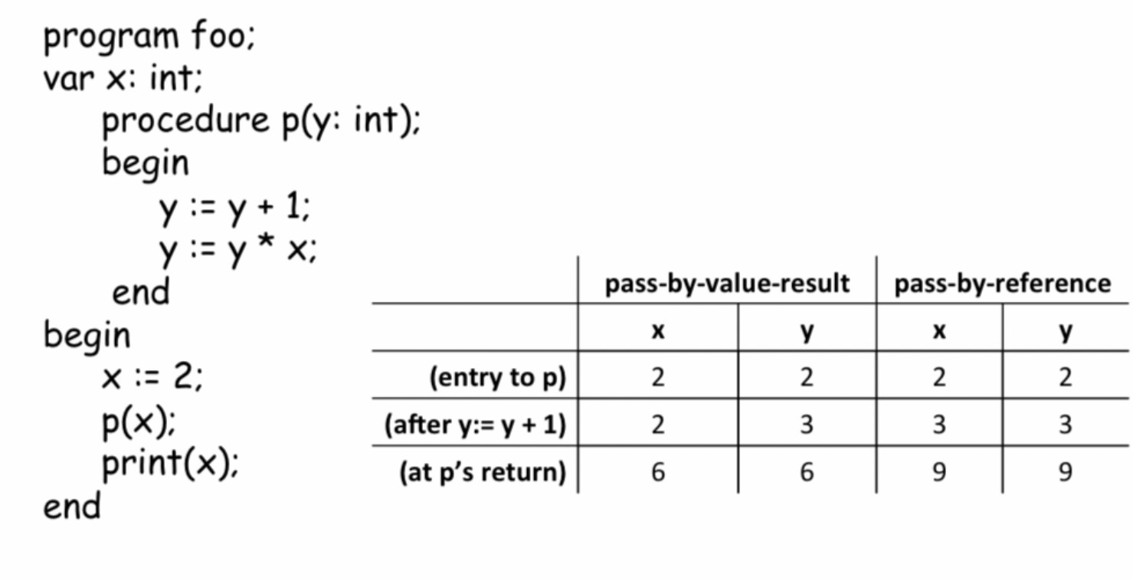
Pass-by-Reference X Pass-by-Value-Result
Copyright © 2017 Pearson Education, Ltd. All rights reserved.
1-<number>

Slide 22
Pass-by-Name (Inout Mode)
By textual substitution
Formals are bound to an access method at the time of the call, but actual binding to a value or address takes place at the time of a reference or assignment
Allows flexibility in late binding
Implementation requires that the referencing environment of the caller is passed with the parameter, so the actual parameter address can be calculated
Copyright © 2017 Pearson Education, Ltd. All rights reserved.
1-<number>

Slide 23
Implementing Parameter-Passing Methods
In most languages parameter communication takes place thru the run-time stack
Pass-by-reference are the simplest to implement; only an address is placed in the stack
Copyright © 2017 Pearson Education, Ltd. All rights reserved.
1-<number>

Slide 24
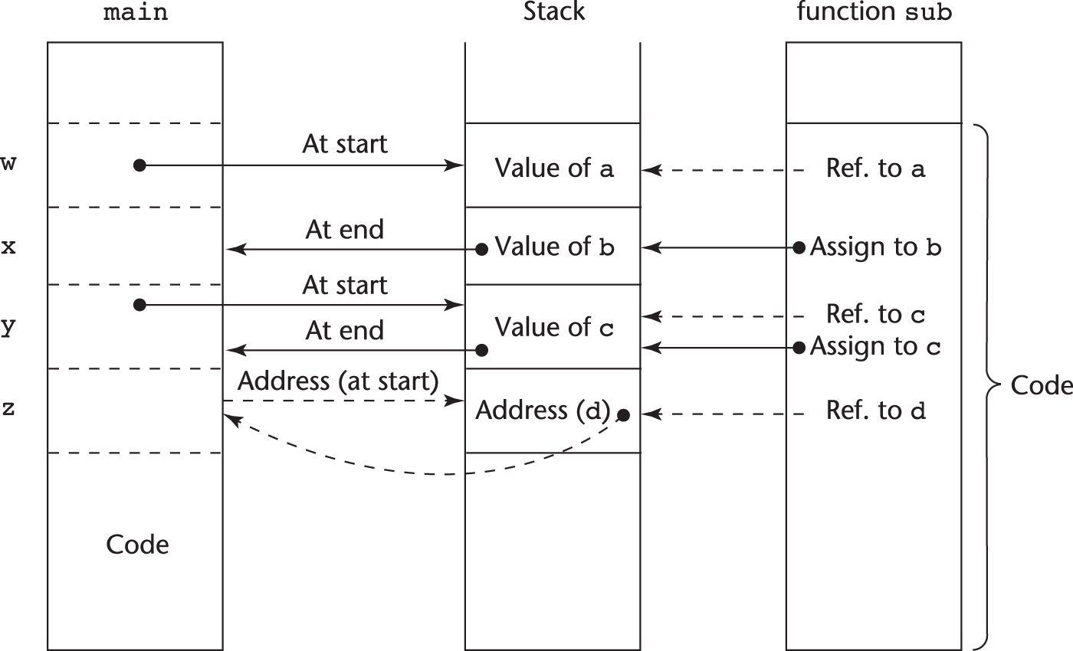
Implementing Parameter-Passing Methods
Function header: void sub(int a, int b, int c, int d)
Function call in main: sub(w, x, y, z)
(pass w by value, x by result, y by value-result, z by reference)
Copyright © 2017 Pearson Education, Ltd. All rights reserved.
1-<number>

Slide 25
Parameter Passing Methods of Major Languages
C
  Pass-by-value
  Pass-by-reference is achieved by using pointers as parameters
C++
  A special pointer type called reference type for pass-by-reference
Java
  All parameters are passed are passed by value
  Object parameters are passed by reference
Copyright © 2017 Pearson Education, Ltd. All rights reserved.
1-<number>

Slide 26
Parameter Passing Methods of Major Languages (continued)
Fortran 95+
- Parameters can be declared to be in, out, or inout mode
C#
- Default method: pass-by-value
  Pass-by-reference is specified by preceding both a formal parameter and its actual parameter with ref
PHP: very similar to C#, except that either the actual or the formal parameter can specify ref
Perl: all actual parameters are implicitly placed in a predefined array named @_
Python and Ruby use pass-by-assignment (all data values are objects); the actual is assigned to the formal
Copyright © 2017 Pearson Education, Ltd. All rights reserved.
1-<number>

Slide 27
Type Checking Parameters
Considered very important for reliability
FORTRAN 77 and original C: none
Pascal and Java: it is always required
ANSI C and C++: choice is made by the user
  Prototypes
Relatively new languages Perl, JavaScript, and PHP do not require type checking
In Python and Ruby, variables do not have types (objects do), so parameter type checking is not possible
Copyright © 2017 Pearson Education, Ltd. All rights reserved.
1-<number>

Slide 28
Multidimensional Arrays as Parameters
If a multidimensional array is passed to a subprogram and the subprogram is separately compiled, the compiler needs to know the declared size of that array to build the storage mapping function
Copyright © 2017 Pearson Education, Ltd. All rights reserved.
1-<number>

Slide 29
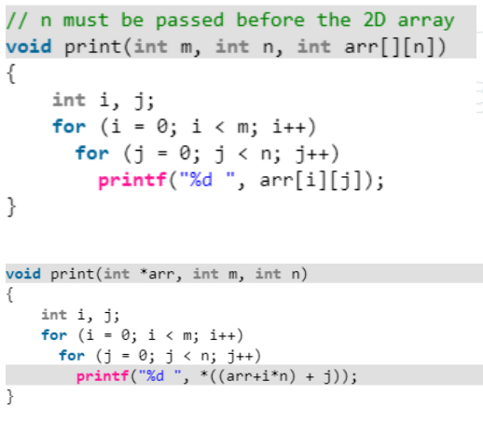
Multidimensional Arrays as Parameters: C and C++
Programmer is required to include the declared sizes of all but the first subscript in the actual parameter
Disallows writing flexible subprograms
Solution: pass a pointer to the array and the sizes of the dimensions as other parameters; the user must include the storage mapping function in terms of the size parameters
Copyright © 2017 Pearson Education, Ltd. All rights reserved.
1-<number>

Slide 30
Multidimensional Arrays as Parameters: Java and C#
Similar to Ada
Arrays are objects; they are all single-dimensioned, but the elements can be arrays
Each array inherits a named constant (length in Java, Length in C#) that is set to the length of the array when the array object is created
Copyright © 2017 Pearson Education, Ltd. All rights reserved.
1-<number>

Slide 31
Design Considerations for Parameter Passing
Two important considerations
  Efficiency
  One-way or two-way data transfer
But the above considerations are in conflict
  Good programming suggest limited access to variables, which means one-way whenever possible
  But pass-by-reference is more efficient to pass structures of significant size
Copyright © 2017 Pearson Education, Ltd. All rights reserved.
1-<number>

Slide 32
Parameters that are Subprogram Names
It is sometimes convenient to pass subprogram names as parameters
Issues:
  Are parameter types checked?
  What is the correct referencing environment for a subprogram that was sent as a parameter?
Copyright © 2017 Pearson Education, Ltd. All rights reserved.
1-<number>

Slide 33
Parameters that are Subprogram Names: Referencing Environment
Shallow binding: The environment of the call statement that enacts the passed subprogram
- Most natural for dynamic-scoped
languages
Deep binding: The environment of the definition of the passed subprogram
- Most natural for static-scoped languages
Ad hoc binding: The environment of the call statement that passed the subprogram
Copyright © 2017 Pearson Education, Ltd. All rights reserved.
1-<number>

Slide 34
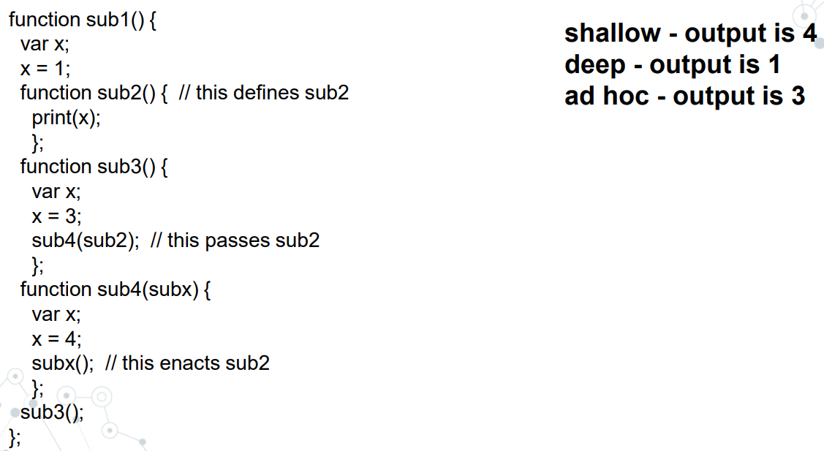

Copyright © 2017 Pearson Education, Ltd. All rights reserved.
1-<number>

Slide 35
Calling Subprograms Indirectly
Usually when there are several possible subprograms to be called and the correct one on a particular run of the program is not know until execution (e.g., event handling and GUIs)
In C and C++, such calls are made through function pointers
Copyright © 2017 Pearson Education, Ltd. All rights reserved.
1-<number>

Slide 36
Calling Subprograms Indirectly (continued)
In C#, method pointers are implemented as objects called delegates
  A delegate declaration:
  public delegate int Change(int x);
  - This delegate type, named Change, can be instantiated with any method that takes an int parameter and returns an int value
  A method: static int fun1(int x) { … }
  Instantiate: Change chgfun1 = new Change(fun1);
  Can be called with: chgfun1(12);
  - A delegate can store more than one address, which is called a multicast delegate
Copyright © 2017 Pearson Education, Ltd. All rights reserved.
1-<number>

Slide 37
Design Issues for Functions
Are side effects allowed?
  Parameters should always be in-mode to reduce side effect (like Ada)
What types of return values are allowed?
  Most imperative languages restrict the return types
  C allows any type except arrays and functions
  C++ is like C but also allows user-defined types
  Java and C# methods can return any type (but because methods are not types, they cannot be returned)
  Python and Ruby treat methods as first-class objects, so they can be returned, as well as any other class
  Lua allows functions to return multiple values
Copyright © 2017 Pearson Education, Ltd. All rights reserved.
1-<number>

Slide 38
Overloaded Subprograms
An overloaded subprogram is one that has the same name as another subprogram in the same referencing environment
  Every version of an overloaded subprogram has a unique protocol
C++, Java, C#, and Ada include predefined overloaded subprograms
In Ada, the return type of an overloaded function can be used to disambiguate calls (thus two overloaded functions can have the same parameters)
Ada, Java, C++, and C# allow users to write multiple versions of subprograms with the same name
Copyright © 2017 Pearson Education, Ltd. All rights reserved.
1-<number>

Slide 39
Generic Subprograms
A generic or polymorphic subprogram takes parameters of different types on different activations
Overloaded subprograms provide ad hoc polymorphism
Subtype polymorphism means that a variable of type T can access any object of type T or any type derived from T (OOP languages)
A subprogram that takes a generic parameter that is used in a type expression that describes the type of the parameters of the subprogram provides parametric polymorphism
- A cheap compile-time substitute for dynamic binding
Copyright © 2017 Pearson Education, Ltd. All rights reserved.
1-<number>

Slide 40
Generic Subprograms (continued)
C++
  Versions of a generic subprogram are created implicitly when the subprogram is named in a call or when its address is taken with the & operator
  Generic subprograms are preceded by a template clause that lists the generic variables, which can be type names or class names
template <class Type>
Type max(Type first, Type second) {
return first > second ? first : second;
}
Copyright © 2017 Pearson Education, Ltd. All rights reserved.
1-<number>

Slide 41
Generic Subprograms (continued)
Java 5.0
- Differences between generics in Java 5.0 and those of C++:
1. Generic parameters in Java 5.0 must be classes
2. Java 5.0 generic methods are instantiated just once as truly generic methods
3. Restrictions can be specified on the range of classes that can be passed to the generic method as generic parameters
4. Wildcard types of generic parameters
Copyright © 2017 Pearson Education, Ltd. All rights reserved.
1-<number>

Slide 42
Generic Subprograms (continued)
Java 5.0 (continued)
  public static <T> T doIt(T[] list) { … }
  - The parameter is an array of generic elements (T is the name of the type)
  - A call:
  doIt<String>(myList);
  Generic parameters can have bounds:
  public static <T extends Comparable> T
  doIt(T[] list) { … }
  The generic type must be of a class that implements the Comparable interface
Copyright © 2017 Pearson Education, Ltd. All rights reserved.
1-<number>

Slide 43
Generic Subprograms (continued)
Java 5.0 (continued)
  Wildcard types
  Collection<?> is a wildcard type for collection classes
  void printCollection(Collection<?> c) {
  for (Object e: c) {
  System.out.println(e);
  }
  }
  - Works for any collection class
Copyright © 2017 Pearson Education, Ltd. All rights reserved.
1-<number>

Slide 44
Generic Subprograms (continued)
C# 2005
- Supports generic methods that are similar to those of Java 5.0
- One difference: actual type parameters in a call can be omitted if the compiler can infer the unspecified type
  Another – C# 2005 does not support wildcards
Copyright © 2017 Pearson Education, Ltd. All rights reserved.
1-<number>

Slide 45
Generic Subprograms (continued)
F#
  Infers a generic type if it cannot determine the type of a parameter or the return type of a function – automatic generalization
  Such types are denoted with an apostrophe and a single letter, e.g., ′a
  Functions can be defined to have generic parameters
  let printPair (x: ′a) (y: ′a) =
  printfn ″%A %A″ x y
  - %A is a format code for any type
  - These parameters are not type constrained
Copyright © 2017 Pearson Education, Ltd. All rights reserved.
1-<number>

Slide 46
Generic Subprograms (continued)
F# (continued)
  If the parameters of a function are used with arithmetic operators, they are type constrained, even if the parameters are specified to be generic
  Because of type inferencing and the lack of type coercions, F# generic functions are far less useful than those of C++, Java 5.0+, and C# 2005+
Copyright © 2017 Pearson Education, Ltd. All rights reserved.
1-<number>

Slide 47
User-Defined Overloaded Operators
Operators can be overloaded in Ada, C++, Python, and Ruby
A Python example
  def __add__ (self, second) :
  return Complex(self.real + second.real,
  self.imag + second.imag)
  Use: To compute x + y, x.__add__(y)
Copyright © 2017 Pearson Education, Ltd. All rights reserved.
1-<number>

Slide 48
Closures
A closure is a subprogram and the referencing environment where it was defined
  The referencing environment is needed if the subprogram can be called from any arbitrary place in the program
  A static-scoped language that does not permit nested subprograms doesn’t need closures
  Closures are only needed if a subprogram can access variables in nesting scopes and it can be called from anywhere
  To support closures, an implementation may need to provide unlimited extent to some variables (because a subprogram may access a nonlocal variable that is normally no longer alive)
Copyright © 2017 Pearson Education, Ltd. All rights reserved.
1-<number>

Slide 49
Closures (continued)
A JavaScript closure:
function makeAdder(x) {
return function(y) {return x + y;}
}
...
var add10 = makeAdder(10);
var add5 = makeAdder(5);
document.write(″add 10 to 20: ″ + add10(20) +
″<br />″);
document.write(″add 5 to 20: ″ + add5(20) +
″<br />″);
- The closure is the anonymous function returned by makeAdder
Copyright © 2017 Pearson Education, Ltd. All rights reserved.
1-<number>

Slide 50
Closures (continued)
C#
  We can write the same closure in C# using a nested anonymous delegate
  Func<int, int> (the return type) specifies a delegate that takes an int as a parameter and returns and int
static Func<int, int> makeAdder(int x) {
return delegate(int y) {return x + y;};
}
...
Func<int, int> Add10 = makeAdder(10);
Func<int, int> Add5 = makeAdder(5);
Console.WriteLine(″Add 10 to 20: {0}″, Add10(20));
Console.WriteLine(″Add 5 to 20: {0}″, Add5(20));
Copyright © 2017 Pearson Education, Ltd. All rights reserved.
1-<number>

Slide 51
Coroutines
A coroutine is a subprogram that has multiple entries and controls them itself – supported directly in Lua
Also called symmetric control: caller and called coroutines are on a more equal basis
A coroutine call is named a resume
The first resume of a coroutine is to its beginning, but subsequent calls enter at the point just after the last executed statement in the coroutine
Coroutines repeatedly resume each other, possibly forever
Coroutines provide quasi-concurrent execution of program units (the coroutines); their execution is interleaved, but not overlapped
Copyright © 2017 Pearson Education, Ltd. All rights reserved.
1-<number>

Slide 52
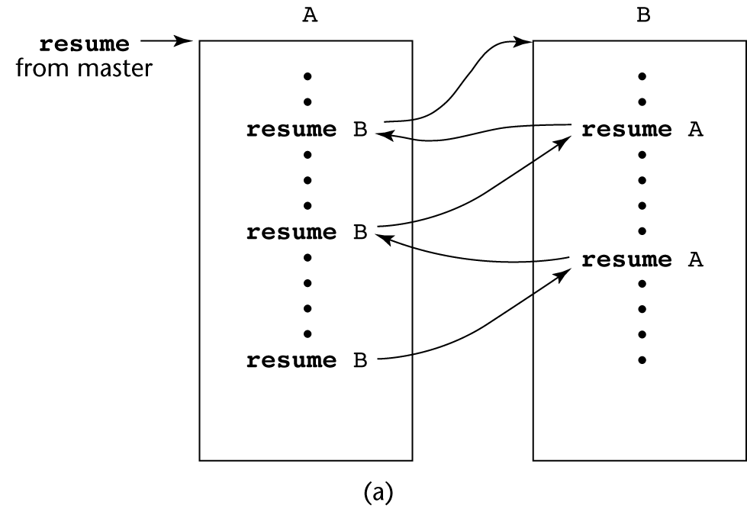
Coroutines Illustrated: Possible Execution Controls
Copyright © 2017 Pearson Education, Ltd. All rights reserved.
1-<number>

Slide 53
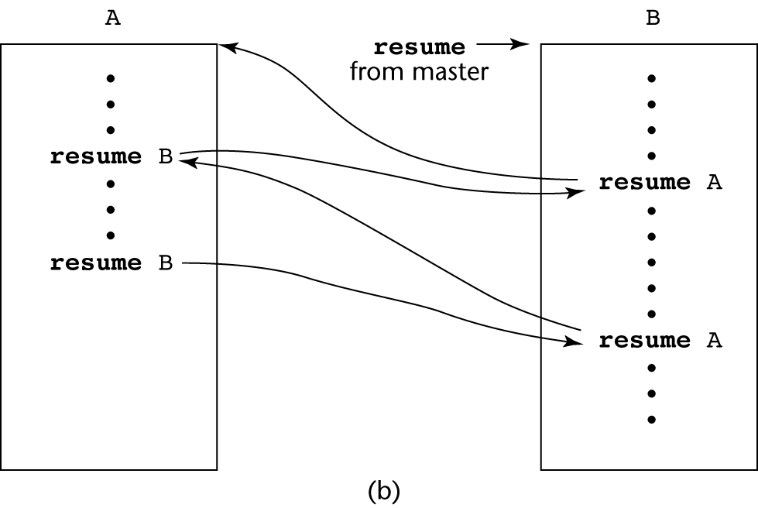
Coroutines Illustrated: Possible Execution Controls
Copyright © 2017 Pearson Education, Ltd. All rights reserved.
1-<number>

Slide 54
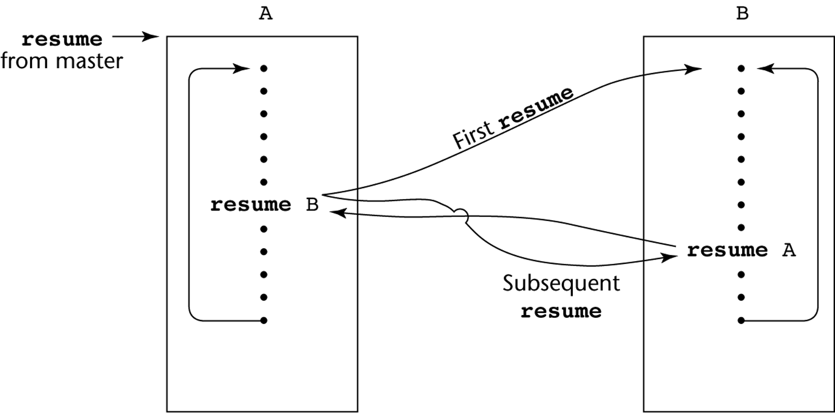
Coroutines Illustrated: Possible Execution Controls with Loops
Copyright © 2017 Pearson Education, Ltd. All rights reserved.
1-<number>

Slide 55
Summary
A subprogram definition describes the actions represented by the subprogram
Subprograms can be either functions or procedures
Local variables in subprograms can be stack-dynamic or static
Three models of parameter passing: in mode, out mode, and inout mode
Some languages allow operator overloading
Subprograms can be generic
A closure is a subprogram and its ref. environment
A coroutine is a special subprogram with multiple entries
Copyright © 2017 Pearson Education, Ltd. All rights reserved.
1-<number>

