Slide 1

Infrared Image Processing Unit
Szilárd Hegedűs

Slide 2
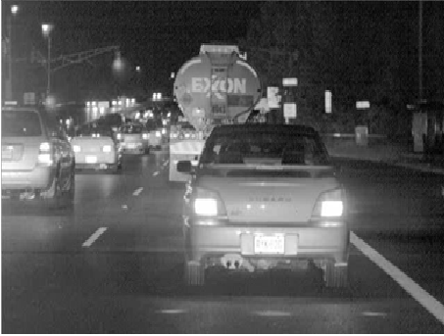

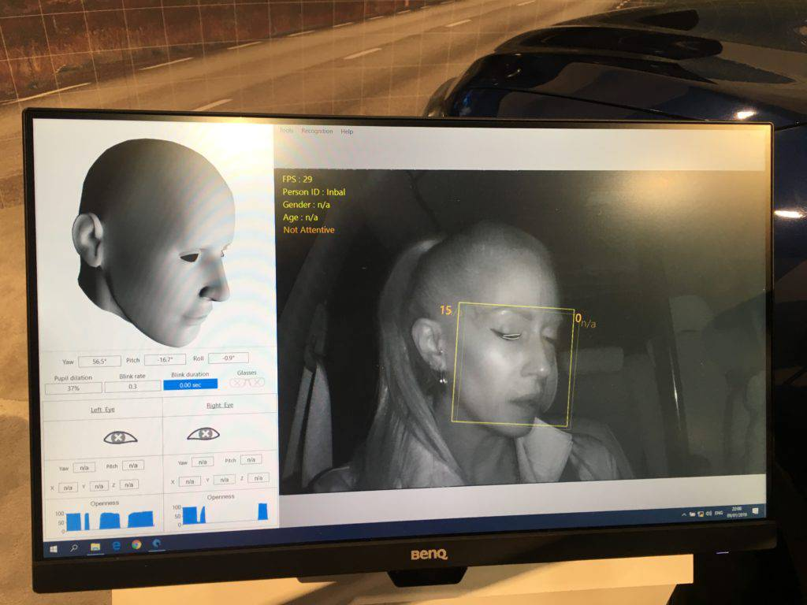
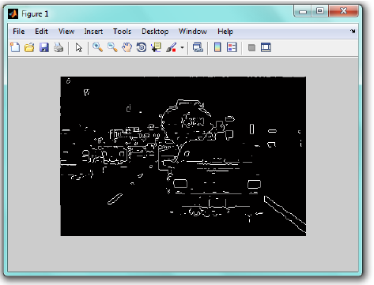
Why inifrared?
Taking over the automotive industry

Slide 3

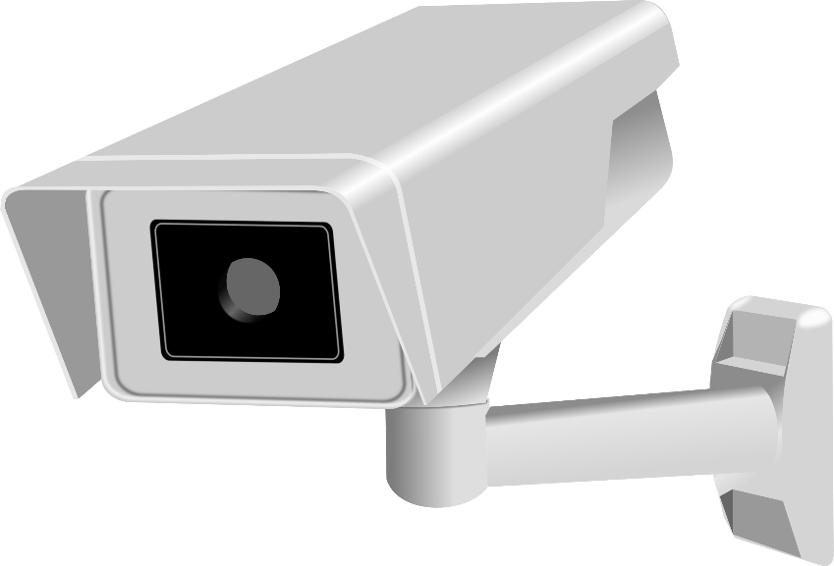
Other applicatios
Medical
Blood analysis
Replacing X-rays with infrared
Tissue analysis
Tumor, cancer detection
Security

Slide 4
Create an architecture for al these applications.
Select the needed features.

Slide 5
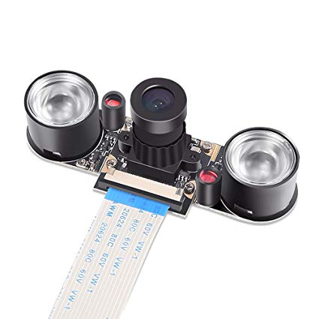
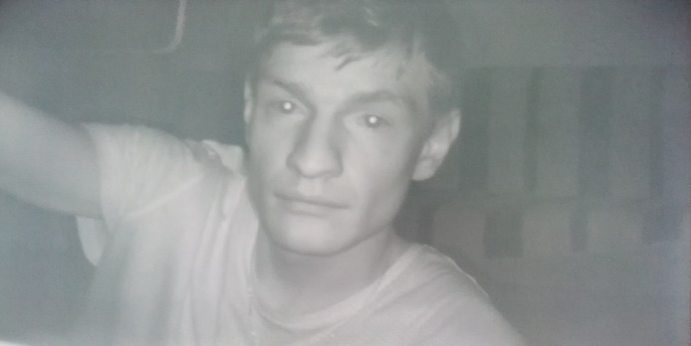
Design overview

Slide 6
Algorithms implemented
Dead/stuck pixel correction
Median filter
Edge detection
Image smoothing
Image sharpening
Note: All these are based upon neighborhood processing and convolutional kernels,
they share the same working mechanism

Slide 7
Creating the 3x3 submatrix

Slide 8
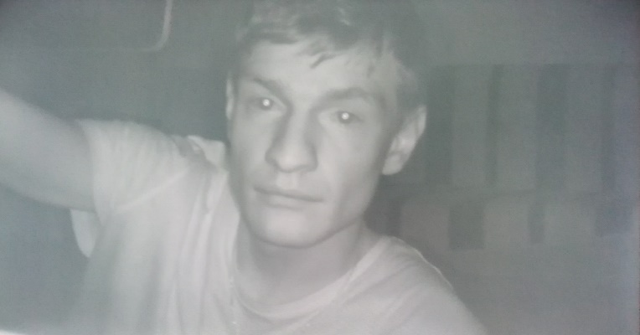
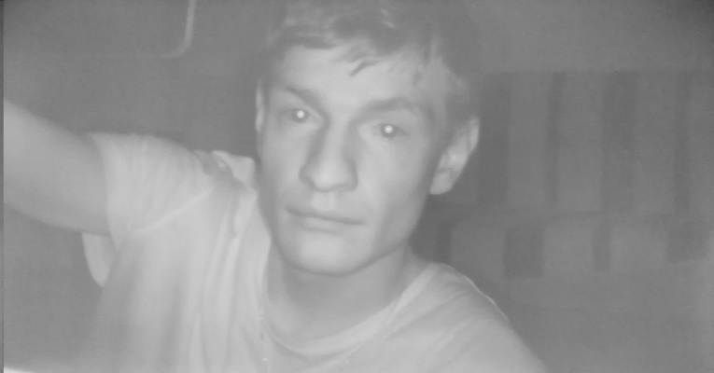
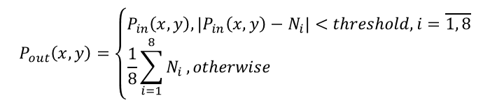
Dead/stuck pixel correction
$$P_{out}\left(x,y\right)=\left\{\begin{matrix}P_{in}\left(x,y\right), \left|P_{in}\left(x,y\right)−N_{i}\right|<threshold, i=\overline{1, 8} \\ \frac{1}{8}\sum_{i=1}^{8}{N_{i}}, otherwise \end{matrix}\right.$$

Slide 9
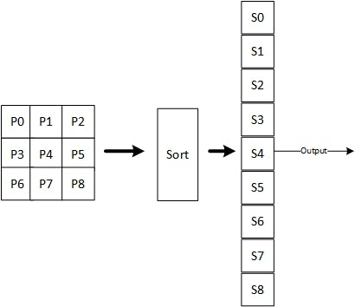
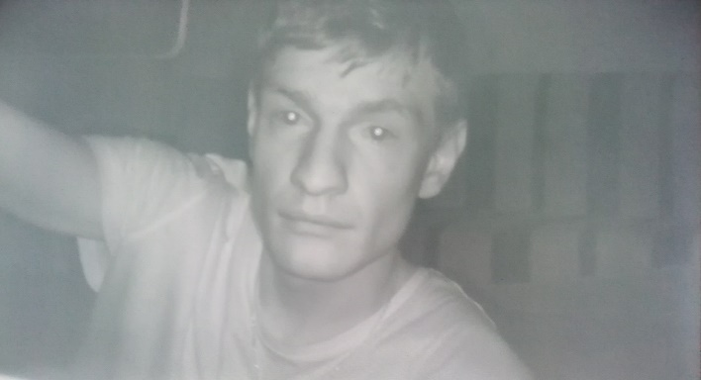
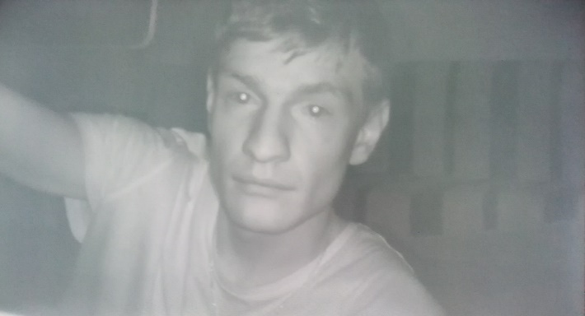
Median filter

Slide 10


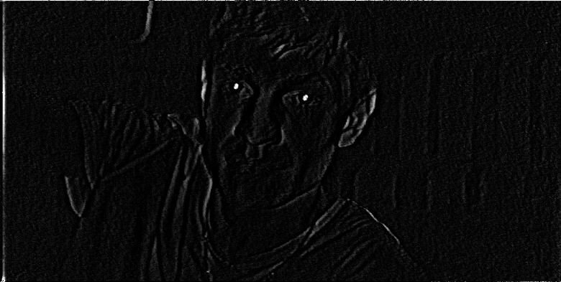
Edge detection

Slide 11

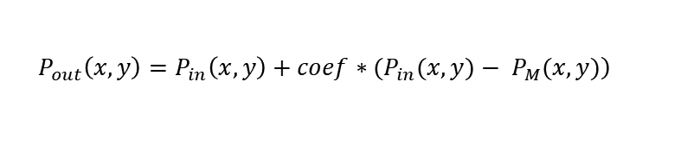
Image sharpening
$$\left.P_{out}\left(x,y\right)=P_{in}\left(x,y\right)+coef∗(P_{in}(x,y)− P_{M}(x,y)\right)$$

Slide 12

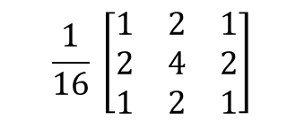
Image smoothing
$$\frac{1}{16} \left[\begin{matrix}1 & 2 & 1 \\ 2 & 4 & 2 \\ 1 & 2 & 1\end{matrix}\right]$$

Slide 13
AXI Read
DDR Memory

Slide 14
Simulation
Create an FPGA environment, simulation in ModelSim:
Interface checkers
Xilinx FIFOs
Register bank
Data injectors (AXI, Frame)
Algorithm check: comparison between the model sim result and Matlab result.
Small differences that cannot be seen with the naked eye.

Slide 15
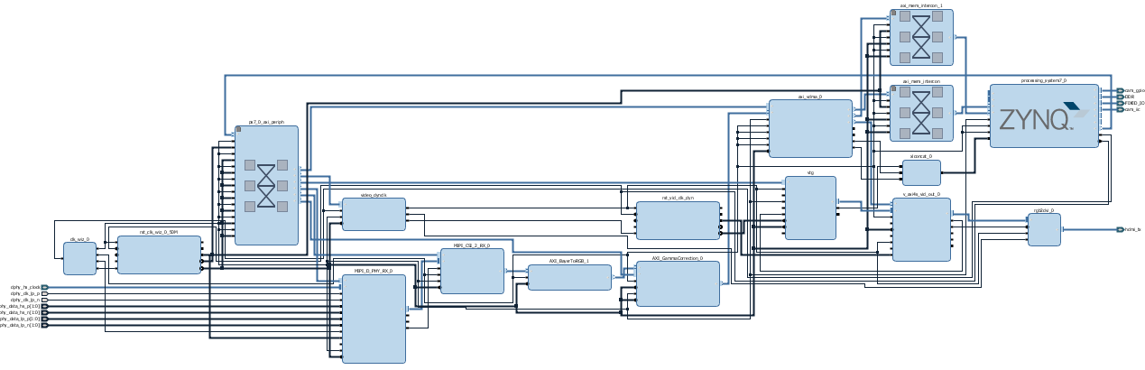
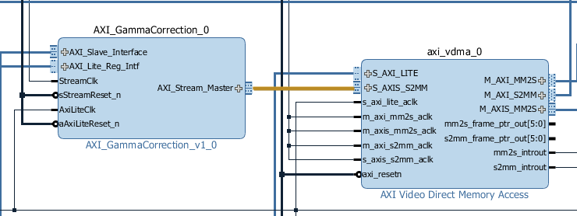
Inserting the module to the Pcam 5C demo
Meets data length requirements
Needs interface conversion from Frame
To AXI Stream

Slide 16
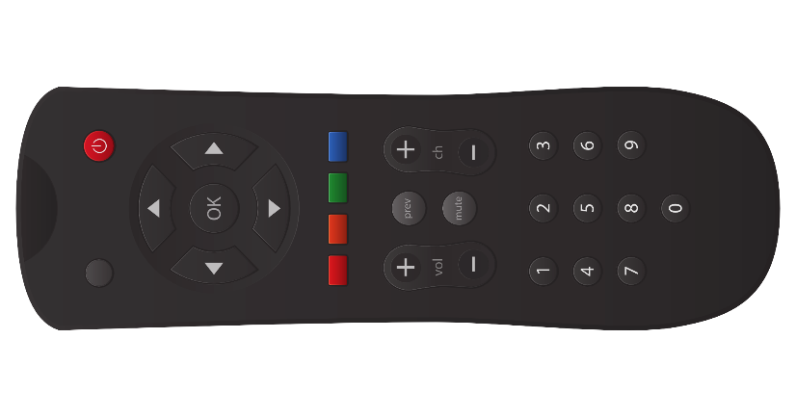
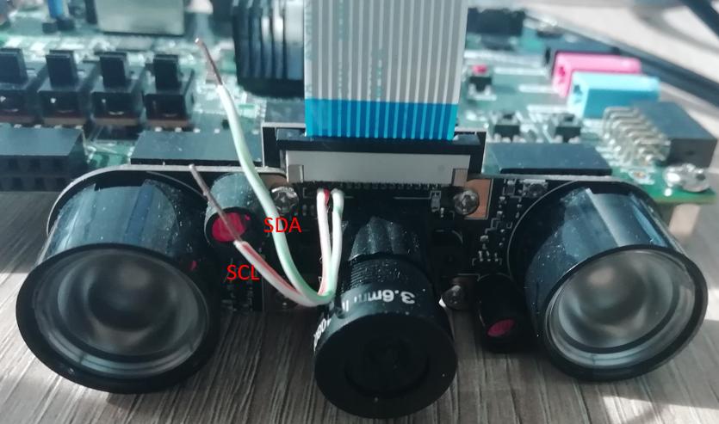
Software
Configuration for OV5647
Solder wires to the I2c pins
Connect camera to Raspberry PI
Connect logic analyzer
Start recording on the Raspberry
Retrieve all data for address 0x36
RGB camera with night vision

Slide 17
Software
Cannot change configuration while enabled
GPIO interrupt handler
Test mode enable
SW2, SW1, SW0 | Filters
0 0 0 | Transparent
0 0 1 | Dead stuck pixel correction
0 1 0 | Median filter
0 1 1 | Laplace filter
1 0 0 | Smoothing filter
1 0 1 | Sharpening filter
1 1 0 | Smooth + Laplace filter
1 1 1 | Smooth + Sharpening + Laplace filter

Slide 18
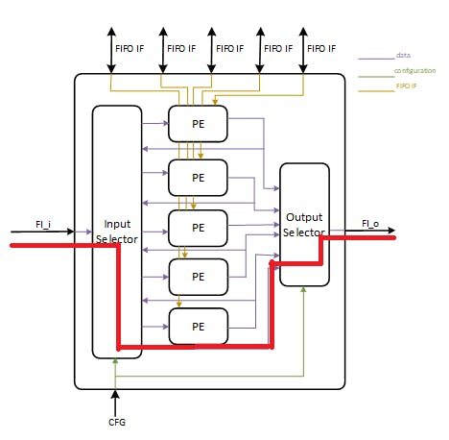
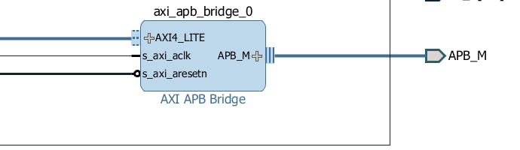
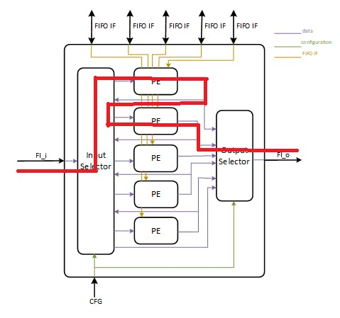
Software
Configurating the hardware
Write registers:
Configure image dimension
Set algorithm succession
Test mode enable/disable
AXI interface parameters: stride, burst size

Slide 19
Software
VDMA interrupt handler

Slide 20

Future work
Increase video resolution: 1080p@60Hz
Increase image processing unit frequency to 150MHz
Process multiple pixels in a clock cycle
Add more complex algorithm eventually neural network based

Slide 21
References
Miman, M., Osman, O. A., & Korkmaz, H. C. (2015). Lane Departure System Design using
with IR Camera for Night-time Road Conditions. Tem Journal, 4(1), 54.
Gonzalez, R. C., & Woods, R. E. (2002). Digital image processing [M].
Publishing house of electronics industry, 141(7).
Maheshwari, R., Rao, S. S. S. P., & Poonacha, P. G. (1997, January). FPGA implementation of
median filter. In Proceedings Tenth International Conference on VLSI Design (pp. 523-524). IEEE.
Diakides, M., Bronzino, J. D., & Peterson, D. R. (Eds.). (2012). Medical infrared imaging:
principles and practices. CRC press.
Zybo Z7 Pcam 5C Demo
https://reference.digilentinc.com/learn/programmable-logic/tutorials/zybo-z7-pcam-5c-demo/start

Slide 22
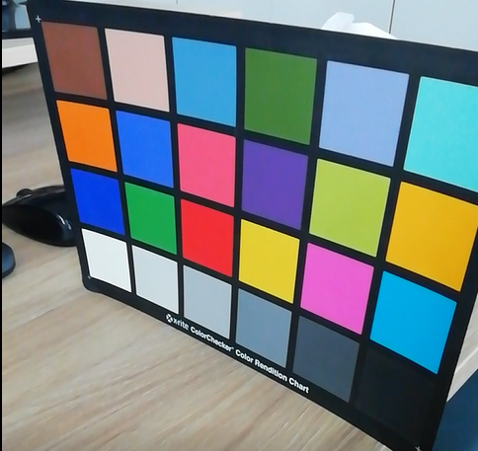
DEMO

