Slide 1
Arxiv.ga summary
From 20200806

Slide 2
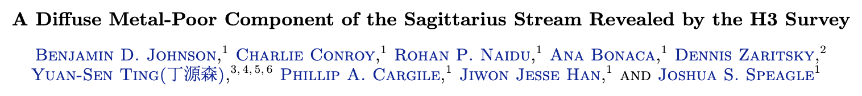
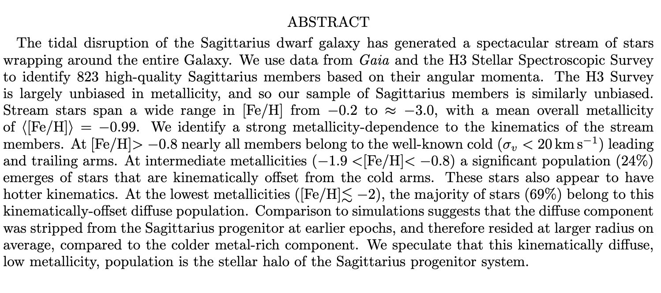
2007.14408.pdf

Slide 3
https://arxiv.org/pdf/2008.00341.pdf by Freeman, W. & Madore B.
Mathematical underpinnings of the multi-wavelength structure of the TRGB
We consider the application of the tip of the red giant branch (TRGB) in the optical and in the near infrared for the determination of distances to nearby galaxies. We analyse ACS VI (F555W & F814W) data and self-consistently cross-calibrate WFC3-IR JH (F110W & F120W) data using and absolute magnitude calibration of MI= -4.05 mag as determined in the LMC using detached eclipsing binary star geometric parallaxes. We demonstrate how the optical and near-infrared calibrations of the TRGB method are mathematically self-consistent, and illustrate the mathematical basis and relations amongst these multi-wavelength calibrations. We go on to present a method for determining the reddening, extinction and the true modulus to the host galaxy using multi-wavelength data. The power of the method is that with high-precision data, the reddening can be determined using the TRGB stars themselves, and decreases the systematic (albeit generally small) uncertainty in distance due to reddening for these halo stars.

Slide 4
https://arxiv.org/pdf/2008.02280.pdf by Iorio, G. & Belokurov V.
We present the results of a multi-component kinematic model of a large sample of RR Lyrae detected by Gaia. By imposing a four-fold symmetry and employing Gaia proper motions, we are able to infer the behaviour of the velocity ellipsoid between≈3and≈30kpc from the centre of the Galaxy. We detect the presence of two distinct components: a dominant non-rotating halo-like population and a much smaller rotating disc-like population. We demonstrate that the halo RR Lyrae can be described as a superposition of an isotropic and radially-biased parts. The radially-biased portion of the halo is characterised by a high orbital anisotropyβ≈0.9and contributes between 50% and 80% of the halo RR Lyrae at5<R(kpc)<25. In line with previous studies, we interpret this high-βcomponent as the debris cloud of the ancient massive merger also known as the Gaia Sausage (GS) whose orbital extrema we constrain. The light curve properties of the RR Lyrae support the kinematic decomposition: the GS stars are more metal-rich and boast higher fractions of Oosterhoff Type 1 and high amplitude short period (HASP) variables compared to the isotropic halo component. The metallicity/HASP maps reveal that the inner 10 kpc of the halo is likely inhabited by the RR Lyrae born in-situ. The mean azimuthal speed and the velocity dispersion of the disc RR Lyrae out toR≈30kpc are consistent with the behaviour of a young and metal-rich thin disc stellar population.

Slide 5
2009.01855.pdf by Carballo-Bello, Martinez-Delgado et al.
We present DECam imaging combined with Gaia DR2 data to study the Canis Major overdensity. The presence of the so-called Blue Plume stars in a low-pollution area of the color-magnitude diagram allows us to derive the distance and proper motions of this stellar feature along the line of sight of its hypothetical core. The stellar overdensity extends on a large area of the sky at low Galactic latitudes, below the plane, and between 230∘<ℓ<255∘. According to the orbit derived for Canis Major, it presents an on-plane rotation around the Milky Way. Moreover, additional overdensities of Blue Plume stars are found around the plane and across the Galaxy, proving that these objects are not only associated with that structure. The spatial distribution of these stars, derived using Gaia astrometric data, confirms that the detection of the Canis Major overdensity results more from the warped structure of the Milky Way disk than from the accretion of a dwarf galaxy.

