Slide 1
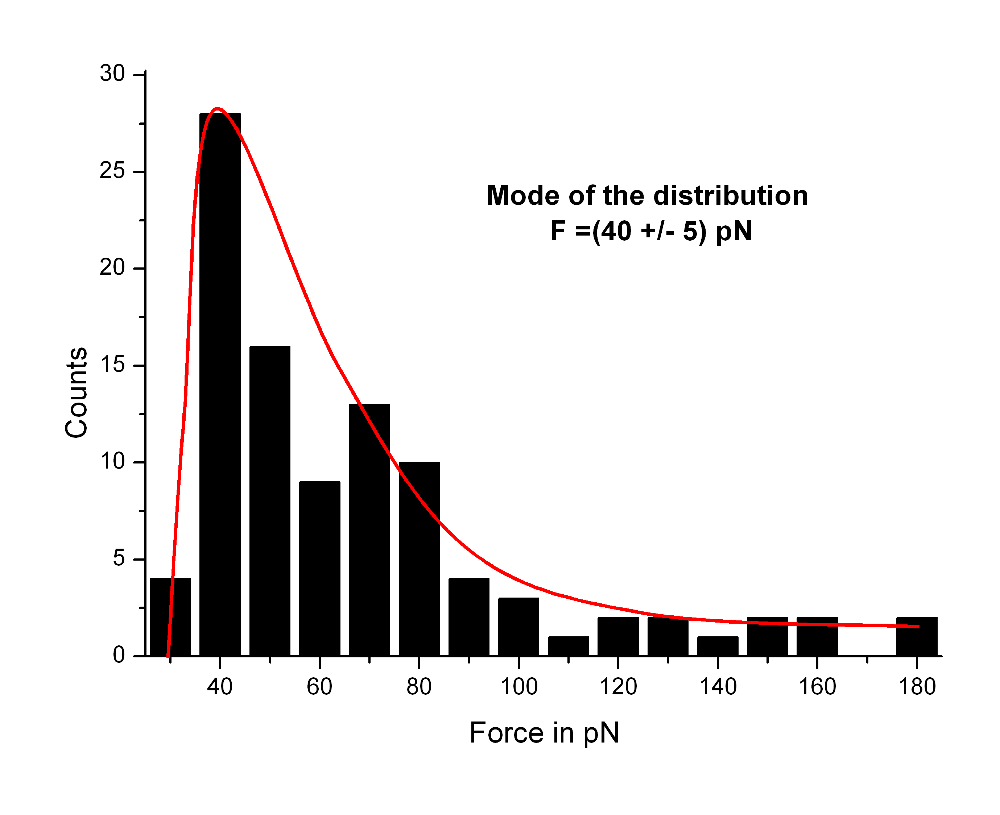
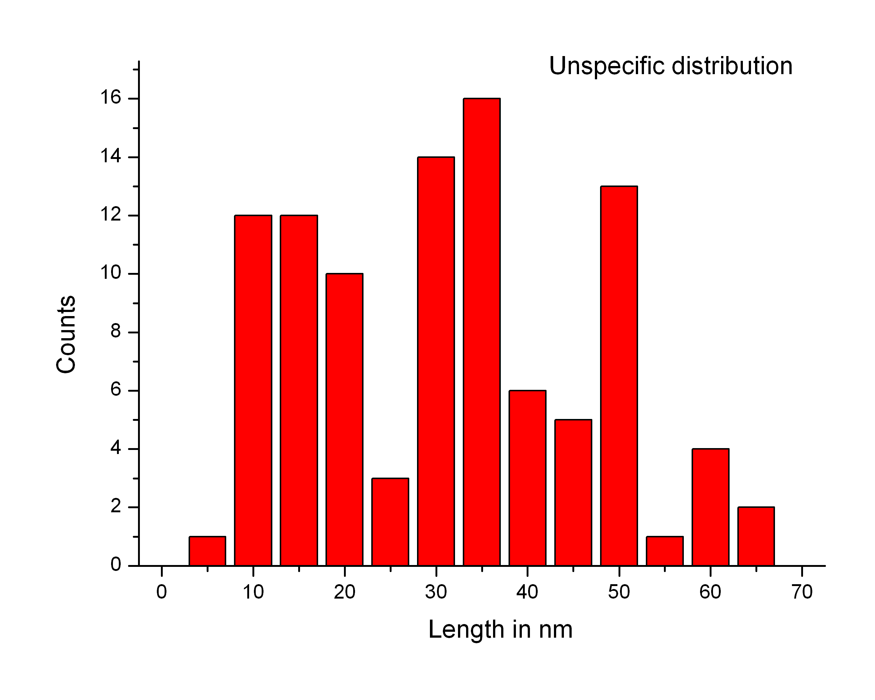
Pulling on type I collagen 10 μg/ml in PBS
Parameters :
Lever : microlever (3rd one) air : 0.04 N/m peak @16kHz liquid : 0.023N/m peak @ ~3.5kHz
Freq :0.842Hz Av. Load= 7 nN
Pulling length 500nm, Population : 1518 curves
Deflection sens. :75nmV % events : 6.25 %
sampling : 2048
03-10-14

Slide 2
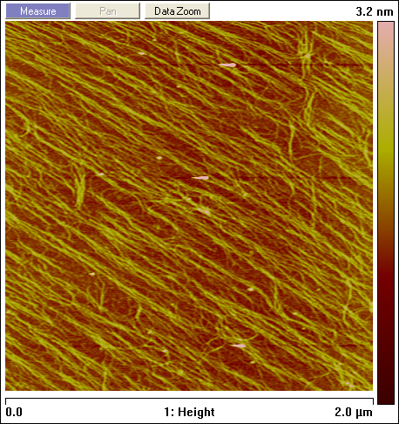
Confirmation of the surface coverage
Micro cantilever tips (Olympus) : RF : 342.7, DA 42.6mv for RMS=1.32
➔ Dry tapping
03-10-14

