Slide 1
IEEE Fraud Detection
Final Project for Supervised Learning
Notes:
Hi, thank you very much for listening. This is presentation of IEEE Fraud Detection which I selected for Final Project of Supervised learning

Slide 2
Table of contents
Purpose and Data
NaN vs Probability of Fraud
Feature in Time Domain
Encoding Categorical Columns
Train and Validation Plan
Random Forest Classifier
XG Boost Classifier
Conclusion
Notes:
This video consists of how to deal with NaN, Time Series Features, and Categorical values.
Then compare RF and XGB.

Slide 3
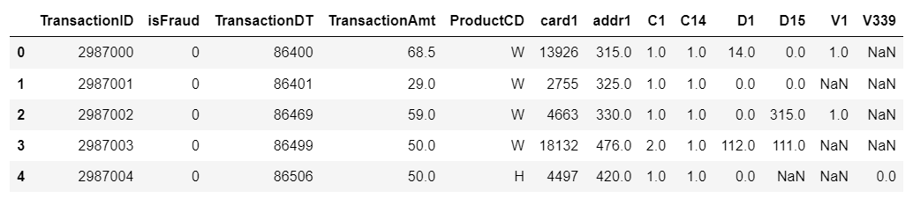
Purpose and Data
Project Title: IEEE Fraud Detection in Kaggle Competition
https://www.kaggle.com/competitions/ieee-fraud-detection/data
Purpose:
To achieve AUC 0.900 at detecting fraud
Problems in Data
Imbalance: only 3.5% of Y is positive
Both categorical and numeric columns exist
Lots of NaNs
Y: 3.5% positive in train data (imbalanced)
590540 (train)
506691 (test)
394 columns
Notes:
The purpose of this projet is to achieve AUC 0.9. This data has problems which needs preprocessing. First, data is imbalanced. Only 3.5 s positive. Data consists of half million rows and 400 cols.

Slide 4
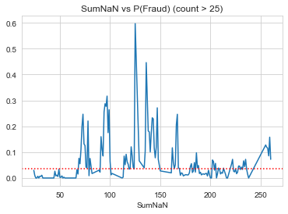
#NaN vs Probability of Fraud
NaN is information
SumNaN: How many NaN exist in a row?
Before dropping columns NaN[%] > 70%
Overall P(Fraud) = 3.5%
Hot spots
There should be reasons to have NaN
Notes:
It is counted before dropping columns.
This figure shows probability of Sum of NaN. There are some hot spots which has much higher p than overall mean. So, there should be reasons to have NaN.

Slide 5
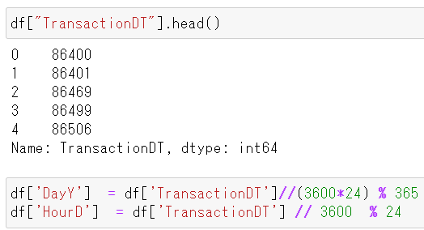
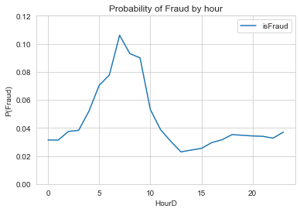
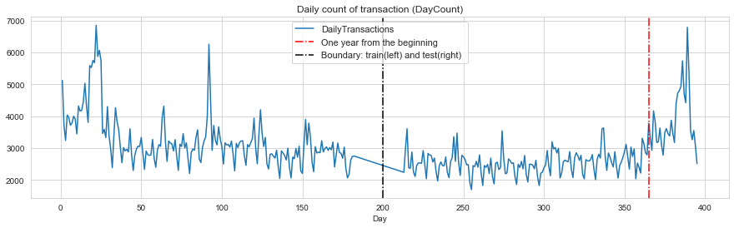
Features in time domain
P(Fraud) vs. HourD
TransactionDT: Interger
Converted to Day, Day of the Year,
Hour of the Day, etc
Transactions/day
Peak of Probability
Train data
Test data
365days
Notes:
Next one is time series feature. Transaction is recorded in time domain, and date time is integer values.
It is converted to day, day of the year, hour of the day.
Then, I counted transactions of each day. It has periodic pattern every four weeks. There are two global outliers, which have exactly one year interval. Maybe new years day. So, day of the year is important.
Another feature is probability of fraud in each hour. At 7 is much higher than others.

Slide 6

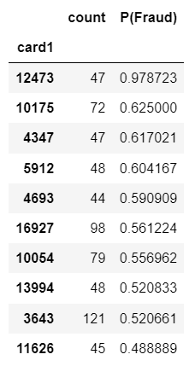
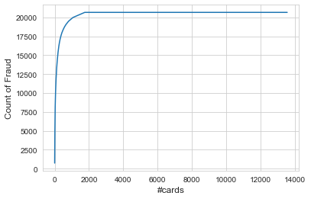
Encoding Categorical cols
Problem: too many unique values
Probability of Fraud
Replace value
13,351
1740 cards were used by fraud
Notes:
Finally, encoding of categorical columns
Problem is there are too many unique values in category. For example card1 has 13000 uniques.
Although only 1700 were used by fraud.
So, I calculated probability of fraud group by each values. And replaced values.

Slide 7
Train and Validation Plan
Day1
Day182
Day213
Day395
Train Data (Original)
Test Data
Day120
70%
3.5% positive
Validation Data
177,162
(3.5% positive)
Imbalanced
Train Data
29,076
(50% positive)
Balanced
Notes:
In this project, test data is newer than train data.
So, the validation needs to be consistent with it.
First, I selected latter 30% for validation. It is imbalanced.
But train data needs to be balanced. So I limited number of negative samples from first 70%.

Slide 8
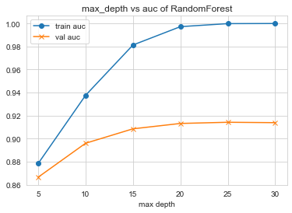
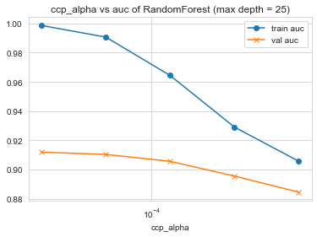
Random Forest Classifier
ccp_alpha did not help.
Best max depth = 25
train auc
val auc
150 features are selected for modeling (auc improved)
Validation AUC = 0.914 (max depth = 25, ccp_alpha = 0)
Kaggle private score (test auc) = 0.901
Notes:
This is tuning of RF. First, auc was highest when max depth is 25.
Ccp_alpha did not help. Val auc was not improved.
As a result, this model had auc 0.901 in Kaggle private score. So the purpose is achieved.

Slide 9
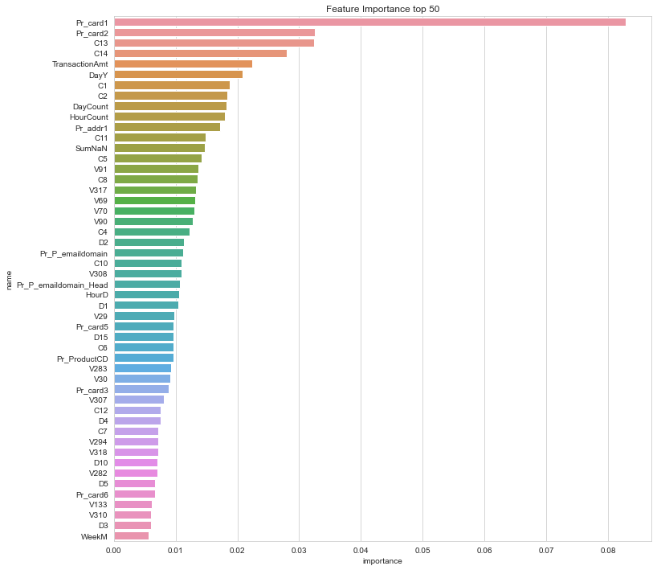
RF Feature Importance Top 25
Pr_ : Prob encoded
Day of the year
#transaction per day/hour
#NaN
Notes:
Probability of category is ranked at the top.
Some new features created by myself are also ranked.

Slide 10
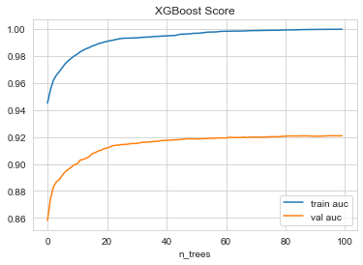
XG Boost Training
XGB Parameters:
max depth = 12
n_estimators = 100
Early stopping round = 10
Learning rate = 0.15
Validation AUC 0.92 (> RF AUC 0.914)
Kaggle private score : 0.884 (< RF AUC 0.901)
Notes:
This is XG Boost result. After trying many times, I selected max depth 12 and estimator 100 with early stop
It had validation auc 0.92 which was higher than randomforest, but in Kaggle is much worse than RF.
It maybe overfitted. So I compared feature importance of both method.

Slide 11
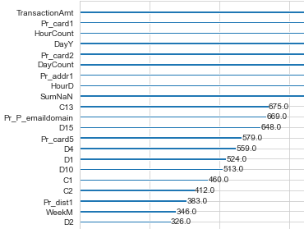
XGB Feature Importance
RF Importance
XGB Importance
RF Importance ≠ XGB Importance, but kind of similar

Slide 12
Conclusion
RF AUC 0.901 > objective: 0.900
XGB overfitted more than RF, but powerful for data similar to train
NaN can be information.
Feature can be found in time domain
Encoding works, but risk of overfit. N/A for new values.
AUC | Random Forest | XG Boost
Train | 0.999 | 0.999
Validation | 0.914 | 0.921
Test (Kaggle score) | 0.901 | 0.884
Notes:
To sum up, RF achieved auc 0.9. XGB overfitted more than RF. But XGB should be more powerful when data distribution is same as train .

Slide 13
Summary of Data Cleaning & Feature Engineering
Drop Columns: if NaN[%] > 70
→ 168 columns were removed
Imputation
Numeric: Mean
Categorical: Mode or ‘Z’
Feature Engineering
Number of NaNs : SumNaN (Before drop Columns)
TransactionDT (integer) → Day of the Year: DayY
Hour of the Day: HourD
Number of transaction is counted by day (DayCount), ad by hour (HourCount)
Categorical values → P(Fraud)
New category
If NaN[%] is negligible
Notes:
This is summary of ..
First, cols with nan more than 70% were dropped.
Numeric values are imputed by mean, cat were by mode or new category, when col has many nans.

