Slide 1
KKBox Music Recommender Challenge
Kaggle Competition in 2018

Slide 2
Table of contents
Purpose and Data
Features
Content based approach
Collaborative filtering: SVD
Collaborative filtering: KNN
Scores
Conclusion

Slide 3
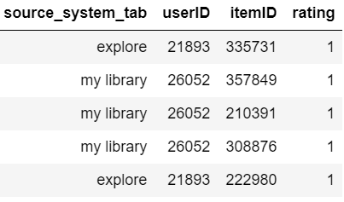
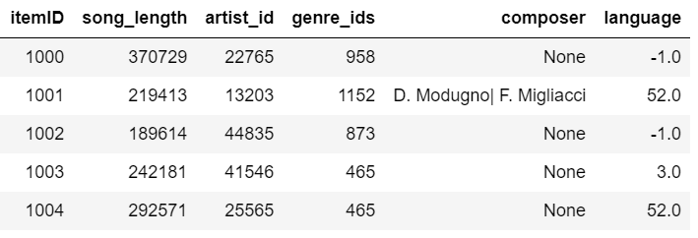
Purpose and Data
Purpose: To predict user liked song or not in probability, metric = AUC
Target: AUC > 0.66 by Unsupervised approach
KKBox Benchmark = 0.613, My RandomForest = 0.65998
Problem: 419,781 songs, 34,403 users → rating matrix needs 100GB RAM
Rare items and users → cold start problem
Method: Hybrid Recommender (Content-based + Collaborative filtering)
Train data
7,377,418 rows
Item attributes

Slide 4


What is Content-based approach ?
No user info
Popular products
Top sellers
Non-personalized Recommendation

Slide 5
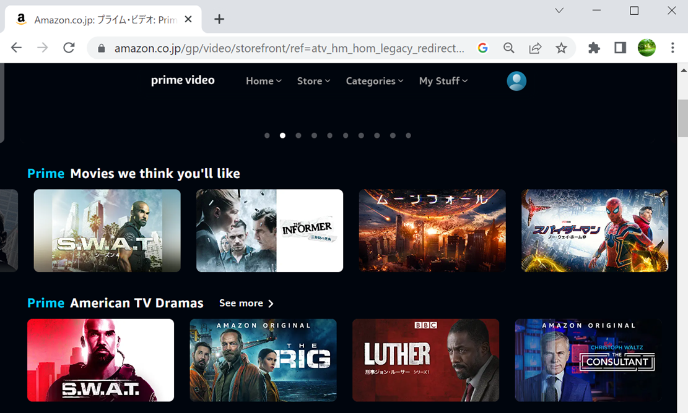
What is Collaborative filtering?
My user ID
Recommendation for specific users
Personalized: based on users’ records

Slide 6
Hybrid Recommender Concept
Threshold (count) = 20
Rare item
Frequent items
Feature only content based (CB)
CB + item bias
Rare users
Threshold (count) = 20
CB + user bias
CB + item bias + user bias +
Collaborative filter
Frequent users
bias: mean rating
User bias: users’ mean rating

Slide 7
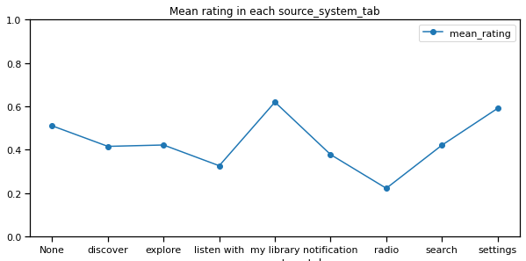
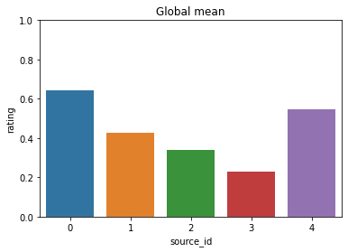
Basic feature: where a user listened to a song
Mean ratings
Grouping (source_id)
0: my library, settings
1: discover, explore, search
2: listen with, notification
3: radio
4: None
All the methods are divided by source
(CB, SVD, etc)

Slide 8
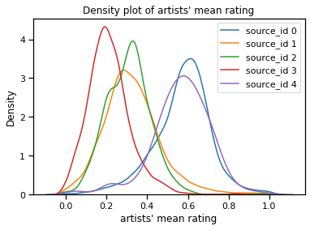
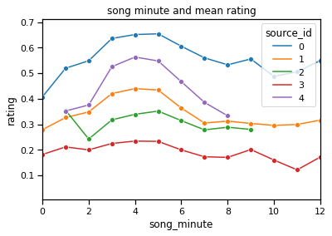
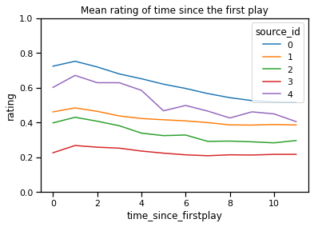
mean ratings of features
Artists
Song length (minutes)
Time (index) since 1st play in data
decays
5e+5
Artist mean is normally distributed
3-5 minutes songs are most popular

Slide 9
Validation Plan
20%
Train data
Test Data
Val
Index ≈ Time

Slide 10
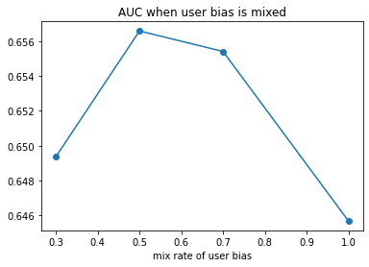
Content based approach
Val AUC
Feature only CB
mean (artist, song minute, time) 0.6046
CB + item bias (for frequent items) 0.6217
0.5*(CB + item bias) + 0.5*user bias 0.6565
Tuned mix_rate
Ensemble is effective

Slide 11
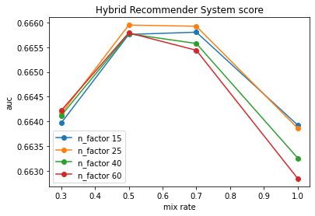
Collaborative filtering: SVD
SVD (of numpy, sklearn) needs rating matrix and NaN shall be imputed
Surprise package’s SVD does not need rating matrix
Hyper parameter: n_factor, mix_rate for hybridization
Best params:
n_factor = 25
mix_rate = 0.5
AUC: 0.6659
(0.6565 + 0.013)

Slide 12
Collaborative filtering: KNN
1. Calculate similarity from rating data (RAM issue)
2. Find k-nearest similar users
3. Weighted average of k-ratings
SVD KNN (surprise package)
Train time (sec): 127 770
Prediction time: 16 481
AUC 0.6659 0.6569
SVD is selected for Collaborative filtering

Slide 13
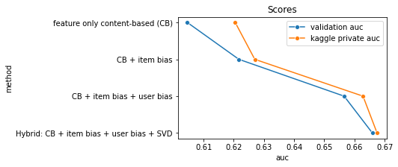
Scores
target
mix_rate =1
mix_rate =0.5
mix_rate =0.5

Slide 14
Conclusion
Hybridization solved cold-start problem.
Effect of ensemble is confirmed
Efficiency of surprise’s SVD: It does not need rating matrix

