Slide 1
KKBox Music Recommender Challenge
Kaggle Competition in 2018

Slide 2
Table of contents
Purpose and Data
Features
Content based approach
Collaborative filtering: SVD
Collaborative filtering: KNN
Scores
Conclusion

Slide 3
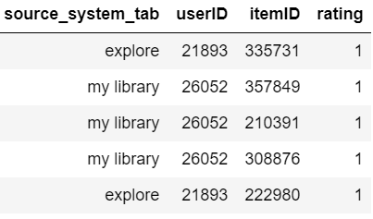
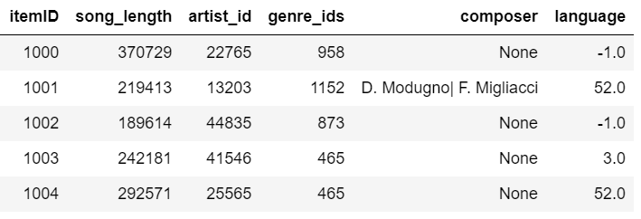
Purpose and Data
Purpose: To predict user rating of songs 0 – 1 (liked) in probability, metric = AUC
Target: AUC > 0.66 by Unsupervised approach
KKBox Benchmark = 0.613, My RF = 0.653
Problem: 419,781 songs, 34,403 users → full rating matrix needs 100GB RAM
Rare items and users, new items and users in test data → cold start problem
Train data
7,377,418 rows
Item attributes

Slide 4
Hybrid Recommender Concept
Rare item
Frequent items
Feature only content based (CB)
CB + item bias
Rare users
CB + user bias
CB + item bias + user bias +
Collaborative filter
Frequent users
bias: mean rating
User bias: users’ mean rating

Slide 5
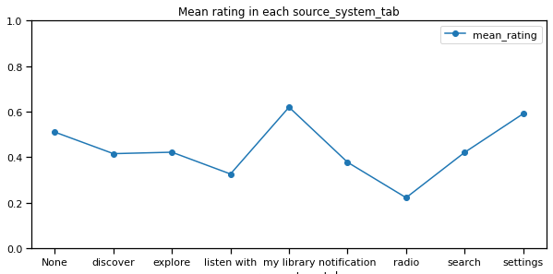
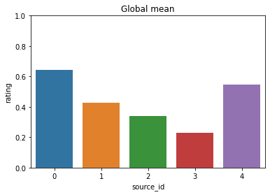
Basic feature: where a user listened to a song
Grouping (source_id)
0: my library, settings
1: discover, explore, search
2: listen with, notification
3: radio
4: None
All the methods are divided by source in this project
(CB, SVD, etc)

Slide 6
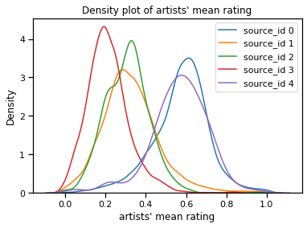
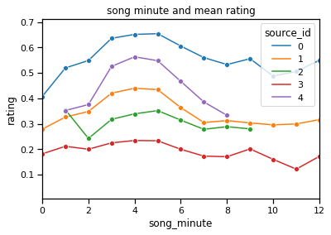
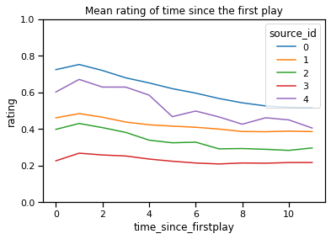
Item features and mean rating
Artists
Song length (minutes)
Time since 1st play
Artist mean is normally distributed
3-5 minutes songs are most popular
Songs become less popular as time goes by

Slide 7
Validation Plan
20%
Train data
Test Data
Val
Index ≈ Time

Slide 8
Content based approach
Val AUC
Feature only CB
mean (artist mean, song minute, time) 0.6046
CB + item bias (for frequent items) 0.6217
0.5*(CB + item bias) + 0.5*user bias 0.6565
Tuned mix_rate
Ensemble is effective

Slide 9
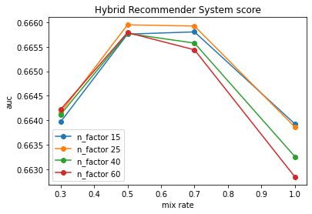
Collaborative filtering: SVD
Conventional SVD (numpy, sklearn) is not optimized for Recommender
Surprise package’s SVD is selected for frequent items and users.
Hyper parameter: n_factor of SVD, mix_rate for hybridization
Best params:
n_factor = 25
mix_rate = 0.5
AUC: 0.6659
(0.013 improved)

Slide 10
Collaborative filtering: KNN
1. Calculation of similarity from rating data
2. Find k-nearest similar users
3. Weighted average of k-ratings
SVD KNN (surprise package)
Train time (sec): 127 770
Prediction time: 16 481
AUC 0.6659 0.6569
SVD is selected for Collaborative filtering

Slide 11
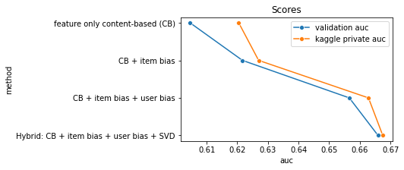
Scores
Target: auc > 0.66 is achieved

Slide 12
Conclusion
Cold start problem and RAM limitation are solved by Hybridization
Ensemble is more effective than single predictors
Surprise’s SVD is efficient in computation and accuracy

