Slide 1
Dynamic Demand Modeling
Population Dislocation Models

Slide 2
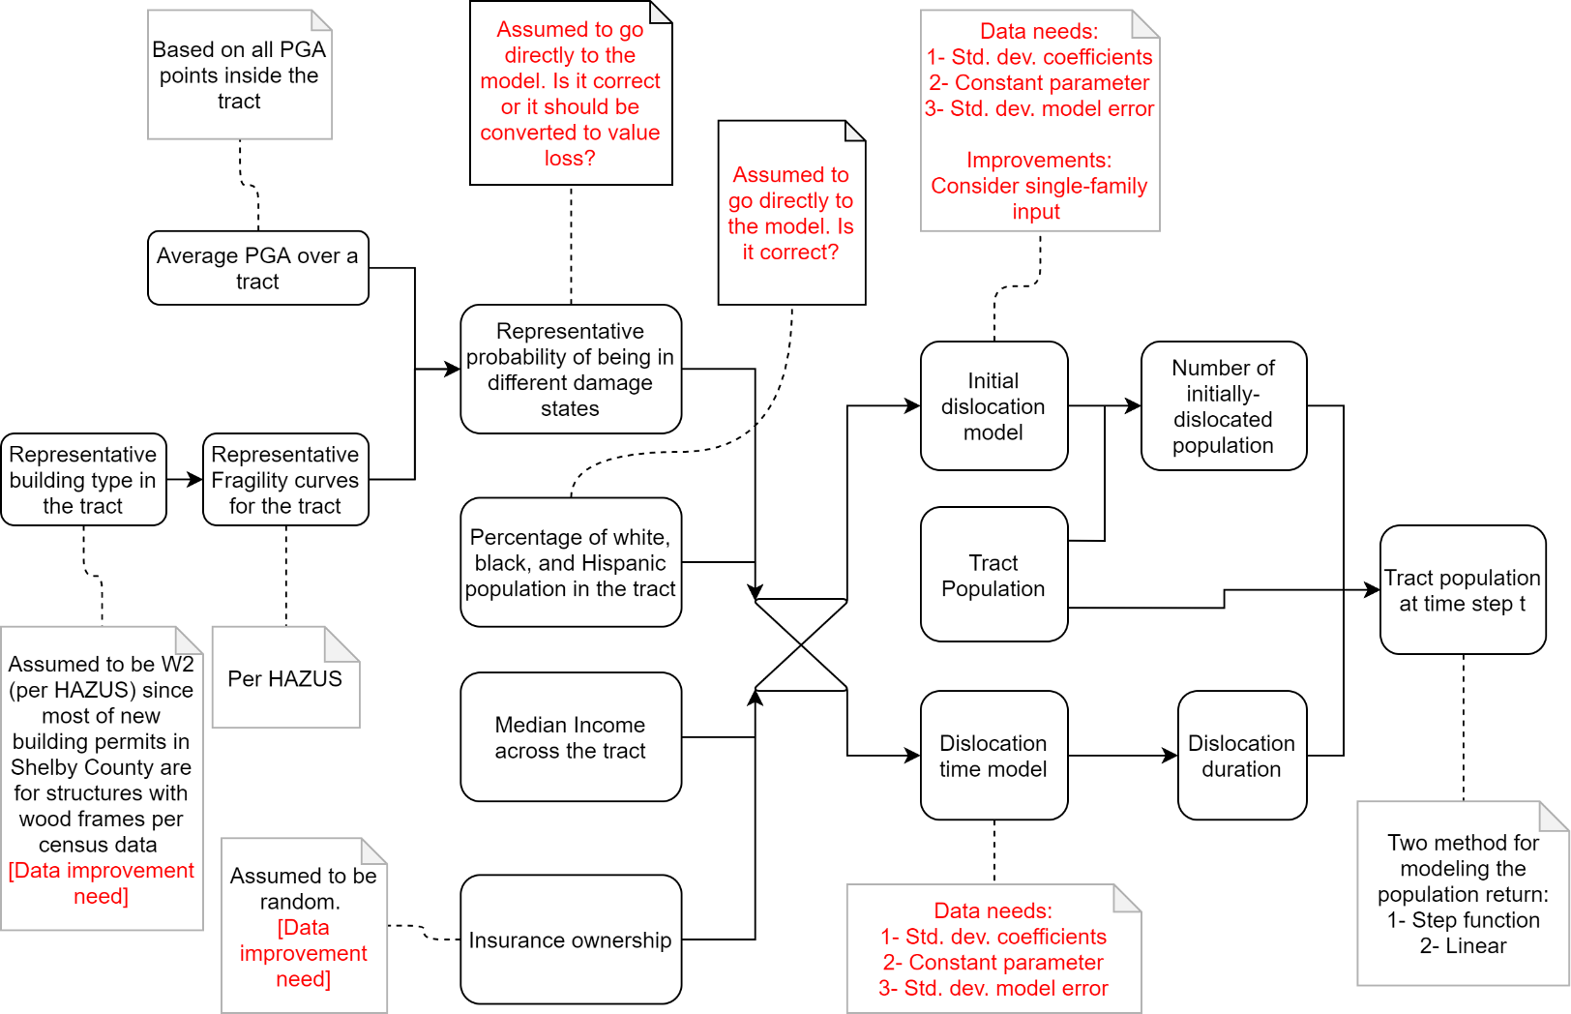
Flowchart
For each census tract
(red comments are
current data issues
or model ambiguities).

Slide 3
Main issues
Dislocation models are based on Lumberton data and we use them for Shelby County.
Dislocation models are based on hurricane data and we use them for seismic events.
Dislocation models are for individual households and we use them on the census-tract level.
Dislocation models have low prediction power.

Slide 4
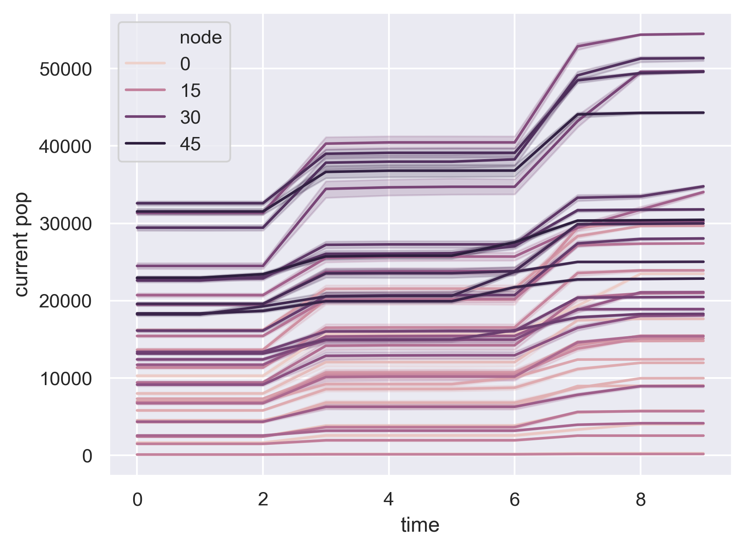
Demand trends (power net, step-function)

Slide 5
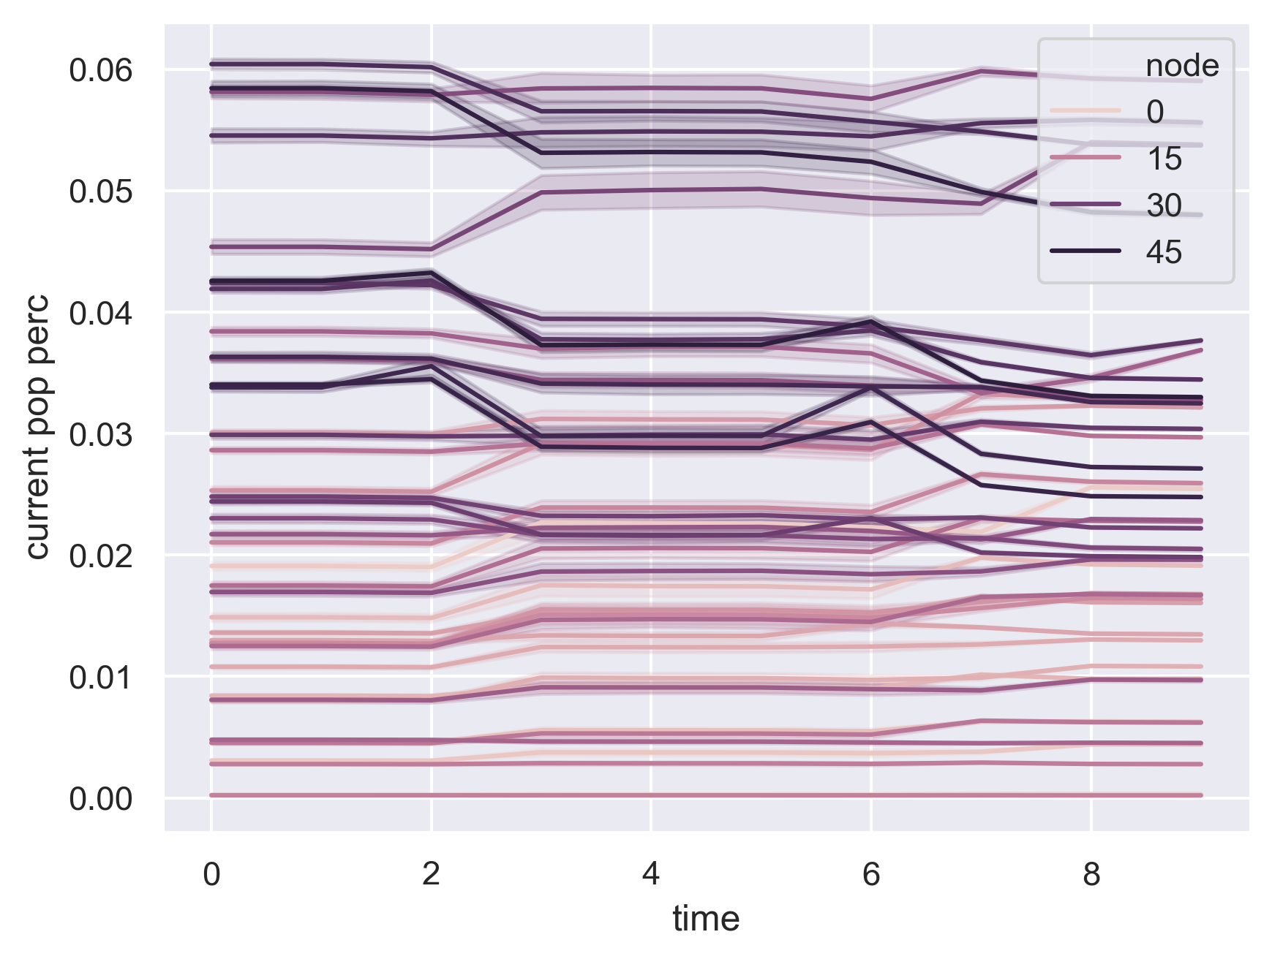
Demand trends (power net, step-function)

Slide 6
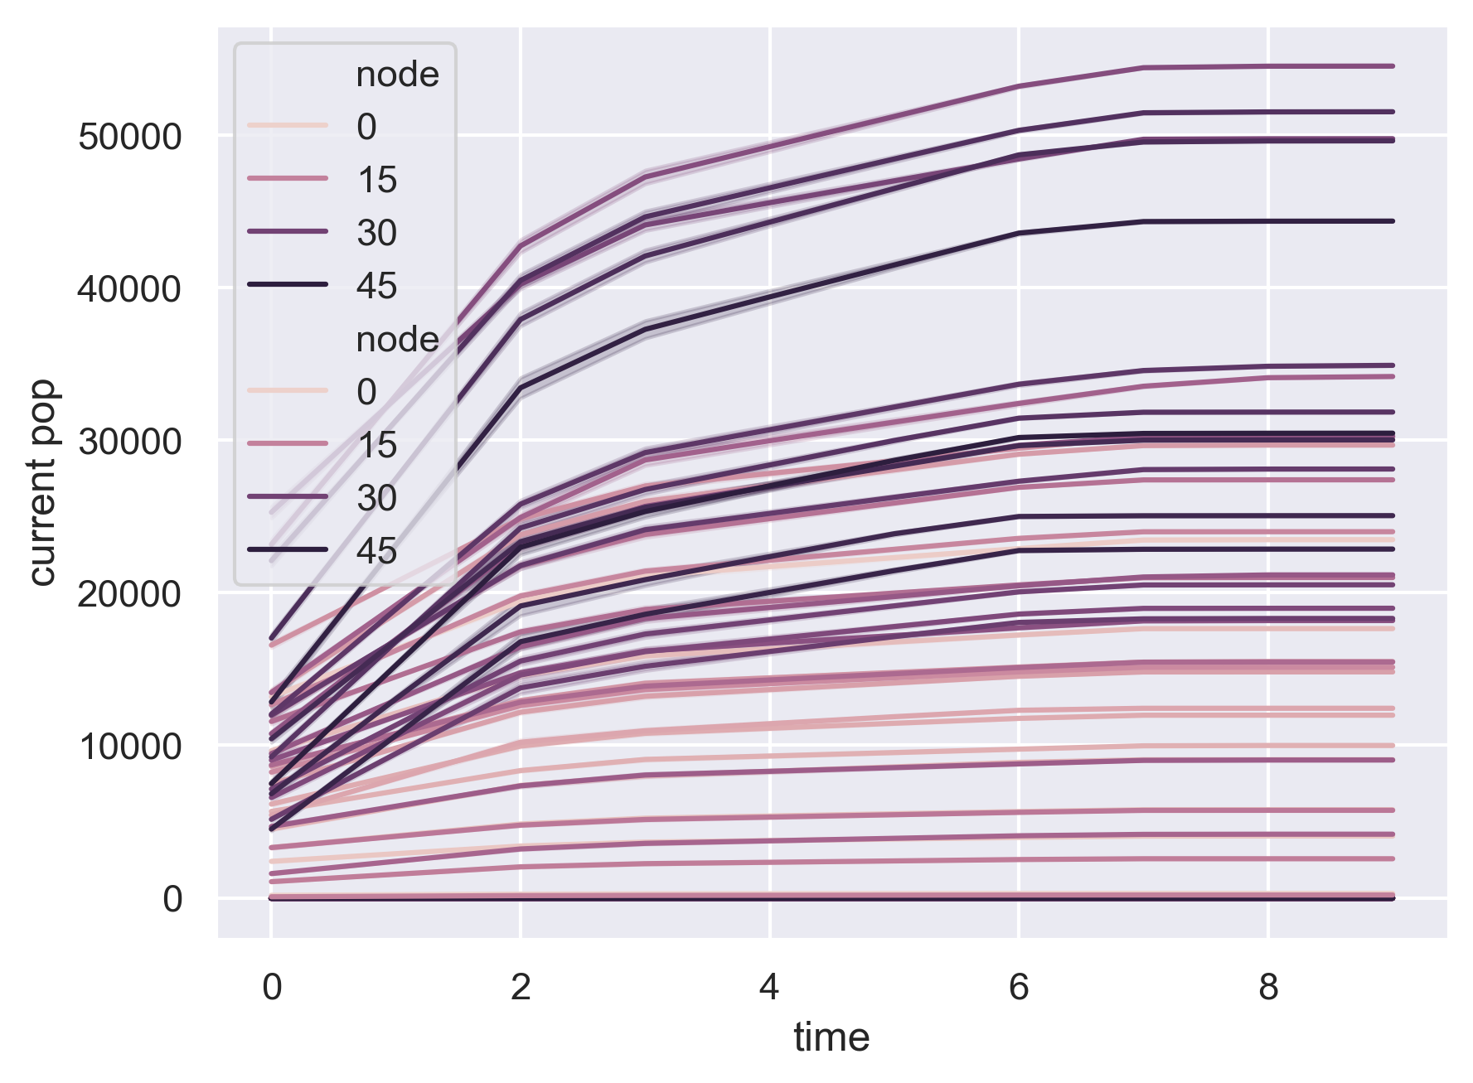
Demand trends (power net, linear)

Slide 7
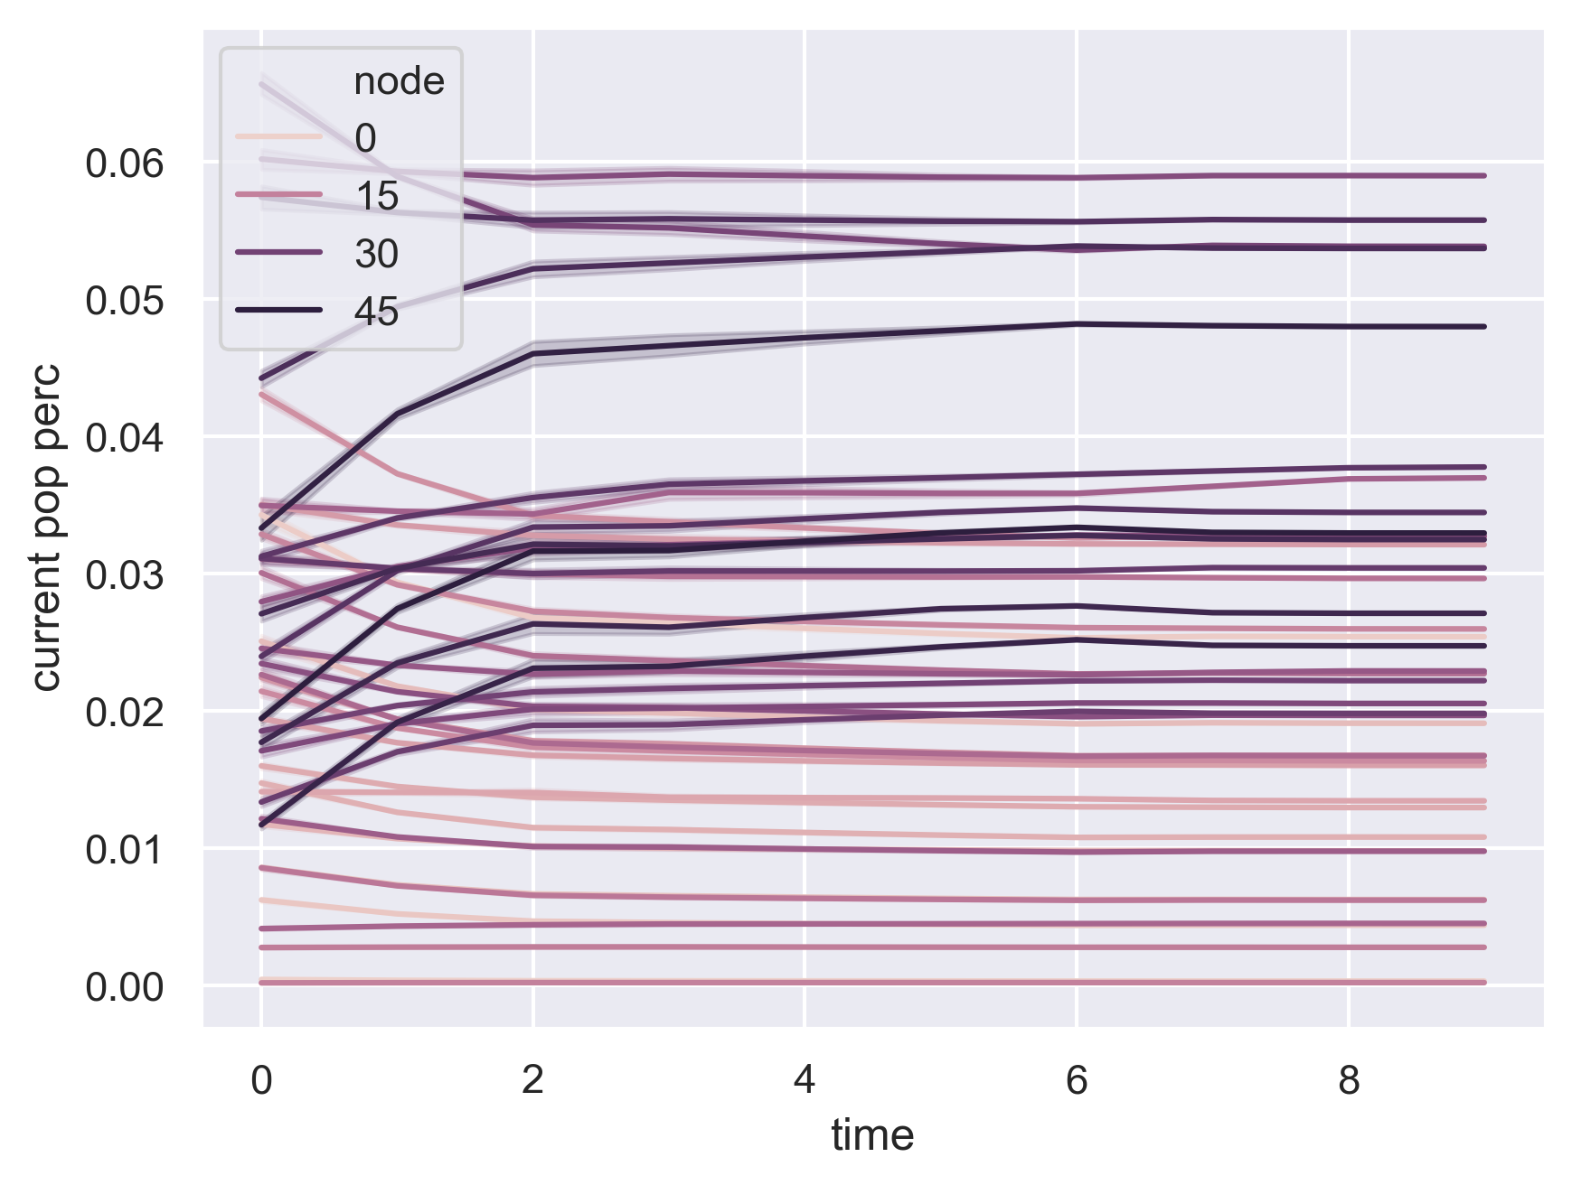
Demand trends (power net, linear)

