Slide 1
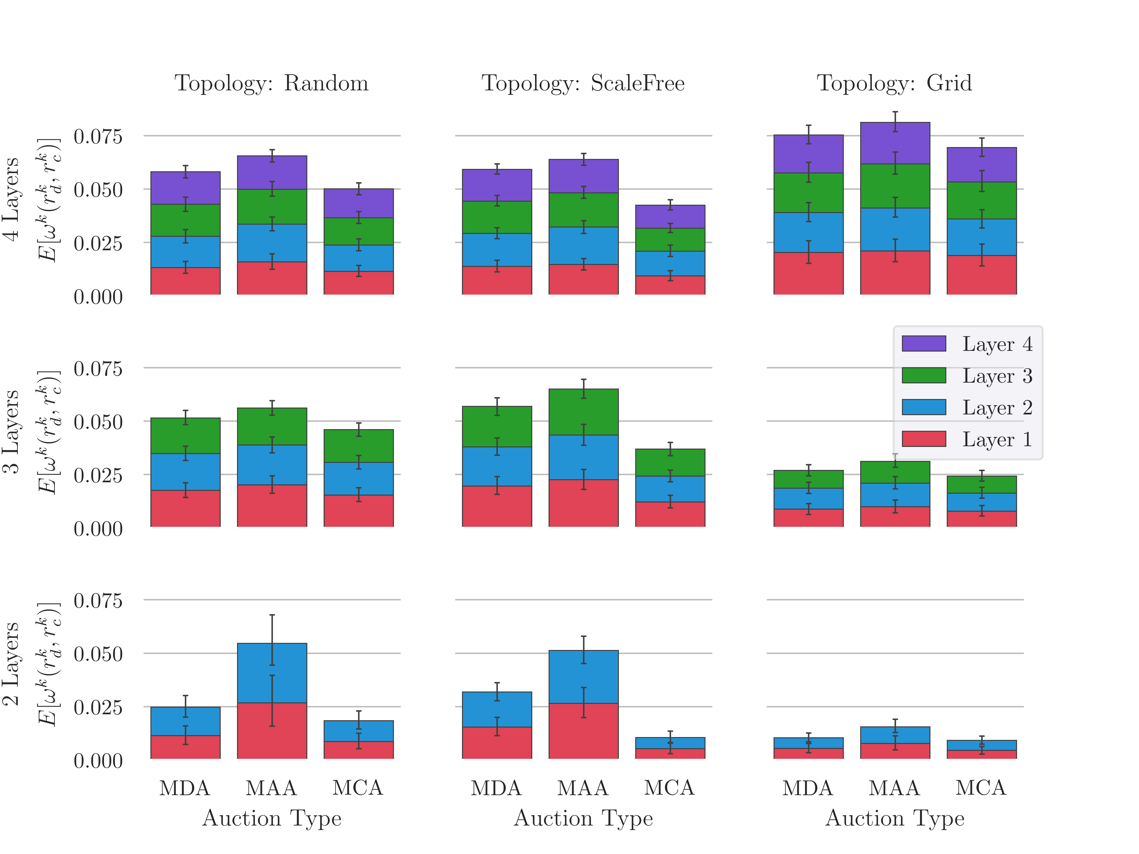
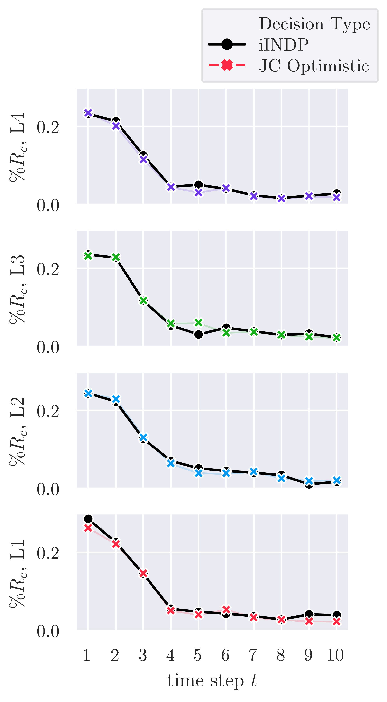
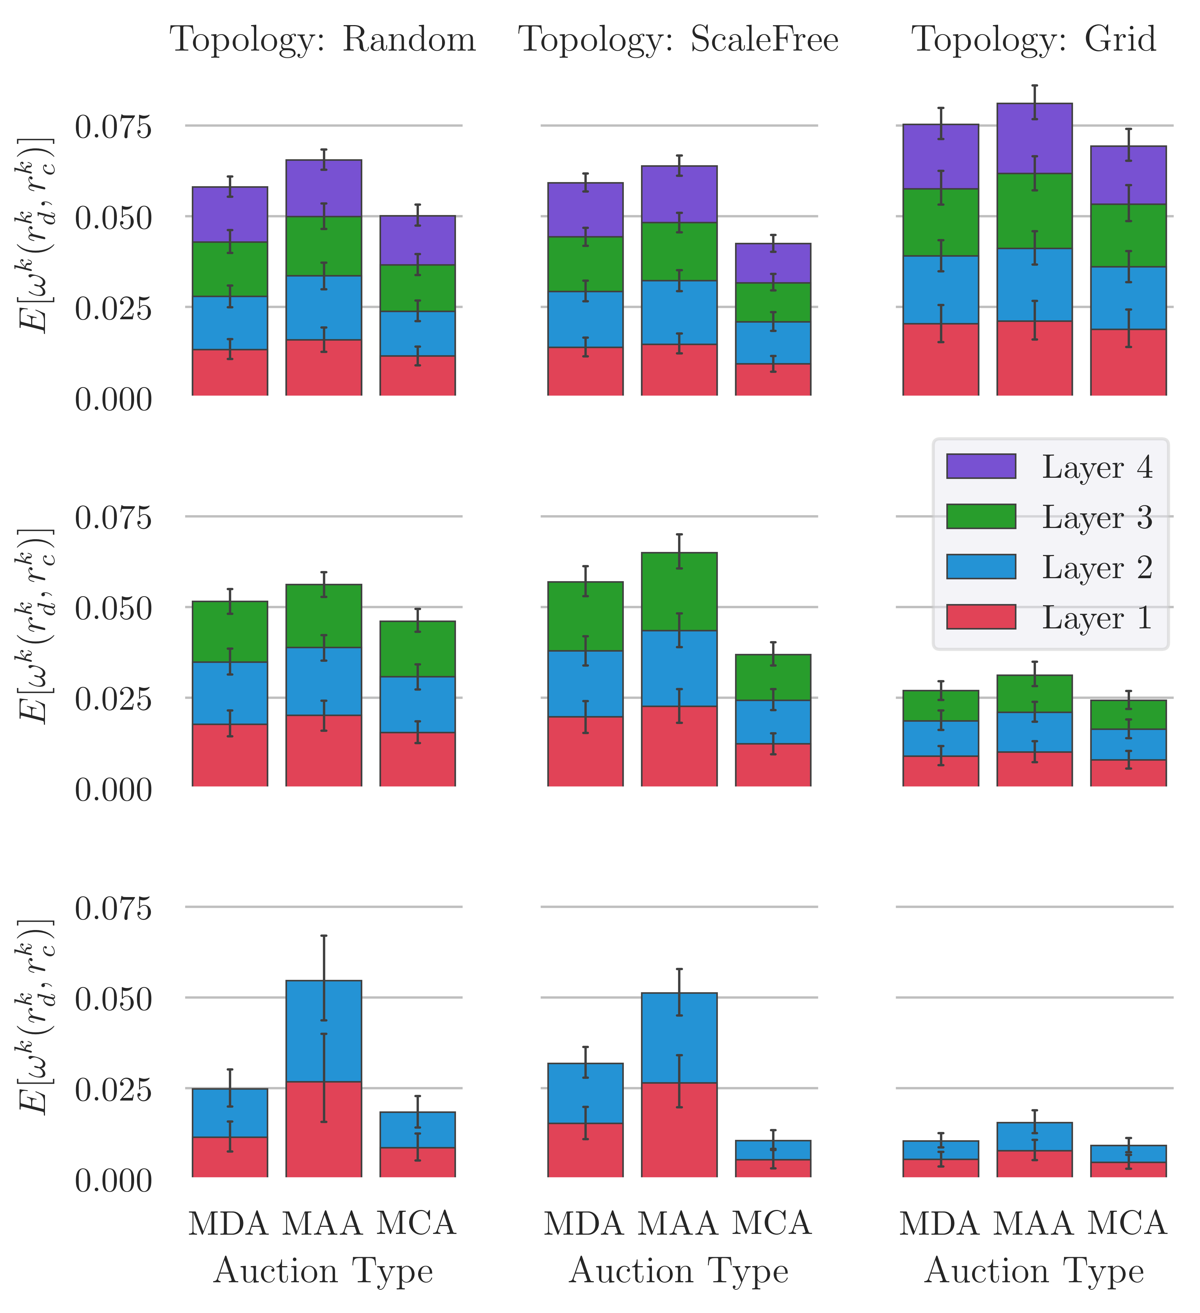
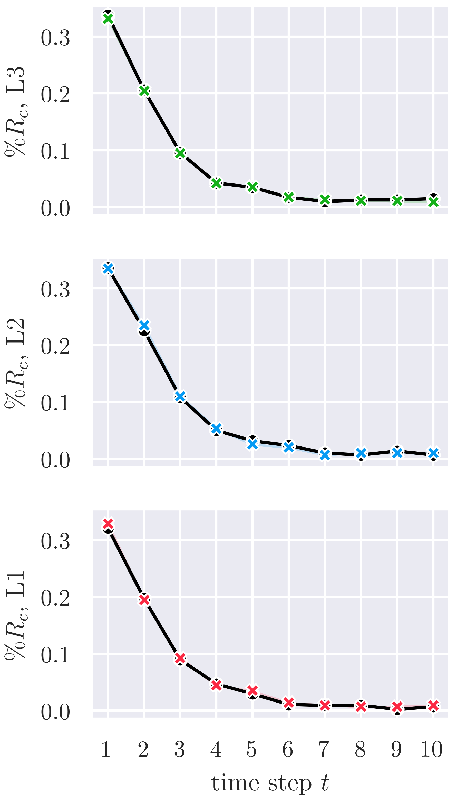
Allocation Type
iINDP (Optimal)
Auction-based
Allocation Type
iINDP (Optimal)
Auction-based

Slide 2
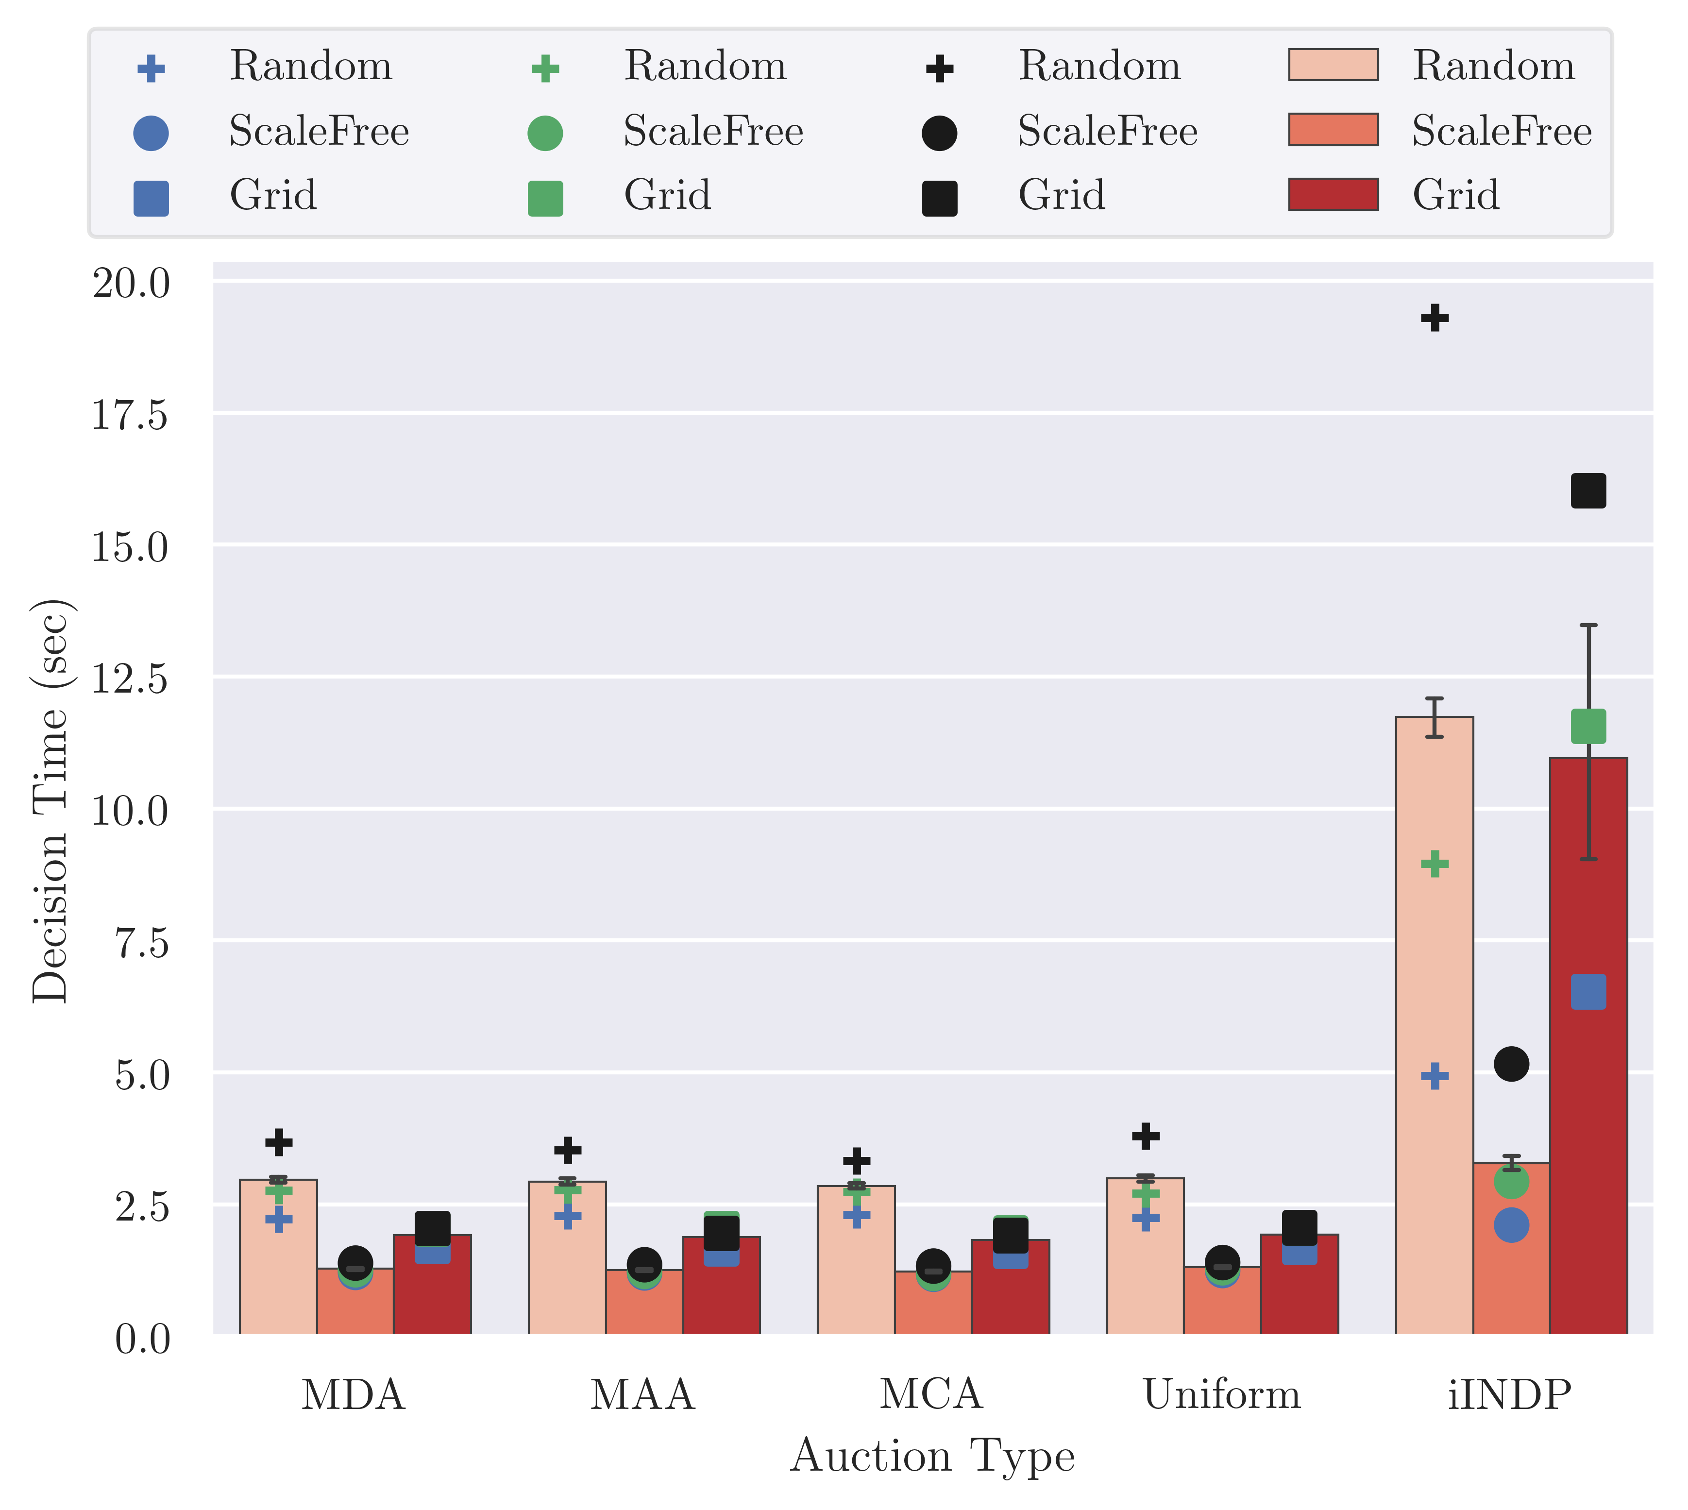
Topology
Random
Scale Free
Grid
Mean
Overall 2L 3L 4L

