Slide 1
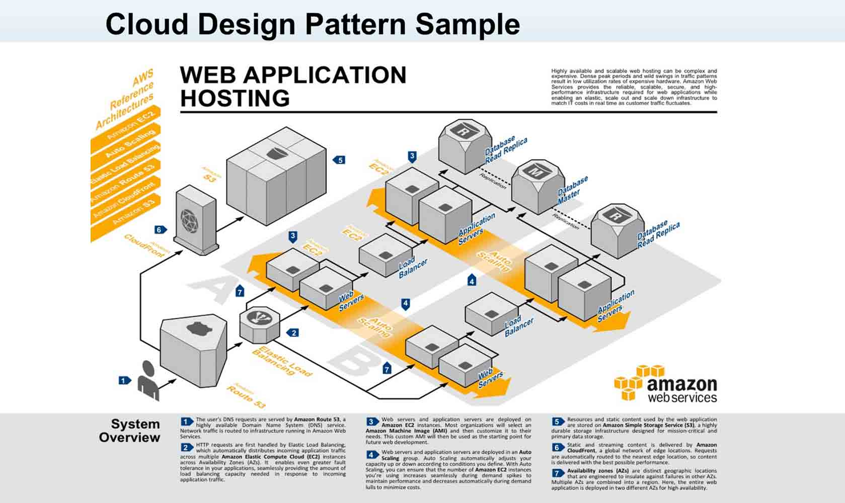

Slide 2
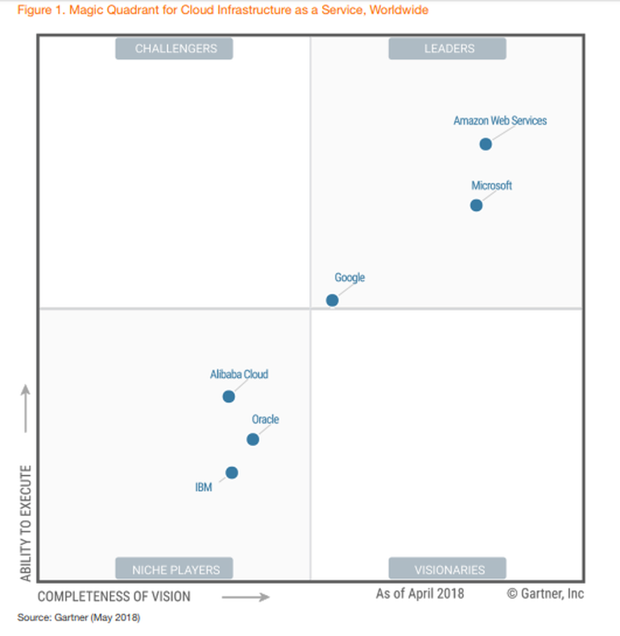

Slide 3
Midterm Scope
Midterm Structure
Practical Exam Portion – Speed Drill Rubric
Must display Best Practices
Use of GitHub Repository
Based on Zurb Foundation
Includes Angular JS
Includes Fonts Awesome
Includes datatables.net
Commented your code
Must have 5 pages structured with a working menu (http://et710.com/website/index.html)
Each page must have Angular JS functioning on all pages
For the home page build the Hatteras Yacht Motor Yacht page (http://et710.com/yachts/) and on the Dealer page include a map and Angular JS enabled email form (http://et710.com/website/contact/index.html)

Slide 4
FRONT END
HTML-CSS-JS
Zurb Foundation
AngularJS
(React, Bootstrap)
BACK END
Full Stack (Rails)
Mean Stack (JS)
Serverless
HTTPS
REST
Transport

