Slide 1
Simulations & Transmission Efficiencies

Slide 2
GEANT4 UserInput
# Two-body reaction: 1+2->3+4
10 # Z1 beam
22 # A1
3 # Z2 target
7 # A2
12 # Z3 recoil
26 # A3
1 # Z4 ejectile
3 # A4
0.0 # min c.m. angle
180 # max c.m. angle
11 # charge state of recoil
11.32 # excitatßion energy of recoil last: 11.910787
Beam Parameters:
10 # beam Z
22 # beam A
10 # beam charge state Q
66 # beam kinetic energy (MeV)
0.2 # fractional energy spread (Sigma %)
1.0 # beam-spot diameter (mm)
0.2 # normalized transverse emittance (pi mm mrad)
# TARGET
IN # IN/OUT
6.0661318 # thickness (um)
0 # target z position offset (cm)
0.8226 # density (g/cm3)
2 # number of elements
3 6.94 0.267 # element 1: Z, M (g/mol), mass fraction
8 18.998 0.7324 # element 2: Z, M (g/mol), mass fraction
# DEGRADER 1 (Carbon Backing)
IN # IN/OUT
0.225 # thickness (um)
2.26 # density (g/cm3)
1 # number of elements
6 12 1 # element 1: Z, M (g/mol), weight ratio

Slide 3
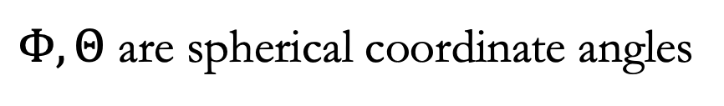


Tracking 26Mg
Commit 881c14f681a4c4a3e2f8b02c081c5b37392fbdab
This is the version of the simulation that outputs 2 files:
Ex_xxMeV_Angledeg.dat (main data file 13 columns),
SpecEx_xxMeV_angledeg.dat (Recoil info for transmission efficiency calculation)
$$Z_{rec}$$ | $$A_{rec}$$ | $$E_{lab_{_}rec}$$ | $$θ_{lab_rec}$$ | $$Φ_{lab_rec}$$ | $$θ_{cm_rec}$$ | $$Z_{ejec}$$ | $$A_{ejec}$$ | $$E_{lab_ejec}$$ | $$θ_{lab_ejec}$$ | $$Φ_{lab_ejec}$$ | $$θ_{cm_ejec}$$ | $$E_{beam}$$
Spectrometer angles $θ,φ$:
$$E_{lab_{_}rec}$$ | $$θ$$ | $$φ$$
$$θ=\arctan{(\tan{Θ}\cos{Φ})}$$
$$φ=\arctan{(\tan{Θ}\sin{Φ)}}$$
$Φ, Θ$ are spherical coordinate angles

Slide 4
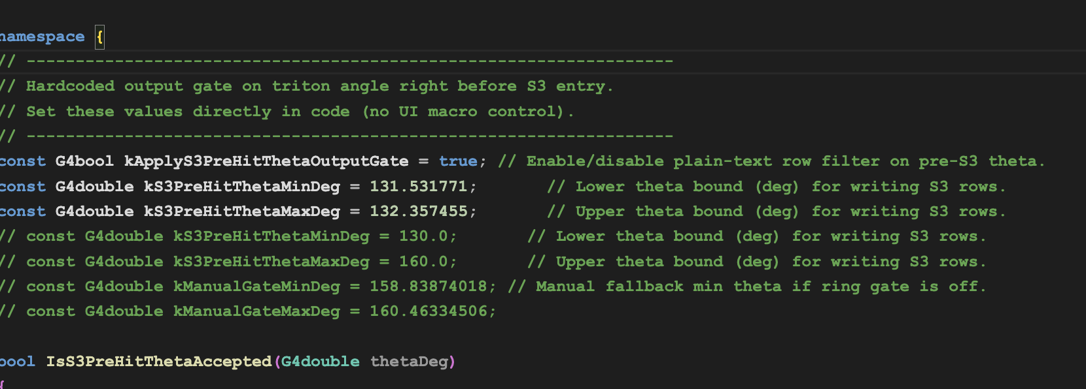
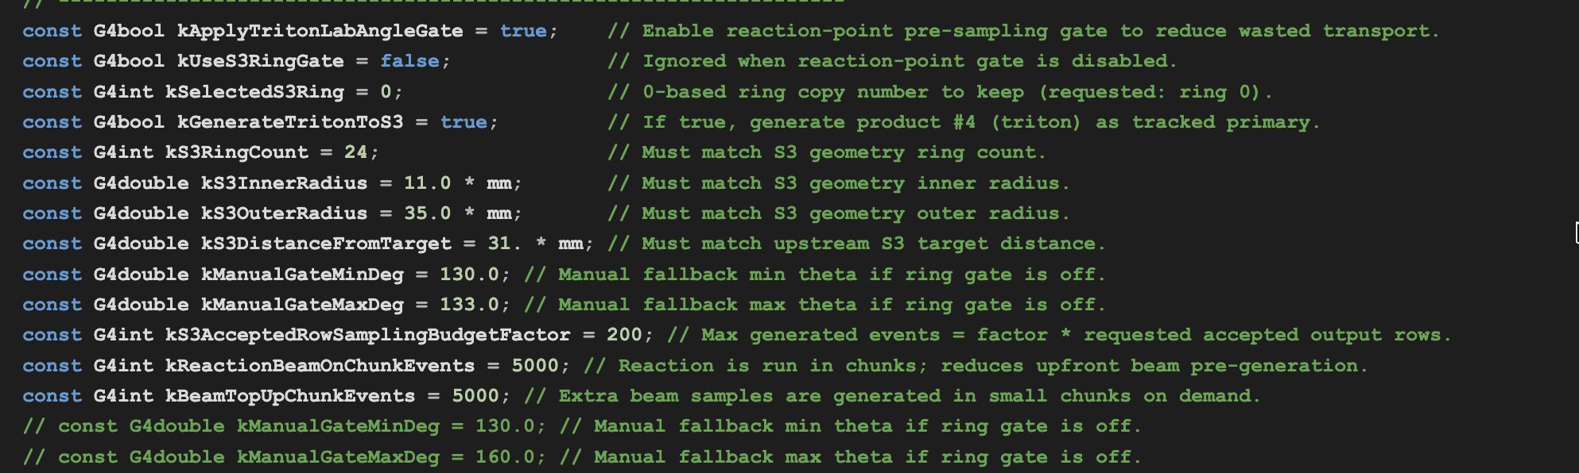
Tracking 3H
Commit 486d8a65c3d3752f5cb7286635d43ecf3d0d6b29
Ouputs: S3_triton_ring_observables.dat that contains energies
and angles of tritons at:
1. the reaction point
2. at target exit
3. just before hitting the S3
4. Energy of triton with gaussian smear
(see the data file header for detail)
EMMAEventAaction.cc
Two Gates: EMMAPrimaryGeneratorAction.cc
sets the gate for the sampler, EMMAEventAaction.cc
gate selects the tritons that actually hit the rings/within the
angle range
EMMAPrimaryGeneratorAction.cc

Slide 5
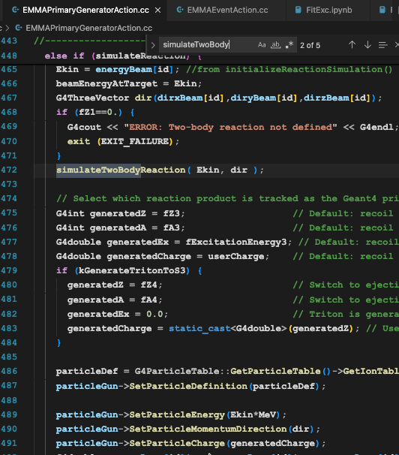
Tracking 3H (Cont’)
Reset pre-event tritons/S3 buffers →
PrimaryGenearatorAaction.cc calls two-body kinematics →
simulateTwoBodyReaction() to compute kinematics,
sample angles, apply gates →
Kill secondary tracks in StackingAction.cc →
Record energy, angles at degrader exit →
Record S3 hits based on geometry

Slide 6
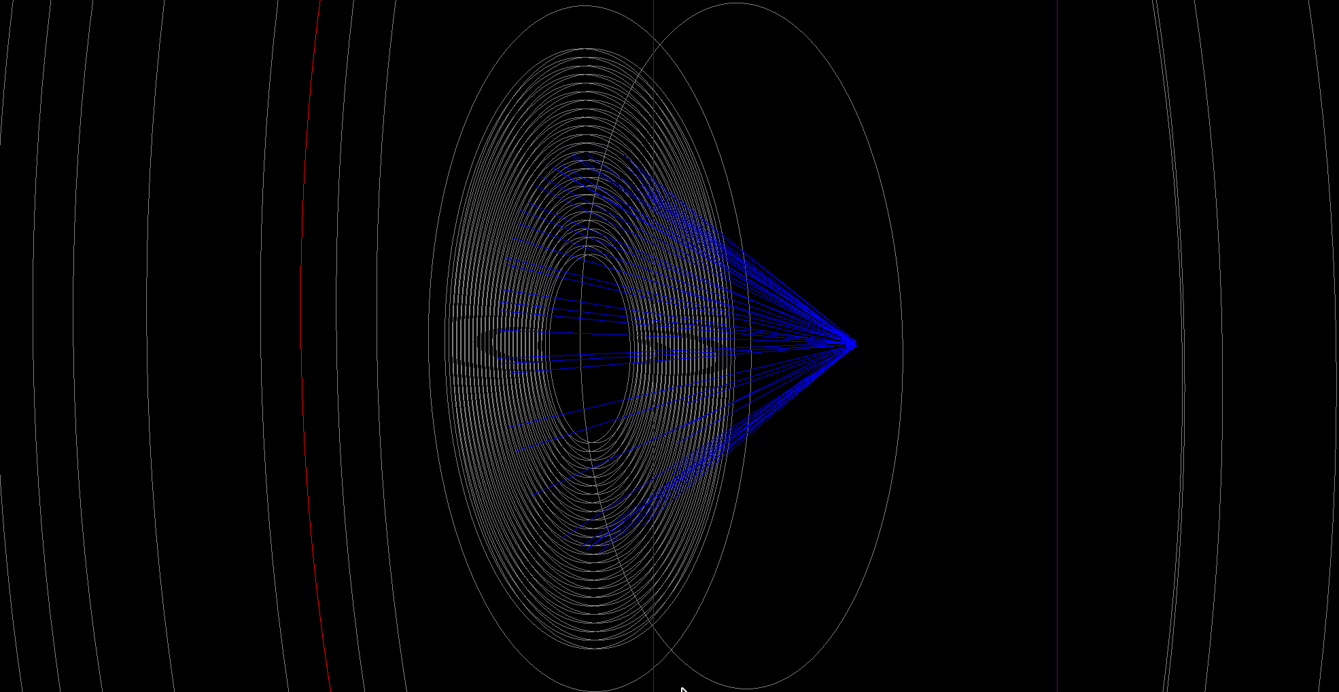
S3 Construction
24 Rings, [131.5, 160.5] degrees.
Primary tracks: Tritons
EMMADetectorConstruction.cc, EMMAS3Detector.cc, EMMAS3Hit.hh

Slide 7
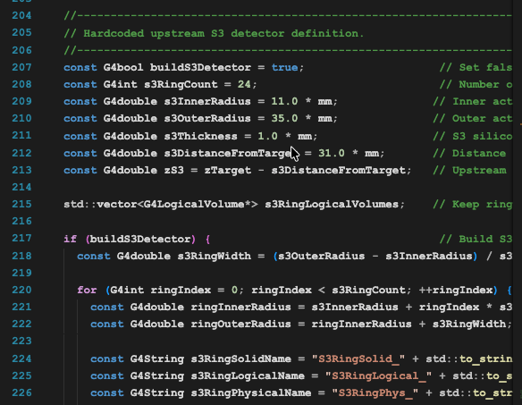
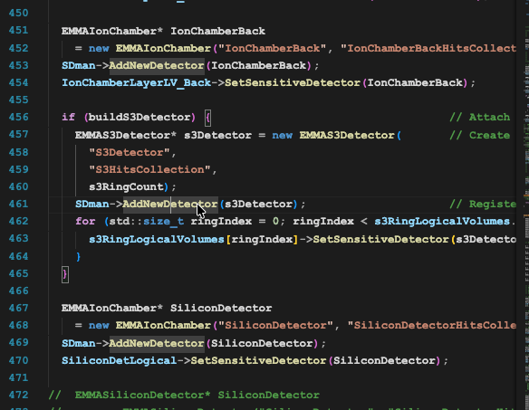
S3 Construction(cont’)
No Sector segmentations yet
I’ve hard coded the S3 geometry in
EMMADetectorConstruction.cc
Build the sensetive detector attached to S3

Slide 8
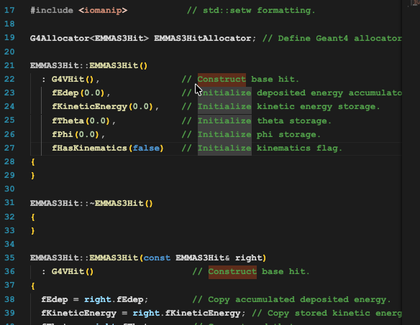
S3 Hits
Record energy, angles of the triton hits

Slide 9
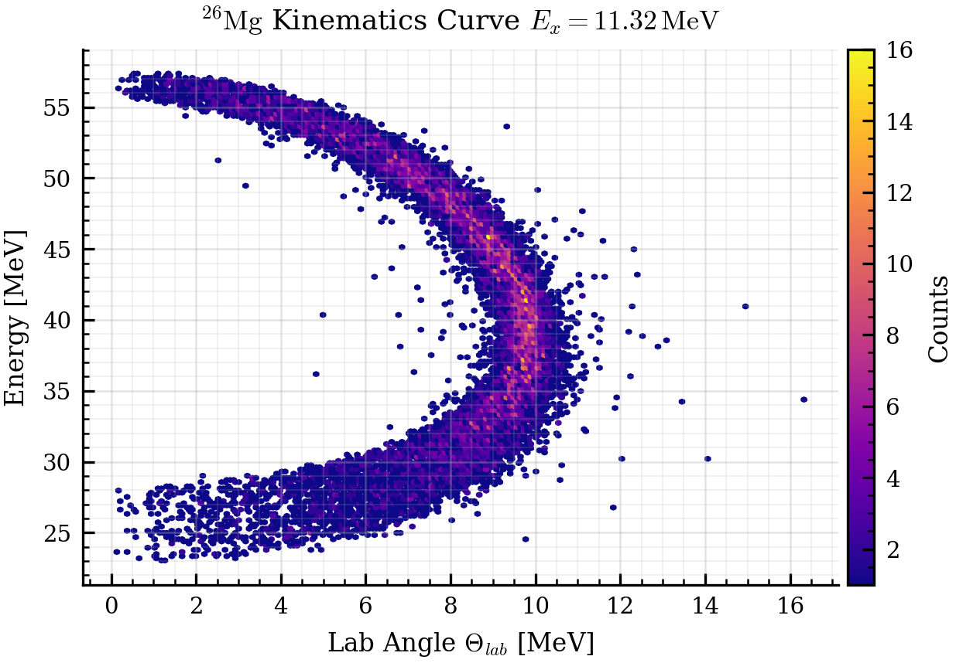
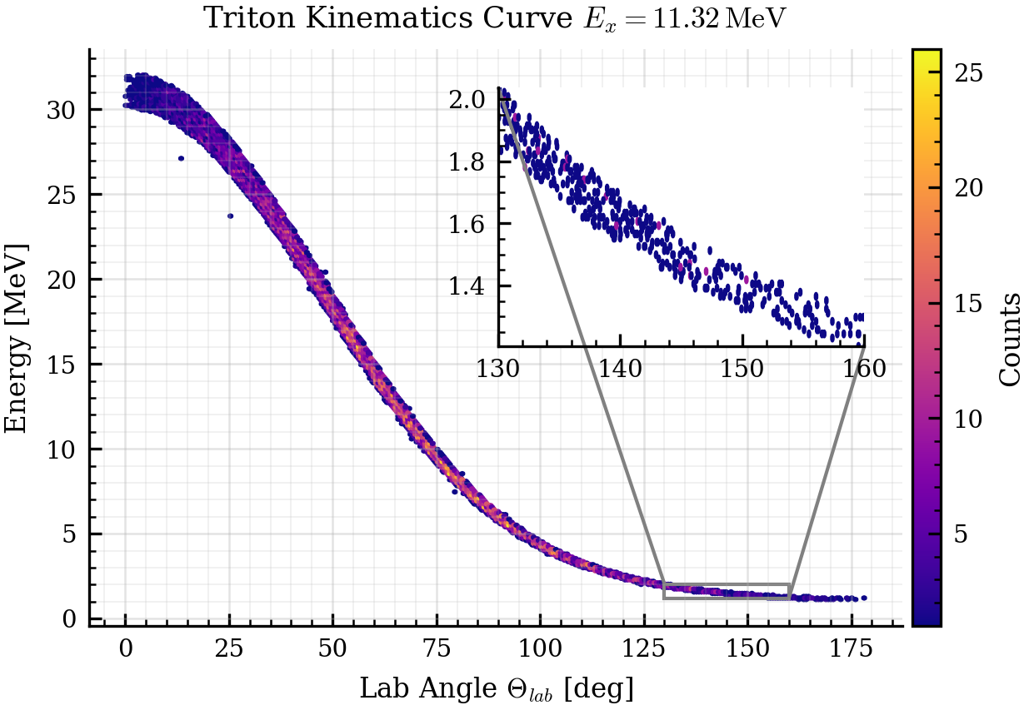
Kinematics
The angles are sampled isotropically

Slide 10
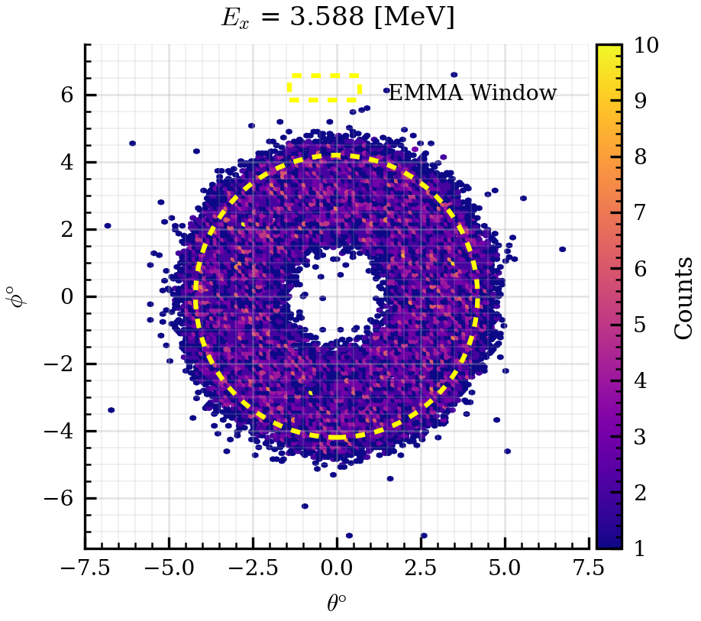
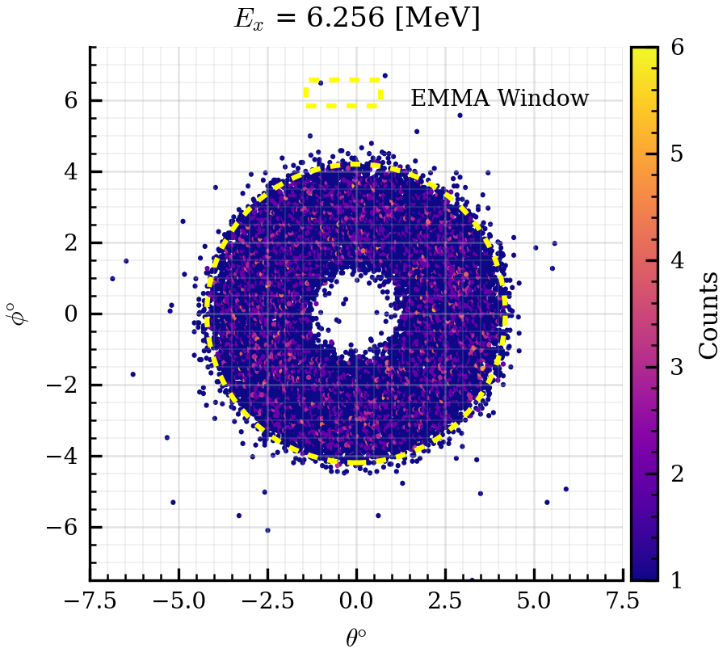
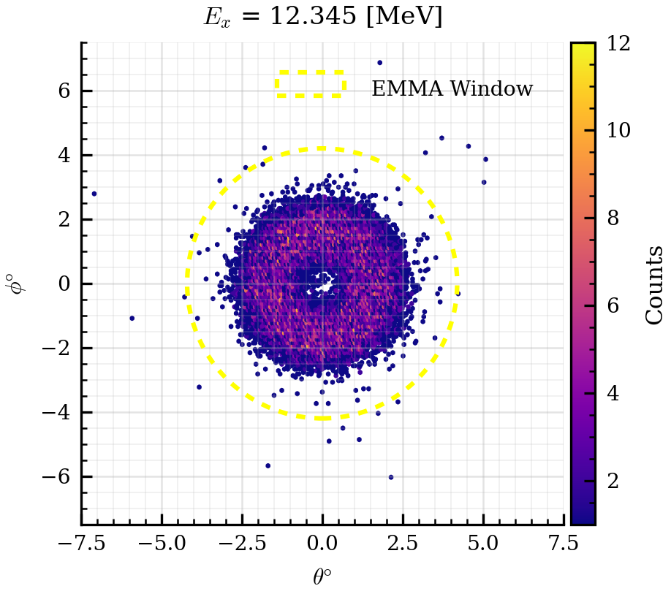




Recoil (²⁶Mg) Distributions
Triton angle $Θ∈\left[130°, 160°\right]$
$E_{x}=3.588 MeV$
$$E_{x}=6.625 MeV$$
$$E_{x}=12.345 MeV$$
This is in the spectrometer coordinate system
Winter Nuclear & Particle Physics Conference, Feb 12-15, 2026

Slide 11
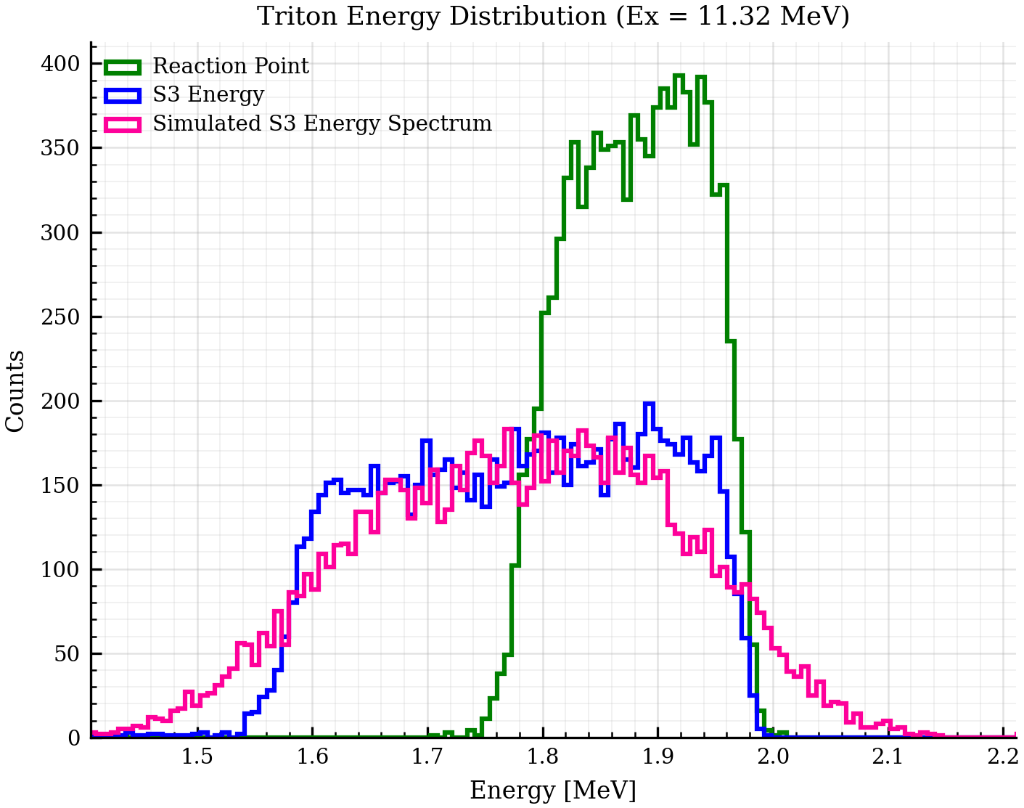
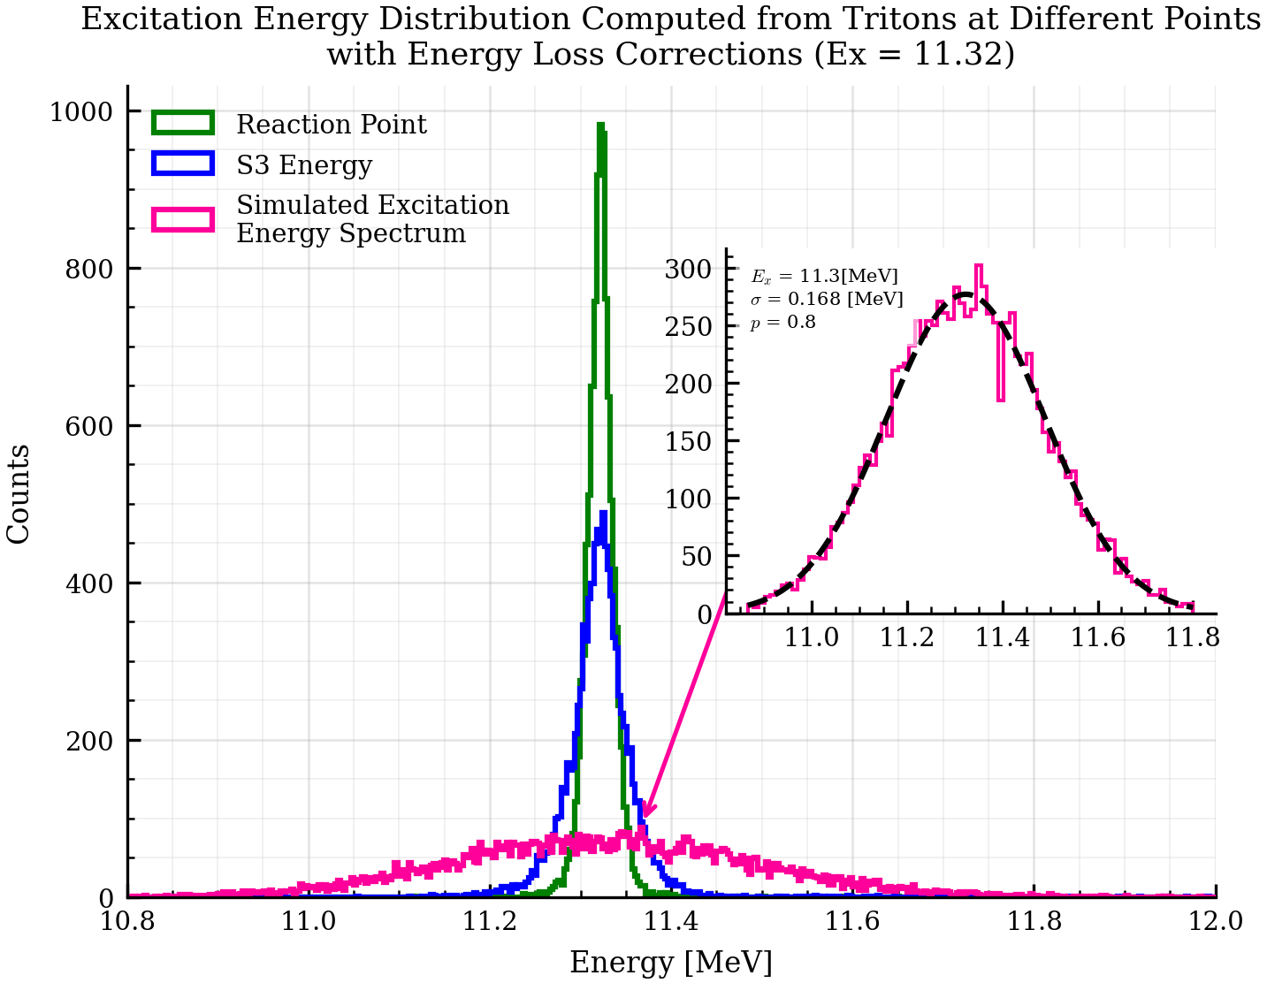
Excitation Energy Reconstruction (11.32 MeV, $1^{−}$ )
Here: Gaussian Smear sigma = 70keV
Winter Nuclear & Particle Physics Conference, Feb 12-15, 2026

Slide 12
Current Status
I have run Monte-Carlo calculations for ~10 states and Barry is going to share his result of the calculation
The strategy now is to fit the the sum of excitation energy distribution of each state to the distribution we see in data. This would tell us the contribution of each state.
We need the DWBA calculations to figure out the angular distributions of each state, my simulation is currently sampling isotropically.

