Slide 1
Yield Strength
Week 5
Yutong, Xiangyu, Haoting, Harsha

Slide 2
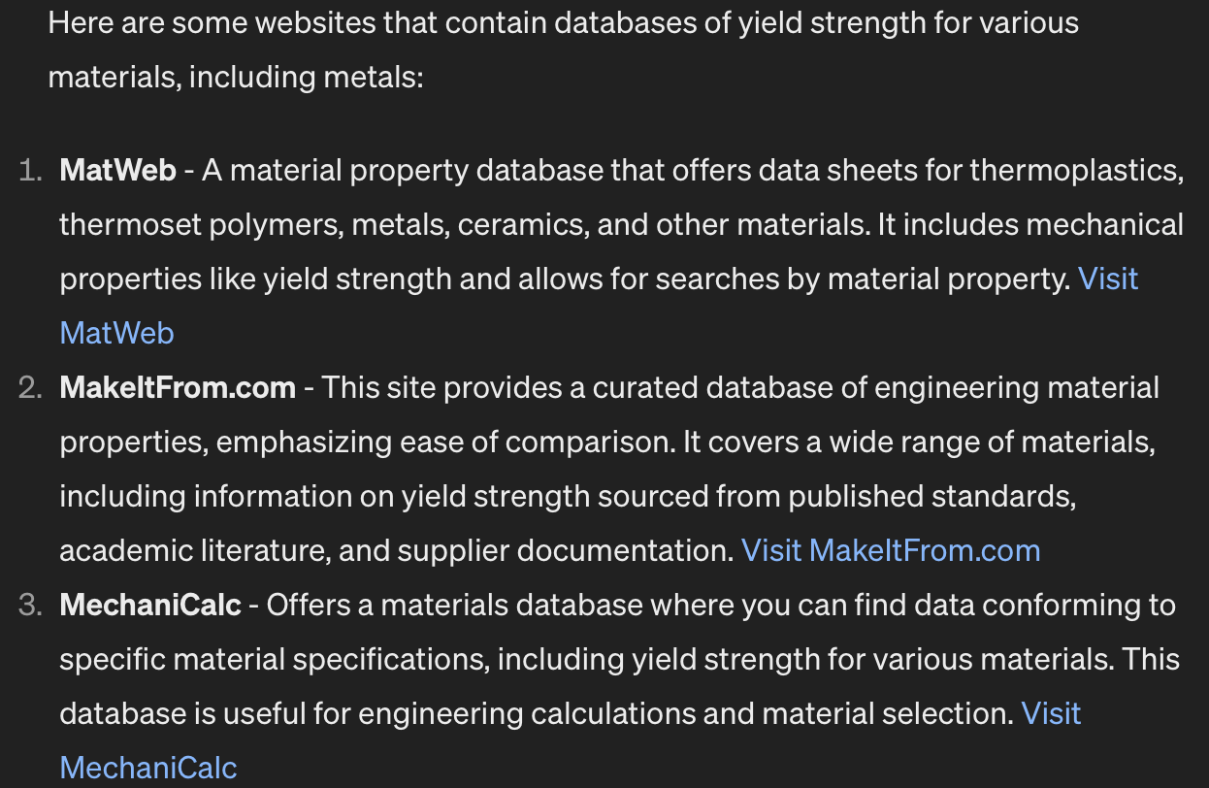
Progress
Trying to find a research paper with ground truth data about yield strength
Ask GPT what are some websites that have Comprehensive ground truth data on yield strength
And GPT yield strength database might come from those websites
The scarcity of yield strength data for individual chemical elements can be attributed to the fact that testing and reporting of yield strength are predominantly focused on materials used in the construction industry. In this context, the emphasis is often on alloys or composite materials rather than on single chemical elements.

Slide 3
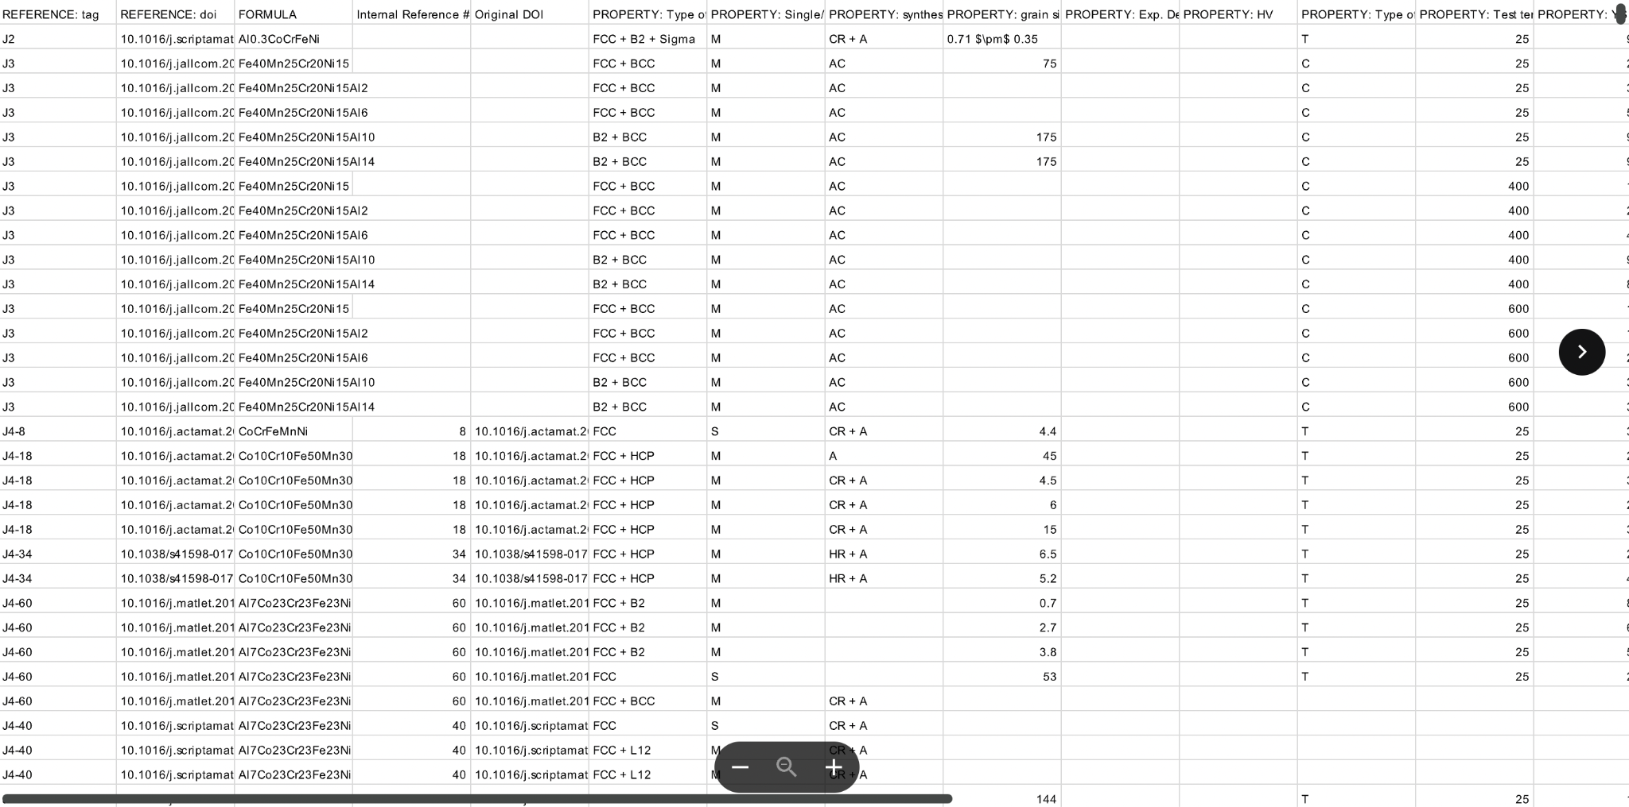
Progress
We found one dataset for yield strength of more complex compounds in this paper https://www.nature.com/articles/s41597-020-00768-9
This contained a csv file with many complex compounds and data related to their properties.

Slide 4
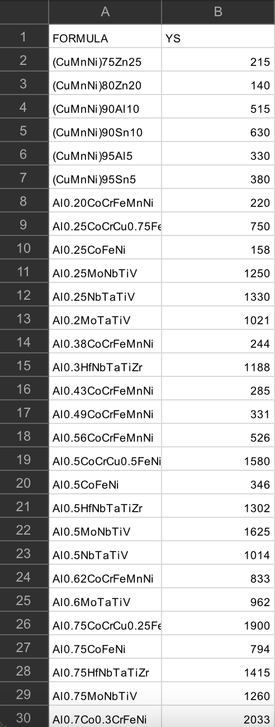
Progress
Using Rstudio to tidy the data
Only contains two columns: chemical compounds
Only the materials have yield strength values
Only yield strength values that are a number
Finally, combine the dataset from 2018 and 2019 and check if duplicated( unit in MPa)
R code: https://drive.google.com/file/d/14bH0hsxIs9QwbQFade5QKeENdivg7GwI/view?usp=share_link
Ground Truth Data:
https://drive.google.com/file/d/1-rlOq9bGIa3Tpybib6ymSy_0P72FamiR/view?usp=share_link
268 entries

Slide 5
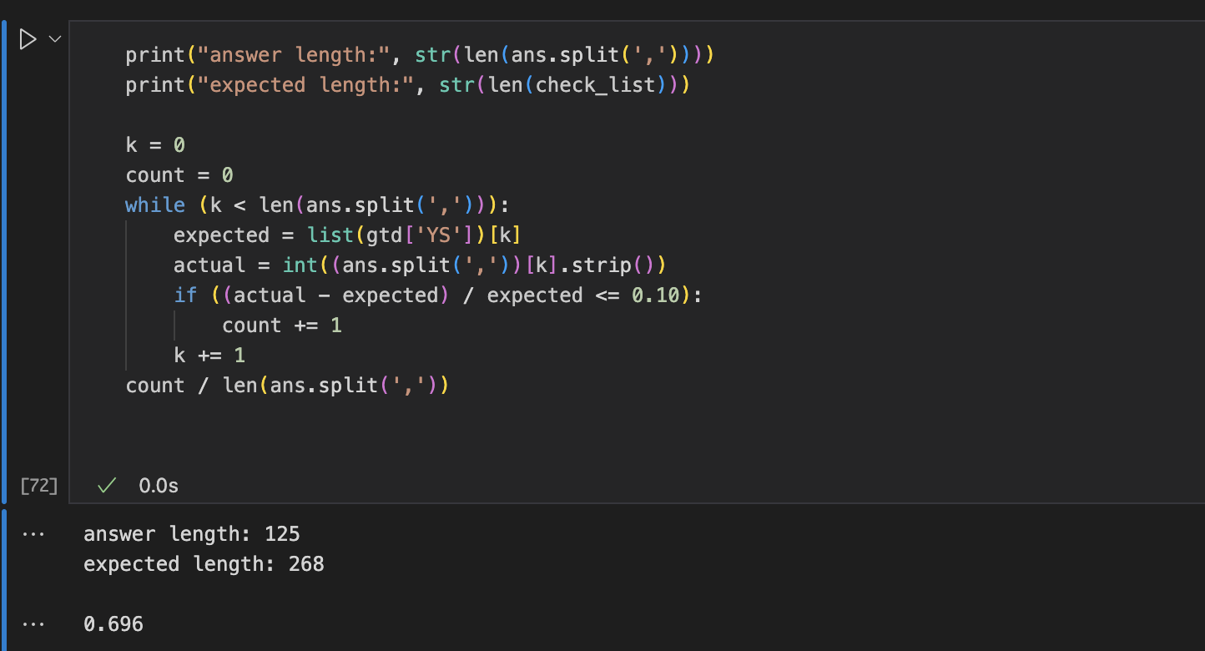
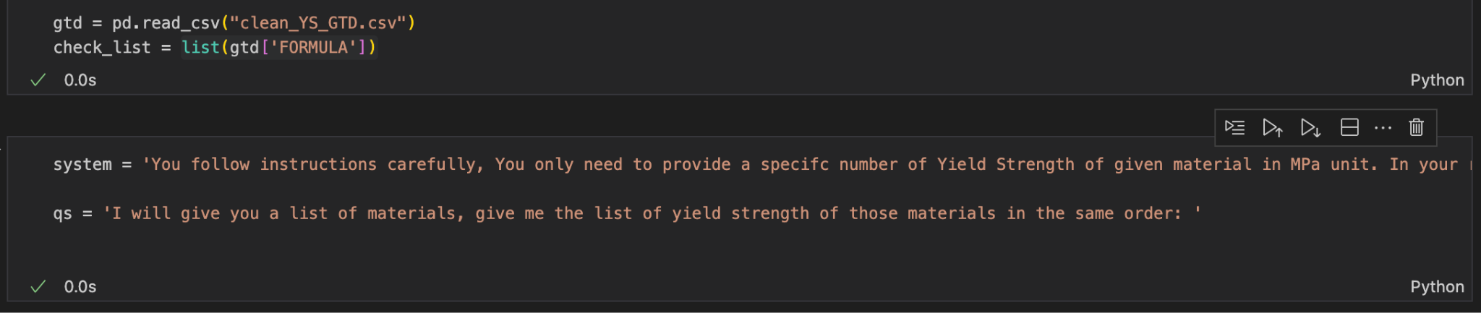
Progress
Since we don’t have much Ground Truth Data on Yield Strength, one possible options at this stage will be: instead of prompting GPT to generate yield strength as much as it can from its database, we give GPT the chemical composition that we found, and check if the value given by GPT matches the one we found online.
We modify the prompt to ask GPT only once and format its answer to a list, then check the result against the ground truth database
Nevertheless, GPT stop at the middle. it CAN’T generate the yield strength of 268 materials, it only produces the yield strength of the first 125 materials
Using 10% error acceptance, GPT get 69.6% correct values of yield strength among the 125 generated entries (I believe it did a good job)

Slide 6
Question / Further Steps
GPT can’t generate results for the whole list of materials. What makes it stops at the middle? Is it timeout exception? Or it just don’t want to generate more and stop there? Or it splits the list we given in the wrong way.(maybe next week prompting GPT a nicer input table)
GPT did a good job when feeding it with specific materials to check. However, will it also did a good job when we don’t prompt specific materials? Will it gives us results that have records in our Ground Truth Database, or completely no overlap?
There are some concerns about the previous steps: we can improve/expand our GT database by searching the unknown of GPT’s answer and put them in our database. However, it is too inefficient in such way, what are some better way to accomplish this?

Slide 7
Summary
Date | Hours | Description of Work
03/10/2023 | 2.5 | Researched and found Dataset with chemical compounds and properties
03/10/2023 | 2 | Cleaned dataset to only include necessary columns and rows
3/10/2023 | 2.5 | Check GTD with GPT

