Slide 1
Yield Strength
Week 6
Yutong, Xiangyu, Haoting, Harsha

Slide 2
Progress
Citation of dataset from last week
Borg, C.K.H., Frey, C., Moh, J. et al. Expanded dataset of mechanical properties and observed phases of multi-principal element alloys. Sci Data 7, 430 (2020). https://doi.org/10.1038/s41597-020-00768-9
Citation of new dataset
Polak, M.P., Morgan, D. Extracting accurate materials data from research papers with conversational language models and prompt engineering. Nat Commun 15, 1569 (2024). https://doi.org/10.1038/s41467-024-45914-8

Slide 3
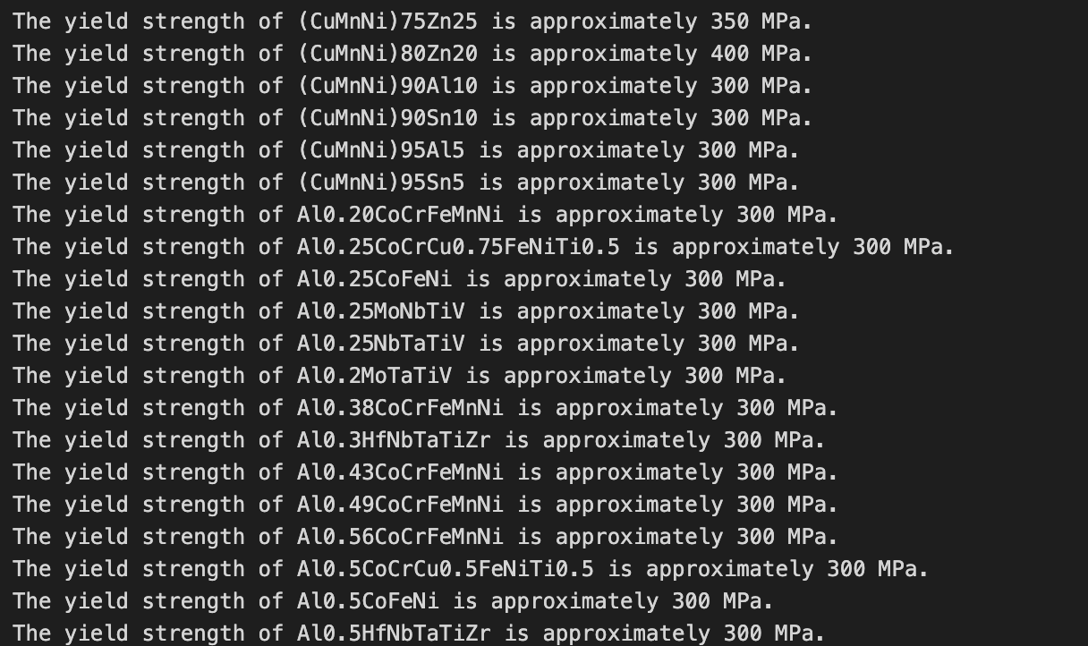
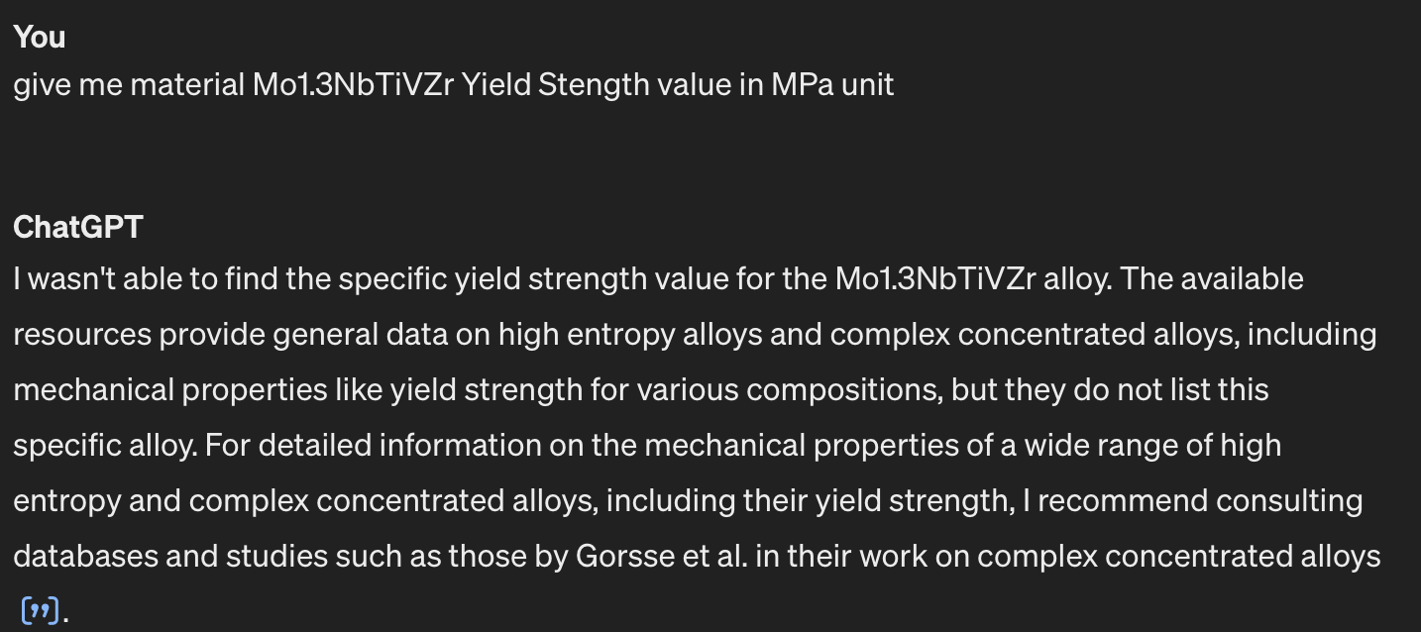
Update From Last week
Last week, when we check the ground truth database with only one conversation with all materials, it stops at the middle with a accuracy of 70%
This week, when we check over the results again with each conversation asking one element. GPT doesn’t seems good at it.
Almost every element has a yield strength of 300 MPa.
When I check one of the material that GPT gets yield strength of 300 MPa, GPT doesn’t know it.
Since GPT doesn’t know much about this database, we found another ground truth database that contains more general materials.

Slide 4
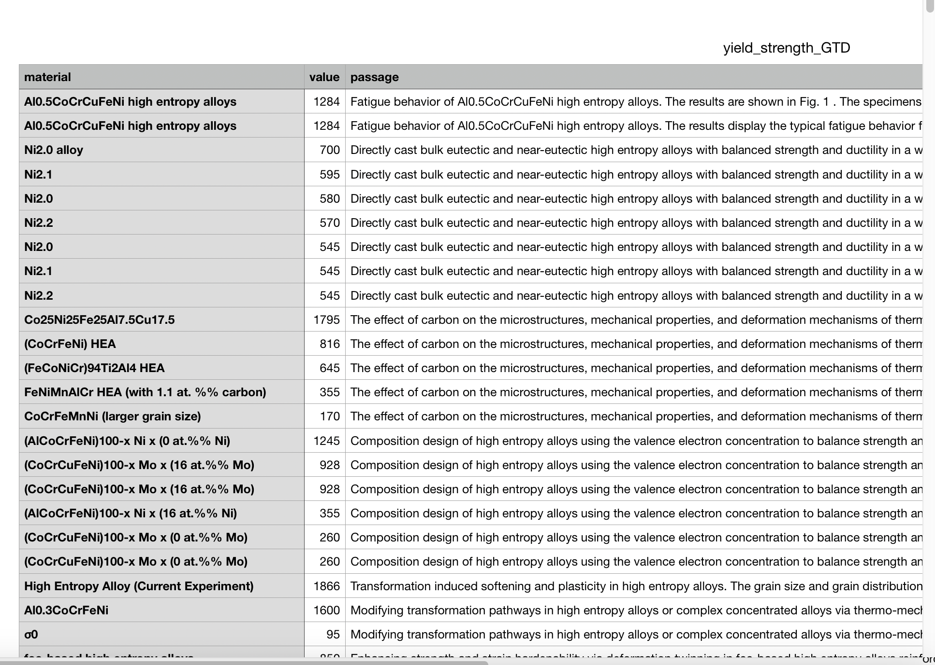
Progress
Link to file: https://drive.google.com/file/d/12oO8yD0oMgzyxlv64yjSg8OfuaId9f-o/view?usp=share_link
Cleaning the new Ground Truth Database contains three columns: material name, value(all converted into MPa unit), and passage describe it.
The cleaned database only contains high entropy alloy (use passage info to filter)
Problem: a specific material name have multiple value of yield strength due to some factors, such as temperature
Length of the GTD: 1064

Slide 5
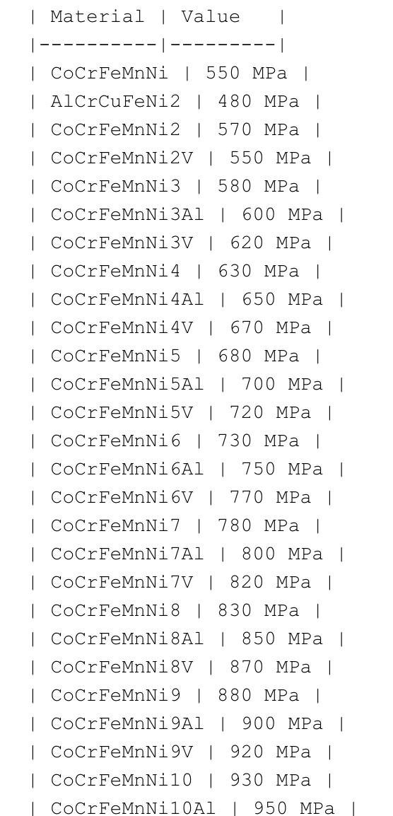
Progress
Asked GPT to generate data for only high entropy alloys
Problem: GPT only gave results with multiple Ni(Ni is the only element with subscript in almost entire result)

Slide 6
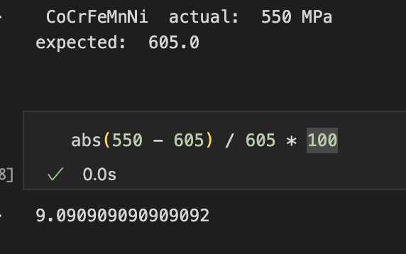
Progress - check against our new ground truth Table
True Positive | 1
False Positive | 0
Unknown | 1063
GPT’s generated result only matches one entry in our GTD. last but not least, it is considered correct under 10% acceptable error
When we dive into the result, most elements are just slightly different from what we have in GTD. For example: GPT: CoCrFeMnNi9 Ground Truth: CoCrFeMnNi

Slide 7
Problem
Multiple entries in the Ground Truth Database due to yield strength varies under different temperatures, how to set a standard of that?
Slightly different in material names, are they the same material?

Slide 8
Summary
Date | Hours | Description of Work
03/17/2023 | 1 | Explored new dataset that was given to us in last week’s meeting
03/17/2023 | 2 | Kept generating the second half of last weeks dataset
03/17/2023 | 1 | Cleaned new dataset to only include high entropy alloys for now

