Slide 1
Fruit Classification Using CNN
Henry Tappa, Ryan Kinsey, Eric Goldman

Slide 2
Introduction
Image Classification using Convolutional Neural Network (CNN)
Fruit Classification Network
Utilized Python and Pytorch on 1 GPU

Slide 3
Application
Automate Customs and Border Protections (CBP) processes for use in agriculture industry
In 2018, CBP apprehended 2.5 tons of prohibited fruit in Ohio
Prohibited due to disease and pest control measures
CBP officers inspect fruit by hand
Deep Learning could aid in the inspection with higher rates of inspection

Slide 4
Data
Fruits 360 Dataset | Kaggle: https://www.kaggle.com/moltean/fruits/version/2
20,000 images with 33 classes of fruit
Images are full-color and 100 x 100 pixels
Training set: 15,506 images
Testing set: 5,195 images
Ran two networks
Subset – 5 fruits
Entire set – 33 fruits

Slide 5
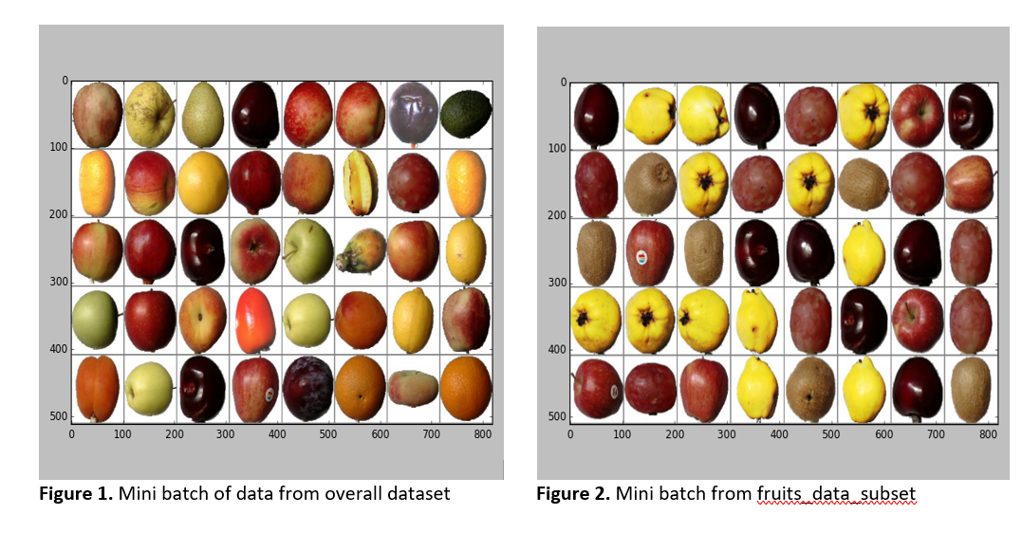
Fruit Images

Slide 6
Network
2-dimension architecture
BatchNorm2D
Non-linear activation function – ReLU
ADAM optimizer
Computes individual learning rates for different parameters

Slide 7
Code
class CNN(nn.Module):
def __init__(self):
super(CNN, self).__init__()
self.layer1 = nn.Sequential(
nn.Conv2d(in_channels=3, out_channels=32, kernel_size=5, padding=2),
nn.BatchNorm2d(num_features=32),
nn.ReLU(),
nn.MaxPool2d(kernel_size=2, stride=2))
self.layer2 = nn.Sequential(
nn.Conv2d(in_channels=32, out_channels=64, kernel_size=5, padding=2),
nn.BatchNorm2d(num_features=64),
nn.ReLU(),
nn.MaxPool2d(kernel_size=2, stride=2))
self.fc = nn.Linear(in_features=40000, out_features=num_classes)
Notes:
2 layer cnn

Slide 8
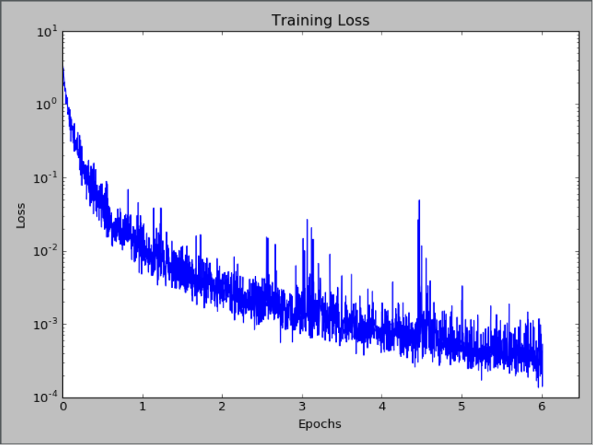
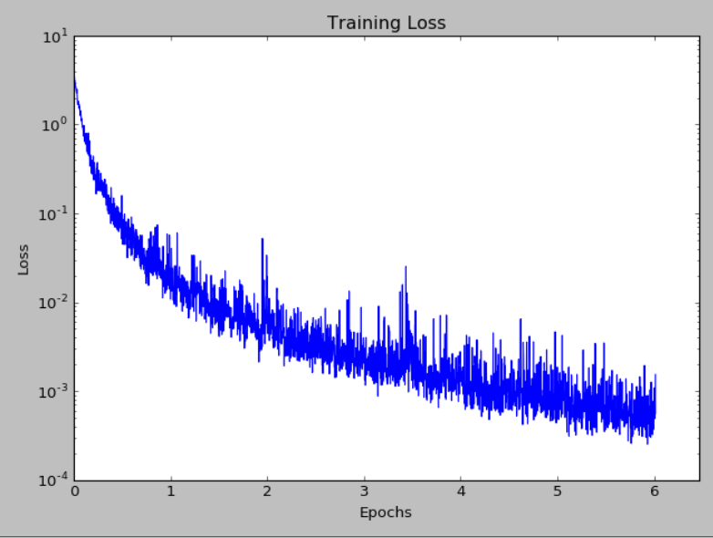
Training Loss
2 Layer Loss
3 Layer Loss

Slide 9
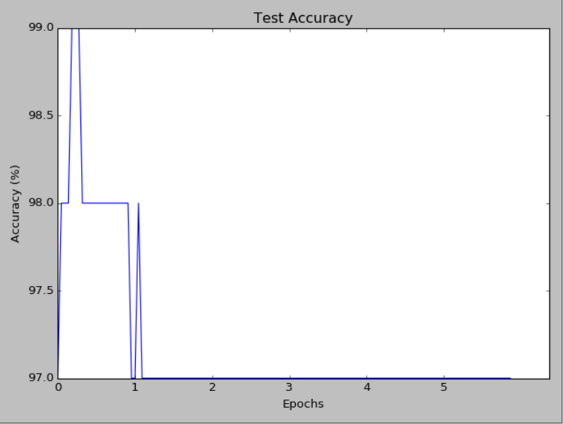
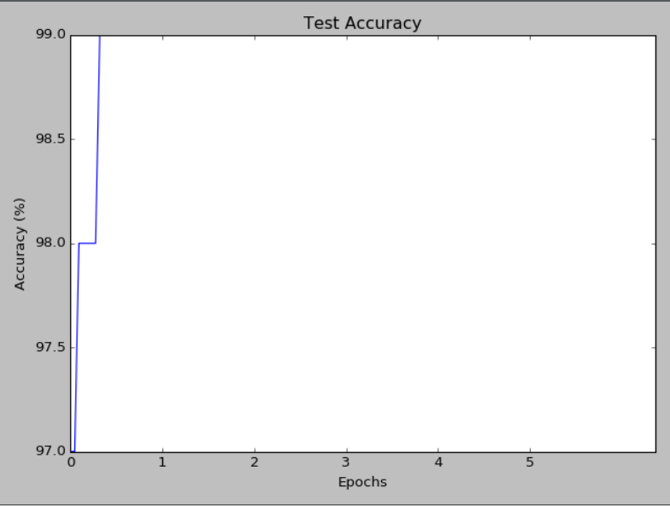
Results – Accuracy
2 Layer Accuracy – 97%
3 Layer Accuracy – 99%

Slide 10
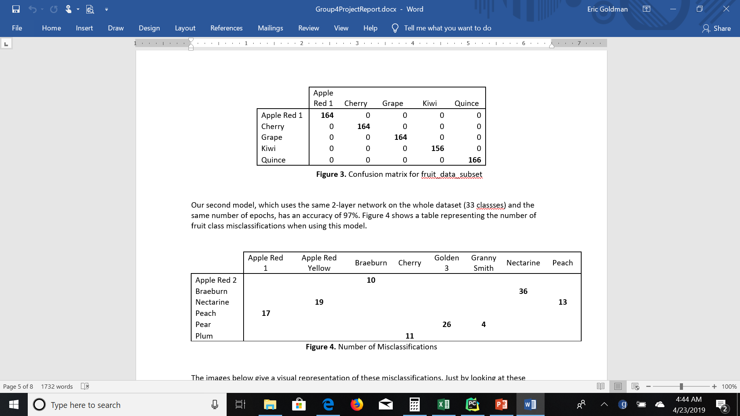
Results – Confusion Matrix

Slide 11
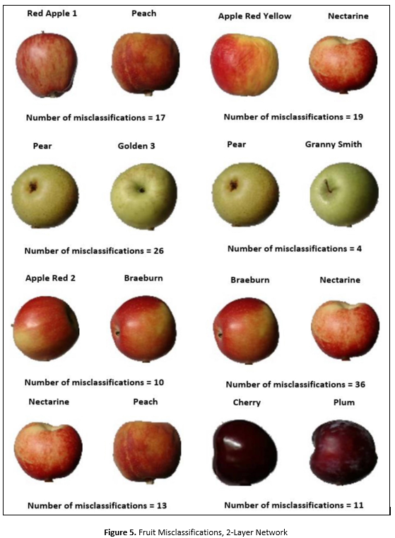
Figure 5. Fruit Misclassifications, 2-Layer Network

Slide 12
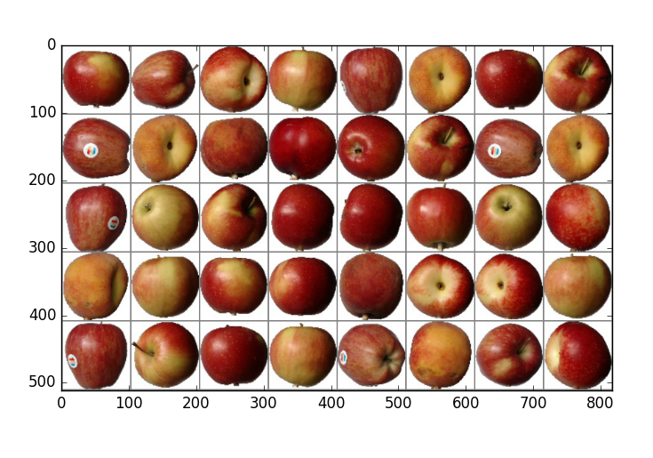
Can You Tell the Difference?

Slide 13
Conclusion
Deep Learning was accurate between 97 and 100 percent in classifying fruits
Government and industry have job processes that are ripe for disruption
CNN and ADAM optimizer were the correct choices for our model

Slide 14
Questions?

