Slide 1
Docker Certified Associate (DCA)
Create by: Hadi Tayanloo
Phone : +98-912-8387233
Linkedin: linkedin.com/in/htayanloo/

Slide 2
Session 10
Kubernetes Managment
Kubernetes Pods
Kubernetes Resource
Kubernetes Volume

Slide 3
Master nodes Porst
Protocol Direction Port Range Purpose Used By
TCP Inbound 6443* Kubernetes API server All
TCP Inbound 2379-2380 etcd server client API kube-apiserver, etcd
TCP Inbound 10250 Kubelet API Self, Control plane
TCP Inbound 10251 kube-scheduler Self
TCP Inbound 10253 kube-controller-manager Self

Slide 4
Worker nodes Porst
Protocol Direction Port Range Purpose Used By
TCP Inbound 10250 Kubelet API Self, Control plane
TCP Inbound 30000-32767 NodePort Services** All

Slide 5
Building Large Clusters
No more than 5000 nodes
No more than 150000 total pods
No more than 300000 total containers
No more than 100 pods per node

Slide 6
Using kubectl explain to discover possible API object fields
$ kubectl explain pods
$ kubectl explain pod.spec

Slide 7
Using labels for categorizing worker nodes
$ kubectl label node k8s-worker-02 gpu=true
node "k8s-worker-02" labeled
$ kubectl get nodes -l gpu=true
NAME STATUS AGE
k8s-worker-02 Ready 1d

Slide 8
Scheduling to one specific node
apiVersion: v1
kind: Pod
metadata:
name: kubia-gpu
spec:
nodeSelector:
kubernetes.io/hostname : "k8s-worker-01"
containers:
- image: luksa/kubia
name: kubia

Slide 9
Deleting pods using label selectors
$ kubectl delete po -l creation_method=manual
pod "kubia-manual" deleted
pod "kubia-manual-v2" deleted

Slide 10
Deleting all pods in a namespace, while keeping the namespace
$ kubectl delete po --all
pod "kubia-zxzij" deleted

Slide 11
Deleting (almost) all resources in a namespace
$ kubectl delete all --all
pod "kubia-09as0" deleted
replicationcontroller "kubia" deleted
service "kubernetes" deleted
service "kubia-http" deleted

Slide 12
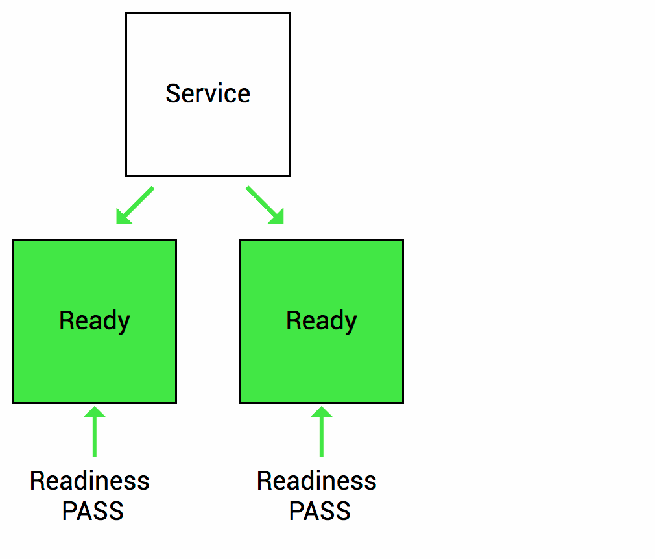
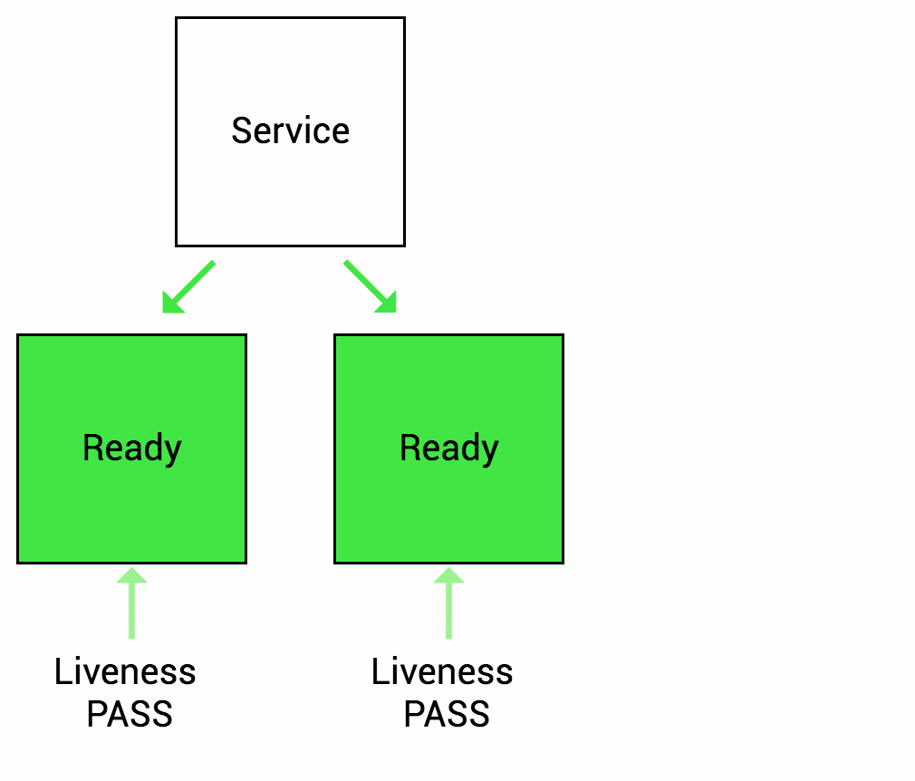
Keeping pods healthy
Readiness Liveness

Slide 13
Type of Probes
HTTP
Command
TCP

Slide 14
Type of Probes :; Command
apiVersion: v1
kind: Pod
metadata:
labels:
test: liveness
name: liveness-exec
spec:
containers:
- name: liveness
image: k8s.gcr.io/busybox
args:
- /bin/sh
- -c
- touch /tmp/healthy; sleep 30; rm -rf /tmp/healthy; sleep 600
livenessProbe:
exec:
command:
- cat
- /tmp/healthy
initialDelaySeconds: 5
PeriodSeconds: 5
For the first 30 seconds of the Container’s life, there is a /tmp/healthy file. So during the first 30 seconds, the command cat /tmp/healthy returns a success code. After 30 seconds, cat /tmp/healthy returns a failure code.

Slide 15
Type of Probes :; Command
$ kubectl create -f https://k8s.io/examples/pods/probe/exec-liveness.yaml
$ kubectl describe pod liveness-exec
FirstSeen LastSeen Count From SubobjectPath Type Reason Message
--------- -------- ----- ---- ------------- -------- ------ -------
24s 24s 1 {default-scheduler } Normal Scheduled Successfully assigned liveness-exec to worker0
23s 23s 1 {kubelet worker0} spec.containers{liveness} Normal Pulling pulling image "k8s.gcr.io/busybox"
23s 23s 1 {kubelet worker0} spec.containers{liveness} Normal Pulled Successfully pulled image "k8s.gcr.io/busybox"
23s 23s 1 {kubelet worker0} spec.containers{liveness} Normal Created Created container with docker id 86849c15382e; Security:[seccomp=unconfined]
23s 23s 1 {kubelet worker0} spec.containers{liveness} Normal Started Started container with docker id 86849c15382e

Slide 16
Type of Probes :; HTTP
apiVersion: v1
kind: Pod
metadata:
labels:
test: liveness
name: liveness-http
spec:
containers:
- name: liveness
image: k8s.gcr.io/liveness
args:
- /server
livenessProbe:
httpGet:
path: /healthz
port: 8080
httpHeaders:
- name: X-Custom-Header
value: Awesome
initialDelaySeconds: 3
periodSeconds: 3

Slide 17
Type of Probes :; HTTP
kubectl create -f https://k8s.io/examples/pods/probe/http-liveness.yaml
kubectl describe pod liveness-http
FirstSeen LastSeen Count From SubobjectPath Type Reason Message
--------- -------- ----- ---- ------------- -------- ------ -------
24s 24s 1 {default-scheduler } Normal Scheduled Successfully assigned liveness-exec to worker0
23s 23s 1 {kubelet worker0} spec.containers{liveness} Normal Pulling pulling image "k8s.gcr.io/busybox"
23s 23s 1 {kubelet worker0} spec.containers{liveness} Normal Pulled Successfully pulled image "k8s.gcr.io/busybox"
23s 23s 1 {kubelet worker0} spec.containers{liveness} Normal Created Created container with docker id 86849c15382e; Security:[seccomp=unconfined]
23s 23s 1 {kubelet worker0} spec.containers{liveness} Normal Started Started container with docker id 86849c15382e

Slide 18
Type of Probes :; TCP
apiVersion: v1
kind: Pod
metadata:
name: goproxy
labels:
app: goproxy
spec:
containers:
- name: goproxy
image: k8s.gcr.io/goproxy:0.1
ports:
- containerPort: 8080
readinessProbe:
tcpSocket:
port: 8080
initialDelaySeconds: 5
periodSeconds: 10
livenessProbe:
tcpSocket:
port: 8080
initialDelaySeconds: 15
periodSeconds: 20

Slide 19
Type of Probes :; TCP
kubectl create -f https://k8s.io/examples/pods/probe/tcp-liveness-readiness.yaml
kubectl describe pod goproxy

Slide 20
readinessProbe
readinessProbe:
exec:
command:
- cat
- /tmp/healthy
initialDelaySeconds: 5
periodSeconds: 5

Slide 21
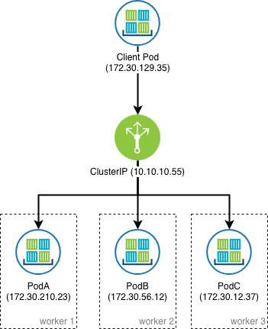
ClusterIP
kubectl run test-nginx --image=nginx --replicas=2 –port=80
kubectl expose deployment test-nginx

Slide 22
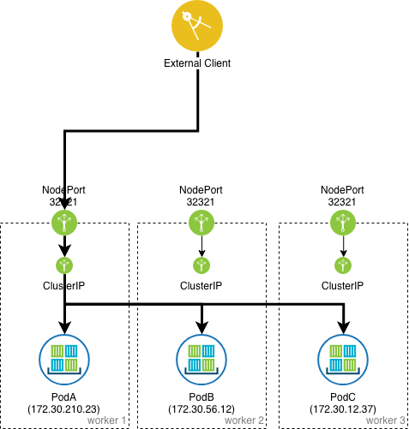
NodePort
Default 30000-32767

Slide 23
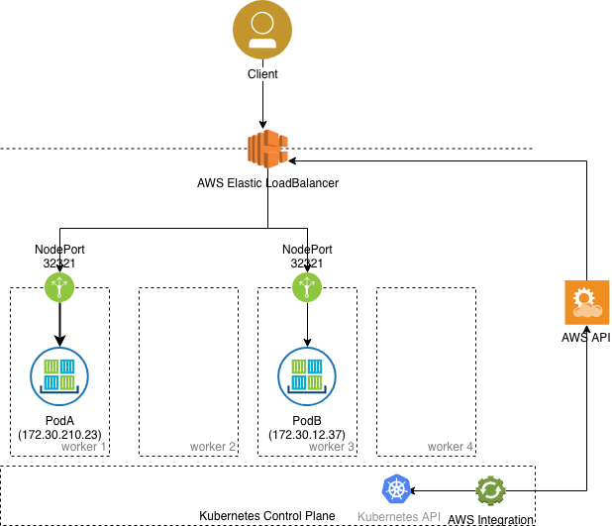
LoadBalancer

Slide 24
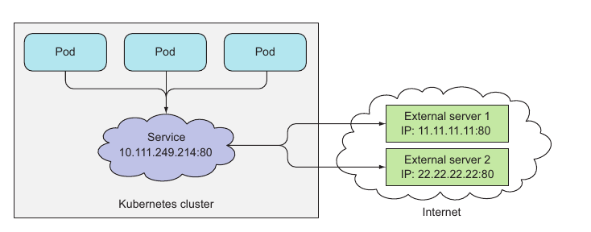
External

Slide 25
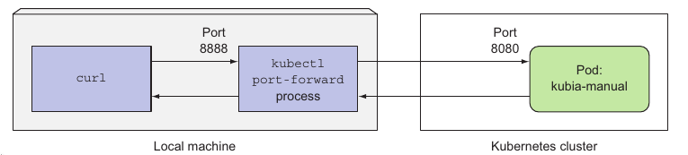
FORWARDING A LOCAL NETWORK PORT TO A PORT IN THE POD
$ kubectl port-forward kubia-manual 8888:8080
... Forwarding from 127.0.0.1:8888 -> 8080
... Forwarding from [::1]:8888 -> 8080

