Slide 1
D3 Library project
Graphing with Jquery
Presented by Clifford J Mauer (cmauer69)

Slide 2
D3
Data Drive Documents
Makes possible
  Bind arbitrary data to a Document Object Model
  Apply data driven transformations to the document
  Use the same data to create an interactive chart
Notes:
Beginning course details and/or books/materials needed for a class/project.

Slide 3
D3 Advantages
Efficent manipulation of documents based on data
Exposes full capabilities of web standards such as HTML,SVG, CSS.
Supports large datasets

Slide 4
D3 Components and Plugins
d3/d3-geo-projection - extended geographic projections.
etiennecrb/d3-xyzoom - independent zoom scaling on x and y axis.
susielu/d3-legend - reusable legends!
tomgp/d3-iconarray - draw an array of icons.
Notes:
A schedule design for optional periods of time/objectives.

Slide 5
Back in the Day….
HP-GL/2 was the best plotting language on the market
Manual is 540 pages
Used by thousands of companies to plot experimental results
In the 1980’s this was good enough

Slide 6
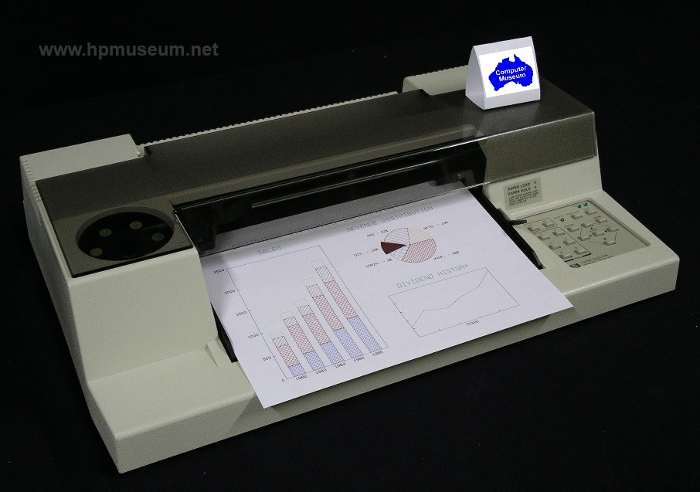
Hp Plotters
Notes:
Introductory notes.

Slide 7
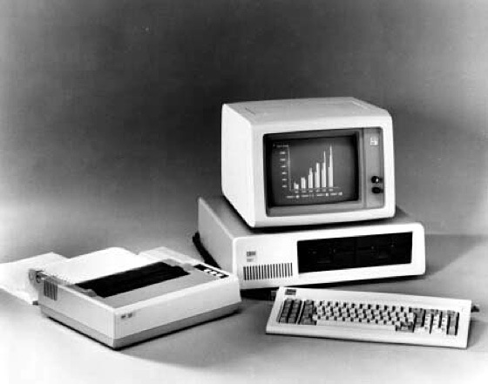
IBM Personal Computers

Slide 8
D3 Sample Project
Boss at work wants to know who is selling the most tablets. He wants it displayed in a graph. There are eight salesreps. All of the data for each rep should be displayed in the same graph.
Use the new D3 Jquery library to produce the graph. You should be able to display the graph on a web site.
Notes:
Objectives for instruction and expected results and/or skills developed from learning.

Slide 9
D3 Graphing Process Part 1
Create an area for the graph on the page
Scale the x and y axes
Append the graph to the DOM
Create the x axis
Create Title
Create the x axis label
Create the y axis
Create the y axis label

Slide 10

D3 Graphing – Part 2
Gather the data from the json data file
Map the domain to the data
Plot the data
Add the x axis
Add the values to the bars
Notes:
A list of procedures and steps, or a lecture slide with media.

Slide 11
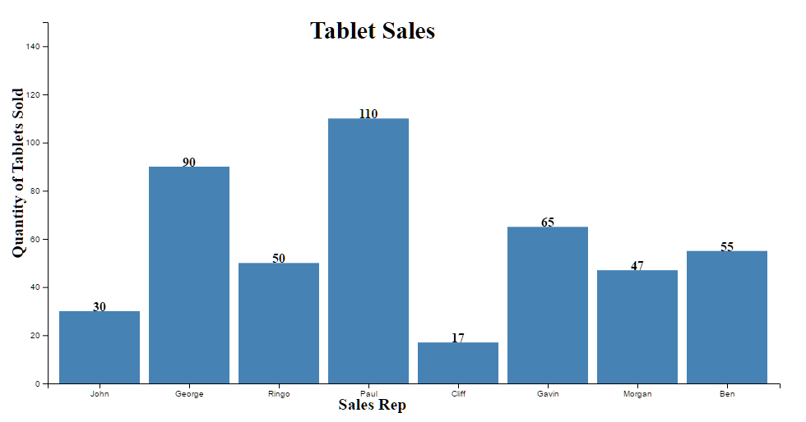
D3 Chart of Tablets Sold
Notes:
Example graph/chart.

Slide 12
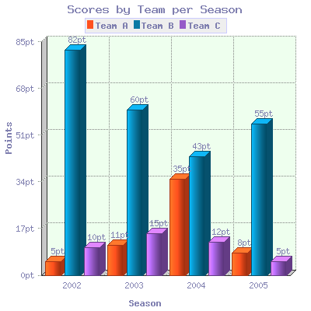
D3 - Examples
This graph is multiple values for each bar.
3 dimensional bars

Slide 13

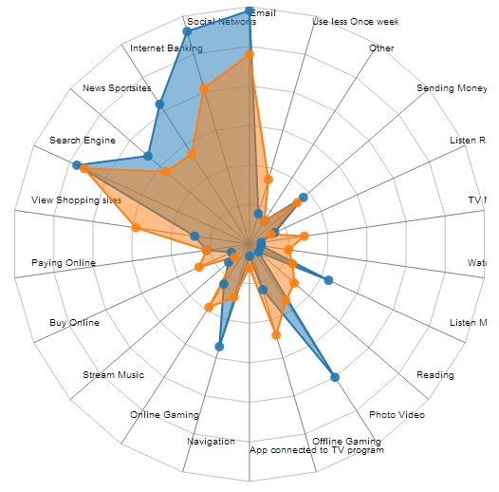
D3 - Examples
This graph show data on multiple axes

Slide 14
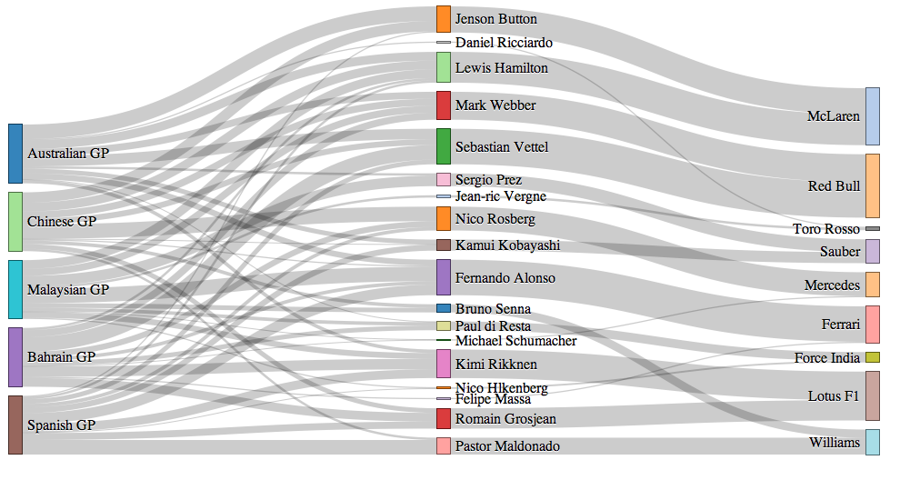
D3 - Examples
This graph shows Grand Prix race car drivers vs how many times they have won and what make of care they were driving.
Notes:
Example graph/chart.

Slide 15
D3 GitHub
D3 source code is stored in a public GitHub repository
Documentation for each of the D3 libraries
GitHub contains thousands of code example for this library.

Slide 16
D3 Coding Example
# Selections
  You can use selectors just the same as your Jquery code
    g.selectAll(".bar")
      This line of code selects all of the bars that are being graphed.
  D3 provides numerous methods for setting attributes or styles
  Direct access to the DOM is also possible, as each D3 selection is simply an array of nodes.

Slide 17
D3 Coding Example
D3 has dynamic properties
  Styles, attributes, and other properties can be specified as functions of data in D3
D3 has many built-in reusable functions and function factories, such as graphical primitives for area, line, and pie charts
To alternate shade of grey for even and odd nodes
d3.selectAll(“p”).style(“color”, function(d,i) {
return I % 2 ? “#fff” : “#eee”;
} );

Slide 18
D3 Coding Example
Enter and Exit
  Using D3’s enter and exit functions, you can create new nodes for incoming data and remove outgoing nodes that are no longer needed.
  A common pattern is to break the initial selection into three parts.
    Updating nodes to modify
    Entering nodes to add
    Exiting nodes to remove

Slide 19
Conclusion
D3 is a very powerful graphing library
The programmer has an infinite number of choices on how to visualize data.
Allow lots of time for learning
Allow lots of time for thinking
Notes:
Conclusion to course, lecture, et al.

Slide 20
Questions/Discussions
Is it easy to learn?
  Yes, there are many available examples
  Youtube videos are also available
Is this open source?
  Yes
What are some of the gotchas?
  There is a steep learning curve
  You can’t mix version 3 examples with version 4 libraries.
Notes:
An opportunity for questions and discussions.

