Slide 1

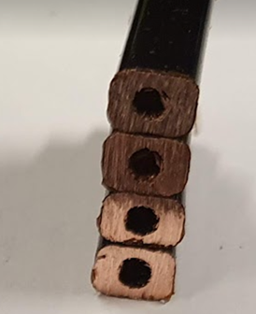
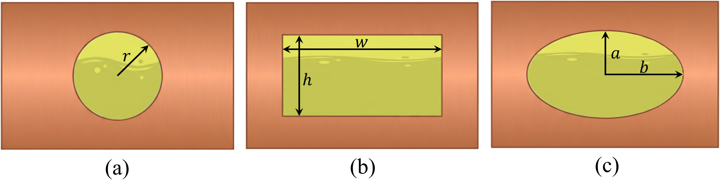
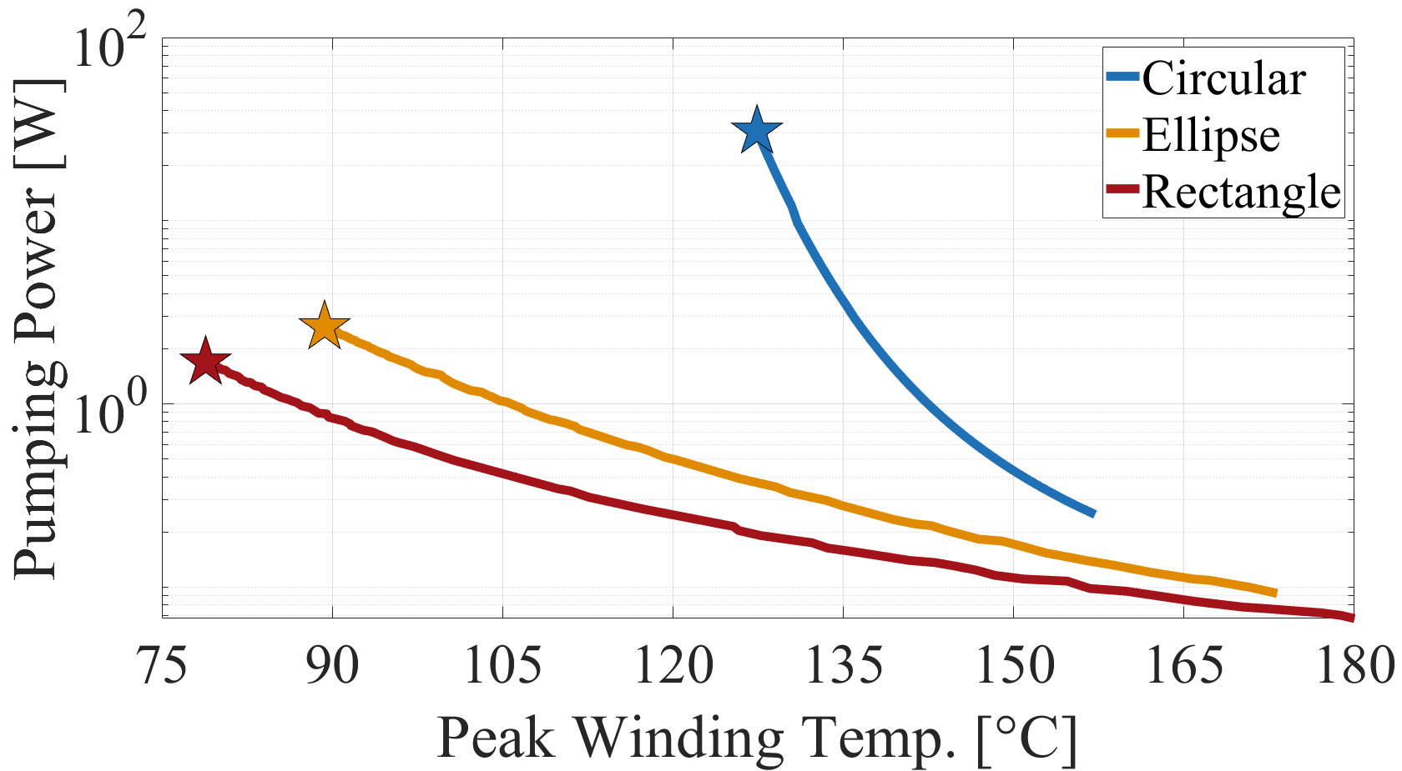
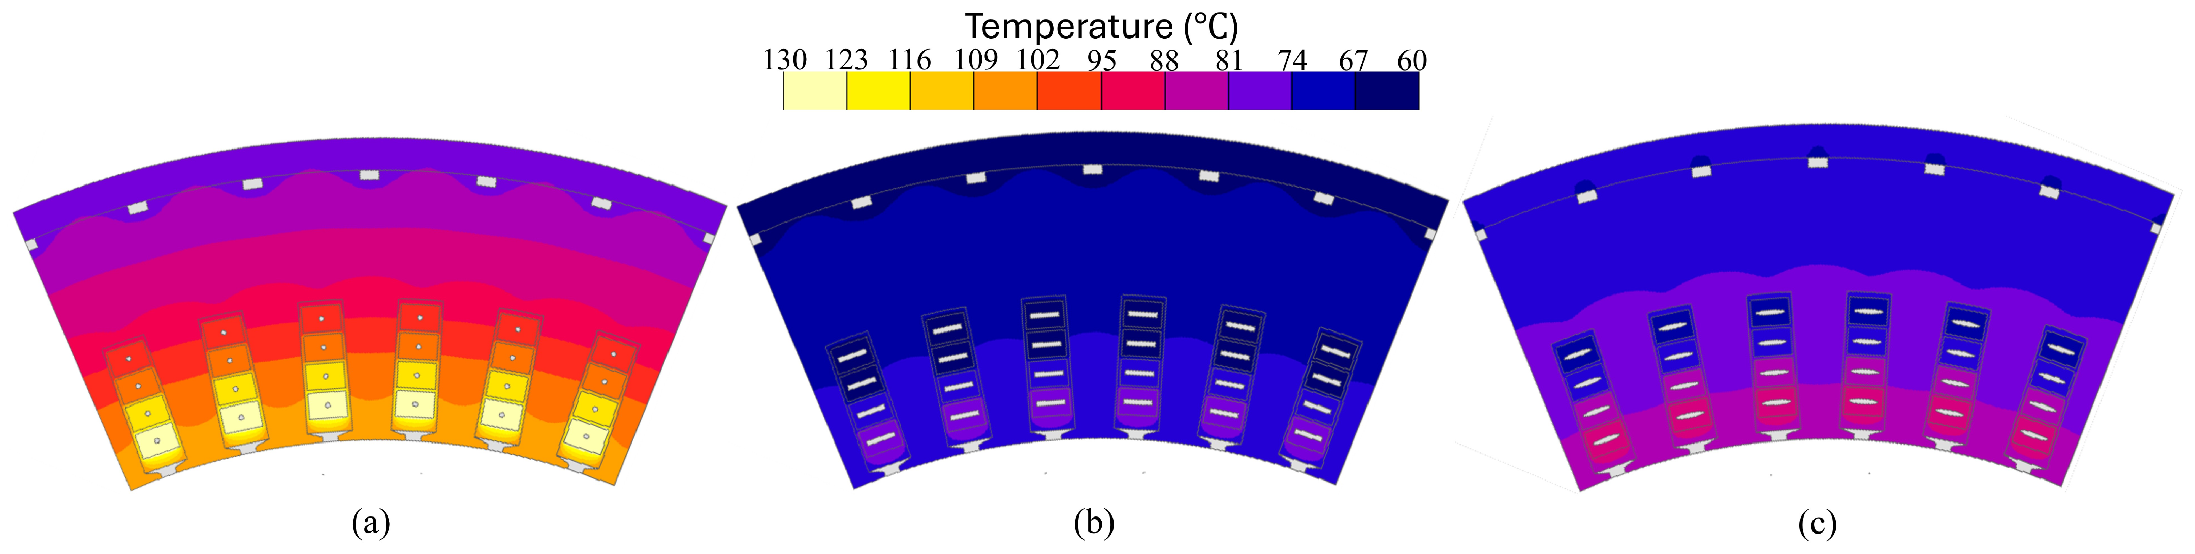
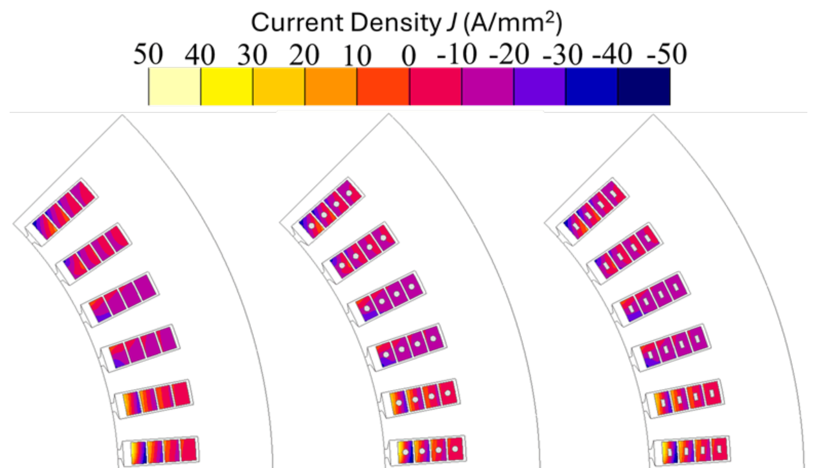
IMPACT OF COOLING CHANNEL SHAPE ON THE PERFORMANCE OF HOLLOW HAIRPIN WINDINGS
Multiphysics analysis and multi-objective channel shape optimization for direct oil-cooled hairpin windings
Hüseyin Tayyer Canseven
Department of Electrical Engineering, LUT University, Finland
Motivation
Channel-shape optimization
Traction motors: higher speed and frequency
Hairpin windings = industry standard
AC losses → severe local hot spots
Water jacket: long thermal path
Bigger channel: more surface, less copper
Smaller channel: steep pressure drop
Temperature vs. pumping power compete
128 FE samples → surrogate → GA
Wall and opening ≥ 0.75 mm
Direct oil cooling
Oil flows inside each conductor
Heat extracted at the source
Hot spots suppressed
+277 % continuous current
Reference machine
Power / speed | 300 kW / 2000 rpm
Slots × layers | 48 × 4
Conductor | 6 × 4 mm
Current / frequency | 350 A, 266.7 Hz
Coolant | Oil, 65 °C, 10 L/min
Flow regime | Laminar
Shape | Optimal size | Peak T | Pumping
Circular | Ø 0.75 mm | 127.4 °C | 34.8 W
Elliptical | 4.5 × 0.75 mm | 89.3 °C | 2.98 W
Rectangular | 4.5 × 0.75 mm | 78.8 °C | 1.92 W
Electromagnetic analysis
2D FEA: 350 A rms, 266.7 Hz
Current crowds at the periphery
Channel sits in the “dead zone”
Optimal designs: (a) circular (b) rectangular (c) elliptical
Conclusions
Channel centre is EM “dead”: < 0.25 %
Shape it purely for cooling
Rectangle > ellipse ≫ circle
Round → rectangular: −10 °C peak
Optimum: 78.8 °C at 1.92 W
Next: manufacturing + motorette test
(a) solid (b) round (c) rectangular
AC loss per layer (W)
Can the channel be shaped freely for cooling?
LABORATORY OF ELECTRICAL DRIVES TECHNOLOGY
Contact: Hüseyin T. Canseven (huseyin.canseven@lut.fi)
Ilya Petrov (ilya.petrov@lut.fi)

