Slide 1

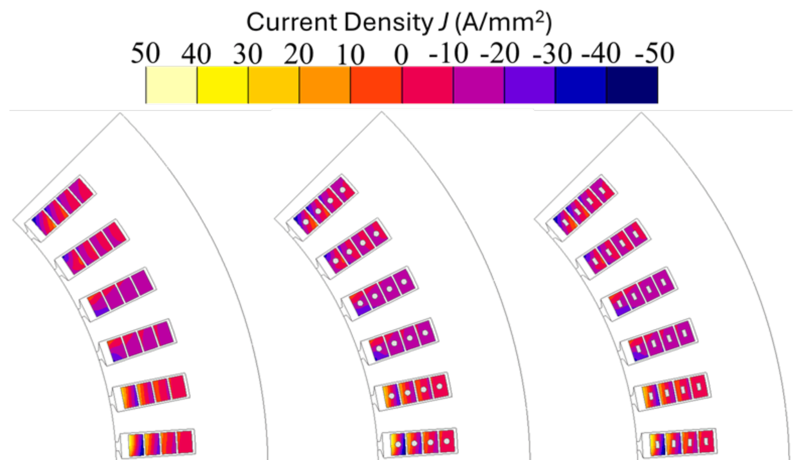
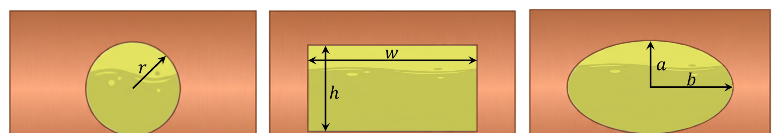
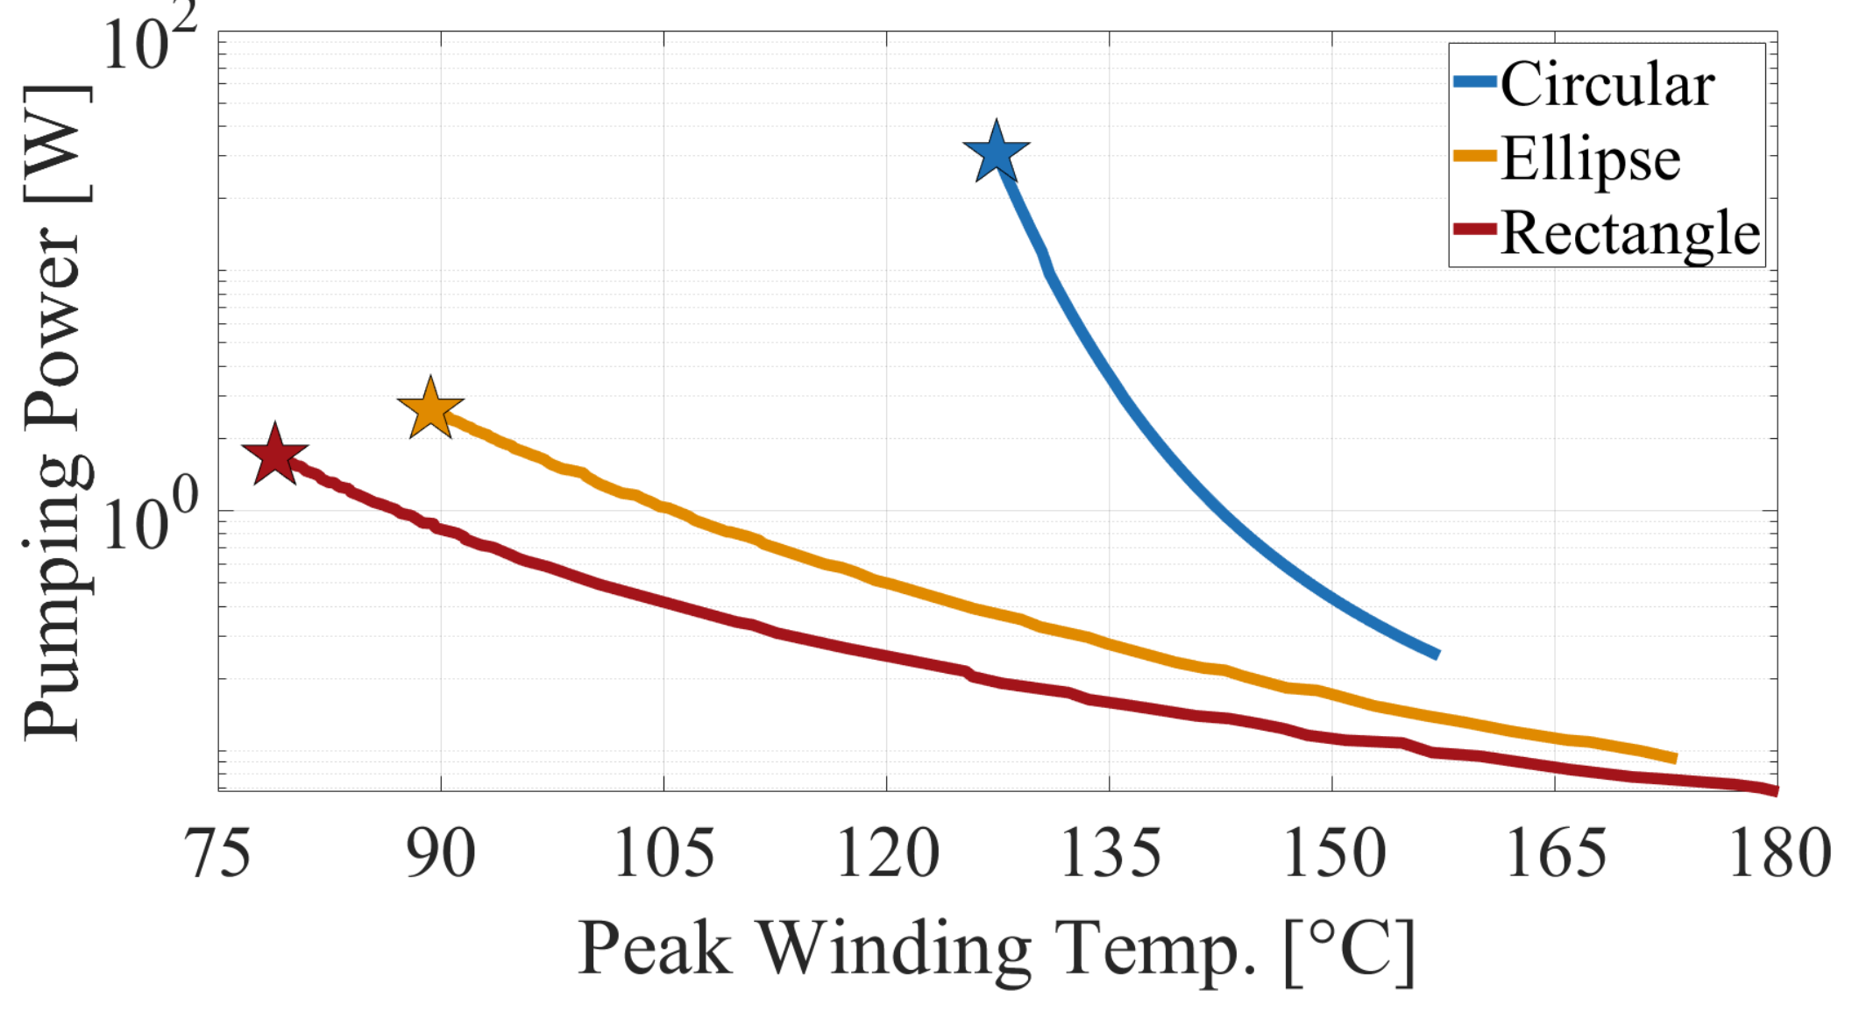
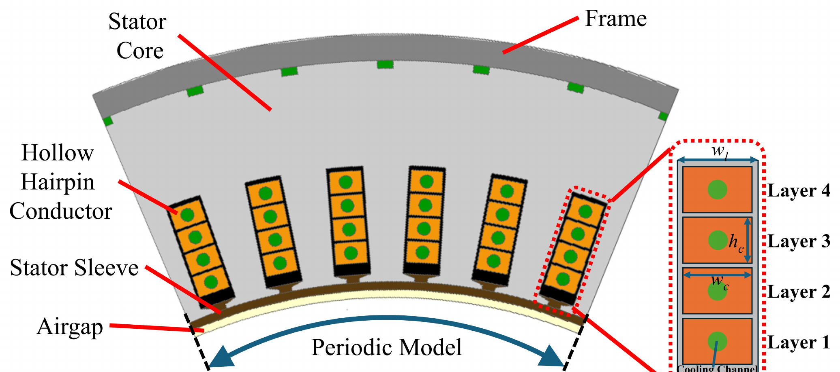
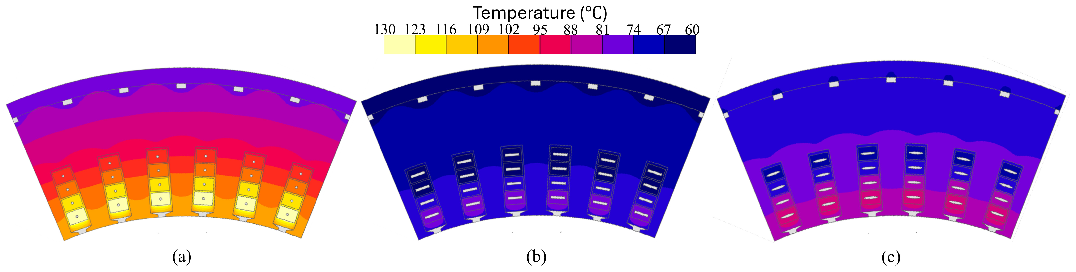
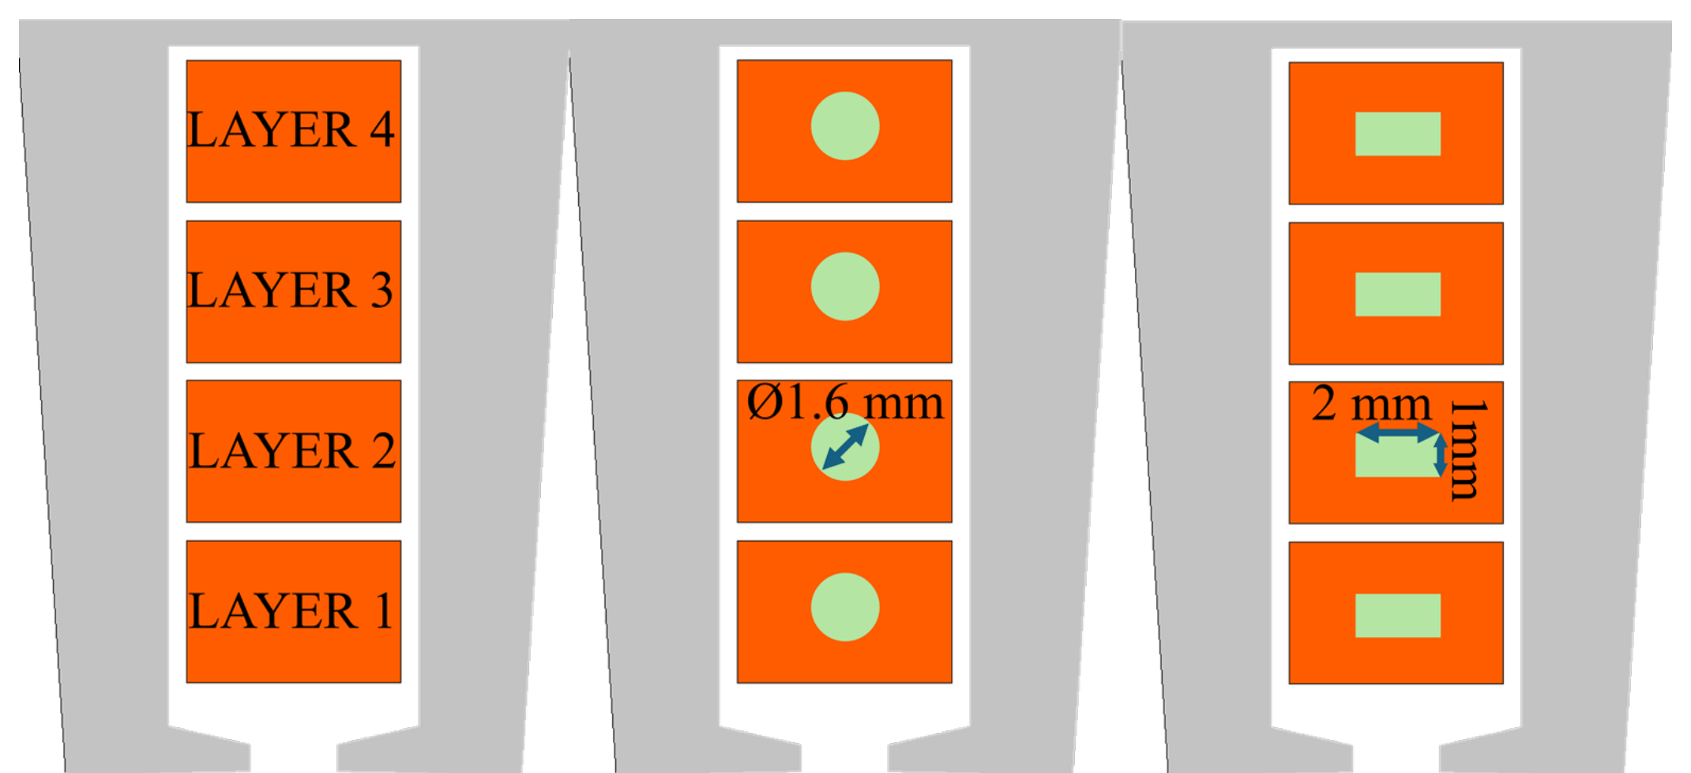
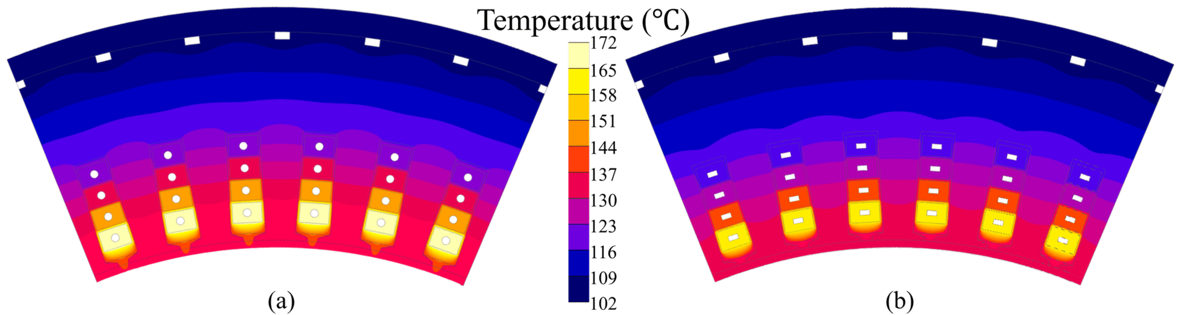
IMPACT OF COOLING CHANNEL SHAPE ON THE PERFORMANCE OF HOLLOW HAIRPIN WINDINGS
Electromagnetic–thermal analysis and multi-objective shape optimization of direct oil-cooled hairpin windings for traction motors
RESEARCH TEAM
Based on the authors' ICEM 2026
and ECCE 2026 conference papers
Hüseyin Tayyer Canseven¹ · Pratik Bisale¹ · Ilya Petrov¹ · Lassi Aarniovuori¹ · Juho Montonen² · Juha Pyrhönen¹
¹ Department of Electrical Engineering, LUT University, Finland ² Danfoss Editron, Lappeenranta, Finland
Motivation
Electromagnetic analysis
Channel-shape optimization
Electrified traction pushes motors to higher speeds and frequencies — hairpin windings are the standard thanks to high slot fill and automated manufacturing.
Skin and proximity effects concentrate AC losses in the conductors nearest the slot opening: severe local hot spots limit the continuous power rating.
Water jackets remove heat only after it has crossed slot insulation and stator core — a long, high-resistance thermal path.
2D FEA of all three topologies at the rated worst case: 350 A rms, 266.7 Hz.
High-frequency current crowds at the conductor periphery — the centre acts as a low-current “dead zone”, exactly where the cooling channel sits.
Enlarging the channel adds wetted surface but removes copper (higher DC loss); shrinking it raises the pressure drop steeply — peak temperature and pumping power genuinely compete.
Surrogate-based optimization: 128 thermal-FE samples per shape → surrogate model → multi-objective GA → Pareto front, with pumping power in closed form.
Manufacturability constraints: wall thickness ≥ 0.75 mm, channel opening ≥ 0.75 mm.
Direct oil cooling through hollow conductors
Dielectric oil flows through a channel inside each hairpin conductor: heat is extracted directly at the source, hot spots are suppressed and the critical end-winding region is cooled too.
Direct liquid cooling can sustain up to 277 % higher continuous current than a water jacket at the same winding temperature limit.
Current density at rated frequency: solid, round and rectangular conductors (left → right). The channel region carries almost no current.
Candidate shapes within the same conductor: circular, rectangular, elliptical.
High-frequency AC losses per layer (W)
Pareto fronts (log pumping-power scale); stars mark minimum-temperature designs. The rectangular channel dominates the entire trade-off range.
Layer 1 lies next to the airgap and dominates the loss — yet its AC losses are shape-independent.
Shape | Optimal channel | Peak T | Pump power
Circular | Ø 0.75 mm | 127.4 °C | 34.8 W
Elliptical | 4.5 × 0.75 mm | 89.3 °C | 2.98 W
Rectangular | 4.5 × 0.75 mm | 78.8 °C | 1.92 W
Reference machine: 300 kW hairpin-winding PMSM, modeled as a 1/6 periodic sector. Every conductor carries an internal cooling channel.
< 0.25 %
AC-loss difference between round and rectangular channels in the critical airgap-side layer — and only +2.4 % total loss for hollow vs solid conductors.
Reference machine & fair comparison
Thermal & hydraulic modelling
18 ×
less pumping power and −48.6 °C: the optimized rectangular channel (78.8 °C at 1.92 W) versus the optimized circular channel (127.4 °C at 34.8 W).
Rated power / speed | 300 kW / 2000 rpm
Stator slots × layers | 48 × 4 hollow conductors
Conductor cross-section | 6 mm × 4 mm
Rated current / frequency | 350 A rms / 266.7 Hz
Coolant (dielectric oil) | 65 °C inlet, 10 L/min total
Flow regime | Laminar (Re ≤ 113)
Equal area ⇒ equal mean velocity: the shapes differ only in wetted perimeter P and hydraulic diameter Dₕ = 4A/P.
Laminar flow ⇒ h = Nu·k / Dₕ — a larger wetted perimeter directly buys heat-transfer surface.
Fair-comparison rule: every channel keeps the same flow area (2 mm²) → same mean oil velocity and same copper removed — the pure shape effect is isolated.
 | Round | Rectangular
Wetted perimeter | 5 mm | 6 mm (+20 %)
Hydraulic diameter Dₕ | 1.60 mm | 1.33 mm
Nusselt number Nu | 4.36 | 4.12
Heat-transfer coeff. h | ≈ 350 W/(m²K) | ≈ 400 W/(m²K)
Temperature fields at each shape's minimum-temperature design: (a) circular, (b) rectangular, (c) elliptical. All optima are wide, shallow channels.
Conclusions
Steady-state thermal FEA
The channel interior is electromagnetically “dead” — AC-loss penalty < 0.25 %: the channel can be shaped purely for cooling.
Wetted perimeter within the fixed conductor envelope sets the thermal ranking: rectangle > ellipse ≫ circle.
An equal-area swap from round to rectangular already buys −10 °C peak temperature.
The optimized 4.5 × 0.75 mm rectangular channel reaches 78.8 °C at only 1.92 W pumping power.
Next: manufacturing of the optimized hollow profiles and experimental validation on a motorette.
Compared slot topologies: solid baseline, round channel Ø 1.6 mm, and rectangular channel 1 mm × 2 mm.
Temperature field at rated load — (a) round vs (b) rectangular channels. 2D FE slot model with layer-resolved losses and convection boundaries; the hot spot sits in Layer 1 next to the airgap.
Can the internal channel be shaped freely for cooling — without an electromagnetic penalty?
−10 °C
peak winding temperature: 172 °C (round) → 162 °C (rectangular) at the same 10 L/min oil flow — from the channel shape alone.
This work was supported by the Academy of Finland Centre of Excellence in High-Speed Electromechanical Energy Conversion Systems and by Danfoss Editron.
RESEARCH TEAM
CONTACT
Hüseyin Tayyer Canseven
huseyin.canseven@lut.fi
Pratik Bisale
pratik.bisale@lut.fi
Ilya Petrov
ilya.petrov@lut.fi
Lassi Aarniovuori
lassi.aarniovuori@lut.fi
Juho Montonen
juho.montonen@danfoss.com
Juha Pyrhönen
juha.pyrhonen@lut.fi
ICEM 2026 · ECCE 2026

