Slide 1
R for Medical Studies from Genomic big data

Slide 2
Schedule
2020/03/05 使用R分析基因的表現(1)
2020/03/12 使用R分析基因的表現(2)
2020/03/26使用Matlab分析運動表現(1)
2020/04/30使用Matlab分析運動表現(2)
2020/05/14使用Python進行影像分類(1)
2020/05/28 使用Python進行影像分類(2)
2020/06/11使用QIIME分析微生物組數據

Slide 3
Points of View about using R
From a researcher
A tool of statistics
A tool to produce figures
To investigate relationship between subjects such as diseases, genes and environment
To analyze variable data from cases
From a programmer
Data structures
Inputs and outputs
Commands and parameters
Algorithms and Comparisons

Slide 4
Correlation and dependence
Statistical relationship between two random variables
Phenotypes ad genotypes
Gene expressions and therapies
Genetic biomarkers and diagnosis

Slide 5
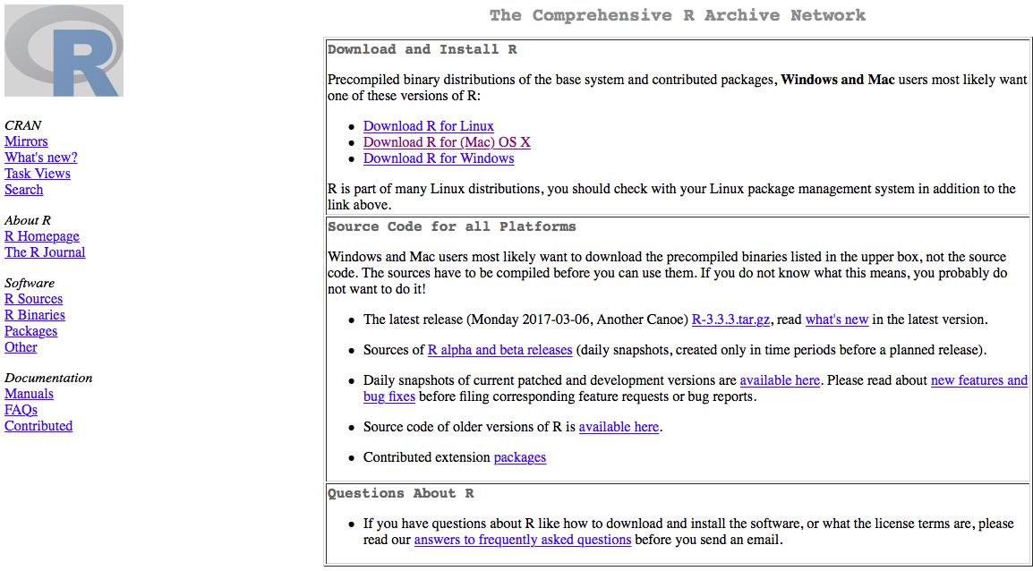

Slide 6
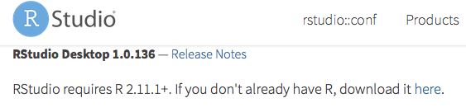

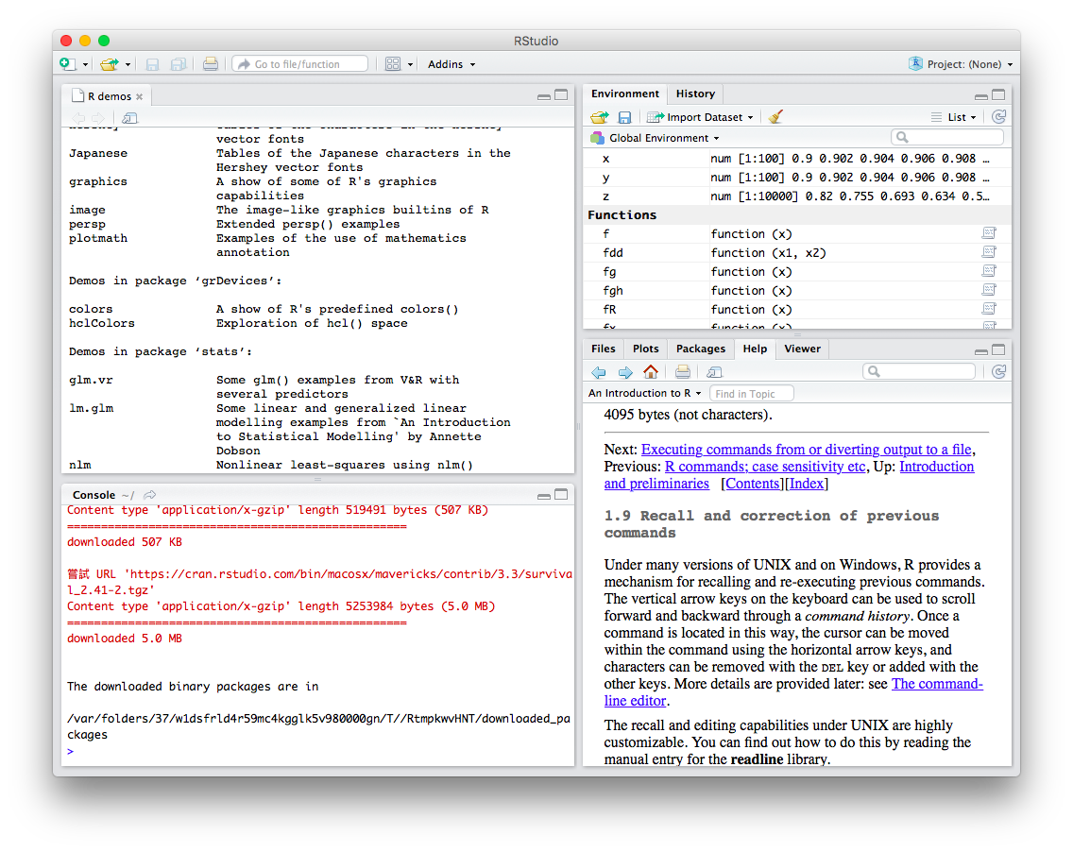

Slide 7


Slide 8
R as a programming tool
R interpreter
R studio
Deseq2
source("https://bioconductor.org/biocLite.R")
biocLite("DESeq2")

Slide 9
R Basics

Slide 10
Hello world
x <- "Hello World!"
print(x)

Slide 11
install.packages
install.packages("dtplyr")
install.packages(“devtools")
devtools::install_github("hadley/dtplyr")

Slide 12
source
source("http://wush978.github.io/R/init-swirl.R")
> help(solve)
> ?solve
> source("commands.R")

Slide 13
Convert numeric data
z <- 0:9
digits <- as.character(z)
d <- as.integer(digits)

Slide 14
e <- numeric()
attr(z, "dim") <- c(10,10)

Slide 15
R programming
Data structure
vector
data.frame
table
Program
input
output
combine
plot

Slide 16
Vectors and assignment
c(): concatenating
x <- c(10.4, 5.6, 3.1, 6.4, 21.7)
c(10.4, 5.6, 3.1, 6.4, 21.7) -> x
> 1/x
y <- c(x, 0, x)
> x[1]
> x[1:5]
x<-rep(c(1,2,2,1), times=4)

Slide 17
Input & output
read.table(file, header = FALSE, sep = "", quote = "\"'",
dec = ".", numerals = c("allow.loss", "warn.loss", "no.loss"),
row.names, col.names, as.is = !stringsAsFactors,
na.strings = "NA", colClasses = NA, nrows = -1,
skip = 0, check.names = TRUE, fill = !blank.lines.skip,
strip.white = FALSE, blank.lines.skip = TRUE,
comment.char = "#",
allowEscapes = FALSE, flush = FALSE,
stringsAsFactors = default.stringsAsFactors(),
fileEncoding = "", encoding = "unknown", text, skipNul = FALSE)
read.csv(file, header = TRUE, sep = ",", quote = "\"",
dec = ".", fill = TRUE, comment.char = "", ...)
write.table(x, file = "", append = FALSE, quote = TRUE, sep = " ",
eol = "\n", na = "NA", dec = ".", row.names = TRUE,
col.names = TRUE, qmethod = c("escape", "double"),
fileEncoding = "")
write.csv(...)
write.csv2(...)

Slide 18
Bioconductor

Slide 19


Slide 20
Using Bioconductor
if (!requireNamespace("BiocManager", quietly = TRUE))
install.packages("BiocManager")
BiocManager::install()
library(BiocManager)

