Slide 1


AOI Quick Tutorial
AOI01-AOI Basics
Hsueh-Ting Chu

Slide 2
01
Ways of optical inspection
Over-kill and inder-kill problems
02
Deep Learning & CNN
Transfer Learning
03
AIdea AOI dataset
Jupyter notebook and Colab

Slide 3
01-Automated Optical Inspection

Slide 4
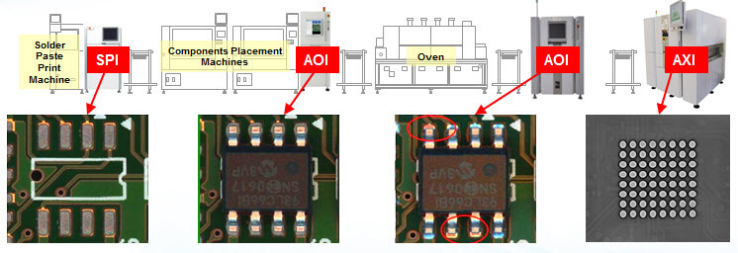
Automated Optical Inspection
SPI (Solder Paste Inspection)
AOI (Auto Optical Inspection)
AXI (Automatic X-ray Inspection)

Slide 5
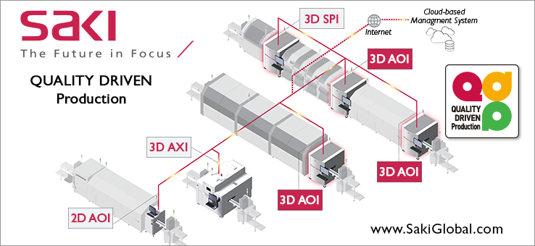
SPI, AOI, AXI
SPI (Solder Paste Inspection)
AOI (Auto Optical Inspection)
AXI (Automatic X-ray Inspection)

Slide 6
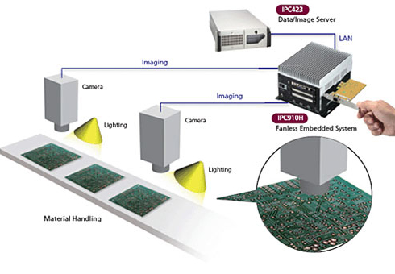
AOI system architecture

Slide 7
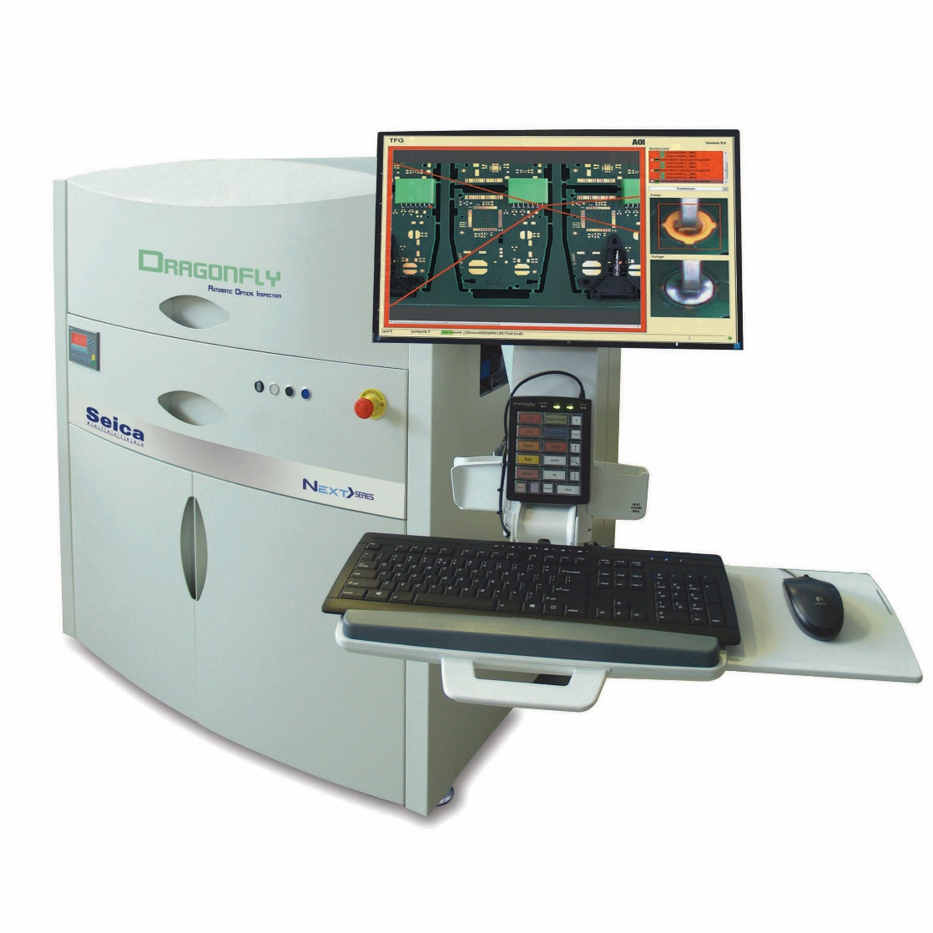
AOI Machine

Slide 8
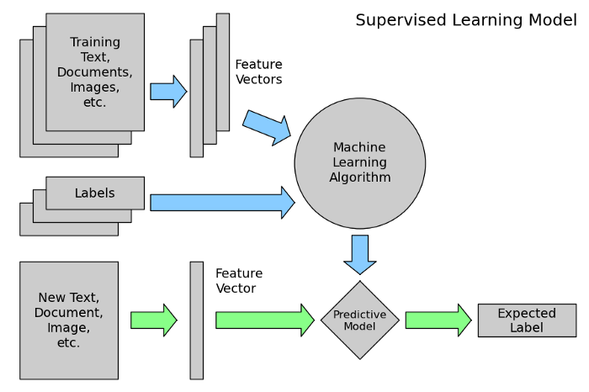
Machine Learning model

Slide 9
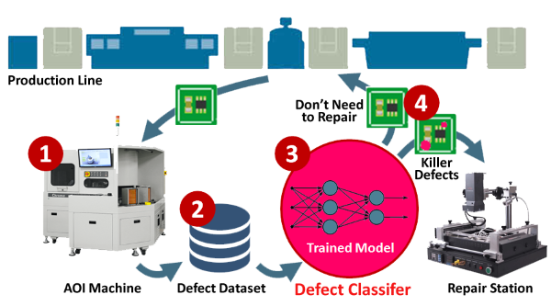
AOI with Deep Learning models

Slide 10
02-Deep Learning for AOI

Slide 11
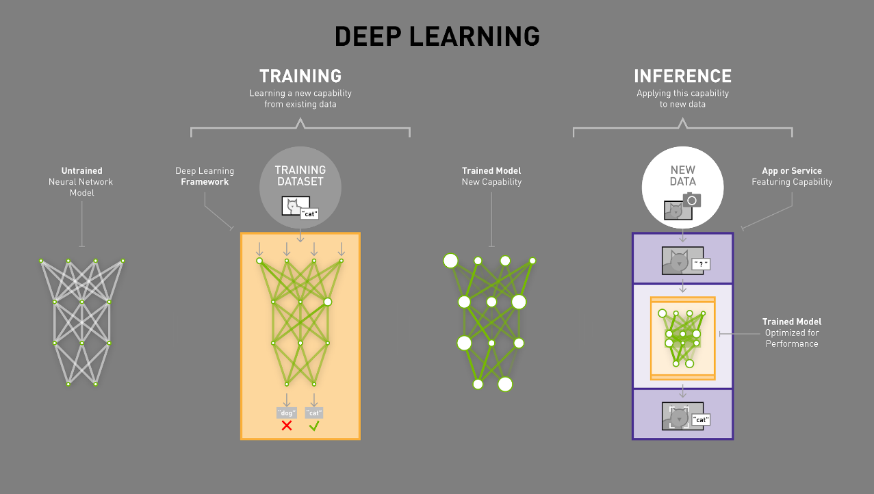
HOW IT WORKS
Notes:
Once the model has been trained, much of the generalized flexibility that was necessary during the training process is no longer needed, so it’s possible to optimize the model for significantly faster runtime performance.
[Story: How Cooper learned to classify cars, “tucks”, busses, motorcycles, etc.]
Common optimizations include fusing layers to reduce memory and communication overhead, pruning nodes that do not contribute significantly to the results, and other techniques supported in the NVIDIA TensorRT runtime.
The fully trained and optimized model is then ready to be integrated into an application that will feed it new data, in this case images of dogs and cats that it hasn’t seen before, and it will be able to quickly and accurately infer the correct answer based on its training. And your application can be deployed on a GPU-accelerated platform in your datacenter, in the cloud, on a local workstation, in a robot, a smart camera, or even a self-driving car.

Slide 12
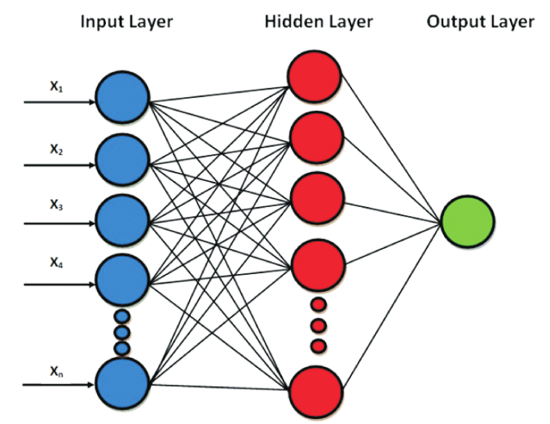
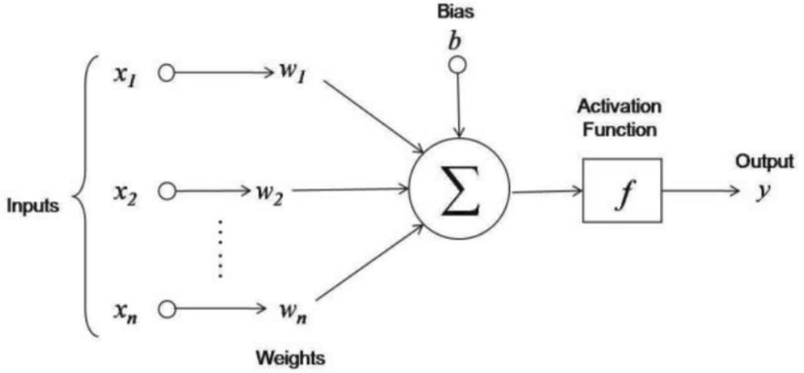
Feed Forward Neural Networks

Slide 13
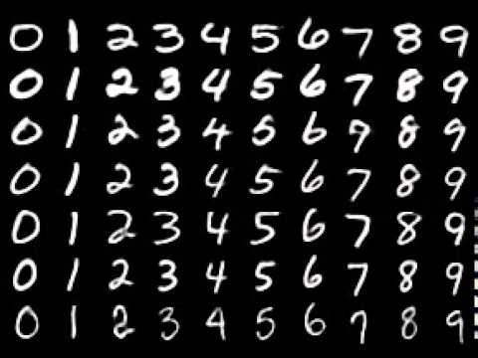
MNIST handwritten digit dataset

Slide 14
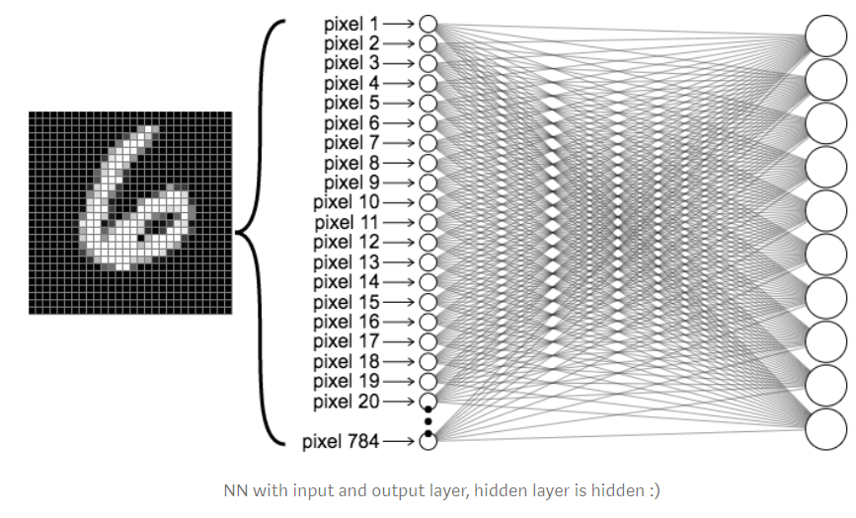
Feed Forward Neural Networks
model = keras.models.Sequential([
keras.layers.Flatten(input_shape=(28, 28)),
keras.layers.Dense(128, activation='relu'),
keras.layers.Dropout(0.2),
keras.layers.Dense(10, activation='softmax')
])
model.compile(optimizer='adam',
loss='sparse_categorical_crossentropy',
metrics=['accuracy'])
model.fit(x_train, y_train, epochs=5)
model.evaluate(x_test, y_test)

Slide 15
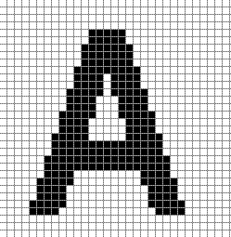
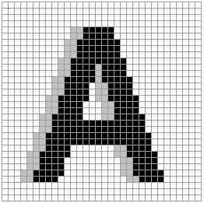
Drawbacks of Feed Forward neural networks
Little or no invariance to shifting, scaling, and other forms of distortion

Slide 16
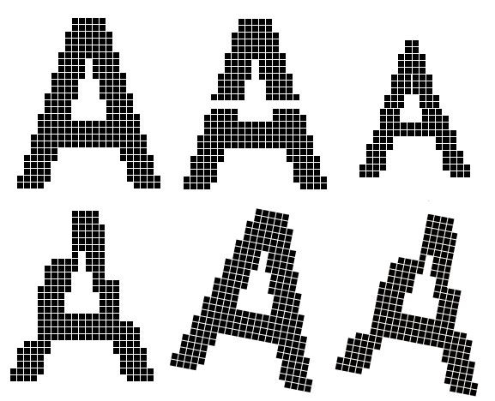
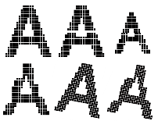
Scaling, and other forms of distortion

Slide 17

CNN History
Yann LeCun, Professor of Computer Science The Courant Institute of Mathematical Sciences New York University Room 1220, 715 Broadway, New York, NY 10003, USA. (212)998-3283 yann@cs.nyu.edu
In 1995, Yann LeCun and Yoshua Bengio introduced the concept of convolutional neural networks.

Slide 18
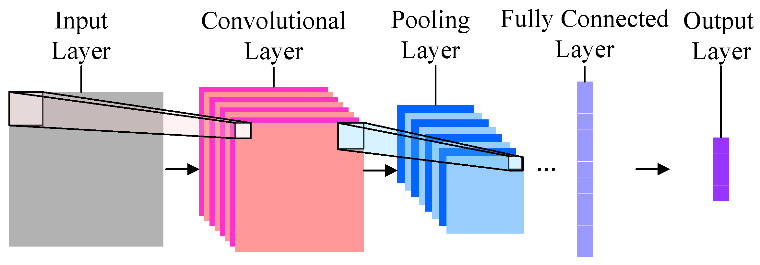
CNN

Slide 19
Convolutional neural network(CNN)
Add convolution and pooling layers before feedforward neural network
卷積計算
步伐(stride)
填充(padding)
池化運算
keras.layers.Conv2D(filters, kernel_size, strides=(1, 1), padding='valid', data_format=None, dilation_rate=(1, 1), activation=None, use_bias=True, kernel_initializer='glorot_uniform', bias_initializer='zeros', kernel_regularizer=None, bias_regularizer=None, activity_regularizer=None, kernel_constraint=None, bias_constraint=None)
keras.layers.MaxPooling2D(pool_size=(2, 2), strides=None, padding='valid', data_format=None)

Slide 20
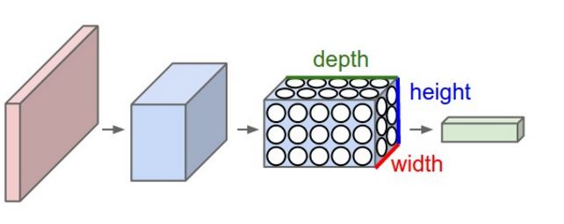
Convolutional layer

Slide 21
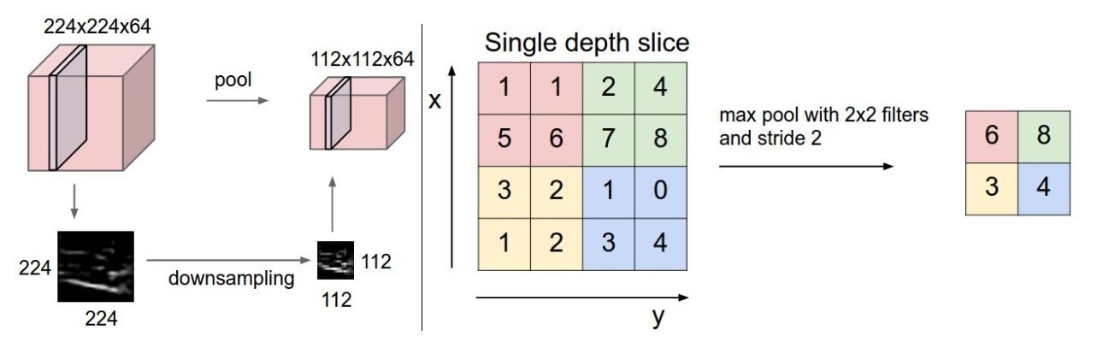
Pooling layer

Slide 22
Convolution
These are the network parameters to be learned.
1 | -1 | -1
-1 | 1 | -1
-1 | -1 | 1
1 | 0 | 0 | 0 | 0 | 1
0 | 1 | 0 | 0 | 1 | 0
0 | 0 | 1 | 1 | 0 | 0
1 | 0 | 0 | 0 | 1 | 0
0 | 1 | 0 | 0 | 1 | 0
0 | 0 | 1 | 0 | 1 | 0
Filter 1
-1 | 1 | -1
-1 | 1 | -1
-1 | 1 | -1
Filter 2
……
6 x 6 image
Each filter detects a small pattern (3 x 3).

Slide 23
Convolution
1 | -1 | -1
-1 | 1 | -1
-1 | -1 | 1
Filter 1
stride=1
1 | 0 | 0 | 0 | 0 | 1
0 | 1 | 0 | 0 | 1 | 0
0 | 0 | 1 | 1 | 0 | 0
1 | 0 | 0 | 0 | 1 | 0
0 | 1 | 0 | 0 | 1 | 0
0 | 0 | 1 | 0 | 1 | 0
Dot
product
3
-1
6 x 6 image

Slide 24
Convolution
1 | -1 | -1
-1 | 1 | -1
-1 | -1 | 1
Filter 1
If stride=2
1 | 0 | 0 | 0 | 0 | 1
0 | 1 | 0 | 0 | 1 | 0
0 | 0 | 1 | 1 | 0 | 0
1 | 0 | 0 | 0 | 1 | 0
0 | 1 | 0 | 0 | 1 | 0
0 | 0 | 1 | 0 | 1 | 0
3
-3
6 x 6 image

Slide 25
Convolution
1 | -1 | -1
-1 | 1 | -1
-1 | -1 | 1
Filter 1
stride=1
1 | 0 | 0 | 0 | 0 | 1
0 | 1 | 0 | 0 | 1 | 0
0 | 0 | 1 | 1 | 0 | 0
1 | 0 | 0 | 0 | 1 | 0
0 | 1 | 0 | 0 | 1 | 0
0 | 0 | 1 | 0 | 1 | 0
3
-1
-3
-1
-3
1
0
-3
-3
-3
0
1
3
-2
-2
-1
6 x 6 image

Slide 26
Convolution
-1 | 1 | -1
-1 | 1 | -1
-1 | 1 | -1
Filter 2
stride=1
Repeat this for each filter
1 | 0 | 0 | 0 | 0 | 1
0 | 1 | 0 | 0 | 1 | 0
0 | 0 | 1 | 1 | 0 | 0
1 | 0 | 0 | 0 | 1 | 0
0 | 1 | 0 | 0 | 1 | 0
0 | 0 | 1 | 0 | 1 | 0
Feature
Map
3
-1
-3
-1
-1
-1
-1
-1
-3
1
0
-3
-1
-1
-2
1
-3
-3
0
1
-1
-1
-2
1
3
-2
-2
-1
6 x 6 image
-1
0
-4
3
Two 4 x 4 images
Forming 2 x 4 x 4 matrix

Slide 27
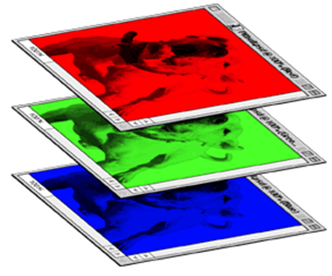
Color image: RGB 3 channels
1 | -1 | -1
-1 | 1 | -1
-1 | -1 | 1
-1 | 1 | -1
-1 | 1 | -1
-1 | 1 | -1
1 | -1 | -1
-1 | 1 | -1
-1 | -1 | 1
-1 | 1 | -1
-1 | 1 | -1
-1 | 1 | -1
1 | -1 | -1
-1 | 1 | -1
-1 | -1 | 1
-1 | 1 | -1
-1 | 1 | -1
-1 | 1 | -1
Filter 1
Filter 2
Color image
1 | 0 | 0 | 0 | 0 | 1
0 | 1 | 0 | 0 | 1 | 0
0 | 0 | 1 | 1 | 0 | 0
1 | 0 | 0 | 0 | 1 | 0
0 | 1 | 0 | 0 | 1 | 0
0 | 0 | 1 | 0 | 1 | 0
1 | 0 | 0 | 0 | 0 | 1
0 | 1 | 0 | 0 | 1 | 0
0 | 0 | 1 | 1 | 0 | 0
1 | 0 | 0 | 0 | 1 | 0
0 | 1 | 0 | 0 | 1 | 0
0 | 0 | 1 | 0 | 1 | 0
1 | 0 | 0 | 0 | 0 | 1
0 | 1 | 0 | 0 | 1 | 0
0 | 0 | 1 | 1 | 0 | 0
1 | 0 | 0 | 0 | 1 | 0
0 | 1 | 0 | 0 | 1 | 0
0 | 0 | 1 | 0 | 1 | 0

Slide 28
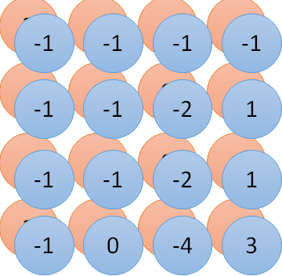
Convolution v.s. Fully Connected
1 | 0 | 0 | 0 | 0 | 1
0 | 1 | 0 | 0 | 1 | 0
0 | 0 | 1 | 1 | 0 | 0
1 | 0 | 0 | 0 | 1 | 0
0 | 1 | 0 | 0 | 1 | 0
0 | 0 | 1 | 0 | 1 | 0
1 | -1 | -1
-1 | 1 | -1
-1 | -1 | 1
-1 | 1 | -1
-1 | 1 | -1
-1 | 1 | -1
convolution
image
1 | 0 | 0 | 0 | 0 | 1
0 | 1 | 0 | 0 | 1 | 0
0 | 0 | 1 | 1 | 0 | 0
1 | 0 | 0 | 0 | 1 | 0
0 | 1 | 0 | 0 | 1 | 0
0 | 0 | 1 | 0 | 1 | 0
Fully-connected
……
……

Slide 29
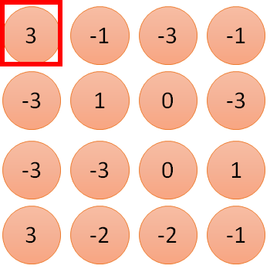
1 | -1 | -1
-1 | 1 | -1
-1 | -1 | 1
1
1
Filter 1
2
0
3
0
3
4:
0
1 | 0 | 0 | 0 | 0 | 1
0 | 1 | 0 | 0 | 1 | 0
0 | 0 | 1 | 1 | 0 | 0
1 | 0 | 0 | 0 | 1 | 0
0 | 1 | 0 | 0 | 1 | 0
0 | 0 | 1 | 0 | 1 | 0
…
0
8
1
9
0
10:
0
…
13
0
6 x 6 image
14
0
fewer parameters!
15
Only connect to 9 inputs, not fully connected
1
16
1
…

Slide 30
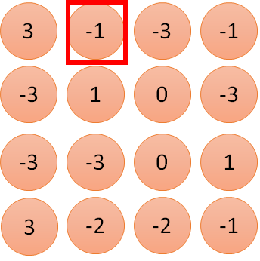
1 | -1 | -1
-1 | 1 | -1
-1 | -1 | 1
1:
1
Filter 1
2:
0
3:
0
3
4:
0
1 | 0 | 0 | 0 | 0 | 1
0 | 1 | 0 | 0 | 1 | 0
0 | 0 | 1 | 1 | 0 | 0
1 | 0 | 0 | 0 | 1 | 0
0 | 1 | 0 | 0 | 1 | 0
0 | 0 | 1 | 0 | 1 | 0
…
7:
0
8:
1
-1
9:
0
10:
0
…
13:
0
6 x 6 image
14:
0
Fewer parameters
15:
1
16:
1
Shared weights
Even fewer parameters
…

Slide 31
Max Pooling
1 | -1 | -1
-1 | 1 | -1
-1 | -1 | 1
-1 | 1 | -1
-1 | 1 | -1
-1 | 1 | -1
Filter 1
Filter 2
3
-1
-3
-1
-1
-1
-1
-1
-3
1
0
-3
-1
-1
-2
1
-3
-3
0
1
-1
-1
-2
1
3
-2
-2
-1
-1
0
-4
3

Slide 32
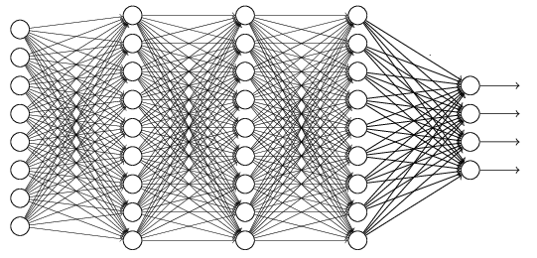
The whole CNN
0, 1, 2, 3……
Convolution
Max Pooling
Can repeat many times
Fully Connected Feedforward network
Convolution
Max Pooling
Flattened

Slide 33
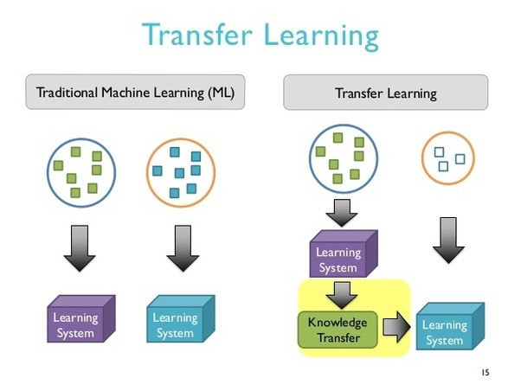
Concept of Transfer learning

Slide 34
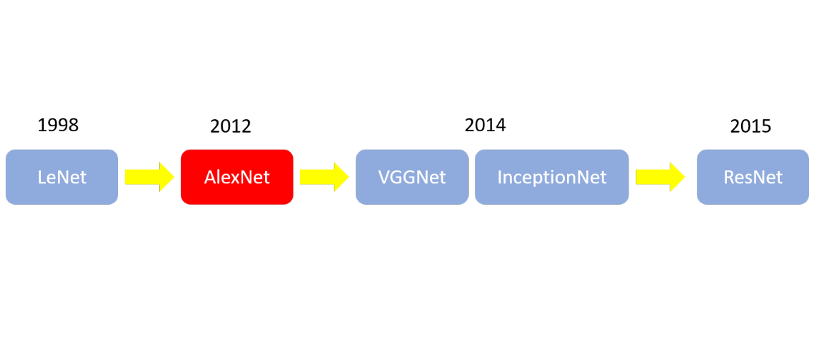
ImageNet CNN Models

Slide 35
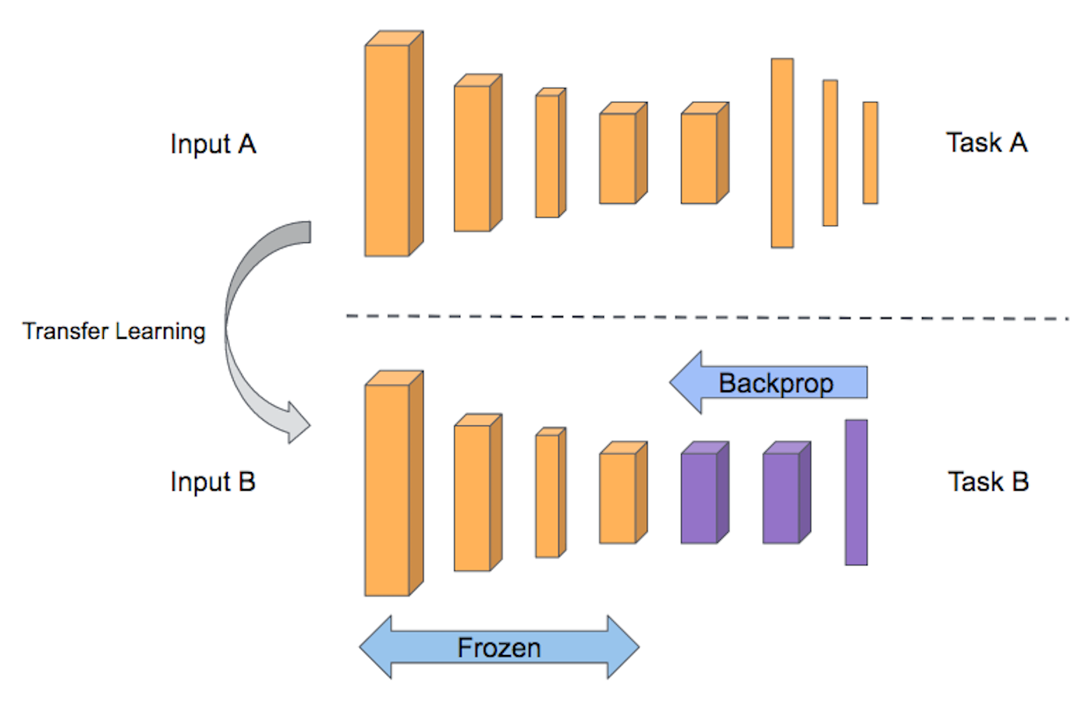
Transfer learning model

Slide 36
Frozed layers
layer.trainable = False

Slide 37
Keras Layers
Core Layers
Dense
Activation
Dropout
Flatten
Input
Reshape
Convolutional Layers
Conv2D
ZeroPadding2D
Pooling Layers
MaxPooling2D
Recurrent Layers
RNN
SimpleRNN
GRU
LSTM
Embedding Layers
Embedding
Layer wrappers
Bidirectional

Slide 38
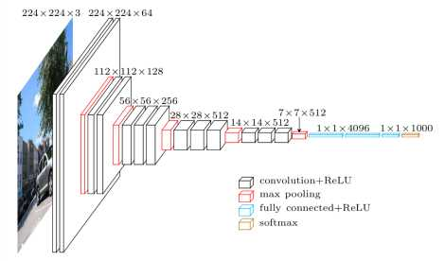
Transfer VGG model

Slide 39
03-Learning Deep Learning-based AOI

Slide 40
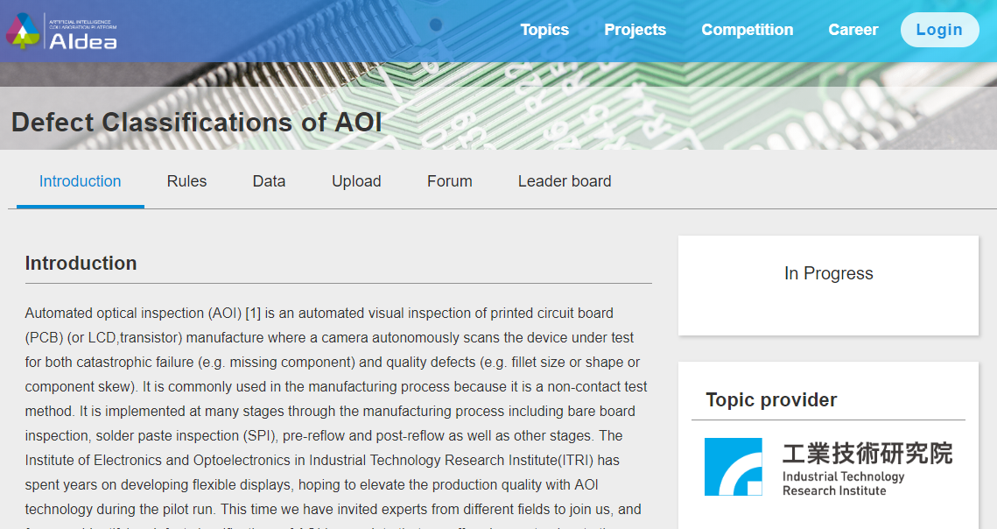
AIdea AOI project
https://aidea-web.tw/topic/a49e3f76-69c9-4a4a-bcfc-c882840b3f27

Slide 41
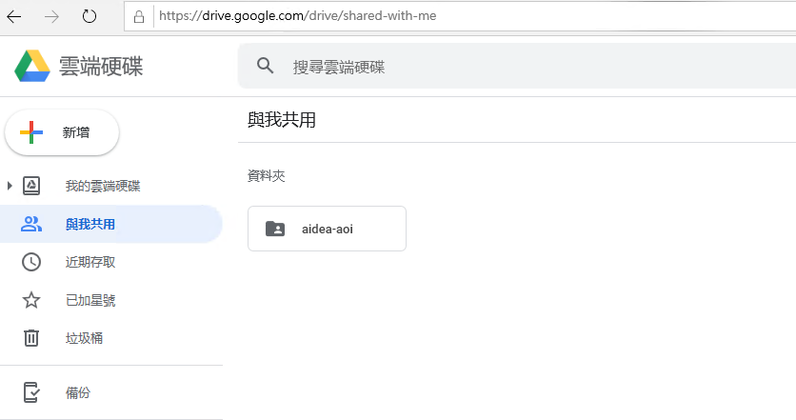
Google Drive
Click https://drive.google.com/open?id=15tGIHAPAatgdB8iZh_m80jCBPa-CrI_P

Slide 42
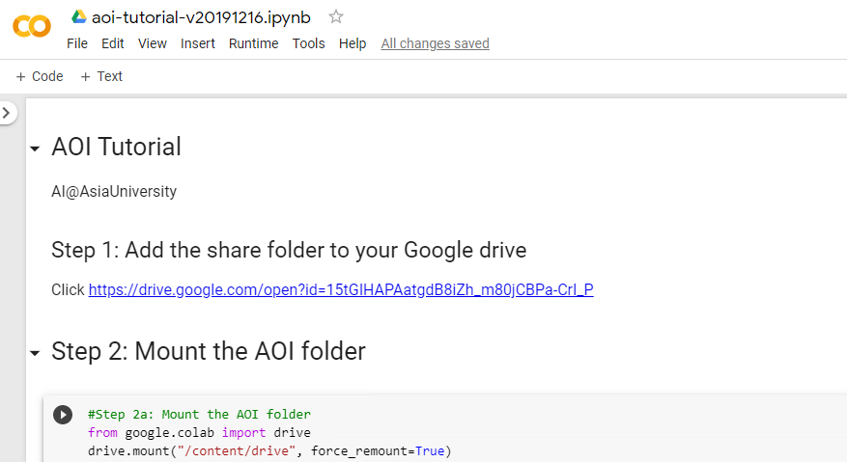
Google Colab

Slide 43
Q&A
T
hanks!

