Slide 1

深度學習 Deep Learning (14C) hands-on training
Hsueh-Ting Chu/朱學亭
htchu@asia.edu.tw

Slide 2
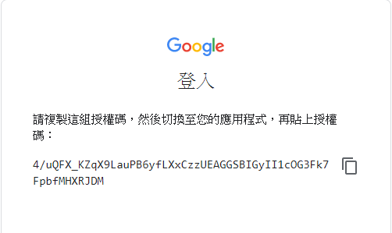

Slide 3
Projects
Ex14-1: generative_adversarial_networks_101
Ex14-1: DCGAN-tensorflow

Slide 4
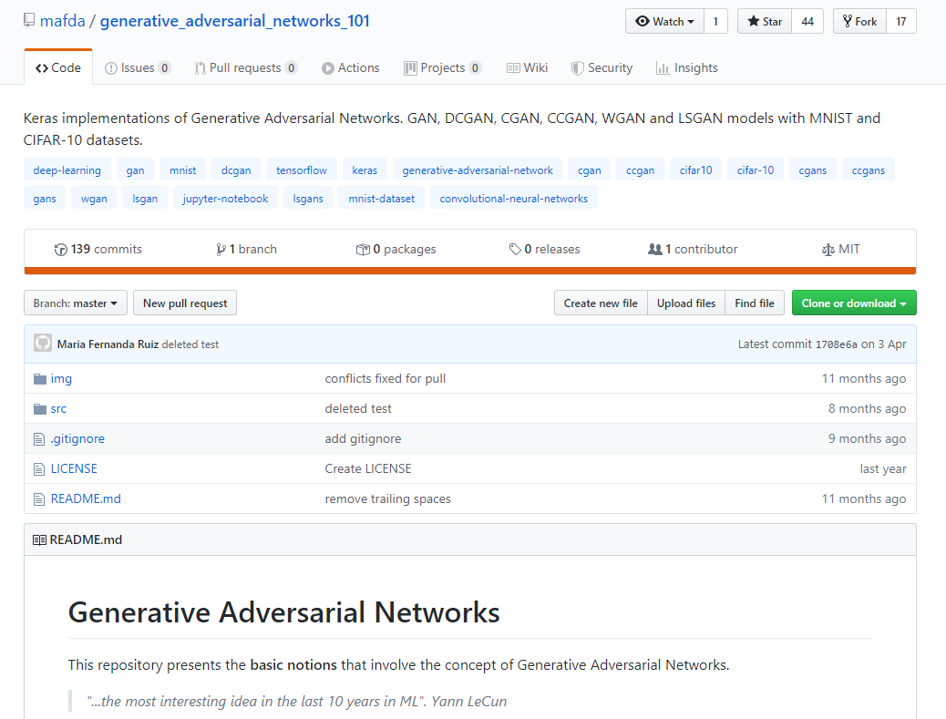
generative_adversarial_networks_101

Slide 5
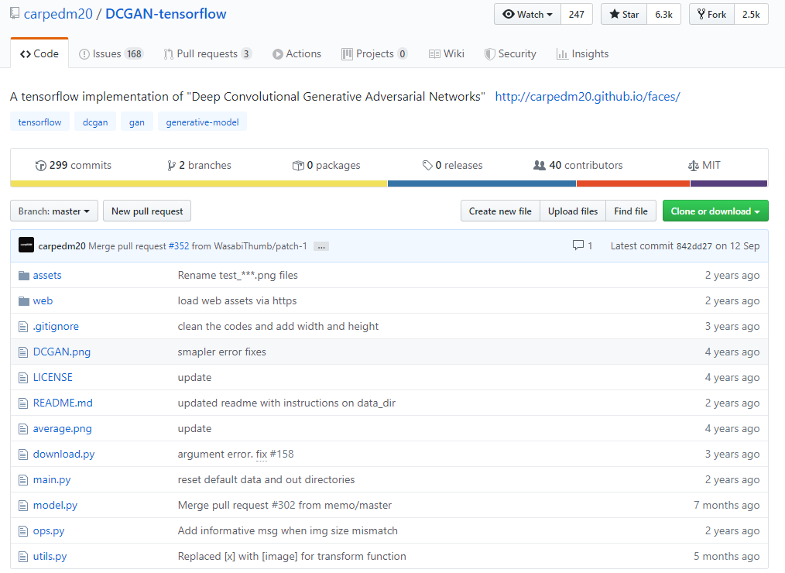
DCGAN-tensorflow

