Slide 1

Python Quick Tutorial
(3)-Basic program model
Hsueh-Ting Chu

Slide 2

課程大綱-程式設計簡介
1) I-P-O program model (Input-Process-Output)
2) Simple sorting of data
3) Simple visualization of data

Slide 3
(1)寫程式的基本模型
Input-Process-Output 程式模型
Input
Process
Output
inFile = open(‘in.txt',‘r')
inFile.read(…)
inFile.close()
if score>60:
count += 1
outFile = open(‘out.txt',‘w')
outFile.write(…)
outFile.close()

Slide 4
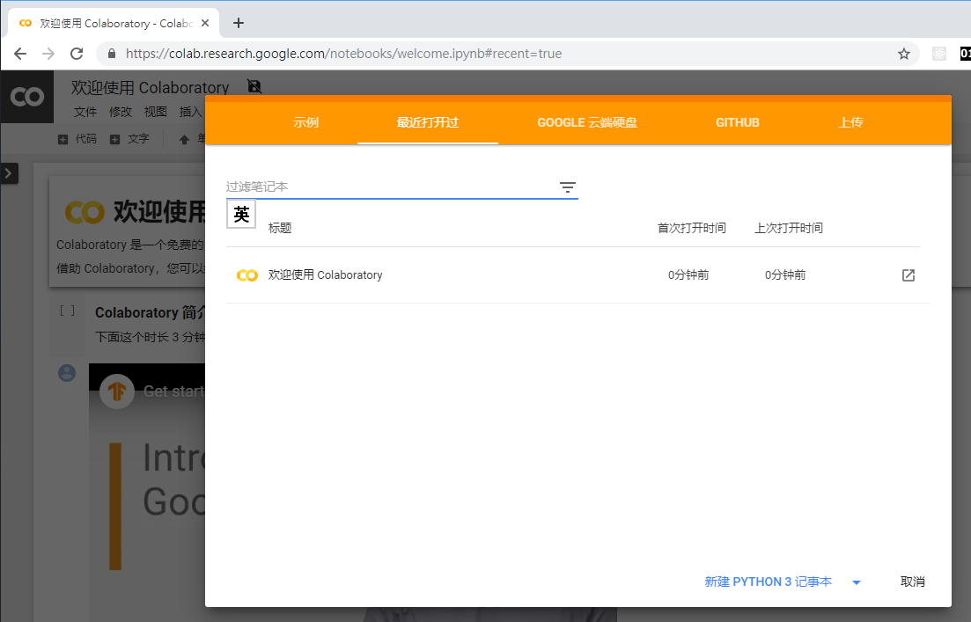

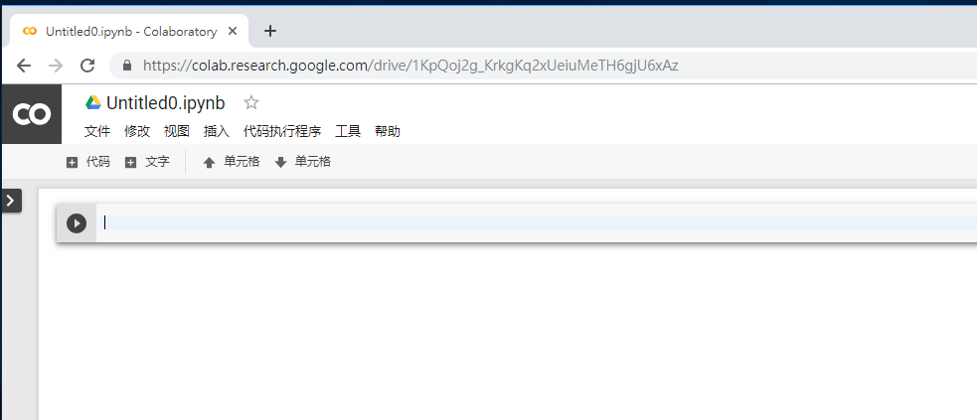
(2.a)打開Colab

Slide 5
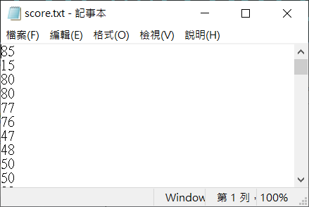
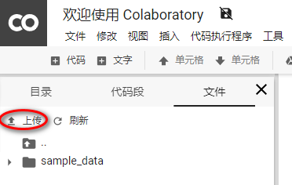
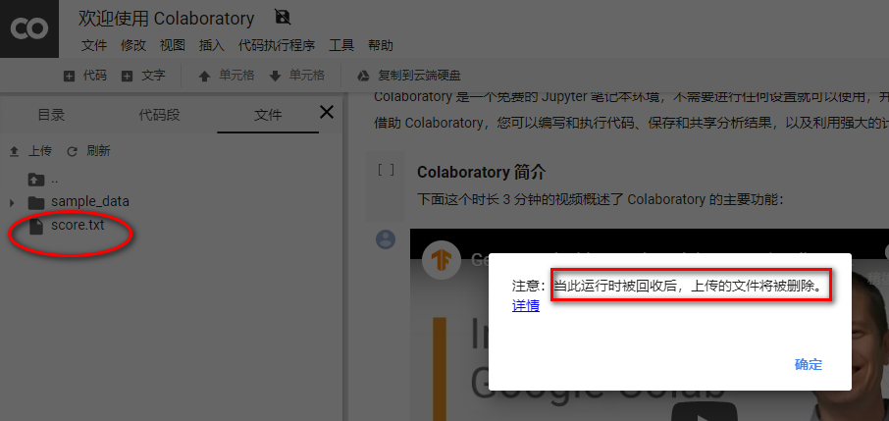
(2.b) 把score.txt上傳到colab
按上傳
當此運行時被回收後 上傳的檔將被刪除。

Slide 6
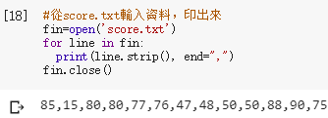
(2.c) 將score.txt檔案讀入程式
fin=open(‘score.txt’)
for line in fin:
fin=open(‘score.txt’)
for line in fin:
print(line.strip(), end=",")
fin.close()

Slide 7
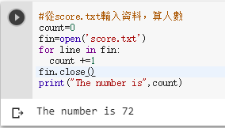
(2.d) 計算score.txt檔案中人數
count +=1
print("The number is“,count)
#從score.txt輸入資料，算人數
count=0
fin=open('score.txt')
for line in fin:
count +=1
fin.close()
print("The number is",count)

Slide 8
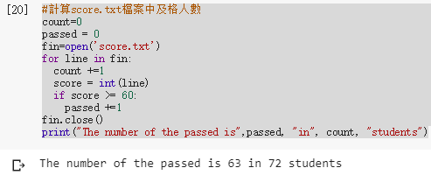
(2.e) 計算score.txt檔案中及格人數
score = int(line)
if score >= 60:
count=0
passed = 0
fin=open('score.txt')
for line in fin:
count +=1
score = int(line)
if score >= 60:
passed +=1
fin.close()
print("The number of the passed is",passed, "in", count, "students")

Slide 9
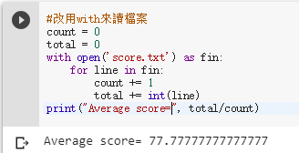
(3.a) 改用with來讀檔案
with open('score.txt') as fin:
for line in fin:
#改用with來讀檔案
count = 0
total = 0
with open('score.txt') as fin:
for line in fin:
count += 1
total += int(line)
print("Average score=", total/count)

Slide 10
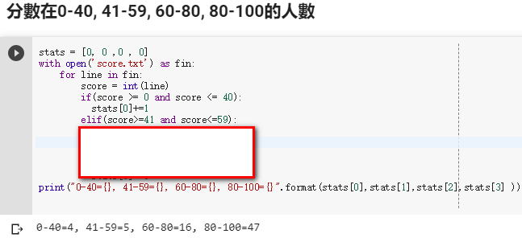
(3.b) 計算分數在0-40, 41-59, 60-80, 80-100的人數
if(score >= 0 and score <= 40):
elif(score>=41 and score<=59):
if 判斷條件1:
執行語句1……
elif 判斷條件2:
執行語句2……
elif 判斷條件3:
執行語句3……
else:
執行語句4……
條件可以加and 或or

Slide 11
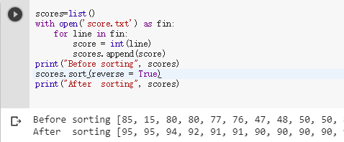
(3.c) 將成績由高到低排列
scores=list()
scores.append(score)
scores.sort(reverse = True)
scores=list()
with open('score.txt') as fin:
for line in fin:
score = int(line)
scores.append(score)
print("Before sorting", scores)
scores.sort(reverse = True)
print("After sorting", scores)
#sort() 函數用於對原序列進行排序
list.sort(reverse=False)

Slide 12
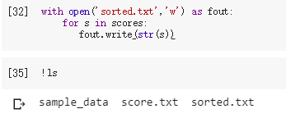
(3.d) 將成績由高到低輸出到檔案
Fout=open('sorted.txt','w') fout.write(str(s))
with open('sorted.txt','w') as fout:
for s in scores:
fout.write(str(s))

Slide 13
REVIEWS：
(1) open()函數如何決定檔案用來讀入還是寫出？
(2) List如何由大到小或由小到大排列?
(3) If判斷式如何有兩個以上判斷條件?
(4) 如何讀入從檔案讀入每一行

Slide 14
單元3的習題：
完成步驟(3.b)的多重判斷條件
將步驟(3.e)改成由小到大排列

