Slide 1

Python Quick Tutorial
(4)-Function definition and function call
Hsueh-Ting Chu

Slide 2
Function definition and function call
1) Define functions and call functions
2) Import module import, import as and from import
3) Crawler practice

Slide 3
(1)程式要素：資料結構和演算法
演算法；具體計算步驟的序列，可以用紙筆計算。
計算240和96的最大公因數gcd，使用輾轉相除法
紙筆計算：
240÷96=2…48
96÷48=2…0
當餘數是0時，除數就是gcd
所以，240和96的gcd=48
演算法：
a=240; b=96
r=a%b
while r!=0:
a=b;b=r
r=a%b
print("gcd=",b)
當餘數是0時，除數就是gcd
寫成函數：
def gcd(a, b):
r=a%b
while r!=0:
a=b;b=r
r=a%b
return b

Slide 4
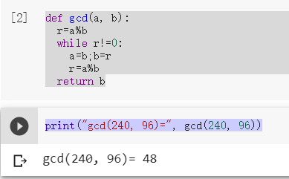
(1.b) 函數的定義及呼叫
def gcd(a, b):
....
return b
def gcd(a, b):
r=a%b
while r!=0:
a=b;b=r
r=a%b
return b
print("gcd(240, 96)=", gcd(240, 96))

Slide 5
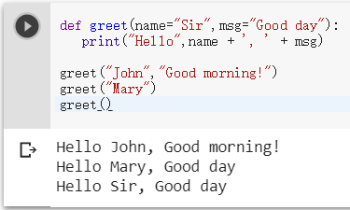
(1.c) 函數的預設參數
def foo(para1=“…",para2=“…"):
def greet(name="Sir",msg="Good day"):
print("Hello",name + ', ' + msg)
greet("John","Good morning!")
greet("Mary")
greet()

Slide 6
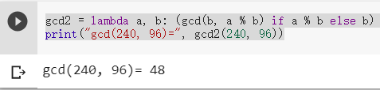
(1.d) lamda表示式
def foo(para1,para2): statements
foo=lambda para1,para2: expression
gcd2 = lambda a, b: (gcd(b, a % b) if a % b else b)
print("gcd(240, 96)=", gcd2(240, 96))

Slide 7
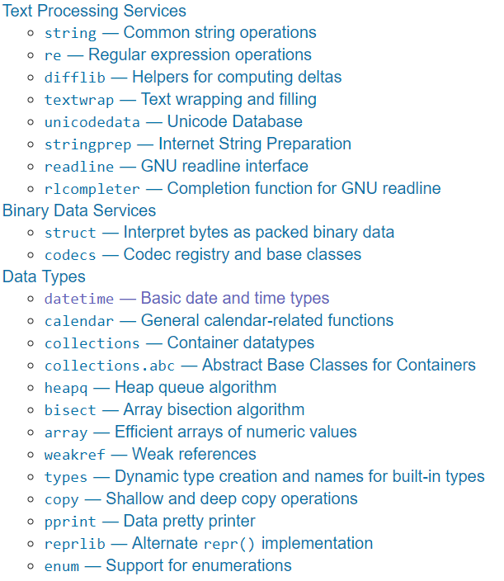
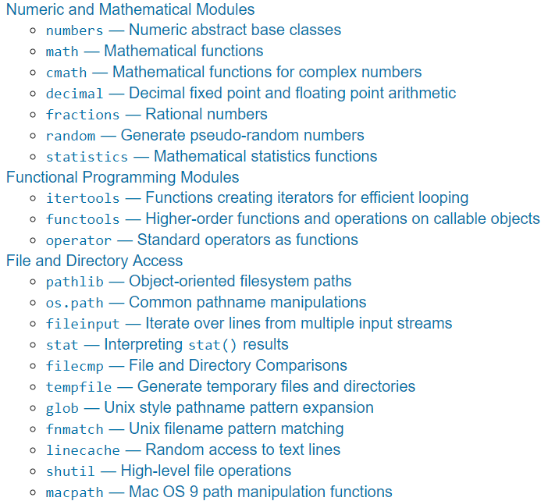
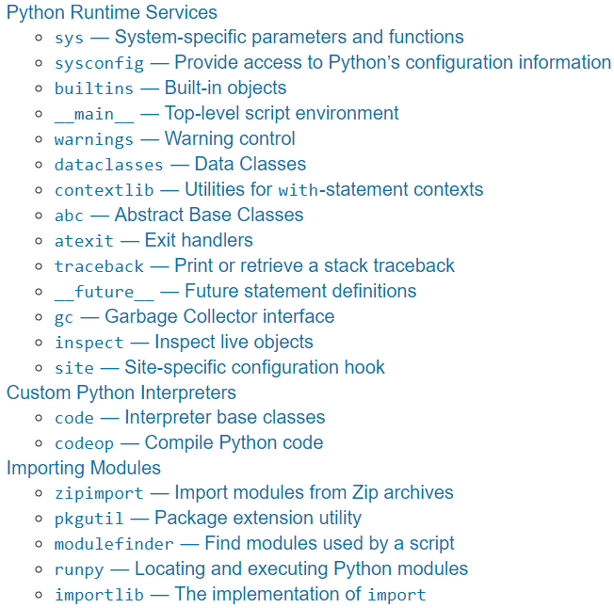
(2.a) 大部份需要的函數都被寫好了
The Python Standard Library

Slide 8
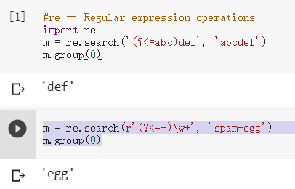
(2.b)re正規運算式
import re
m = re.search('(?<=abc)def', 'abcdef')
import re
m = re.search(r'(?<=-)\w+', 'spam-egg')
m.group(0)
(?<=…) 匹配字符串前面匹配 … 的内容。
(?<!…) 匹配字符串前面不配 … 的内容。

Slide 9
(2.c) random --- 生成亂數
import random as rd
a=rd.random()
#random --- 生成亂數
import random as rd
a=rd.random() # Random float: 0.0 <= x < 1.0
b=rd.uniform(2.5, 10.0) # Random float: 2.5 <= x < 10.0
c=rd.randrange(10) # Integer from 0 to 9 inclusive
d=rd.choice(['win', 'lose', 'draw']) # Single random element from a sequence
print(a,b,c,d)。

Slide 10
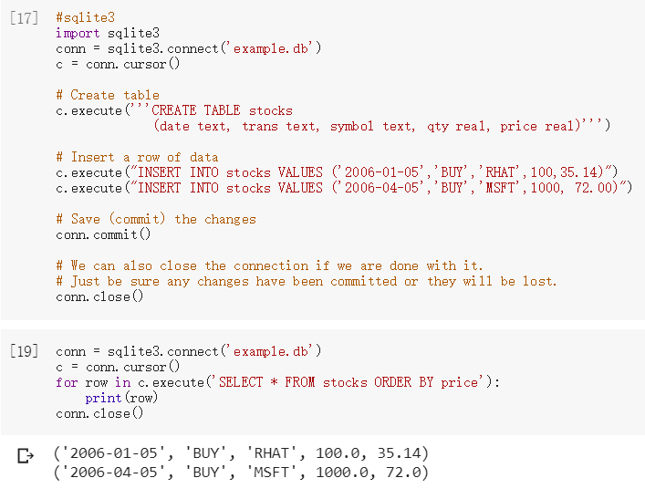
(2.d) sqlite3 --- SQLite 數據庫
import sqlite3
conn = sqlite3.connect('example.db')
conn = sqlite3.connect('example.db')
c = conn.cursor()
c.Execute()
conn.commit()
conn.close()

Slide 11
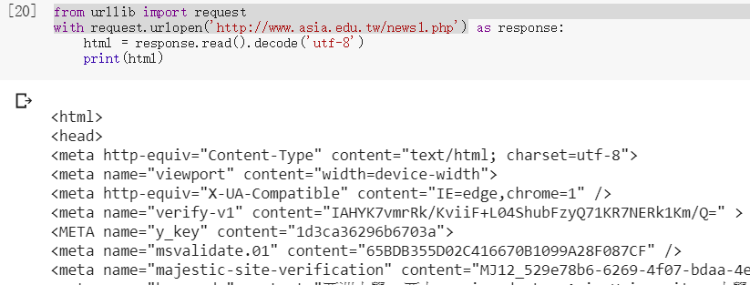
(2.e) urllib --- URL 處理模組
from urllib import request
request.urlopen('http://…')
from urllib import request
with request.urlopen('http://www.asia.edu.tw/news1.php') as response:
html = response.read().decode('utf-8')
print(html)

Slide 12
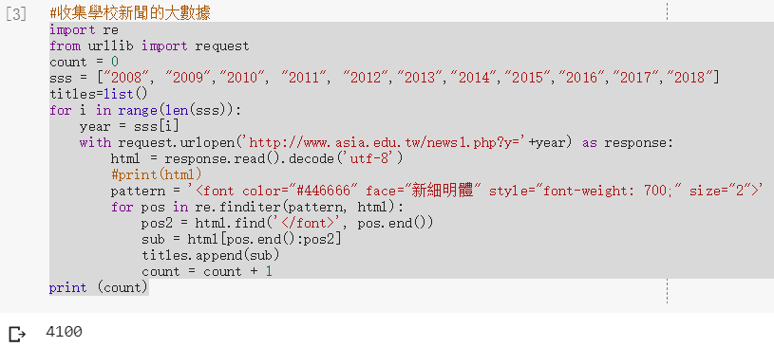
(3.a)收集學校新聞的大數據
from urllib import request
import urllib.request
import re
from urllib import request
count = 0
sss = ["2008", "2009","2010", "2011", "2012","2013","2014","2015","2016","2017","2018"]
titles=list()
for i in range(len(sss)):
year = sss[i]
with request.urlopen('http://www.asia.edu.tw/news1.php?y='+year) as response:
html = response.read().decode('utf-8')
#print(html)
pattern = '<font color="#446666" face="新細明體" style="font-weight: 700;" size="2">'
for pos in re.finditer(pattern, html):
pos2 = html.find('</font>', pos.end())
sub = html[pos.end():pos2]
titles.append(sub)
count = count + 1
print (count)

Slide 13
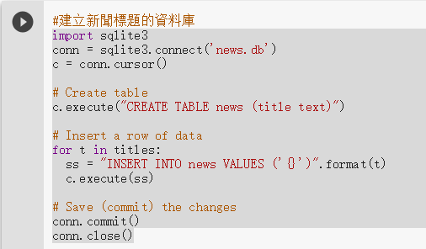
(3.b)建立新聞標題的資料庫
for t in titles:
ss = "INSERT INTO news VALUES ('{}')".format(t)
c.execute(ss)
import sqlite3
conn = sqlite3.connect('news.db')
c = conn.cursor()
# Create table
c.execute("CREATE TABLE news (title text)")
# Insert a row of data
for t in titles:
ss = "INSERT INTO news VALUES ('{}')".format(t)
c.execute(ss)
# Save (commit) the changes
conn.commit()
conn.close()

Slide 14
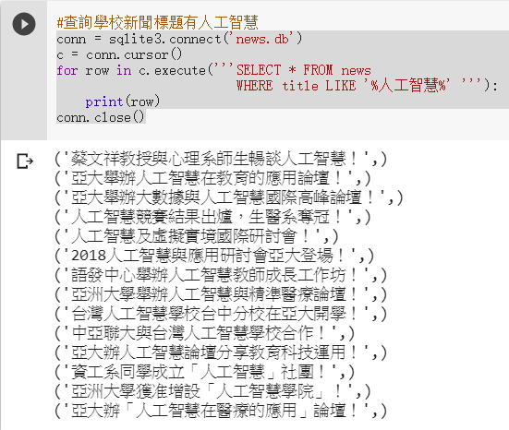
(3.c)查詢學校新聞標題有人工智慧
for row in c.execute('''SELECT * FROM news
WHERE title LIKE '%人工智慧%' '''):
conn = sqlite3.connect('news.db')
c = conn.cursor()
for row in c.execute('''SELECT * FROM news
WHERE title LIKE '%人工智慧%' '''):
print(row)
conn.close()

Slide 15
REVIEWS：
(1) 定義函數的關鍵字為何？
(2) import 和import from使用上有何不同?
(3) urllib庫提供什麼樣的功能?
(4) 上網查詢SELECT LIKE的各種SQL語法。

Slide 16
單元4的習題：
更改步驟(3.a)，從html中找新聞標題的時間
更改步驟(3.c)查詢標題有校慶的學校新聞

