Slide 1

高中生遠距先修課程
Python程式設計(6)-資料結構
朱學亭老師

Slide 2
課程大綱-資料結構
1) Python資料結構 (List, Tuple, Set, Dictionary)
2) 第三方函式庫 (Numpy, Scipy, cv2)
3) 外部資料的處理 (json, csv, image)

Slide 3
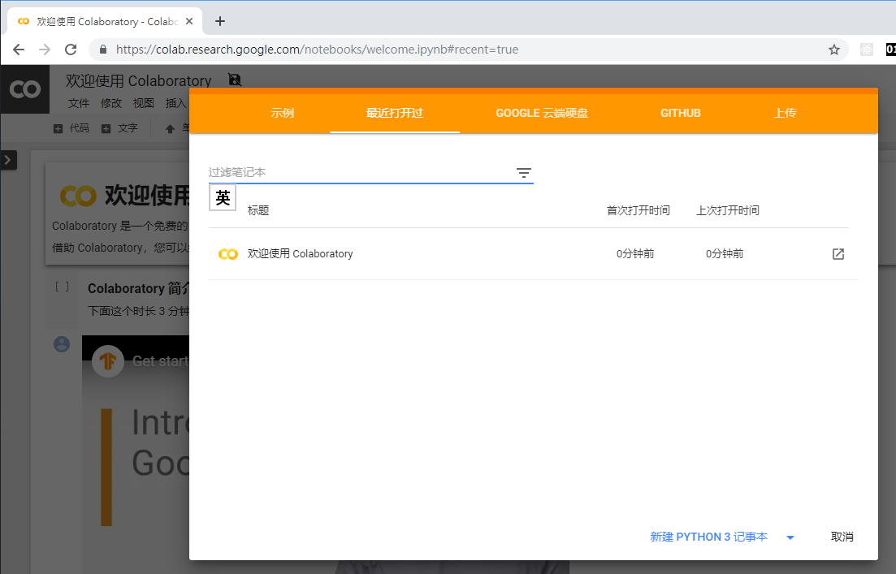

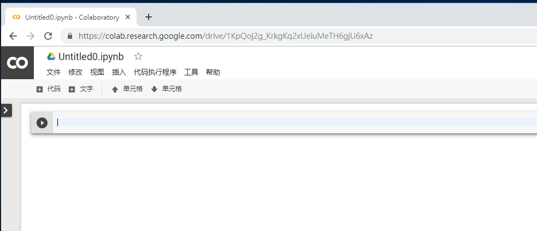
(1.a)打開Colab

Slide 4
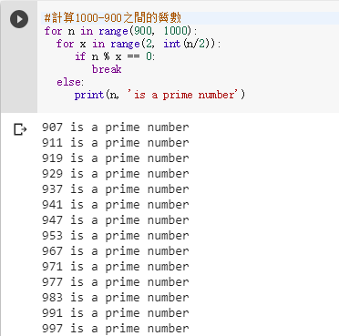
(1.b) 計算1000-900之間的質數
for x in range(2, int(n/2)):
if n % x == 0:
break
#計算1000-900之間的質數
for n in range(900, 1000):
for x in range(2, int(n/2)):
if n % x == 0:
break
else:
print(n, 'is a prime number')

Slide 5
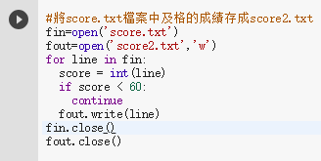
(1.c) 將score.txt檔案讀入程式
for line in fin:
if score < 60:
continue
#將score.txt檔案中及格的成績存成score2.txt
fin=open('score.txt')
fout=open('score2.txt','w')
for line in fin:
score = int(line)
if score < 60:
continue
fout.write(line)
fin.close()
fout.close()

Slide 6
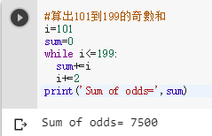
(1.d)算出101到199的奇數和
while i<=199:
i=101
sum=0
while i<=199:
sum+=i
i+=2
print('Sum of odds=',sum)

Slide 7
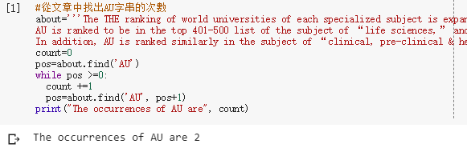
(2.a) 從文章中找出AU字串的次數
pos=about.find('AU')
while pos >=0:
pos=about.find('AU', pos+1)
about='''The THE ranking of world universities of each specialized subject is expanded this year to include the top 500 ones.
AU is ranked to be in the top 401-500 list of the subject of “life sciences,” and is the No.3 private university in Taiwan in this specialized area.
In addition, AU is ranked similarly in the subject of “clinical, pre-clinical & health,” and is the No.4 private university in Taiwan in this area.'''
count=0
pos=about.find('AU')
while pos >=0:
count +=1
pos=about.find('AU', pos+1)
print("The occurrences of AU are", count)

Slide 8
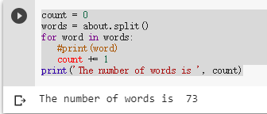
(2.b)算文章的字數
words = about.split()
count = 0
words = about.split()
for word in words:
#print(word)
count += 1
print('The number of words is ', count)

Slide 9
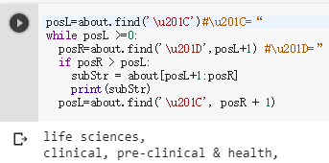
(2.c) 找出“ ”中的字串
Unicode character '\u201C'
subStr = about[posL+1:posR]
posL=about.find('\u201C')#\u201C=“
while posL >=0:
posR=about.find('\u201D',posL+1) #\u201D=”
if posR > posL:
subStr = about[posL+1:posR]
print(subStr)
posL=about.find('\u201C', posR + 1)
子字串:
string[start: end: step]

Slide 10
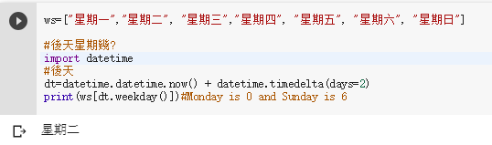
(3.a) 後天星期幾?
datetime.now()
datetime.timedelta(days=2)
datetime.datetime
#後天星期幾?
import datetime
#後天
dt=datetime.datetime.now() + datetime.timedelta(days=2)
print(ws[dt.weekday()])#Monday is 0 and Sunday is 6

Slide 11
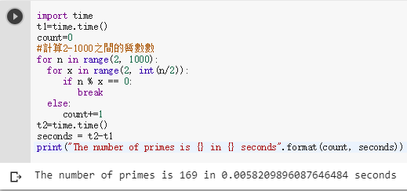
(3.b) 程式跑了多久
t1=time.time() 1970/1/1,0:00
seconds = t2-t1
import time
t1=time.time()
count=0
#計算2-1000之間的質數數
for n in range(2, 1000):
for x in range(2, int(n/2)):
if n % x == 0:
break
else:
count+=1
t2=time.time()
seconds = t2-t1
print("The number of primes is {} in {} seconds".format(count, seconds))

Slide 12
REVIEWS：
(1) break對for迴圈有何作用？
(2) continue對for迴圈有何作用？
(3) split()有何作用?
(4) find()如果找不到要找的字串回傳什麼?

Slide 13
單元6的習題：
找出步驟(2.a)的about字串中有幾個in字?
將步驟(3.a)改成昨天星期幾?

Slide 14
REVIEWS：
(1) Python 是編譯還是直譯語言？
(2) 要用Python 2還是Python 3？
(3) 哪個工具可以寫Python程式？
(4) 為什麼要用Python語言寫程式？

