Slide 1

Python Quick Tutorial
(1)-Introduction to programming
Hsueh-Ting Chu

Slide 2
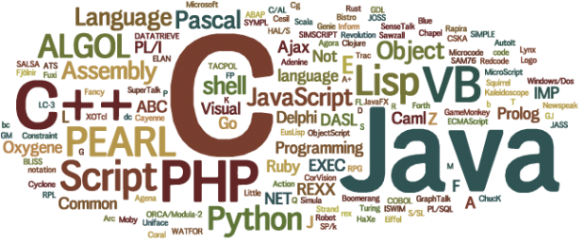
Course Outline - Introduction to Programming
(1) Writing a program
(2) Introduction to various programming languages
(3) Preparation before writing a Python program

Slide 3
(1.a)About programming
Computer：Hardware and software
Hardware ：CPU、memory、hds、screen
Software：system programs, application programs
Application programs ：APPs、WORD、GAME、…

Slide 4
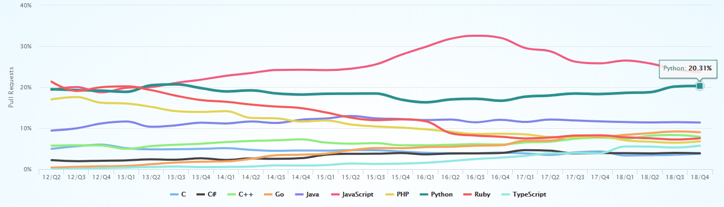
(2.a)Programming language ranking
Python、C 、 C++、Objective-C、Smalltalk、Delphi、Java、Swift、C#、Perl、Ruby、Julia、Kotlin 、 PHP 、 R 、GO、JavaScript
https://madnight.github.io/githut/

Slide 5
(2.b) Program language classification
Object oriented programming language ：
Python、 C++、Objective-C、Smalltalk、Delphi、Java、Swift、C#、Perl、Ruby、Julia、Kotlin 、 PHP 、 JavaScript
Non-object-oriented (function and structure) programming language ：
C、 GO、R
Compiled language
C 、 C++、 Java 、C#
Interpreting language
PHP、 Python 、JavaScript 、R

Slide 6
(2.c) programming language applications
Python、C 、 C++、Objective-C、Smalltalk、Delphi、Java、Swift、C#、Perl、Ruby、Julia、Kotlin 、 PHP 、 R 、GO、JavaScript
Windows programming: C++, Java, C#, JavaScript
Web programming: PHP, Python, Ruby, JavaScript
System Programming: C, C++, GO
APP programming: Java, Swift, Kotlin, JavaScript
Data Science Programming: R, Python

Slide 7
(3.a) Preparation before writing a Python program
Python official website
Program editing tools
Jupyter notebook

Slide 8
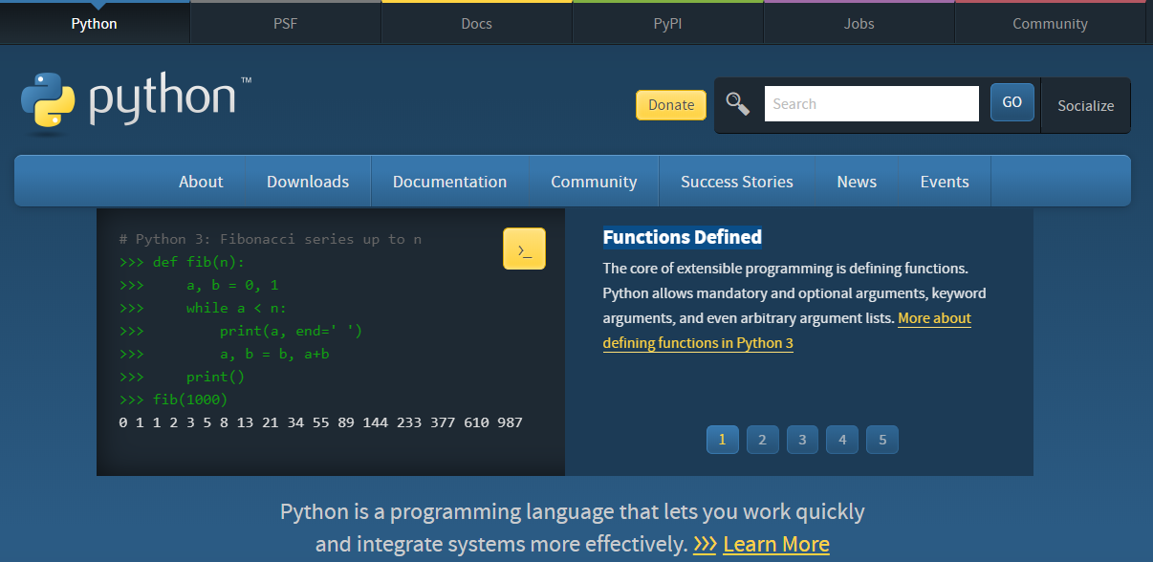
(3.b) Python official website

Slide 9
(3.c) Python version
Current version 2.7.x & 3.x
print function
Unicode
Division operation

Slide 10
Division operation
10 / 2
-> 5.0
11 / 2
-> 5.5
10 // 2
-> 5
11 // 2
-> 5
# -------------------------
10.0 // 2
-> 5.0
10 // 2.0
-> 5.0
11.0 // 2
-> 5.0

Slide 11
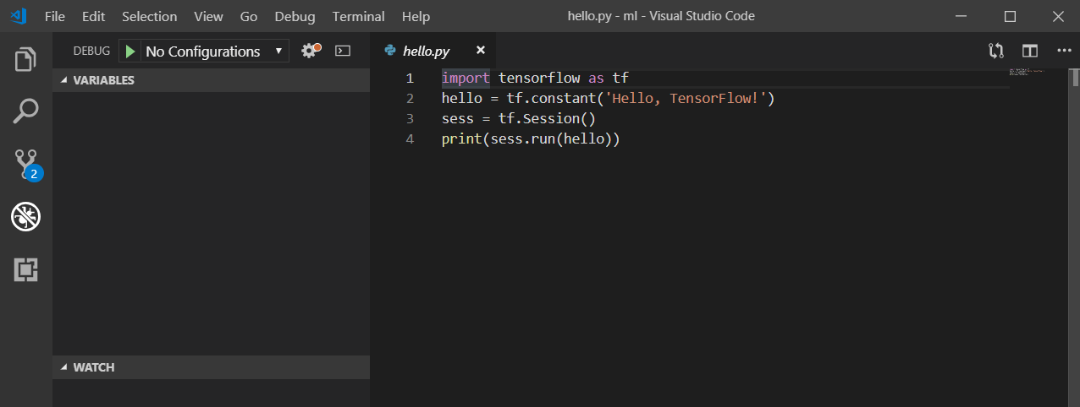
(3.d) Python editor
Python IDLE tools
Visual Studio Code
PyCharm

Slide 12
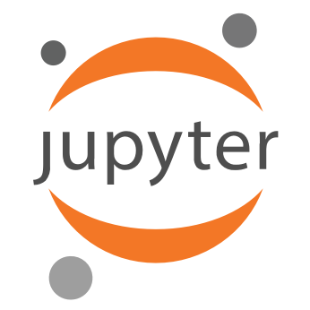
(3.e) Jupyter notebook
Jupyer Notebook is a tool that can write code on a web page.
The program can be executed directly on the web page and the output can be rendered directly on the web page.
The entire web page can be exported and distributed as a notebook.
The discussion of data analysis and machine learning platforms (such as Kaggle) is in the form of a Jupyter notebook.
Support a variety of mainstream literal translation languages like Python, R, Julia.

Slide 13
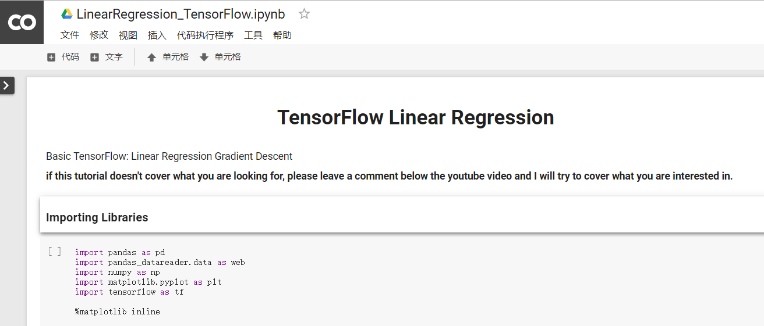
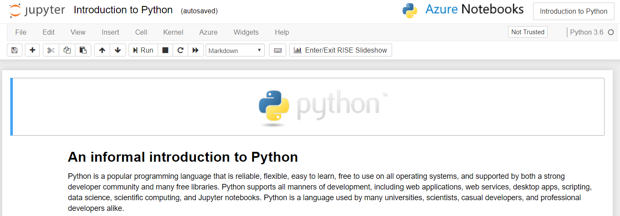
(3.f) Jupyter notebook的雲端平台
Google Colab
Microsoft Azure Notebooks

Slide 14
REVIEWS:
(1) Is Python a compiled or interpreted language?
(2) Do you perfer Python 2 or Python 3?
(3) Which tool can write Python programs?
(4) Why write a program in Python?

