Slide 1

Python Quick Tutorial
(2)-Begin to write Python programs
Hsueh-Ting Chu

Slide 2
課程大綱-程式設計簡介
(1) HelloWorld program
(2) Screen printing functions of various data types
(3) N ways to print a 99 multiplication table

Slide 3
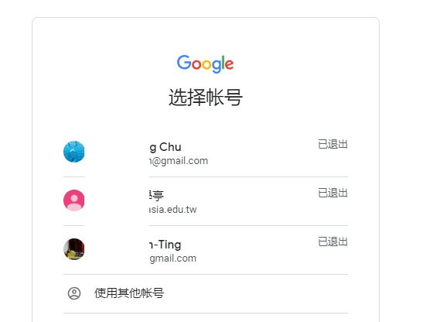
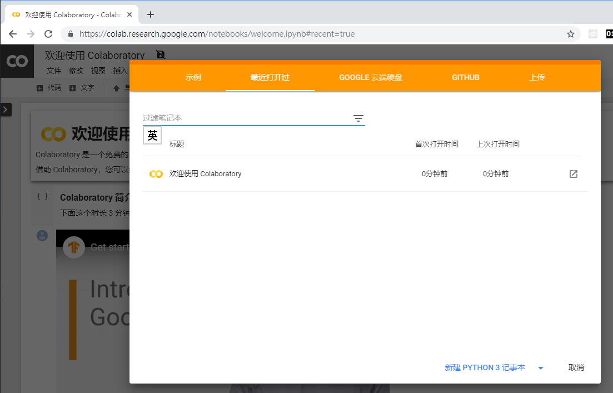
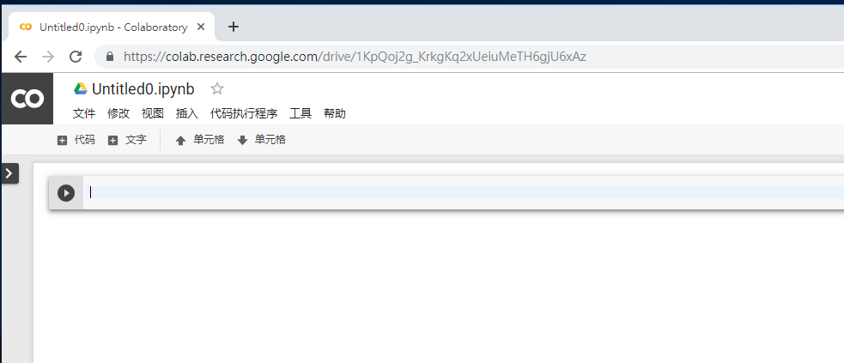
(1.a)Open Colab

Slide 4
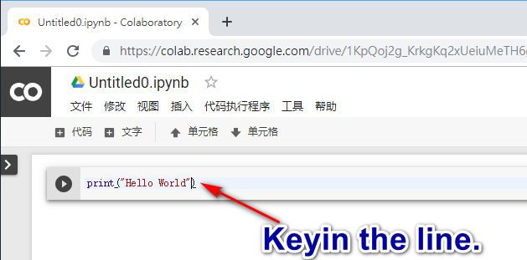
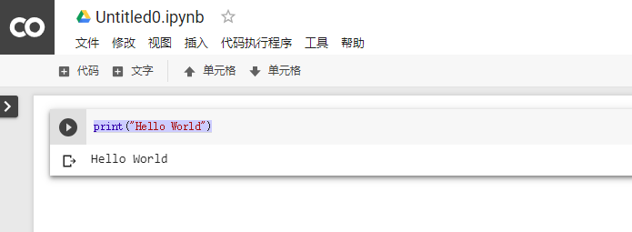
(1.b) First program
Press the run button
print("Hello World")
Program output

Slide 5
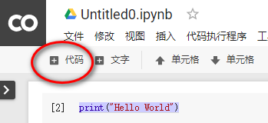
(1.c) Add code block
print("Hello World")

Slide 6
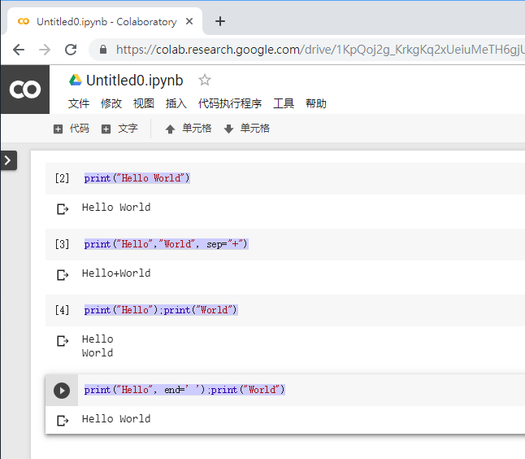
(1.d) print()
print("Hello" World")
print("Hello","World", sep="+")
print("Hello");print("World")
print("Hello", end=' ');print("World")
sep -- separator，Default is ' '。
end --end，Default is '\n' (line feed)。

Slide 7
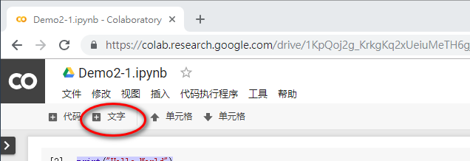
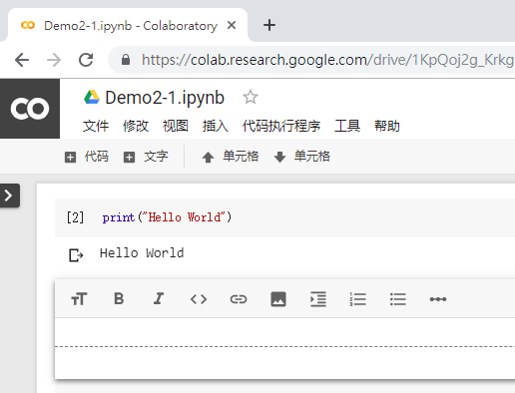
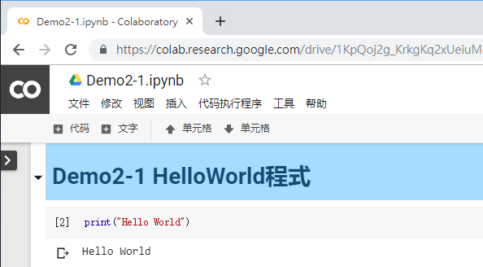
(1.e) Add a text block as a program header
#Demo2-1 HelloWorld

Slide 8
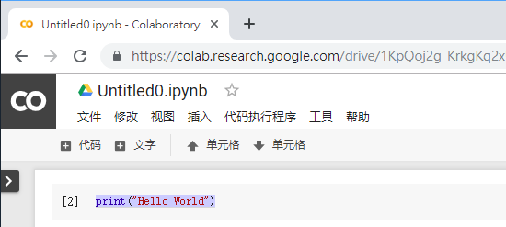
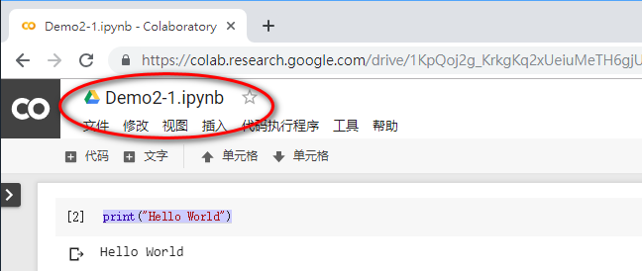
(1.e) Save the notebook

Slide 9
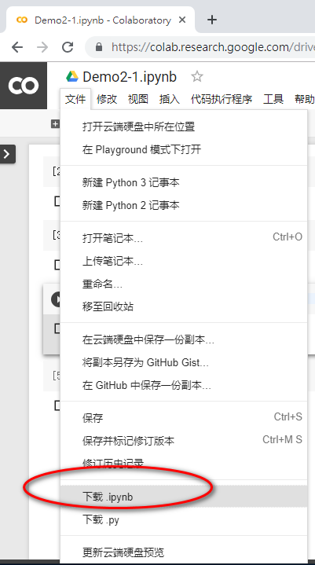
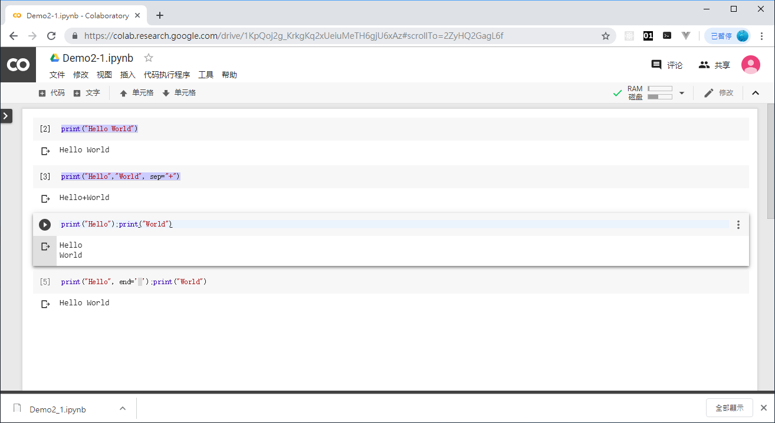
(1.f) download the notebook

Slide 10
(2.a) Data type of variables
variable =value
Var = 1.55
Hint:
varA = 66 #declare an integer variable
varB = 1.68 #declare a variable with a decimal (computer called floating point number)
varC = 'GoPython' #declare a string variable
Print(type(varA), type(varB), type(varC), sep='...')
type(var) return the type of the variable。

Slide 11
(2.b) Numerical and string conversion
Variable name = int (string variable)
Variable name = str (numeric variable)
Hint：
varD = str(varA) # convert the integer 88 into a string of 88
varE = str(varB) # convert the floating point number 1.68 into a string of 1.68
varF = int('2019') # Convert the string 2019 to an integer value of 2019
varG = float('3.14') # Convert the string 3.14 to a floating-point number of 3.14print(varD, varE, varF,varG, sep=',')

Slide 12
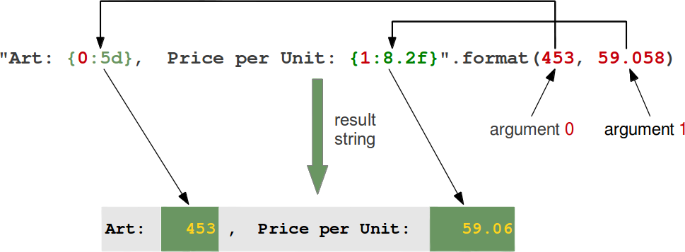
(2.c) Formated string
Var = “{} {}”.format(varA, varB)
Hint：
{0:5d} #Print pos-0 variable in the width of 5 into an integer
{1:8.2f} #Print the pos-1 variable after the width of 5 into a 2-digit decimal

Slide 13
(2.d) Formatted printing
" ".format()
" "%()
Hint：
New formatted printing function
print("Art: {0:5d}, Price per Unit: {1:8.2f}".format(435, 59.058))
Old formatted printing function
print('Art: %5d, Price per Unit: %8.2f' % (435, 59.058))

Slide 14
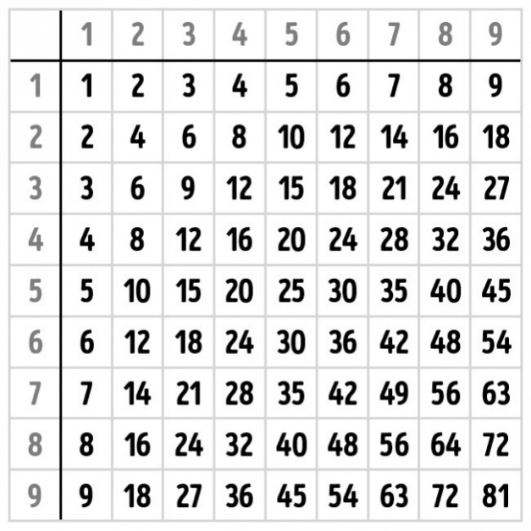
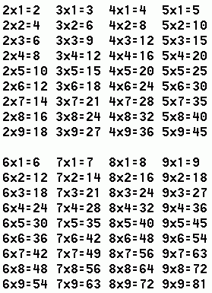
(3.a) Different 99 multiplication tables

Slide 15
(3.b) representing the number sequence 1-9
var=[1, 2, 3, 4, 5, 6, 7, 8, 9]
[ ] is a list，add the list items.
Hint：
numbers = [1, 2, 3, 4, 5, 6, 7, 8, 9]
print(numbers)

Slide 16
(3.c) Print the numbers 1-9 iteratively
A simple for-loop
for n in numbers:
Hint：
for n in numbers:
print(n, end=' ')
1. Using the loop, iterate the n variable from the number of sequences
2. The code in the loop should be indented

Slide 17

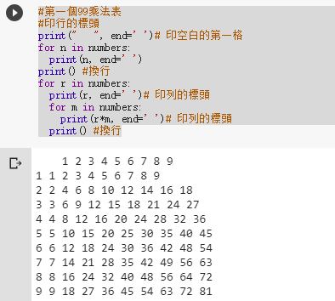
(3.d) First multiplication table
for r in numbers:
for m in numbers:
Hint：
How to align the output 99 multiplication table?

Slide 18
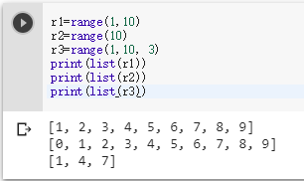
(3.e) range function
numbers = [1, 2, 3, 4, 5, 6, 7, 8, 9]
numbers = range(1, 10)
Hint：
range(start, stop[, step])
Start: Start counting value. The default is to start at 0.
For example range(5)=range(0,5);
Stop: Ends the count value, but does not include stop.
For example: range(0,3)=[0, 1, 2] no 3
Step: step size, the default is 1.
For example: [2, 4, 6, 8] = range(2, 10, 2)

Slide 19
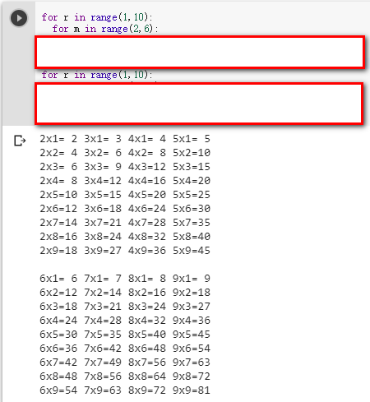
(3.f) Second multiplication table
for r in range(1,10):
for m in range(2,6):
Hint：
How do I complete the program on the right to print a neat multiplication table?

Slide 20
REVIEWS：
(1) How does the print() function separate different parameters?
(2) How does the print() function control the printing width?
(3) What does the range(), list() function do?
(4) What is the colon (:) of the For Loop?

Slide 21
Unit 2 exercises
(1) Complete the formatted output of step (3.d)
(2) Complete the loop of step (3.e)

