Slide 1

Python Quick Tutorial
(3)-Basic program model
Hsueh-Ting Chu

Slide 2

Course Outline – Python Programming
1) I-P-O program model (Input-Process-Output)
2) Simple sorting of data
3) Simple visualization of data

Slide 3
(1) Basic model of program
Input-Process-Output Model
Input
Process
Output
inFile = open(‘in.txt',‘r')
inFile.read(…)
inFile.close()
if score>60:
count += 1
outFile = open(‘out.txt',‘w')
outFile.write(…)
outFile.close()

Slide 4
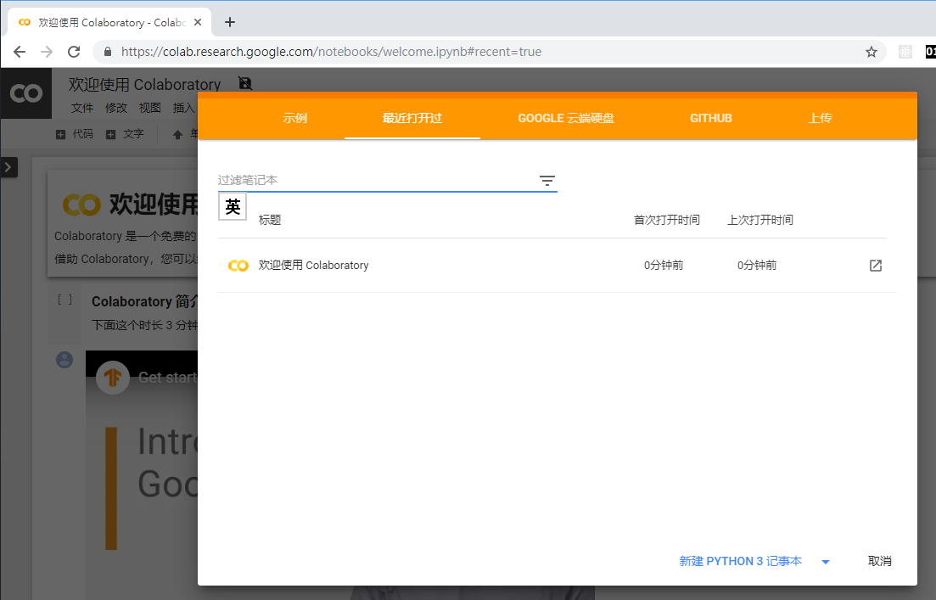

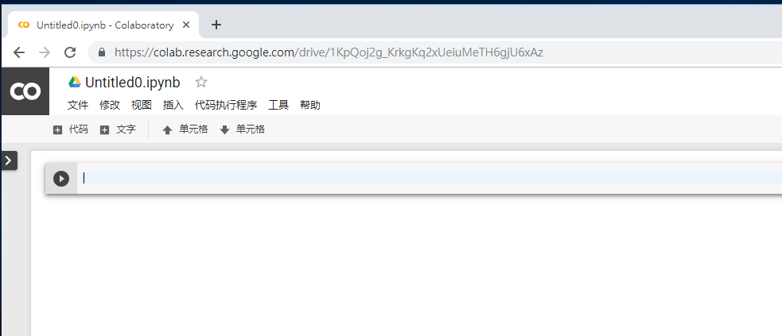
(2.a)Open Colab

Slide 5
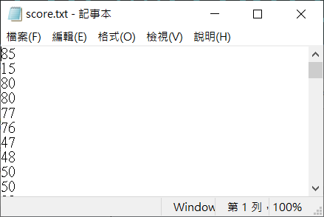
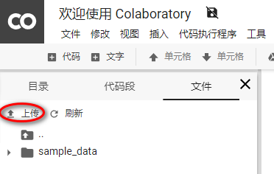
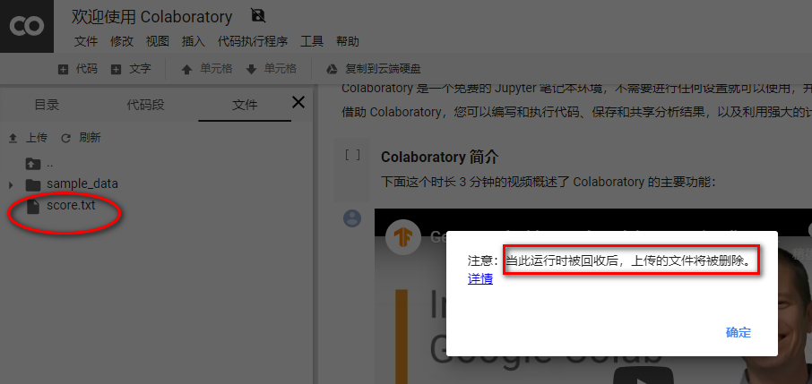
(2.b) upload score.txt to colab
按上傳

Slide 6
(2.c) Open score.txt for reading
fin=open(‘score.txt’)
for line in fin:
fin=open(‘score.txt’)
for line in fin:
print(line.strip(), end=",")
fin.close()

Slide 7
(2.d) Count the number of scores
count +=1
print("The number is“,count)
#
count=0
fin=open('score.txt')
for line in fin:
count +=1
fin.close()
print("The number is",count)

Slide 8
(2.e) Count pass number of scores
score = int(line)
if score >= 60:
count=0
passed = 0
fin=open('score.txt')
for line in fin:
count +=1
score = int(line)
if score >= 60:
passed +=1
fin.close()
print("The number of the passed is",passed, "in", count, "students")

Slide 9
(3.a) using with
with open('score.txt') as fin:
for line in fin:
Hint:
count = 0
total = 0
with open('score.txt') as fin:
for line in fin:
count += 1
total += int(line)
print("Average score=", total/count)

Slide 10
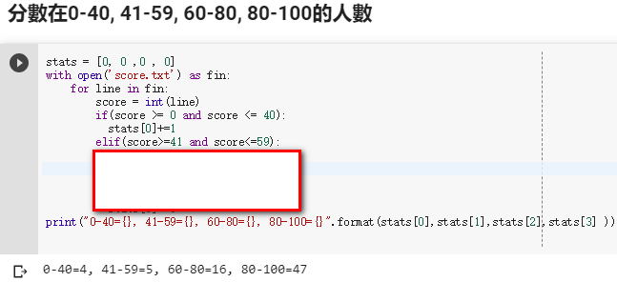
(3.b) Score in 0-40, 41-59, 60-80, 80-100
if(score >= 0 and score <= 40):
elif(score>=41 and score<=59):
If condition 1:
statement 1...
elif condition 2:
statement 2...
elif condition 3:
statement 3...
else:
statement 4...
Condition can be added and/ or

Slide 11
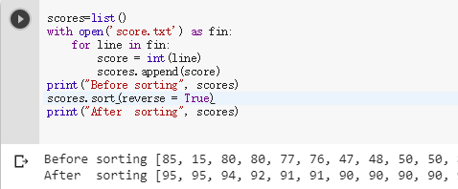
(3.c) Sorting the scores
scores=list()
scores.append(score)
scores.sort(reverse = True)
scores=list()
with open('score.txt') as fin:
for line in fin:
score = int(line)
scores.append(score)
print("Before sorting", scores)
scores.sort(reverse = True)
print("After sorting", scores)
#sort() function is used to sort the original sequence list.sort(reverse=False)

Slide 12
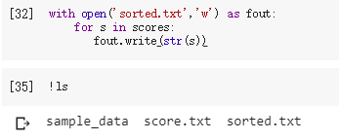
(3.d) Output sorted scores
Fout=open('sorted.txt','w') fout.write(str(s))
with open('sorted.txt','w') as fout:
for s in scores:
fout.write(str(s))

Slide 13
REVIEWS：
(1) How does the open() function determine whether a file is for reading or writing?
(2) How can Lists be sorted in descending/ascending order?
(3) How does the if-statement contain more than two conditions?
(4) How to read each line from the file

Slide 14
Unit 3 exercises ：
Complete the multiple if-statement of step (3.b)
Change step (3.e) to be arranged in ascending order

